Slide 1


Beyond Resilience: Facilitating Learning and Well-Being in the Refugee Language Classroom
An Enquiry-Based Study of ELT Provision for Refugees in a UK University
Sarah Hunt
PhD Candidate
Dept. of Neuroscience, Psych. & Behaviour, UoL
Presenting today:
Aleks Palanac
Head of Sanctuary
Sanctuary Seekers’ Unit
CITE, University of Leicester
@AleksPalanac
ap417@le.ac.uk
21st April 2023
Prof. Pamela Rogerson Revell
Prof. of Applied Linguistics & TESOL
School of Education, University of Leicester
Prof. Wasyl Cajkler
Prof. of Education
School of Education, University of Leicester
Gabi Witthaus
PhD Candidate
Dept. of Education, Lancaster University
Research Team

Slide 2
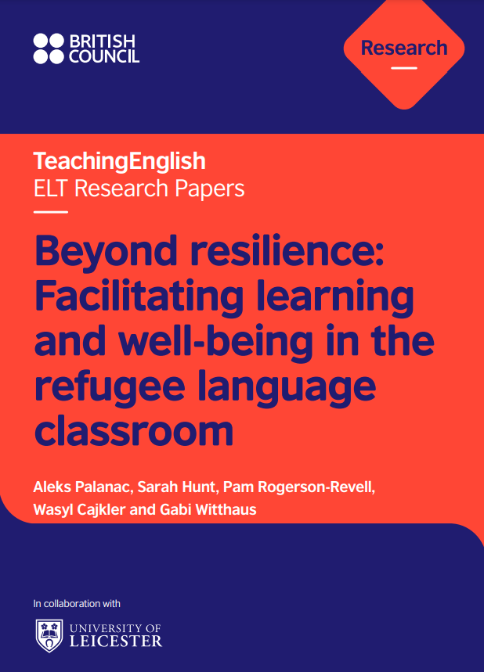
Palanac, A., Hunt, S., Rogerson-Revell, P., Cajkler, W., & Witthaus, G. (2023). Beyond resilience: Facilitating learning and wellbeing in the refugee language classroom. British Council. Available online: doi.org/10.57884/6SN8-AF69
(publication web page: https://www.teachingenglish.org.uk/publications/case-studies-insights-and-research/beyond-resilience-facilitating-learning-and-well)

Slide 3
Outline
- the context, challenge and RQs of this study
- research design
- our findings and recommendations
- conclusions

Slide 4
1. Context, challenge and RQs of this study

Slide 5
Context
functioning in daily life / ‘integration’ / navigating services
making friends / building networks
gaining employment
accessing FE/HE and training
By the end of 2021, 90 million people worldwide had been forcibly displaced (UNHCR, 2022)
learning language of resettlement country

Slide 6

The Challenge (in a nutshell)
refugees tend to have a far greater mental health need than the general population, with higher incidences of depression, anxiety and Post-Traumatic Stress Disorder
(Fazel et al, 2005)
PTSD has a direct detrimental effect on refugee language learning (Furneaux, 2018)
many English language teachers feel unable to support refugee-background students adequately (Capstick and Delaney, 2016)
very little research and practitioner training exists with this focus (trauma-informed ELT for adult refugees – facilitating both learning AND well-being)

Slide 7
Research Questions
Can English language provision facilitate Psychological Well-Being in a University of Sanctuary setting, and, if so, in what ways?
What skills, strategies and resources do language teachers need in order to optimise the psycho-social and linguistic experiences of their refugee learners?
In relation to RQ2, what constitutes good practice in ELT provision for refugees in a University of Sanctuary context, both at present and in the future?
Notes:
to gain an in-depth understanding of the effects of attending classes for refugee-background language learners
What works in the classroom, not just in terms of lang learning, but also wellbeing
What extra support can institutions provide to support what happens in the classroom? We want to disseminate project findings and contribute to good practice in this area.

Slide 8
2. Research design

Slide 9

Research Design : What, who and when?
What?
UoL’s English language provision:
  Leicester City of Sanctuary ESOL classes (non-formal, 1.5-3 hours per week)
  UoL’s pre-sessional (academic) English classes (formal, full time)
Who?
41 refugee-background students (including 6 case students)
  3:1 male:female
  1/3 refugee status, 1/3 claiming asylum, 1/3 LLR / Ankara Agreement / ‘other’
  under half were in UK for under a year
  More than 2/3 had been studying English with us for under 6 months
  Most were educated to university level in their country of origin
6 teachers of refugee-background students
When?
Data collection – between Jan and Sept 2020
Analysis and write up – between Oct 2020 and Dec 2021

Slide 10
Multi-disciplinary approach
Methodological framework
Research Design: Methodological Framework
Multi-disciplinary approach:
Education – Lesson Study (e.g. Cajkler et al, 2013)
Applied Linguistics - Oxford’s (2011) Strategic Self-Regulation (S²R) Model of Language Learning –
Psychology - Ryff and Singer’s (1996) six dimensions of psychological well-being
Self-acceptance
Autonomy
Purpose in
Life
Environmental mastery (EM)
Personal Growth
Positive relations with others
Psychological well-being (PWB)
Ryff and Singer (1996)

Slide 11
Research Design: Mixes Methods
Phase 1: Quantitative (Jan/Feb 2020)
  Student Questionnaires (f2f)
  Part 1: About You – demographics, background, etc
  Part 2: In Your English Class – information about RBSs’ experiences/feelings in English classes
    Oxford’s (2011) Strategic Self-Regulation (S²R) Model of Language Learning - framework of strategies and meta-strategies in the cognitive, affective and sociocultural-interactive dimensions
    Harvard Trauma Questionnaire 5 Part IV
  Part 3: How do you feel about yourself now? - self-report of changes in levels of functioning and psychological well-being (PWB) since leaving home country
    Joseph et al’s (2012) Psychological Wellbeing-Post-Traumatic Changes Questionnaire (PWB-PTCQ) – slightly adapted
    Ryff and Singer’s (1996) six dimensions of Psychological Well-Being.

Slide 12
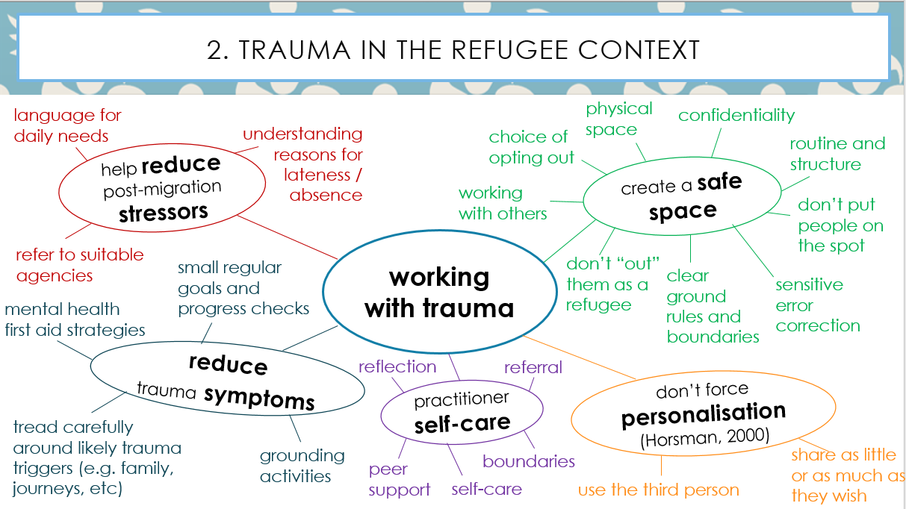
Research Design: Mixed Methods
Phase 2: Qualitative (March 2020)
  3 Lesson Study classroom observations (f2f)
    Input/training:
      Trauma training workshops
      Lesson Study orientation workshop
    Research lesson planning meetings (3 tutor pairs)
    Teaching/observation of research lesson
    Lesson evaluation meetings (3 pairs of tutors)
  Phase 3: Qualitative (June-Sept 2020)
  tutor focus group (online – 90 minutes)
    5 tutors’ experience of participation in project (e.g. usefulness of training, impact on practice, etc)
    Mix of open and closed questions
    Qs based on – RQs, SQs, trauma training, themes/insights from LS data
  student interviews (online)
    6 students - 3 via Zoom (two with video and one with audio) + 3 via telephone
    Interview guide approach (pre-specified topics + questions, re-worded if needed)
    Qs based on – RQs, SQs, trauma training, themes/insights from LS data

Slide 13
3. Findings & Recommendations

Slide 14
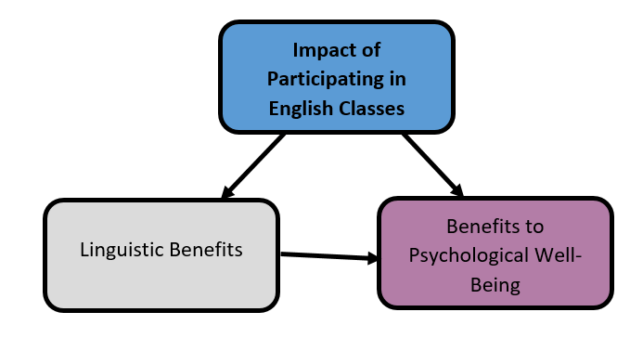
Findings: RQ1
RQ1 - Can English language provision facilitate Psychological Well-Being in a University of Sanctuary setting, and, if so, in what ways?

Slide 15
Findings: RQ1 – Linguistic benefits
“I feel that, and my family say that, your English improved in your class” (Omar)
General English
proficiency improving
  80% always/often in SQs
  all 6 case students – esp S,L,W
Academic English
  proficiency improving (all students on PSP)
  seen as offering an invaluable opportunity and progression route (as opposed to college ESOL classes)
  “I learned how … can I communicate” (Jamal)
  “general English … help me … deal with life” (Fareed)
“it's really an excellent course … I do many course of English, but this one is more academic and well-prepare you to next step which is very good” (Munir)

Slide 16
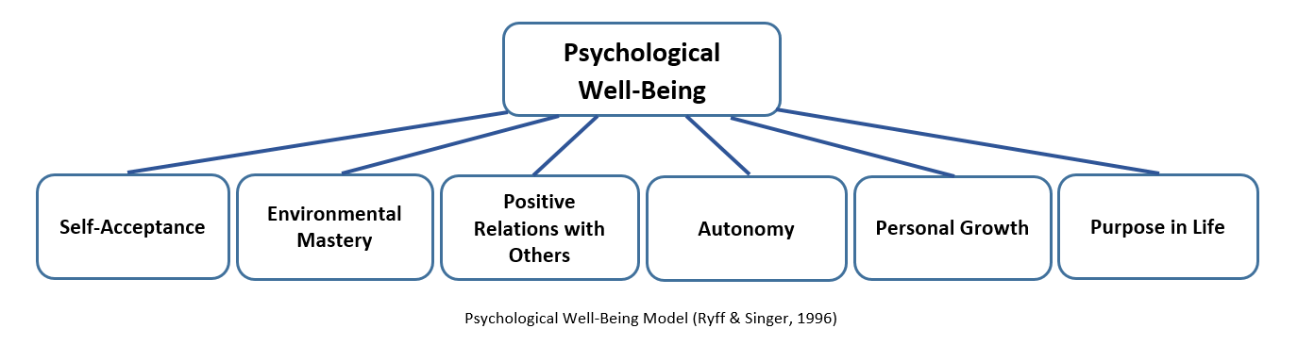
Findings: RQ1 – Benefits to PWB
  Part 3 questionnaire data demonstrated:
    both increases and decreases in PWB since leaving home country across the cohort for every item (with Environmental Mastery scoring low most often)
    but increases significantly out-scored corresponding decreases overall
  Students attributed increases in PWB to their English classes in their interview responses

Slide 17
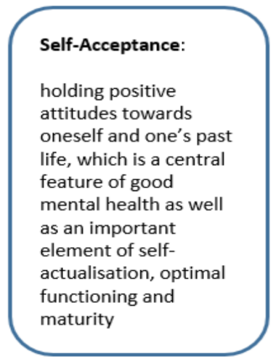
Findings: RQ1 – Benefits to PWB (self-acceptance)
  All 6 case students demonstrated positive attitudes towards themselves (Eng. level, confidence, independence, positivity)
    All could identify areas for improvement too
“I think I feel confidence, it’s easy. I can speak now with anyone easily. I can write something without help, without my son help … It makes feel good for me” (Omar)
“it’s not comfortable for me … about my personality, about my life, what I did, what I was in my country … there is no way, if you talk about my personal life, there is no way I can feel comfortable” (Omar)
    A number of Ss expressed discomfort re thinking/talking about past lives in class
Notes:
All 6 case students demonstrated positive attitudes towards themselves (5 scored high in SQ Part 3), mainly related to:
attending English classes and/or improving English level
gaining in confidence and
independence in daily lives
generally feeling more positive in themselves
Re attitudes towards past lives:
Two students felt very uncomfortable thinking or talking about this (links to Isserlis, 2000)
Item from Student Questionnaire, ‘I am happy to talk about my life in class’ scored lowest of all items

Slide 18
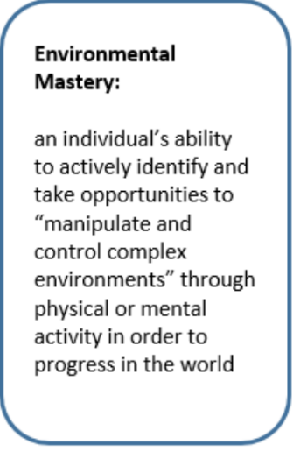
Findings: RQ1 – Benefits to PWB (environmental mastery)
“When I was came to UK, I couldn't go to outside just myself … Always I feel depend other person and I feel very bad myself. But now, I can go everywhere just alone ... just myself ... er ... I think it's better. I feel happy because I can do my jobs … I can go market, supermarket, hospital, everywhere now” (Sumeyye)
  All 6 case students indicated their EM had increased in one or more respects due to attending classes
  Some (but not all) were also able to use various meta-strategies in lang. learning
  However, all 4 students on PSPs also emphasised importance of:
  External factors facilitating access (e.g. fee waivers)
  Knowledge of opportunities
  Accessing help when needed
“when we finished early on Friday we not go direct home, sometimes we go to University of Leicester, we met new students, we sit with them, we introduced ourselves, so (laughs) … I made a lot of new friends there …” (Munir)
Notes:
However, all 4 students on PSPs also emphasised importance of:
External factors facilitating access (e.g. fee waivers)
Knowing what opportunities and resources exist
Being able to ask for help when needed

Slide 19
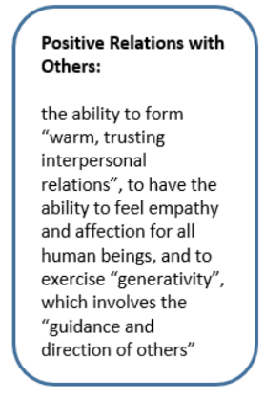
Findings: RQ1 – Benefits to PWB (positive relations with others)
  Case students highly valued opps to:
meet and communicate with others
expand social networks
Learn from peers (though one struggled with supporting others)
“In group, or as a pair, you can learn something from others … about their country, about their culture, about their religion, they can, they explain something in other way … this is a chance for learn something” (Fareed)
  In SQ (Part 2 – In Your English Class), Socio-cultural-Interactive domain scored highest overall:
  E.g. I feel welcome in my class (88% - always/often)
    I am happy to work with other
    students in class (90% - always/often)
“If my friends level better than me, I like to work together because they help me. But if my friends level less than me, I feel very stressful because, er, I'm not sure about my information. Er, I think maybe I can say wrong things … The reason is, erm, my, erm, my uncomfortable feelings” (Sumeyye)
Notes:
Case students highly valued opps to:
meet and communicate with others (esp. from other cultures)
expand social networks / develop friendships
engage in mutual support (e.g. informal study networks + emphasis on reciprocity)
In SQ (Part 2 – In Your English Class), Socio-cultural-Interactive domain scored highest overall:
E.g. I feel welcome in my class (88% - always/often)
I am happy to work with other
students in class (90% - always/often)

Slide 20
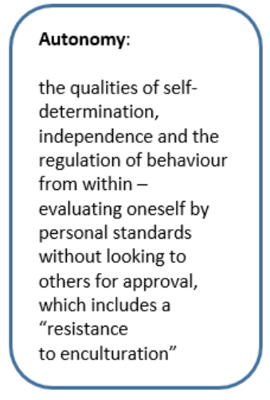
Findings: RQ1 – Benefits to PWB (autonomy)
  All case students indicated increased sense of agency + independence
  Some Ss used of specific learning strats + meta-strats from Oxford’s (2011) S2R model:
  Seeking opps to practise English (SI)
  Reframing challenges as opps (MA)
  Actively generalising strategies (MC)
“we learning that you can plan in advance … so before you start anything you have to put your plan - one, two, three - and then you have to follow this step by step” (Munir)
“when I ... make a target … maybe it's gonna be like a wrong decisions … When I be with ... like, in a group … or with a teacher … like, by, by, er ... their advice maybe I will choose ... a good way to be ... like to reach my goals as well or something like that” (Jamal)
  But others needed ongoing support
  In SQ (Part 2 – In Your English Class), Cognitive domain scored lowest overall:
  E.g. I check my work for mistakes (61% -
  always/often)
  I plan how to improve my work next
  time (68% - always/often)
Notes:
All case students indicated increased sense of agency + independence in daily lives (partly due to improved Eng level)
+ also belonging/integration
Re learning, some Ss demonstrated use of specific learning strategies + meta-strategies from Oxford’s (2011) S2R model:
Seeking opps to practise English outside class (SI)
Reframing challenges as opportunities to learn (MA)
Actively generalising strategies learnt in class (MC)
But others expressed need for ongoing guidance + support from teachers + peers in self study
Cognitive scored lowest - many indicated difficulty identifying using these in their language learning

Slide 21

Findings: RQ1 – Benefits to PWB (purpose in life)
“.. if it's not ELTU, maybe to be honest I be in depression because you know, er ... when I was asylum, it's very hard situation, to be honest. If we are doing nothing, like, without studying, without anything, it's gonna be like too hard …” (Jamal)
  4 case students – increased purpose + direction:
  keep occupied
  stave off depression
  progression pathway to university
  proximity to university community
  strong goal of HE study > higher motivation levels during pandemic
“Now, I feel confident, and, erm, feel … my life is going in the right direction, because you know ... the sanctuary classes, and, er ... you know, it's open your mind because you, and, er, you're near the, the, the high class of education … you see the teachers from university. You see the student going to study at university ... around those people, they can give you more hope” (Fareed)
Notes:
4 students said studying at ELTU helped them gain sense of purpose and direction in life
keep occupied + stave off depression
progression pathway to university - ‘meaningful future-oriented activity’ (Hartley and Fleay, 2014, in Stevenson and Baker, 2018)
Proximity to university community – stronger vision
PSP students with a strong goal of studying in HE better sustained motivation to continue studying during pandemic

Slide 22
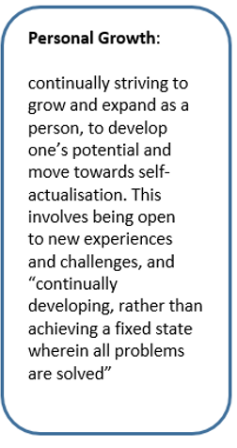
Findings: RQ1 – Benefits to PWB (personal growth)
  Attending classes > development of elements of ‘growth mindset’ (Dweck, 2006):
3 ss saw challenge as a means to grow and learn
5 ss wished to improve themselves through learning from peers
“it was very challenge, but, I mean, if someone have objective to achieve, you have to challenge yourself” (Munir)
“Er, sometimes I can't find the true words. Er, sometimes I I couldn't feel myself, I couldn't feel myself, er, relax. Er, I mean, I'm usually feel myself in stressful. I want to speak fluently and correctly” (Sumeyye)
  However, different attitudes towards risks + mistakes in speaking:
  2 ss felt comfortable speaking in class and receiving feedback
  2 others overly fixated on correctness + felt stressed
“normally I have obsessive behaviour. Therefore, … communication speaking very, very difficult for me, because all, all puzzle it must be same time ... speaking skills very difficult for me” (Mehmet)
Notes:
Attending classes facilitated development of elements of ‘growth mindset’ – a belief that abilities can be developed (Dweck, 2006):
3 ss saw challenge as a means to grow and learn
5 ss wished to improve themselves through learning from peers (not only English level, but also countries, cultures, ideas, perspectives) – growth in more than one respect

Slide 23
Findings + Recommendations: RQ2
RQ2. What skills, strategies and resources do language teachers need in order to optimise the psycho-social and linguistic experience of their refugee learners?
Supporting students to employ effective learning strategies
Fostering supportive peer interaction
Sensitivity and responsiveness to RBSs’ needs

Slide 24
Findings + Recs: RQ2 (facilitating effective learning strategies)
  Many Ss struggled to identify and employ effective learning strategies + asked for extra support with these (e.g. Horsman, 2004; van der Kolk, 2014)
  “If the teacher gives the key … to be a good student, then I will learn” (Jamal)
Explicitly teach useful strategies and meta-strategies for language learning in the cognitive, affective and socio-cultural-interactive domains (Oxford, 2011)
Foster a growth mindset (Dweck, 2006), esp for students anxious about spoken accuracy and fluency
Encourage peer support with metacognitive tasks (e.g. planning and goal-setting) – ‘near-peer role models’ (Murphey & Arao, 2001)
“Er, if everyone, er, study the same, er, topic maybe, it's better and I can think everybody is studying. I have to study – maybe” (Sumeyye)
Notes:
Many Ss struggled to identify and employ effective learning strategies + asked for extra support with these - many trauma survivors struggle particularly with planning, goal-setting and evaluating progress (e.g. Horsman, 2004; van der Kolk, 2014)
Explicitly teach useful strategies and meta-strategies for language learning in the cognitive, affective and socio-cultural-interactive domains - informed choices > greater sense of agency and control (Oxford, 2011)
Foster a growth mindset (Dweck, 2006), esp for students who are unduly anxious about their accuracy and fluency in speaking
Encourage peer support with metacognitive tasks (e.g. planning and goal-setting) – ‘near-peer role models’ (Murphey & Arao, 2001)

Slide 25
Findings & Recs: RQ2 (fostering supportive interaction)
Ss and Ts emphasized the importance of supportive relationships/interactions in class
Providing opportunities for speaking practice
Helping students build trusting relationships - crucial to effective language learning (Stone, 1995)
Encouraging students to support each other’s learning in and out of class (e.g. WhatsApp groups) - ‘well-becoming through teaching / giving hypothesis’ (Murphey, 2016)
“my teachers, they're very ... er, I feel comfortable with, with them ... so that's why I like (laughs) to speak all the day … they try to help you to think. And when you talk, they focus on what you, what you trying to say and it can help you. They, they let you feel confident and comfortable like that” (Fareed)
Notes:
Ss and Ts emphasized the importance of supportive relationships/interactions in class
Providing opportunities for speaking practice (formal activities and informal opportunities to interact before/during/after class)
Helping students build trusting relationships to help them feel listened to, valued and safe enough to take risks and make mistakes - crucial to effective language learning (Stone, 1995)
Encouraging students to support each other’s learning in and out of class (e.g. WhatsApp groups) - ‘well-becoming through teaching / giving hypothesis’ (Murphey, 2016)

Slide 26
Findings & Recs: RQ2 (sensitivity and responsiveness to needs)
    Need for awareness/sensitivity/responsiveness to Ss’ needs – links to “super-disadvantage” (Lambrechts, 2020)
“I finish my shift at like six o'clock, and nine o'clock I have to come to class … So all the teachers they support me even they ask me if I need break I can take one whenever I need it, so this kind of thing really encourage someone to achieve” (Munir)
    Gain more in-depth understanding of RBSs’ needs/ experiences + how to support them (NA, training, LS observations, etc)
    Importance of prompt flexibility/responsiveness to emergent situations/needs (safety + personalisation)
    BUT address needs with sensitivity (don’t draw attention + don’t overtly treat differently)
“I think I wouldn’t prefer anything different … from other students and I think nobody prefer it, because it’s, er, makes … maybe different, it make different you from others” (Omar)
Notes:
Ss and Ts emphasized the complex, multifaceted nature of RBSs’ needs + the need for Ts to be aware + sensitive + responsive to these – links to Lambrechts’ (2020) concept of “super-disadvantage”
Gain more in-depth understanding of RBSs’ needs/ experiences + how to support them:
In general (e.g. trauma training)
As individuals (needs analysis, Lesson Study observations)
Importance of prompt flexibility/responsiveness to emergent situations/needs (esp. the need to feel safe in class – not forcing personalisation)
BUT address needs with sensitivity (tension) - RBS do not wish for attention to be drawn to their circumstances/needs + do not wish to be seen to be treated differently from others

Slide 27
Findings & Recommendations: RQ3
RQ3. In relation to RQ2, what constitutes good practice in ELT provision for refugees in a University of Sanctuary context, both at present and in the future?
In addition to areas identified for RQ2 (which focused on pedagogy), the following areas focus on wider institutional systems and strategies:
Supporting RBS teachers
Optimising institutional-level systems and support
Providing wider wrap-around support for RBSs before and during studies

Slide 28
Findings & Recs: RQ3 (supporting teachers)
    Ts all found trauma training and Lesson Study process useful – knowledge/skills/strategies + peer support
On trauma training: “I've learnt so much from that and I’ve also gained confidence” (T2)
  more training in best practice in supporting RBSs (needs/identifying signs/strategies)
  lesson study process – focus on individuals’ Ss + collaborative practice
an ongoing tutor support network / community of practice (reducing pedagogical solitude – Shulman, 1993)
“What I was particularly surprised about was how much I didn’t see in the classroom; that was really quite enlightening for me” (T3)
Notes:
Ts all felt that the trauma training and Lesson Study process had been useful – development of knowledge/skills/strategies + also peer support
more training in best practice in supporting RBSs, esp. trauma training - understanding of + sensitivity to needs + confidence identifying signs of trauma + selecting useful strategies
lesson study process – individual student-focused observation (focus on individuals’ needs) + work collaboratively to plan, observe and reflect on teaching
an ongoing tutor support network / community of practice (reducing pedagogic solitude – Shulman, 1993)

Slide 29
Findings & Recs: RQ3 (optimising institution-level systems and support)
    Importance of English language provision being joined up, offering range, choice + progression opportunity
    Full range of levels - from beginner to advanced
    Both general and academic English
    Non-formal (flexible attendance) and formal
    Offering more speaking classes / opportunities
    But, info about range of opportunities available needs to be communicated clearly
“by give more classes … by make different time for classes ... So if it's be like a … more flexible, that mean more students they can … catch up … like, er, maybe sometimes they can't come on Thursday … but ... they can come on Fridays and Monday” (Fareed)
Notes:
Ss emphasized the importance of English language provision being joined up, offering range, choice + progression opportunity
A range of levels - from beginner to advanced (from no English to university-level English)
Both general and academic English
Non-formal (flexible attendance) and formal
Offering more speaking classes / opportunities
But, info about range of opportunities available needs to be communicated clearly

Slide 30
Findings & Recs: RQ3 (wrap-around support before and during studies)
    Need for additional support for RBSs to access provision and learn effectively
“the good thing is it's free for refugee … if for money, I don't think one of refugee have that money to pay to study this course” (Munir)
    Provide resources to access classes
    Fee waivers
    Additional financial support (travel costs, stationery, etc)
    During pandemic, further support needed
    Offer other practical support. E.g.
    psychological support
    guidance in defining goals / aspirations and finding pathways
    accommodation
    help with asylum claims
    addressing safety concerns
    Build networks with and tap into:
      wider university services (e.g. welfare and accommodation)
      external partnerships (e.g. RefuAid and LCofS)
“I'm still, I'm in ... ELTU's accommodation … without them, I’m a homeless … and honestly ... they standing with me a lot, a lot about it, to be honest” (Jamal)
Notes:
Ss and Ts emphasized the pivotal importance of additional support for RBSs to access provision and learn effectively - move away from purely ‘individualised understandings of resilience’ to a resilience enabled by ‘collective support or systemic change’ (Rivers and Webster, 2017, in Stevenson & Baker, 2018)
Provide resources to access classes
Fee waivers – otherwise couldn’t join PSP
Financial support (travel costs, stationery, etc)
During pandemic, extra support was needed – digital
devices, wifi/data
Offer other practical support. E.g.
psychological support
guidance in defining goals / aspirations and finding pathways
accommodation
help with asylum claims
Build networks with and tap into:
wider university services (e.g. welfare and accommodation)
external partnerships (e.g. RefuAid and Leicester City of Sanctuary)

Slide 31
Conclusion
Refugee Background Students
Teachers
of RBSs
Institutions
Impact of English classes
Psycho-social needs
safety
trust
agency
purpose
support
hope
feel valued
unthreatened
Strategies (classroom + self study)
lang. learning strats (C/A/SI)
growth mindset
peer/tutor support in/out of class (esp. w/ meta-cog tasks)
speaking opps
build trusting relationships
don’t force personalisation
meeting safety needs
don’t single RBSs out as different
reframing errors
facilitate choice and agency
Qualities / Skills
sensitivity
alertness + responsiveness
flexibility
empathy
awareness / anticipation of needs
supportiveness
warm + welcoming
Resources / Systems
providing RBSs’ teachers with
    CPD
    Comm of Prac
  ascertaining needs (e.g. NA, Lesson Study obs)
  provision
  joined up
  formal / non-formal
  GE + AcE
  speaking opps
  clear comms abt opps
  wrap around support (finance, travel, stationery, laptops, wifi, psych + careers support)
improved English + PWB levels
Notes:
Rel bet lang learning and PWB seems to be complex and mutually reinforcing
Optimising institutional-level systems/ support
Wrap-around support before + during studies
Yes – all 6 dimensions of PWB
Holistic approach needed
In the classroom + in self-study
Supporting students to employ effective learning + meta-strategies – C, A + SI
Fostering supportive peer interaction
Sensitivity and responsiveness to RBSs’ needs
- move away from purely ‘individualised understandings of resilience’ to a resilience enabled by ‘collective support or systemic change’ (Rivers and Webster, 2017, in Stevenson & Baker, 2018)

Slide 32
We would like to extend our heartfelt thanks to everyone who made this research study possible, and most of all to the refugee-background students who so generously shared their time and experiences with us for the benefit of future students

Slide 33
Palanac, A., Hunt, S., Rogerson-Revell, P., Cajkler, W., & Witthaus, G. (2023). Beyond resilience: Facilitating learning and wellbeing in the refugee language classroom. British Council. Available online: doi.org/10.57884/6SN8-AF69
(publication web page: https://www.teachingenglish.org.uk/publications/case-studies-insights-and-research/beyond-resilience-facilitating-learning-and-well)

Slide 34
Thank you
Any questions?
@AleksPalanac
ap417@le.ac.uk

Slide 35
References (1)
Cajkler, W., Wood, P., Norton, J. & Pedder, D. (2013) Lesson Study: towards a collaborative approach to learning in Initial Teacher Education?, Cambridge Journal of Education, 43:4, 537-554, DOI: 10.1080/0305764X.2013.834037
Capstick, T. & Delaney, M. (2016) Language for Resilience: The role of language in enhancing the resilience of Syrian refugees and host communities. Available at: https://www.britishcouncil.org/sites/default/files/language_for_resilience_report.pdf (Accessed 16/11/21)
Dweck, C. S. (2006) Mindset: The new psychology of success. New York: Random House.
Furneaux, C. (2018) ‘Trauma and second / foreign language learning’ in T. Capstick (ed) Language for Resilience: Cross-Disciplinary Perspectives. Available at: www.britishcouncil.org/sites/default/files/language_for_resilience_-_cross-disciplinary_perspectives_0.pdf (Accessed: 16/11/21)
Horsman, J. (2004) ‘"But is it education?": The challenge of creating effective learning for survivors of trauma’, Women's Studies Quarterly 32/1-2: 130-146 . Available at: www.jstor.org/stable/40004396 (Accessed: 16/11/21)
Isserlis, J. (2000) Trauma and the adult English language learner, ERIC Digest 1-7 . Available at: https://files.eric.ed.gov/fulltext/ED444397.pdf (Accessed: 16/11/21)
Joseph, S., Maltby, J., Wood, A. M., Stockton, H., Hunt, N., & Regel, S. (2012) The Psychological Well-Being—Post-Traumatic Changes Questionnaire (PWB-PTCQ): Reliability and validity. Psychological Trauma: Theory, Research, Practice, and Policy, 4(4), 420–428. https://doi.org/10.1037/a0024740 ((Accessed 20/10/21)
Lambrechts, A.A. The super-disadvantaged in higher education: barriers to access for refugee background students in England. High Educ 80, 803–822 (2020). https://doi.org/10.1007/s10734-020-00515-4

Slide 36
References (2)
Murphey, T. (2016) Teaching to learn and well-become: Many mini renaissances in P.D. MacIntyre, T. Gregersen and S. Mercer (eds) Positive Psychology in SLA. Bristol, UK: Multilingual Matters
Murphey, T. & Arao, H. (2001) ‘Reported belief changes through near peer role modelling’ TESL-EJ 5/3: 1-15 http://tesl-ej.org/ej19/a1.html (Accessed 5/9/21)
Oxford, R. (2011) Teaching and Researching Language Learning Strategies. Harlow: Pearson
Palanac, A., Hunt, S., Rogerson-Revell, P., Cajkler, W., & Witthaus, G. (2023). Beyond resilience: Facilitating learning and wellbeing in the refugee language classroom. British Council. Available online: doi.org/10.57884/6SN8-AF69
Ryff, C.D., & Singer, B. (1996) Psychological Well-Being: Meaning, Measurement, and Implications for Psychotherapy Research. Psychotherapy and Psychosomatics, 65, 14-23.
Shulman, L.S. (1993) Teaching as Community Property, Change, 25:6, 6-7, DOI: 10.1080/00091383.1993.9938465
Stevenson, J., & Baker, S. (2018) Refugees in Higher Education: Debates, Discourse and Practice. Bingley: Emerald Publishing Ltd
Stone, N. (1995) Teaching ESL to Survivors of Trauma, Prospect 10/3: 49-57
UNHCR. (2022). Figures at a Glance. UNHCR. https://www.unhcr.org/figures-at-a-glance.htm
van der Kolk, B. (2014) The Body Keeps the Score: Mind, Brain and Body in the Transformation of Trauma. UK: Penguin

