Slide 1
Involving students in the assessment of their writing: The use (and misuse) of assessment criteria in EAP
BALEAP 2023, University of Warwick
Dr. Phil Smyth
University of Reading

Slide 2
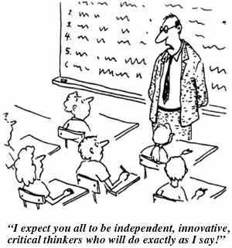

Slide 3
Genre approaches
Teachers feel a genre-based approach gives “an imposed rather than a responsive notion of text” (Kay & Dudley-Evans, 1998, pg. 311).
There is nothing inherently prescriptive or conforming in a genre approach (Hyland, 2018)

Slide 4
1. Building the context
4. independent construction of the text
5. Linking related texts
2. Modelling and deconstructing the text
3. Joint construction of the text
(Feez, 1998)
Assessment?
Competing paradigms?

Slide 5
Assessment criteria
“criteria compliance in pursuit of grades” (p. 286) and could “weaken rather than strengthen the development of learner autonomy” (p. 291).
Torrance (2007)
There is a danger with too much teacher guidance that students develop dependency and their learning strategies are reduced to “chasing what the tutor wants”
(Orsmond & Merry, 2013, p. 748).

Slide 6

Misuse of assessment criteria?

Slide 7
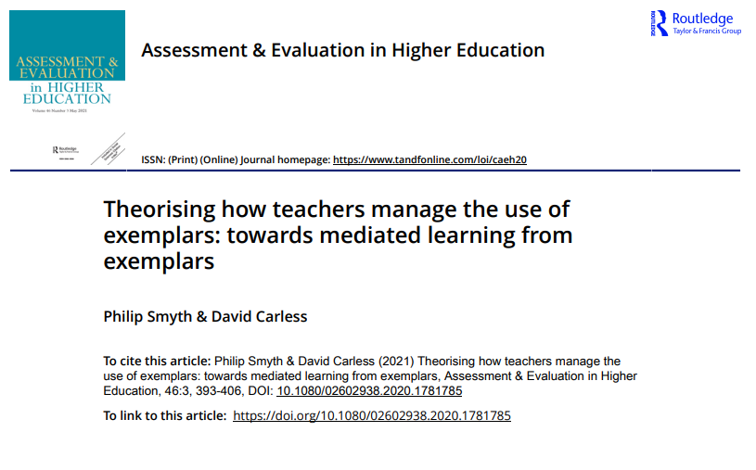

Slide 8
One view…
Criteria viewed as fully determinate and explicit
Criteria are non-negotiable
An attempt to map criteria to the learning (tight correspondence between exemplar and criteria)
Could result in students becoming instrumental in their approach to learning?
Could result in a focus on features not standards?

Slide 9
Examples
(Anika – interview) once the assessment criteria change, I need to change the exemplar
(Anika) so if we’re looking for the exemplar, those exemplars should correspond to the assessment needs and the requirements
(Carl) They (students) prefer a more prescriptive approach…
(Carl) If it’s prescriptive the students can just sit and listen and accept everything you say…

Slide 10
Another view…
Criteria avoided altogether
Seen as overly prescriptive
Students should discover what is required
Are students capable of discovering learning beyond surface features?
Little guidance other than what the teacher reveals?

Slide 11
Examples
(Janet) I'm afraid showing the criteria too early will be too prescriptive
(Gwen) Referring back to the assessment criteria is something I should do more often. But I have the feeling that if I refer to the criteria when examining the sample, then there may seem to be only one way to achieve the criteria, which certainly is not true.

Slide 12
Issues with both approaches
Criteria seen as determinate (tacit knowledge not considered) (borrowed from language testing?)
Criteria use (or lack of use) does not involve students directly
A lack of mediation and dialogue around criteria

Slide 13
A better use?

Slide 14
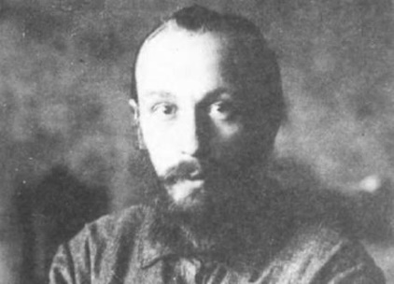
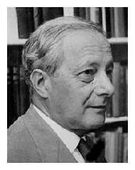
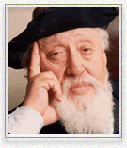
Theoretical perspectives
Dialogism (Bakhtin) - knowledge is seen as “emerging from the interaction of voices” and is concerned with “transformation of understandings”
Tacit knowledge – (Polanyi) - “We know more than we can tell.”
Mediated Learning Experience – (Feuerstein) – “A goal of education is… to assist in the process of self-organization - to modify individuals’ capacity to modify themselves.”

Slide 15
Acquiring tacit knowledge takes place through activities, such as observation, imitation, participation and dialogue (Bloxham & Campbell, 2010).
When students are able to develop tacit knowledge which corresponds broadly with that of the teacher, they are positioned to make sense of the teacher’s judgement and its rationale (Sadler 2010).

Slide 16
Criteria and criteria use for participation and dialogue
Criteria seen as fuzzy Knowledge is conceptualized as both explicit and tacit Assessment viewed as holistic rather than overly atomistic Students have the possibility to interrogate the criteria Exemplars and criteria are shared after writing is done

Slide 17
Tasks that engage students in using criteria (both tacit and explicit)
Grading exercise (4 samples, students rank order and grade then discuss)
Feedback exercise (grade yourself before receiving feedback)
Peer comparisons (what were the most important differences between your and your peers’ work?)

Slide 18
Do-Compare-Make explicit (Nicol, 2020,2021)
Three essential requirements for the deliberate and productive generation of internal feedback
Students must engage in a learning task or produce some work
Teacher must make reference material available for comparisons
Students need to engage purposefully in the comparison process and the results need to be made explicit (e.g. writing).

Slide 19
An example: Students wrote an essay and then compared to three peer essays (two random and one strong from the year before). Then answered 3 questions:
What are the most important differences between your essay and the exemplars?
What did you learn from these differences?
Which essay was the best - explain why?

Slide 20
Recommendations for practice
Use several exemplars demonstrating a range of quality during the course
Use the pre-set criteria as late as possible in the teaching sequence, after students have drafted their assignment and worked with exemplars/peer work
Develop skills in teacher-led discussion. Aim to elicit and critique students’ understandings of quality through peer and whole class dialogue
Encourage co-construction of meaning with students. Push students beyond criteria that focus only on surface features of quality

Slide 21

Difficulties in managing criteria
Time for effective work with criteria
Teacher knowledge and practice of assessment
Knowledge of possible exemplar processes and skills in mediating dialogue
Professional confidence of the teacher

Slide 22
There is no better way to avoid instrumentalism than to foster a culture of collaboration and negotiation in the higher education.
(Dysthe et al., 2008, pg. 129)

Slide 23
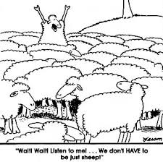
Questions?

