Slide 1

Are we reaching a TEAPing point?:
A qualitative study on managing quality in EAP
Daniel White
Notes:
BALEAP2023. Are we reaching a TEAPing point. Daniel White 15.50-16.30 (SocSci S0.13).pptx

Slide 2
Quality Management Systems
SYSTEM-ORIENTED
Involves education system as a whole and the processes by which quality control/assurance is utlised to broadly improve and enhance quality
i.e. approaches to understanding and monitoring performance
QUALITY MANAGEMENT
QUALITY IMPROVEMENT AND ENHANCEMENT
QUALITY ASSURANCE
QUALITY CONTROL
PROCESS-ORIENTED
Management tool to prevent defects.
e.g. frameworks, accreditation, external examiners
PRODUCT-ORIENTED
Reactive in nature i.e. designed to identify defects
e.g. student-staff feedback, post-course review, peer observations
Neidermeier (2017, p. 319)

Slide 3
Quality in HE
Bologna Process (1999)
Growing interest in standardisation/quality assurance (Seyfried & Pohlenz, 2018)
Introduction of University rankings, metrics and greater strategic orientation among HEIs > comparability measures (Williamson, 2019)
Development of European standards (ESG, 2015)
Development of UK standards (QAA, n.d.) and FHEQs [in 2001, revised: 2008, 2014]

Slide 4
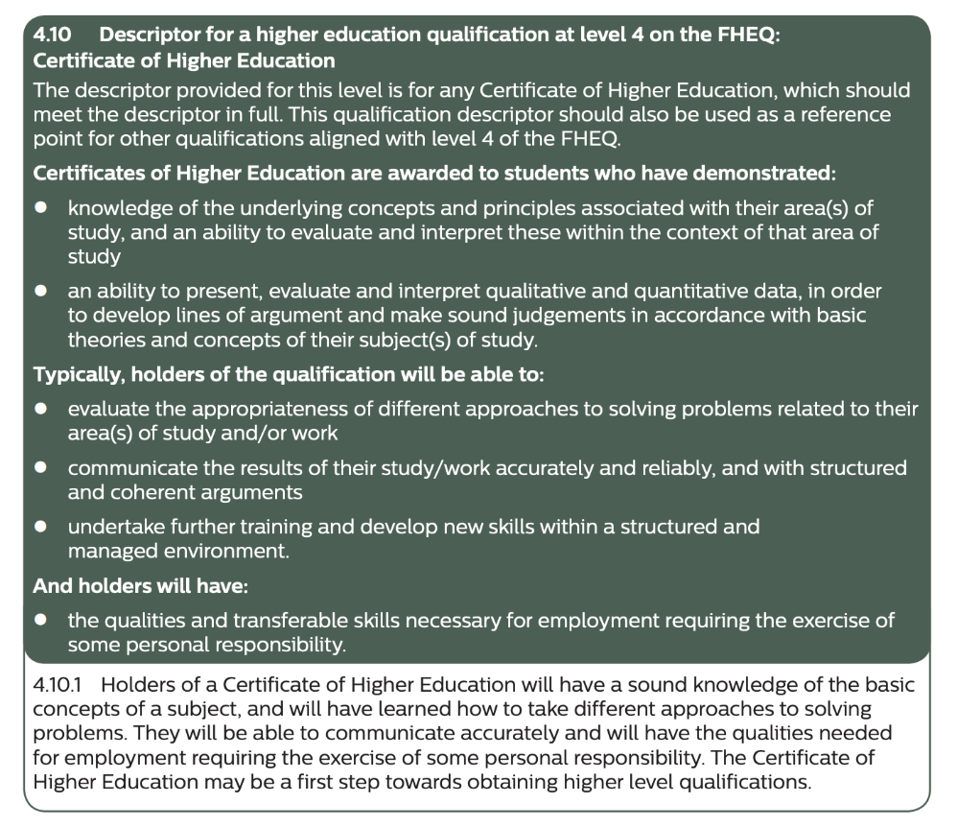
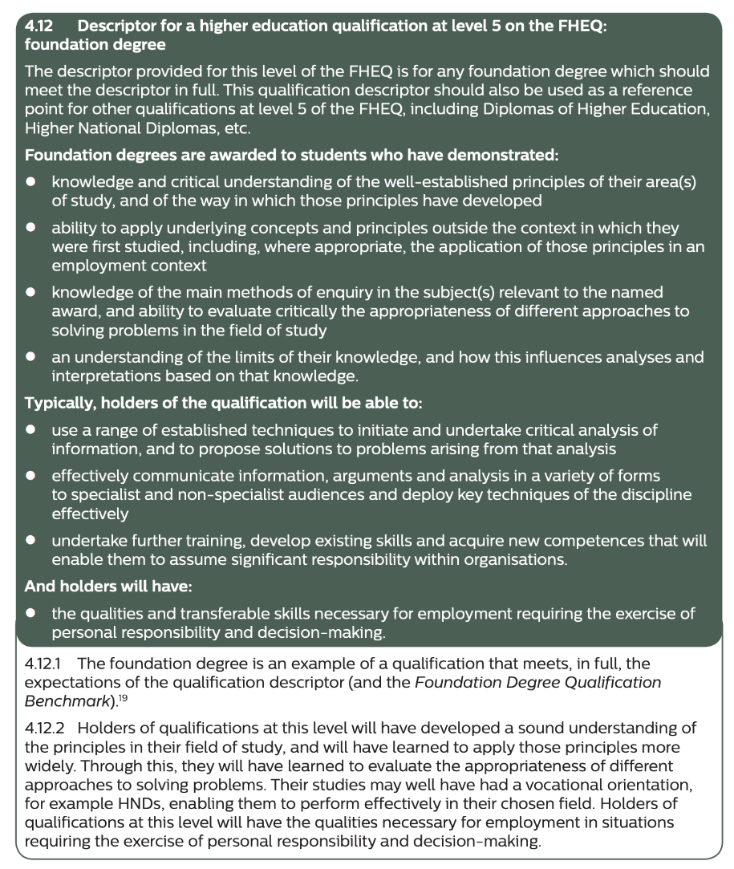
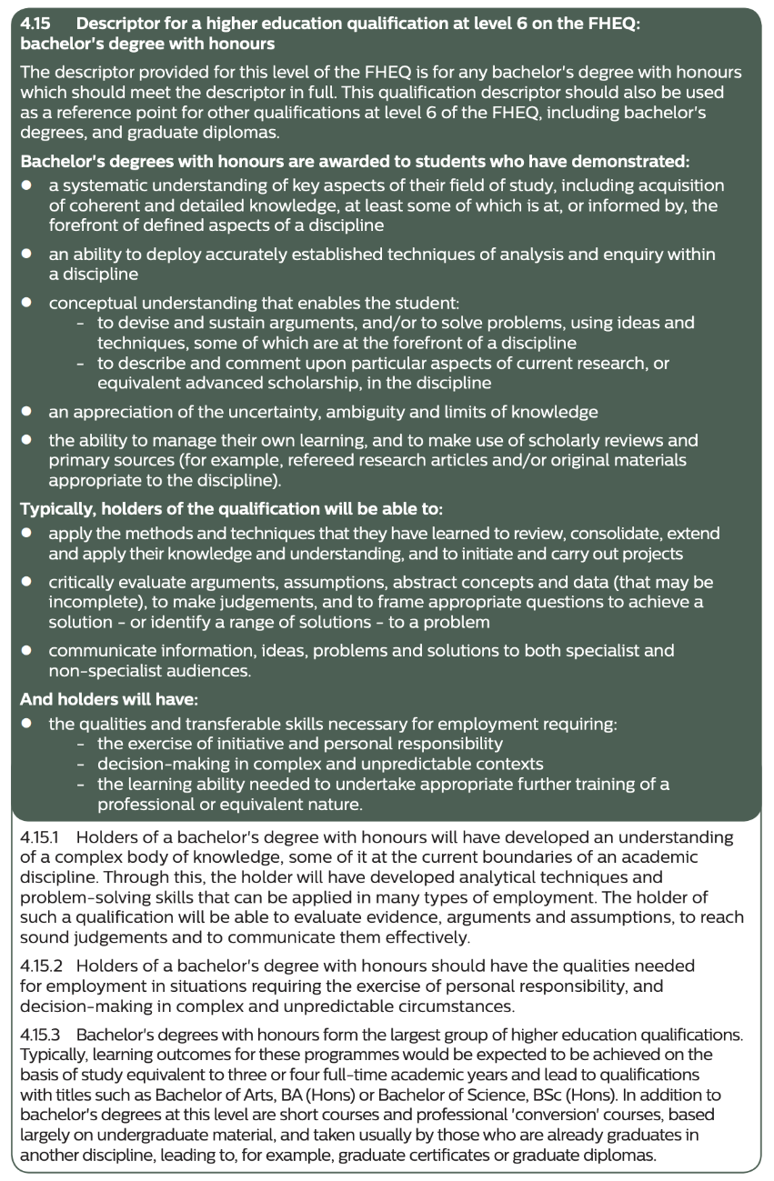
Quality in HE
QAA FHEQs (QAA, 2014)
Part of UK Quality Code for Higher Education for:
  Informing academic frameworks for awards
  Setting and maintaining standards
  Mapping to Europe/International quals frameworks (standardisation)

Slide 5
Quality in EAP
EAP quality management processes largely outside of national frameworks for educational oversight (Blaj-Ward, 2014), though may be considered internally
BC/BALEAP(BAS) accreditation schemes [in 1989, revised: 2011, 2014, 2016] (baleap.org, n.d.)
The CEM Model (Sloan & Porter, 2010) + Balanced Scorecard (Alexander et al., 2017)

Slide 6
Research aims
To explore EAP programme/course quality management in practice
To identify key challenges and opportunities regarding maintenance and enhancement of quality within the sector

Slide 7
Methodology
Semi-structured interviews
Senior Management in EAP (purposive sampling – Ebeto, 2017)
11 HEIs
2 institutions discounted due to different context (elite; British overseas JV)
Analysis using content analysis (theoretical coding) (Thornberg & Charmaz, 2014)
Primary role | n
Pre-sessional Programme Leader | 5
Insessional Programme Leader | 2
Centre Director | 1
Other | 1

Slide 8
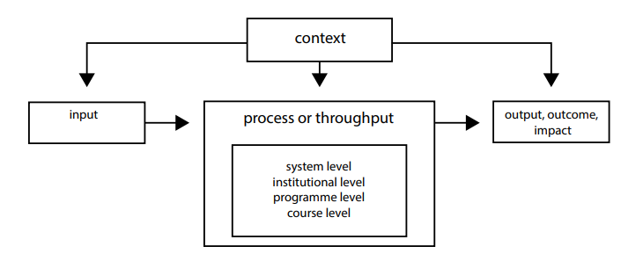
CIPO Model (Scheerens, 2013)
CIPO | Description | Example
Context | Wider QA e.g. by governments/accredited bodies | Language: CEFR; UKVI; Skills: FHEQs; Graduate Characteristics (internal)
Input | Financial and materials resources & incentives; HR and staff qualifications; Service resources | Institutional/dept strategy/goals; budget; teaching qualifications
Process | Teacher/student behaviour; Administration; Quality Assurance; Curriculum | Programme design; assessments; content; admin; QA
Output | Output – end of the process; Outcome – what has changed as result of process; Impact – longer-term indirect result of process | Output: Progression from (e.g.) Pre-sessional Outcome: Student achievement over process Impact: Transferrable skills

Slide 9
Results & Discussion

Slide 10

Theme 1: There is a mission statement, but it’s not made clear to us
The director … might have goals, but he doesn’t tell me about that ... I’m not aware of any targets
Interviewee 1
We haven’t been given any direct aims. It’s articulated [by me] in terms of overarching university strategy … [but] it’s broad.
Interviewee 3
There is a mission statement, but it’s not made clear to us. You have to look yourself really, which I have done in the past and it’s like ‘oh that’s what we’re supposed to be doing’
Interviewee 4

Slide 11
Discussion
Lack of institutional strategic alignment
Uncertainty over where “language centres” fit
(Mis)perceptions of EAP
Unclear what constitutes ‘success’

Slide 12
Theme 2: The primary purpose is X, but I mean for us, the purpose is Y …
The purpose of pre-sessional is to get the students that met the academic requirements for programmes, but not the English language requirements. So, the whole point is to up that English.
Interviewee 2
Students attend to learn English…

Slide 13
Theme 2: The primary purpose is X, but I mean for us, the purpose is Y …
... to enable the students to get their English up to the level that they will be accepted by their department. I suppose that’s the primary reason, but I mean for us, the purpose is to try and prepare them for university life [in terms of] UK academic culture and some of the norms like the things that we think [students] will be asked to do and so on
Interviewee 5
… but we see the main purpose as degree preparation...

Slide 14
Theme 2: The primary purpose is X, but I mean for us, the purpose is Y …
…it’s about preparing international students so that they’re familiar with the academic literacy skills that are required … they develop these skills so they can basically cope when they start on their main programme.
Interviewee 3
For a lot of us, we obviously don’t teach them just English, we teach them EAP and sort of stuff you might call study skills, so part of it is preparing them for kind of being successful once they join their degree
Interviewee 7
We would quite like to, in a way, ditch the language element
Interviewee 1
…focusing more on academic/study skills…

Slide 15
Theme 2: The primary purpose is X, but I mean for us, the purpose is Y …
If I talk about it crudely, I would say the emphasis is more on study skills because of the length of time we’ve got … you can make a difference in a limited way in terms of their language skills … there’s only so much you can do [but] you can take a student who knows next to nothing about academic writing [and] bring them on
Interviewee 3
… as we all know, you can’t do a lot with the English language in six weeks, let alone four weeks
Interviewee 2
It’s really tricky… I say to [our teachers] ‘look, we cannot do this in six weeks. You can’t. You can’t go up 0.5 IELTS in six weeks… [focus on] those [study] skills, get them reading’
Interviewee 8
…because it isn’t deemed possible to reach language goals within the timeframe

Slide 16

For the university, it is the shortfall in students’ language skills that determines the decision to offer a pre-sessional programme route as an alternative to re-sitting the IELTS exam. However, for those teaching and working on the programme, the purpose and remit is wider.
(Kirk, 2018, p. 122, emphasis added)

Slide 17
Impact of study skills focus (pre-sessional)
Students entering via pre-sessional programmes perform less well than students entering directly (Lloyd Jones et al., 2012; Millar, 2002; Pearson, 2020; Ridley, 2006; Thorpe et al., 2017)
Former pre-sessional students are more confident than direct entrants but not reflected in student outcomes (Terraschke & Wahid, 2011, p. 181)
Student expectations of pre-sessionals different to staff (Pearson, 2020, p. 435)
Notes:
“It seems interesting to note that, even though [direct entry] students expressed a greater sense of dissatisfaction, they achieved better results than most [pre-sessional] students overall” (Terraschke & Wahid, 2011, p. 181)
“Many students were aware that they needed to remedy a shortfall in their English language proficiency, and expected the programme to focus more on the mechanical aspects of language development, such as grammar and vocabulary. They were thus surprised that the course focused on enhancing academic skills.” (Pearson, 2020, p. 435)

Slide 18
Is there more to it?...
‘For … senior management team members in charge of internationalisation, it just means bums on seats [and is] an income stream’
Interviewee 10
The starting point is wrong because the starting point says in general UK students seem to be outperforming international students, therefore there’s a problem with international students. They have a deficit …
Interviewee 3
I often think universities don’t help by not making it clear [what the differences in academic culture are]
Interviewee 1
the first problem is that you’re labelling students as being deficient, which is not the intention, but comes across that way. And the second thing is, if almost every student is deficient, then how can you possibly provide the level of support needed differently? Everybody requires [support]
Interviewee 3
international student experience is not something that we do well enough as a rule of thumb
Interviewee 7

Slide 19
Discussion
HEIs lack explicit embedded teaching on how to learn on the whole
EAP has self-defined in order to address wider HEI gaps in L&T
The discipline has largely evolved into eAP (with a small ‘E’).
Yet still a (mis)perception of EAP as English language support

Slide 20
Theme 3: I don’t know really what others are doing … we all do our own thing completely
Because of experience, now I know what to focus on. But in the beginning I’m thinking back I would have asked the course leaders ‘so what do you want me to do?’ … but they don’t have a lot of knowledge about what we do anyway, so they might say ‘grammar, vocabulary’
Interviewee 5
[Contextualising is] very time consuming … you sit there for hours trying to find appropriate things
Interviewee 4
Everyone is left for themselves. People end up [duplicating teaching] … and it just makes it look really a bit shoddy to be fair
Interviewee 4
I don’t really know what others are doing. At the moment, we just do our own thing completely …
Interviewee 5

Slide 21
Theme 3: I don’t know really what others are doing … we all do our own thing completely
[On insessional...] I don’t think the curriculum is based on any framework as such, maybe just speaking with programme leaders and learning student and programme needs
Interviewee 1
I don’t think [there is any skills framework] I don’t think that’s a consideration when there are inspections at that level. We do have a look at what QAA are doing, but not in any great detail at all
Interviewee 8

Slide 22
Discussion
Mapping student needs against different programme needs is a challenge
Variation in support both within and between institutions
  Negative impact on overall quality
  Difficult to monitor/measure
  Lack of coherence (overlap in provision)

Slide 23
Theme 4: I don’t feel confident with assessment design
We are always debating what’s the right way [to assess students]. You know, how do you do that while also making assessments authentic so that you get that positive washback
Interviewee 8
I couldn’t really confidently say that [listening and reading assessments] are aligned to CEFR ... it’s a bit subjective … you’ve got to judge the language level … identify questions you think will elicit that language, and then you’re setting a percentage ‘if you get x percent, it’s equivalent to this’ and it’s tricky
Interviewee 1
I don’t really link [assessments] to learning outcomes … I suppose the links I use to the assessment criteria are in my head
Interviewee 5
I don’t have any support at pre-sessional … We need to pilot … my piloting is talking to a friend of mine just to see if it works
Interviewee 2

Slide 24
Theme 4: I don’t feel confident with assessment design
I don’t think anyone with any expertise is checking [assessment design]
Interviewee 1
This is one of the reasons why I’m leaving after all these years is I’ve had to do everything without support [in relation to assessment design]
Interviewee 2

Slide 25
Discussion
Lack of framework/curriculum results in variability in quality of assessments
Many lack expertise and confidence for English language assessment design, so difficult to determine accuracy of tests used in terms of language

Slide 26
Theme 5: Tracking student performance is something I’d like to do, but it would be so difficult
I’ve tried hard over the last few years to get something that really tells me [how students are doing on degree programmes], but the answer is not really. … We do get quite detailed information about a particularly group of students at programme level, but in terms of systematic data where I can measure outcomes, no.
Interviewee 3

Slide 27
Discussion
Understanding outcomes/impact is challenging
Opportunities to understand overall quality are lost

Slide 28
Conclusions
Context | There is no framework that best fits what EAP practitioners do
Input | Lack of clear direction from institutions in reference to EAP and its purpose
Process | (‘Internationalisation’ has exposed gaps in HEI L&T support for all students) English language specialists have attempted to fill these gaps for international students by broadening scope of teaching (holistic academic/study skills), which essentially has meant ‘self-defining’ the role outside of wider (or lack of) strategic guidance. However, dual purpose of ‘EAP’ is problematic – lack of framework results in variation, yet aims are broadly similar Lack of standardisation creates difficulty for assessment design
Outcomes | Difficult to measure outcomes due to lack of standardisation

Slide 29
Recommendations
Dialogue required around clear purpose of ‘EAP’ at an institutional level
Broader scope (sector):
  Pre-sessional - potential opportunities for national curriculum/centralised assessment design
  Skills framework underpinning all student learning upon which skills development can be mapped for greater coherence of academic support

Slide 30
Limitations
Only 11 HEIs considered – insightful, but not generalisable
Timeframe short, which limited participation
Scope was broad – this allowed holistic overview, but could be narrowed in further research to understand specific contexts

Slide 31
References 1
Alexander, O., Sloan, D., Hughes, K., Ashby, S. (2017). Engaging with quality via the CEM model: Enhancing the content and performance management of postgraduate in-sessional academic skills provision. Journal of English for Academic Purposes, 27, pp. 56-70. https://doi.org/10.1016/j.jeap.2017.04.005
Baleap.org (no date b) BALEAP Accreditation Scheme (BAS) Handbook Quality Enhancement fo English for Academic Purposes Courses and Programmes.
BIS (2011). Higher Education: Students at the heart of the system. Department for Business Innovation & Skills. Retrieved from: https://assets.publishing.service.gov.uk/government/uploads/system/uploads/attachment_data/file/31384/11-944-higher-education-students-at-heart-of-system.pdf
Blaj-Ward, L. (2014). Exploring the Quality, Relevance and Impact of EAP. In Researching Contexts, Practices and Pedagogies in English for Academic Purposes (pp. 145-174). Palgrave Macmillan, London. https://link.springer.com/chapter/10.1057/9781137331878_6
ESG (2015). Standards and Guidelines for Quality Assurance in the European Higher Education Area (ESG). Brussels, Belgium.
Kirk, S. (2018). Enacting the curriculum in English for Academic Purposes: A legitimation code theory analysis. Unpublished PhD thesis. Durham University

Slide 32
References 2
Lloyd-Jones, G, Naeme, C, & Medaney, S. (2012). A multiple case study of the relationship between the indicators of students’ English language competence on entry and students’ academic progress at an international postgraduate university, IELTS Research Reports, 11. British Council, Cambridge Assessment English and IDP: IELTS Australia. Retrieved from: https://www.ielts.org/teaching-and-research/research-reports/volume-11-report-3
Millar, M. (2002). Post-foundation progress: A case of rakes or pilgrims. BALEAP PIM Report, 16. Retrieved from: http://www.uefap.com/baleap/pimreports/2002/ukc/millar.htm
Neidermeier, F. (2017). ). Designing Effective Quality Management Systems in Higher Education Institutions. Module 1. In Randhahn, S. & Niedermeier, F. (Eds.) Training on Internal Quality Assurance Series. Duisburg/Essen: DuEPublico. Retrieved from: http://dx.doi.org/10.17185/duepublico/43222
Pearson, W. S. (2020). The effectiveness of pre‐sessional EAP programmes in UK higher education: A review of the evidence. Review of Education, 8(2), pp. 420-447. https://doi.org/10.1002/rev3.3191
QAA (2014). UK Quality Code for Higher Education - Part A: Setting and maintain academic standards. The frameworks of higher education qualifications of UK degree-awarding bodies. Retrieved from: https://www.qaa.ac.uk/docs/qaa/quality-code/qualifications-frameworks.pdf
QAA (no date). Subject benchmark statements. Retrieved from: https://www.qaa.ac.uk/quality-code/subject-benchmark-statements

Slide 33
References 3
Ridley, D. (2006). Tracking a cohort of pre-sessional students at Sheffield Hallam University. In A. Gillet, & L. Wray (Eds.) Assessing the effectiveness of EAP programmes. London: BALEAP.
Scheerans, J., Luyten, H, & van Ravens, J. (2011). Measuring educational quality by means of indicators. In Scheerans, J., Luyten, H, & van Ravens, J. (Eds.) Perspectives on educational quality (pp. 35-50). London: Springer.
Seyfried, M., Pohlenz, P. (2018). Assessing quality assurance in higher education: Quality managers’ perceptions of effectiveness. European Journal of Higher Education, 8(3), pp. 258-271. https://doi.org/10.1080/21568235.2018.1474777
Sloan, D., & Porter, E. (2010). Changing international student and business staff perceptions of in-sessional EAP: Using the CEM model. Journal of English for Academic Purposes, 9(3), pp. 198-210. https://doi.org/10.1016/j.jeap.2010.03.001
Terraschke, A., & Wahid, R. (2011). The impact of EAP study on the academic experiences of international postgraduate students in Australia. Journal of English for Academic Purposes, 10(3), pp. 173-182. https://doi.org/10.1016/j.jeap.2011.05.003
Thorpe, A, Snell, M., Davey-Evans, S., & Talman, R. (2017). Improving the academic performance of non-native English-speaking students: The contribution of pre-sessional English langauge programmes, Higher Education Quarterly, 71(1), pp. 5-32. https://doi.org/10.1111/hequ.12109

Slide 34
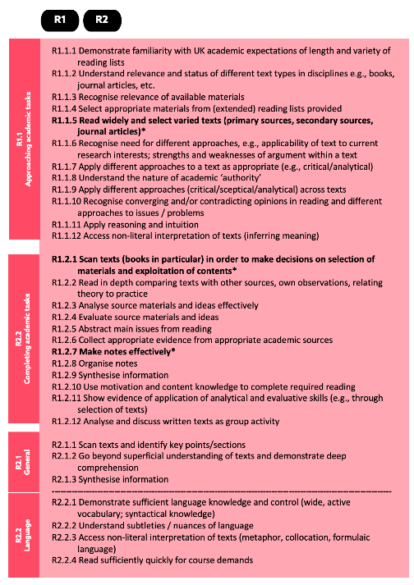
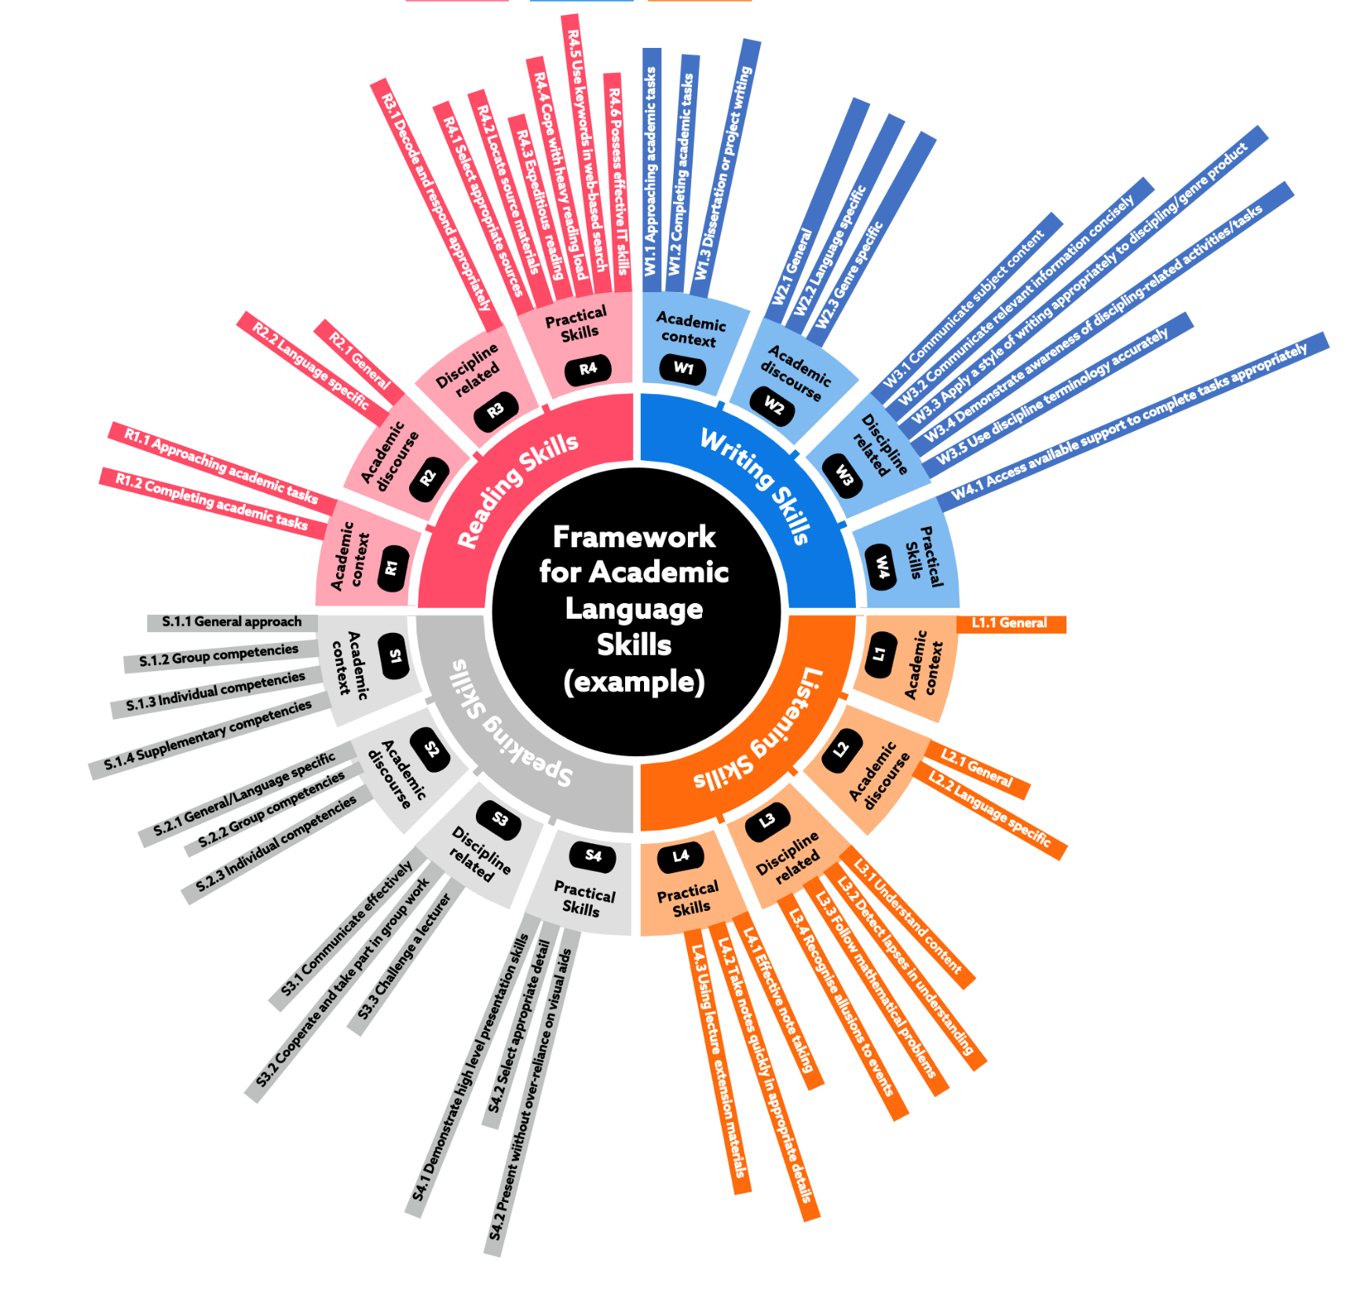
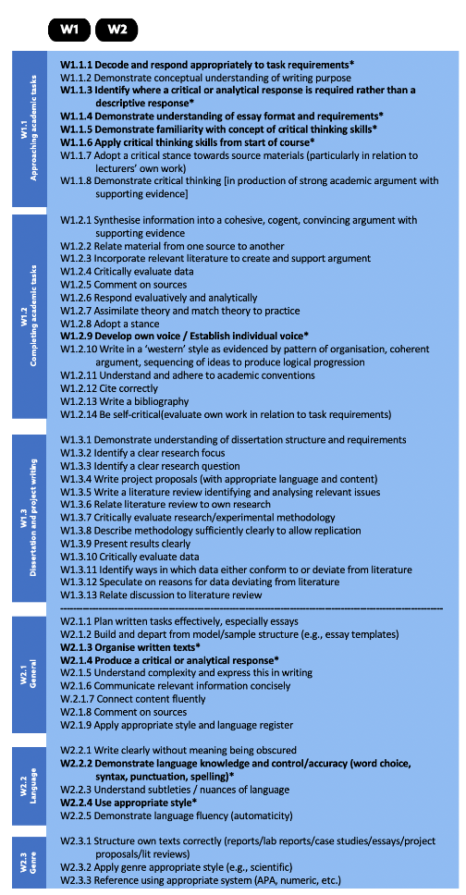
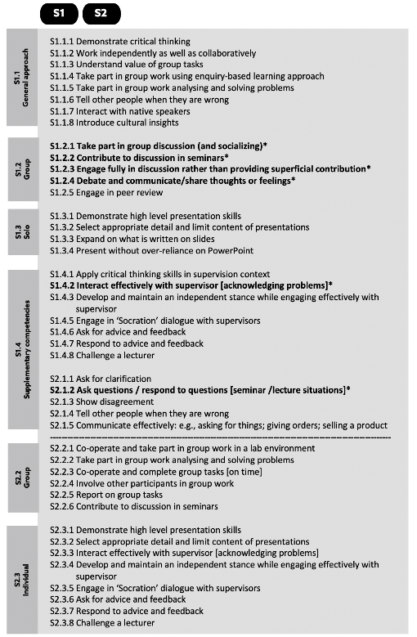
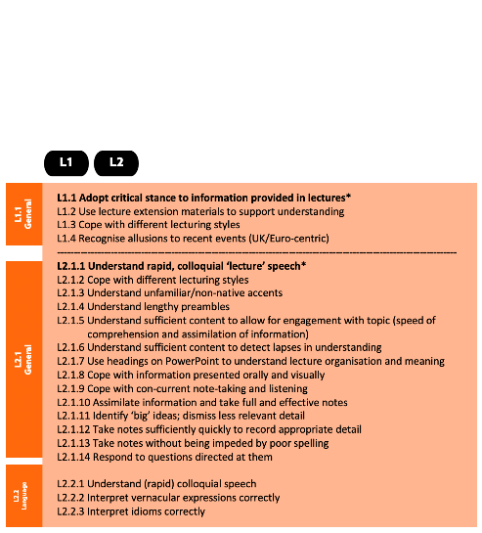
Based on BALEAP Can Do Framework for EAP syllabus design and assessment. Available at: https://www.baleap.org/resources/can-do
Notes:
Example (visualisation of BALEAP can do framework i.e. competency statements for international students at Master's level.

Slide 35
Interview questions (template)
Intro | Tell me a little about your context; what is the purpose of [your provision]?
Context | Are you accredited? What are benefits and challenges? Are internal QA processes in place and how suited are they to your context?
Input | Who are the main stakeholders for the provision? To what extent does dept align to University Strategy (and who communicates need)? Do you have department goals? How do you understand to what extent you are achieving such goals?
Process | Take me through the process of programme design; Who designs assessments? What process is used? To what extent do assessments measure language versus academic/study skills? Tell me about the process of materials design
Output | How do you monitor student performance on programme and/or after programme completed? How do measure outcomes?
Summary | What would you consider to be the main challenges facing EAP for maintaining and enhancing quality

