Slide 1
‘Am I allowed?’
Disrupting academic norms, conventions and 'rules' with postgraduate writers and supervisors
Sherran Clarence, Nottingham Trent University
Steve Kirk, Durham University

Slide 2
Opening salvo
Many universities provide significant help with writing, learning language conventions, time for this for undergrad students
Postgrad, esp. doctoral students (and their supervisors) are generally expected to know what they’re doing.
BUT, do they? Should they?
Literacy demands are not consistent throughout levels of degree study - knowledge-making and meaning-making demands change, writer/student/research identity changes (especially if you’re shifting disciplines or fields from one level to another
This means that doctoral students and supervisors need EAP input, opportunities for learning, materials, and more.

Slide 3
Approaches to postgraduate writing
More than any other level, at D level we use writing to indicate our level of authority and our academic identity - we use language and writing to make novel contributions to knowledge and to construct ourselves as academics worthy of the doctorate and everything it gives us access to.
So, for those working with PG writers, this begs important questions about how we teach writing at this level.
Are we still doing assimilationalist and socialising literacy work in ways that close down different ways of making and sharing knowledge that could diversify the research we are creating in exciting, novel and important ways?
Are we reinforcing Anglocentric and abelist forms of writing, without realising it? What effect might this have on a diverse student population in terms of feeling part of the academy and represented within it
How do we make changes? What changes? Where do we start? With whom should/could we be working?

Slide 4
Debate 1
Thinking about your context, and perhaps your own experience of being a postgraduate student-writer, talk about the following at your table:
What are the implications of IDENTITY on writing at the postgraduate level?
(Do these change the experience of writing? How?)
(What helped you navigate the conventions and norms of your discipline? How did you know and see what these were? What hindered or stumped you?)

Slide 5
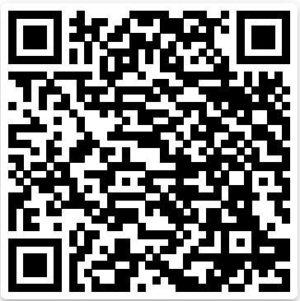
Padlet for your thoughts…

Slide 6
A bit of theory to help with thinking
Specialisation (Legitimation Code Theory)
Helps you to name and explain the “organising principles” that underpin your discipline/field of study or work
Useful for writers because writing conventions are linked to or express these (e.g., in linguistic conventions, turns of phrase, passive/active voice, presence of author in text + more)
Is the knowledge the most valued ‘thing’ or is the knower more valued? If it’s knowledge, you’re likely to see more passive voice + 3rd person, for example. If it’s the knower, you’re likely to need to construct an overt and active authorial presence.
Sciences tend to be more about knowledge || SS and Hum tend to be more about knowers.

Slide 7
Stronger orientations to knowledge
knowledge code
elite code
The Sciences
(typically)
E.g. Drama; Music
(typically)
Weaker orientations
to knowers
Stronger orientations
to knowers
The Humanities
(typically)
‘Study Skills’
relativist code
knower code
The specialisation plane
(Adapted from Maton, 2014, p. 30)
Weaker orientations to knowledge

Slide 8
To help your next debate
Think about the Discourse of the discipline(s) you work in/with.
What are their core underpinning values? What is the basis for successful achievement?
Do writers need to join a community through evidencing expertise in technical/procedural/principled/practical knowledge as the core for success?
Or, do they need to join a community by evidencing the development of a firm perspective, disposition, set of characteristics that mark them as belonging?
Do writers know and see this explicitly? Is this ever explained to them? Or are they expected to know it and do it without explicit guidance?

Slide 9
Debate 2
Thinking about your role as an EAP practitioner/specialist and your university context:
What practices/spaces are in place for PG student-writers (and supervisors?) that could be enhanced/expanded/changed?
(If there are none/few, what could be developed? Why would that be useful?)
(If changes can be made, what changes and why?)

Slide 10
Closing thoughts
Affirming/transforming — socialising/disrupting (norms, ways of working, ‘voice)
Transformative/disruptive work is hard and takes time
Requires agency (recognised and enabled by the university + community)
Responsibility? Risk? [What are our responsibilities (to students, staff, to knowledge-making + criticality)? Who carries the risk if we try to disrupt established norms + ways of writing?]
Can we start to make small changes in our contexts to make knowledge + meaning-making work more open to debate, change, questions, disruption (where needed)? How do we get PG student-writers and supervisors engaged?

