Slide 1
Addition by Subtraction:
Reducing Overload to Optimize Learning for the Knowledge Economy
Kassandra Robertson
BALEAP Conference | April 20, 2023

Slide 2
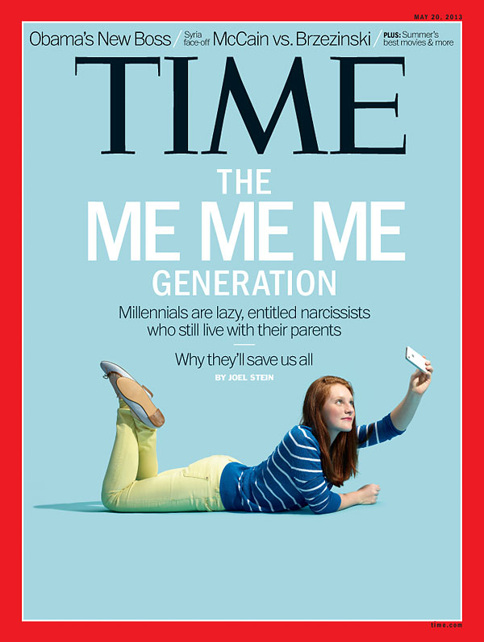
Overview
Who are Gen Z?
Characteristics & Perceptions
Challenges & Opportunities
Cognitive Load Theory (CLT) in Education
Processing Capacity in Learning
Mental Health Considerations
Optimizing Learning for the Knowledge Economy
Reimagining Curricula Objectives
Managing the Input Stream: Principles from Design
Constructive Applications of Generative AI for EAP

Slide 3
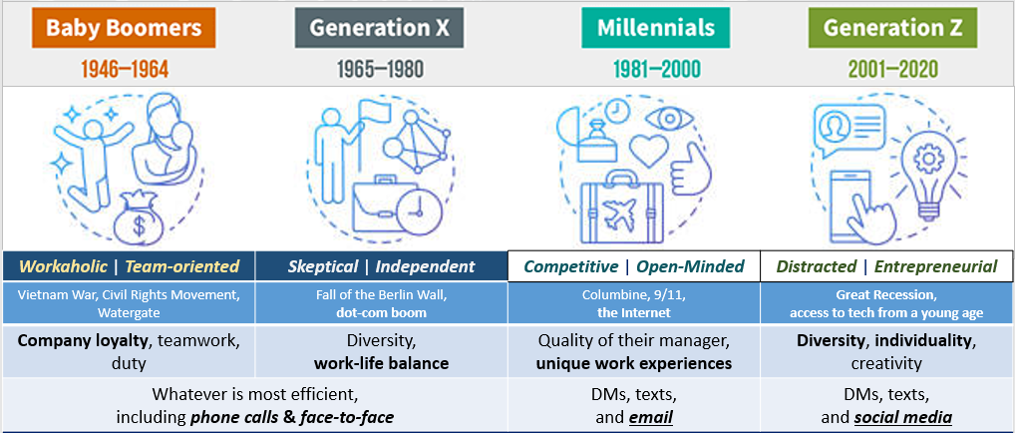
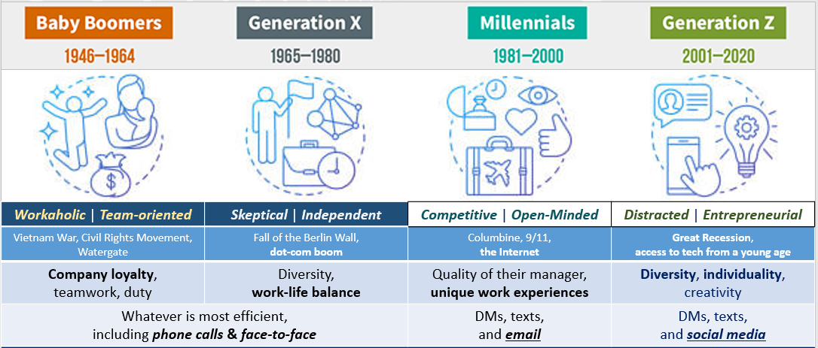
Defining Characteristics
https://www.purdueglobal.edu/education-partnerships/generational-workforce-differences-infographic/

Slide 4

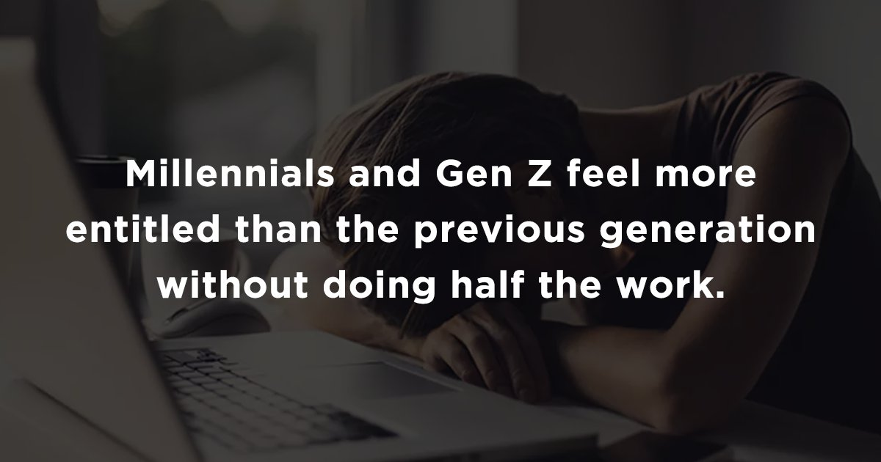
Who are Gen Z?

Slide 5
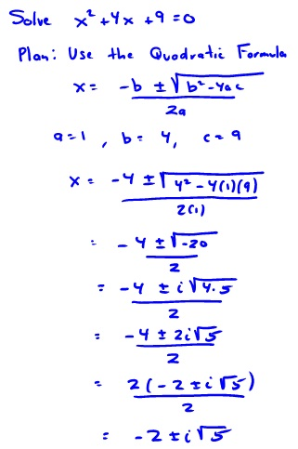

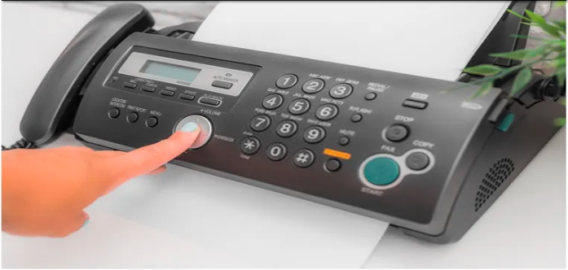
When was the last time you…
Were asked to recite a Shakespeare sonnet?
Used the Quadratic formula?
Needed to balance your checkbook?
Sent a fax?

Slide 6
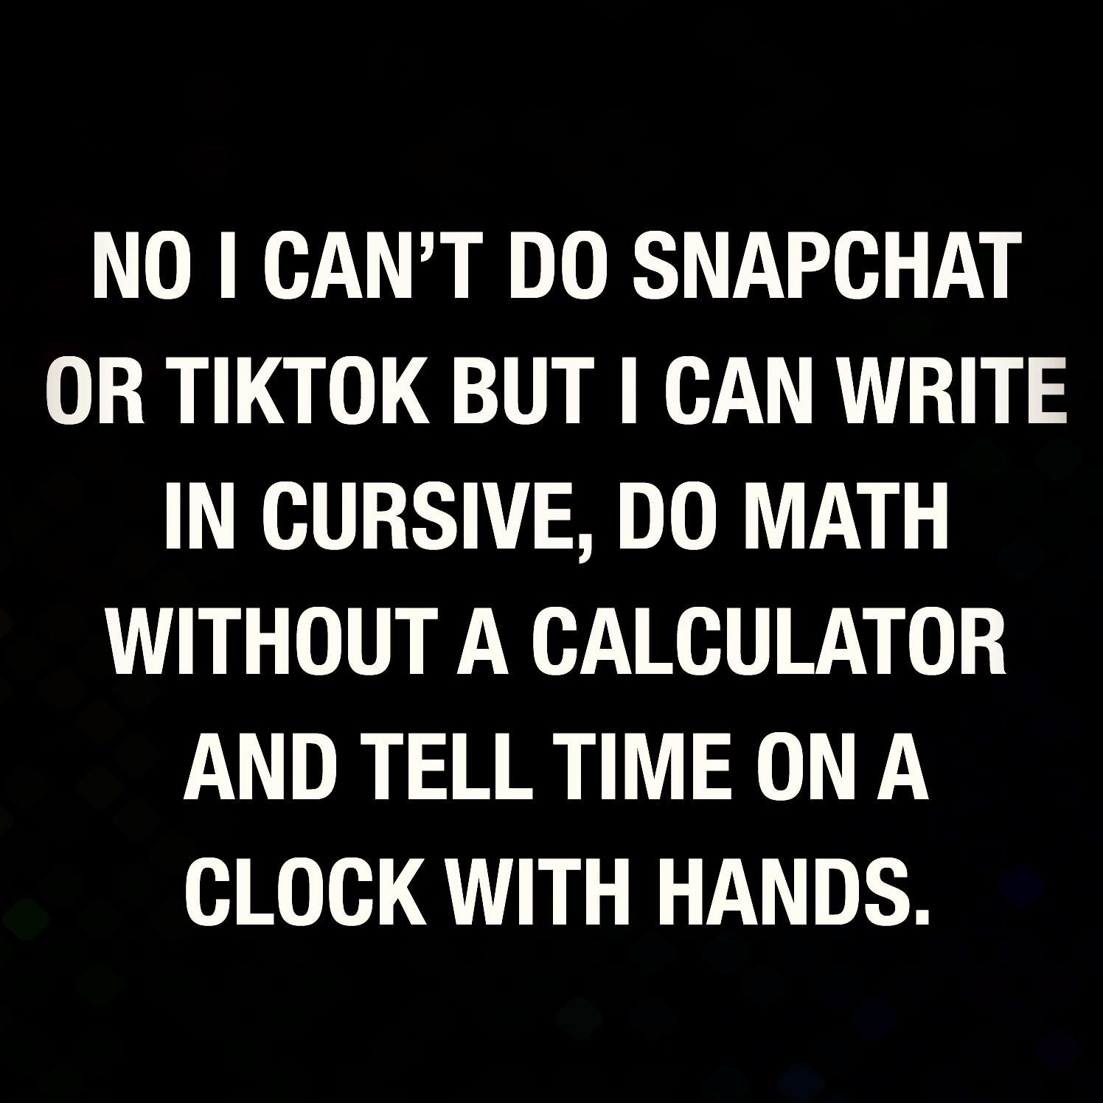
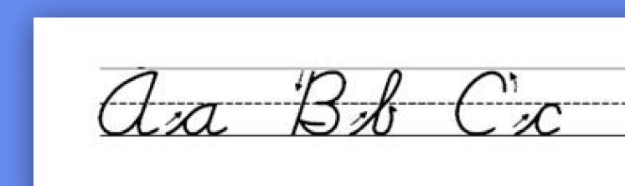
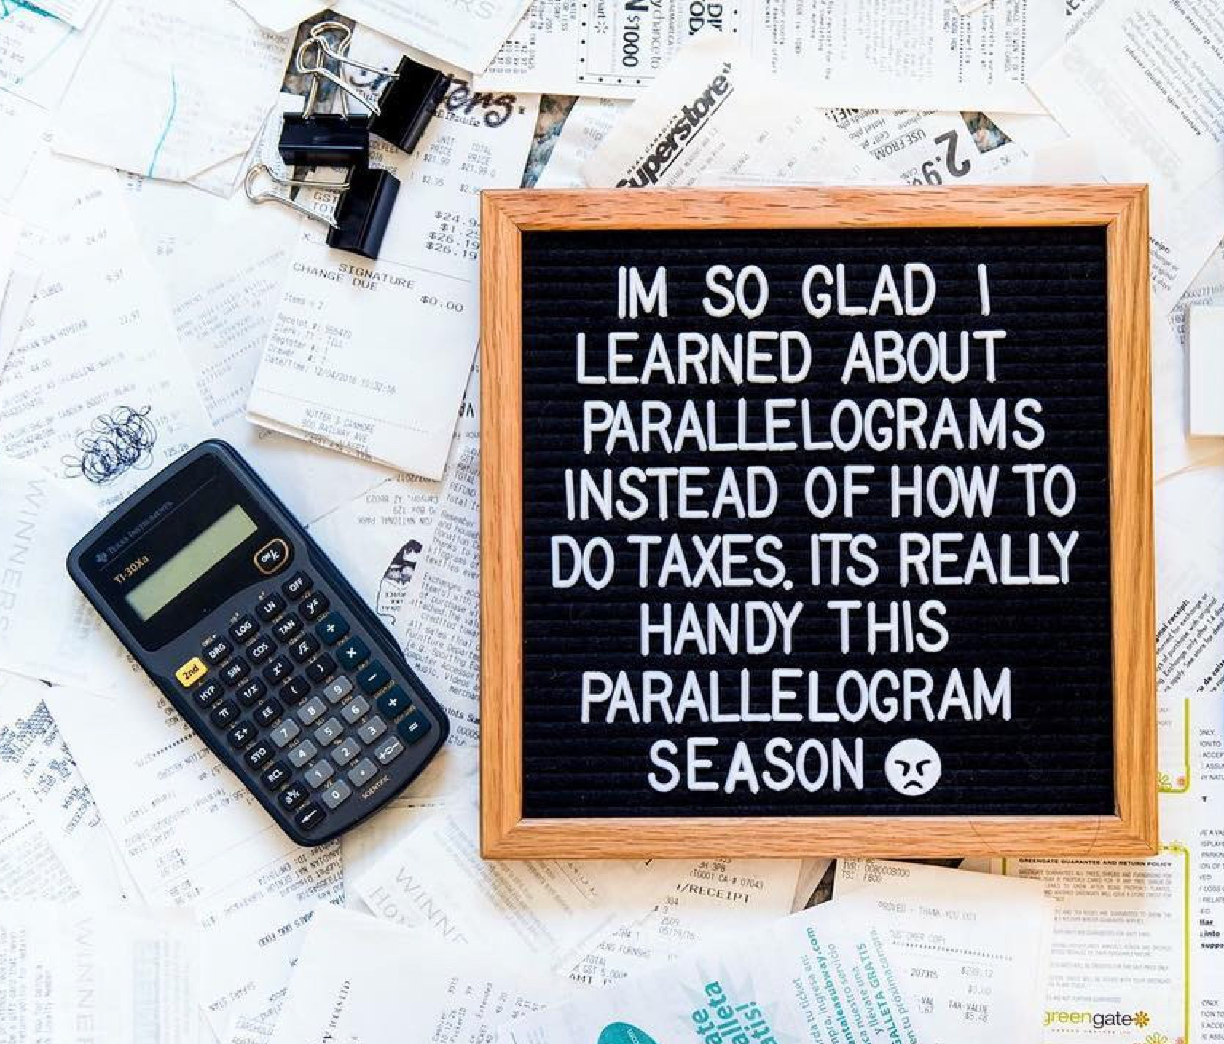



Slide 7
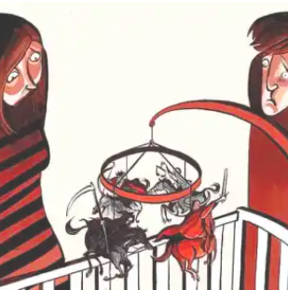

From Baby Boomers to Baby Doomers
Global Challenges:
  Geopolitical conflicts
  Extreme climate events
  Inequality
  Steep rises in levels of inflation
Gen Z’s World:
  Desire to drive change, particularly regarding climate change
  Challenges: Cost of living and financial concerns
    Almost half of Gen Zs (46%) and millennials (47%) live paycheck to paycheck and worry about being able to cover their expenses
(The Deloitte Global 2022 Gen Z and Millennial Survey, 2022)

Slide 8



Post-COVID Labor Market Boom & Bust
– Major shift from employee-driven market to one that is extremely competitive
Great Resignation
“Quiet Quitting”
Quiet Firing
Loud Layoffs
Career Cushioning
Great Resignation
“Quiet Quitting”
Quiet Firing
Loud Layoffs
Career Cushioning

Slide 9

The Value of a College Degree in the 21st Century
Has gotten excessively expensive
  U.K. – ↑300% since 1998, average debt £43,500
  U.S. – ↑500% since 1980s, average debt $40,114
Has become less effective at preparing students for professional life after university
  “[…] one in 10 (11%) business leaders strongly agree that college graduates have the skills […] that their workplaces need.” (Gallup, 2014)
A proliferation of alternatives
  Online courses, YouTube
  Apprenticeships & direct training from companies
Value of formal education = Efficiency & Feedback

Slide 10
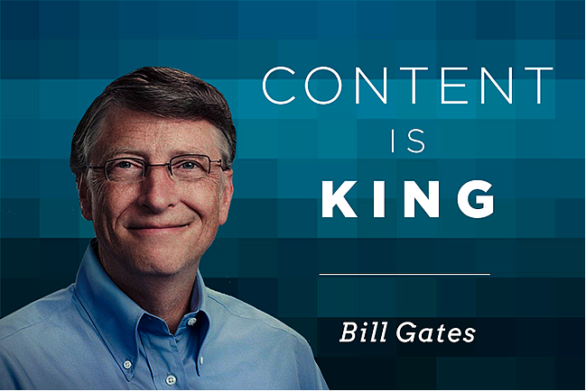
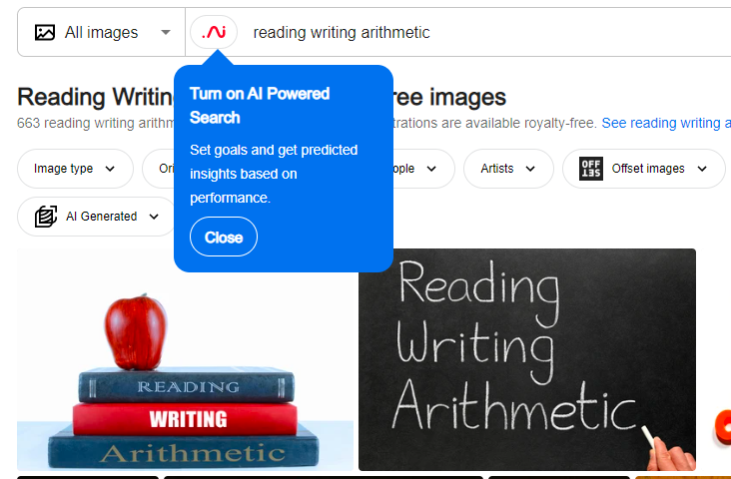
21st Century Skills
?
Distinct from traditional academic skills in being NOT primarily content knowledge-based
“Framework for 21st Century Learning”
(National Education Association, 2002)
Four Cs
Communication
Collaboration
Critical Thinking
Creativity

Slide 11




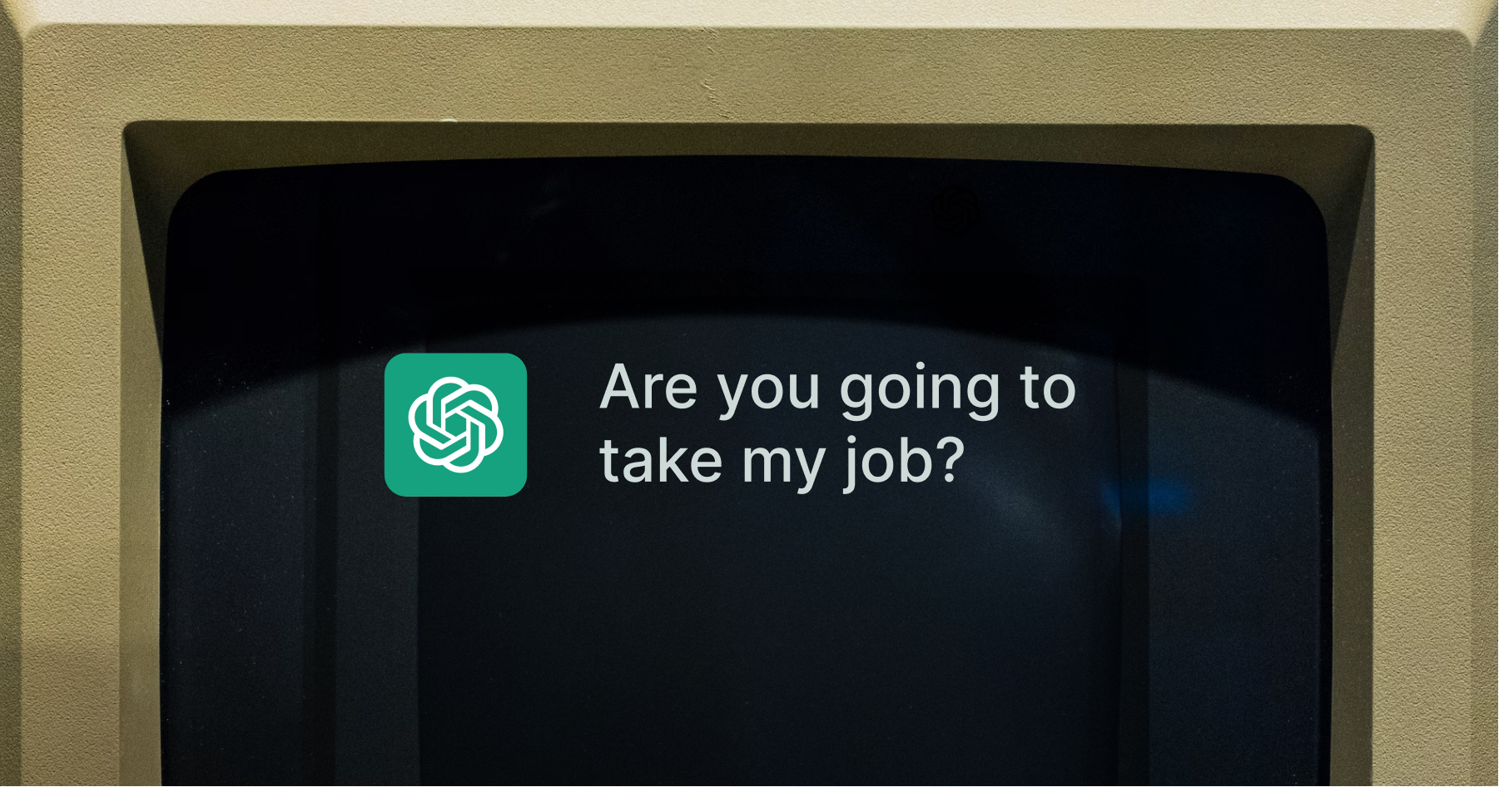

A New Era in What it Means to be ‘Skilled’
– Modern economy increasingly defined in terms of knowledge or creative work
Increased value on the ability to:
– Process massive amounts of information efficiently
– Collaborate effectively with technology to produce exceptional output

Slide 12



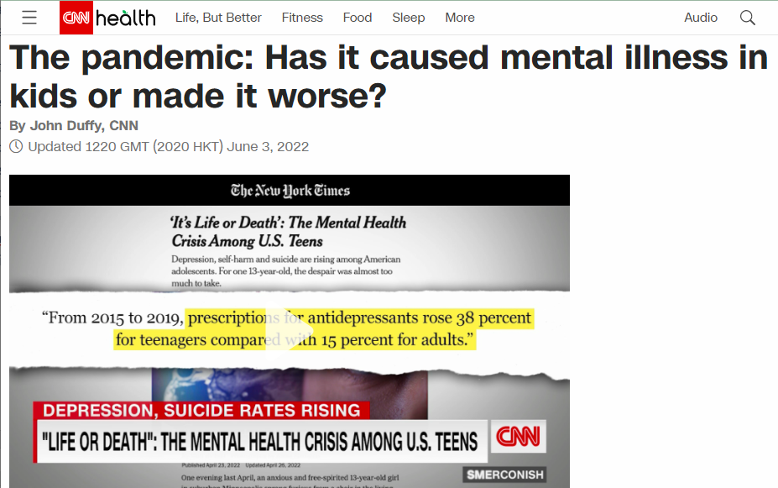
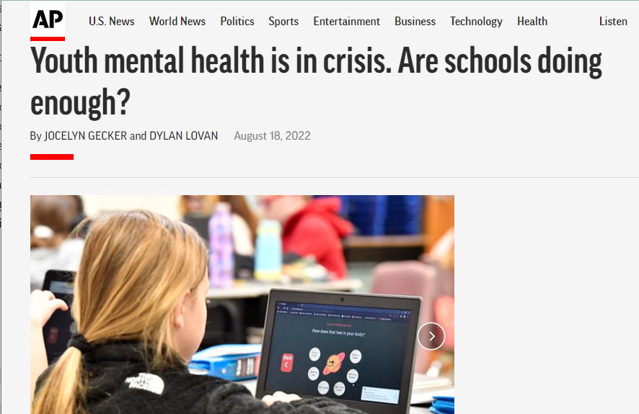
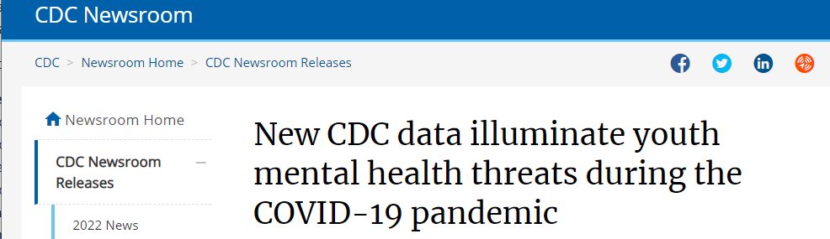

Slide 13


Slide 14
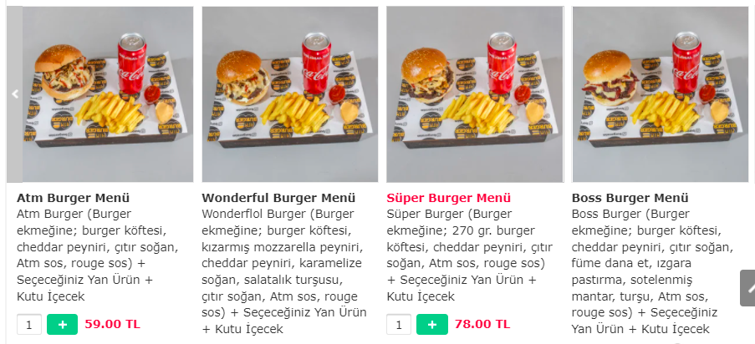
Standard Burger Basket Standard Burger (Burger bun, hamburger patty, cheddar cheese, crispy onions, special sauce, red sauce) + Your choice of side + canned drink | Wonderful Burger Basket Wonderful Burger (Burger bun, hamburger patty, fried mozzarella cheese, cheddar cheese, caramelized onions, pickled cucumbers, crispy onions, special sauce, red sauce) + Your choice of side + canned drink | Super Burger Basket Super Burger (Burger bun, 270 gr hamburger patty, cheddar cheese, crispy onions, special sauce, red sauce) + Your choice of side + canned drink | Boss Burger Basket Boss Burger (Burger bun, hamburger patty, cheddar cheese, crispy onions, smoked beef, sautéed mushrooms, pickles, special sauce, red sauce) + Your choice of side + canned drink

Slide 15
Standard Burger Basket Standard Burger (Burger bun, hamburger patty, cheddar cheese, crispy onions, special sauce, red sauce) + Your choice of side + canned drink | Wonderful Burger Basket Wonderful Burger (Burger bun, hamburger patty, fried mozzarella cheese, cheddar cheese, caramelized onions, pickled cucumbers, crispy onions, special sauce, red sauce) + Your choice of side + canned drink | Super Burger Basket Super Burger (Burger bun, 270 gr hamburger patty, cheddar cheese, crispy onions, special sauce, red sauce) + Your choice of side + canned drink | Boss Burger Basket Boss Burger (Burger bun, hamburger patty, cheddar cheese, crispy onions, smoked beef, sautéed mushrooms, pickles, special sauce, red sauce) + Your choice of side + canned drink

Slide 16
Information Overload
“the state that occurs when the amount or intensity of information exceeds the individual’s processing capacity, leading to anxiety, poor decision-making, and other undesirable consequences.”
(APA Dictionary of Psychology, 2022)

Slide 17
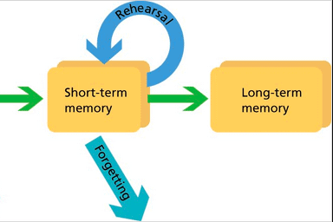

The Cognitive Architecture of Learning
Schema
Working
LIMITED
UNLIMITED
Cognitive Load Theory (CLT)
(Sweller, 1988)
(Atkinson & Shiffrin, 1968)

Slide 18

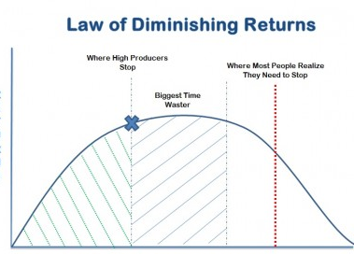
Limits of Cognitive Processing Capacity
For working memory
  ≤30 Seconds, usually less
  7 ±2 ‘Slots’, often less (Miller, 1956)
Daily limit for ‘hard focus’ (Ericsson, 1998 in Newport, 2016)
  A skill that needs to be consciously trained
  Novice: 1 hour
  Expert: up to 4 hours, rarely more

Slide 19




Sources of Cognitive Load
Intrinsic & Extraneous Factors
Task complexity
Redundant information
Time constraints
Learner-specific Factors
Lack of
  prior subject knowledge
  language proficiency
  technical skills
Attitudes toward the subject
Beliefs related to learning
(Shrivastav & Hiltz, 2013)

Slide 20
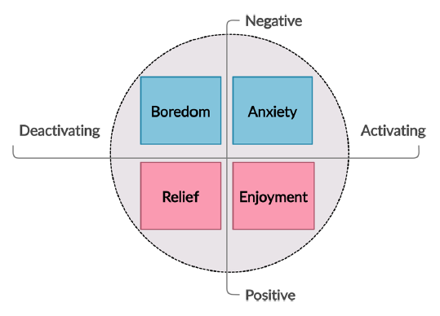
LREs & Achievement
= learning-related emotions
LREs → Achievement via:
Attention
Motivation
Self-regulation
(Pekrun, 2006)

Slide 21
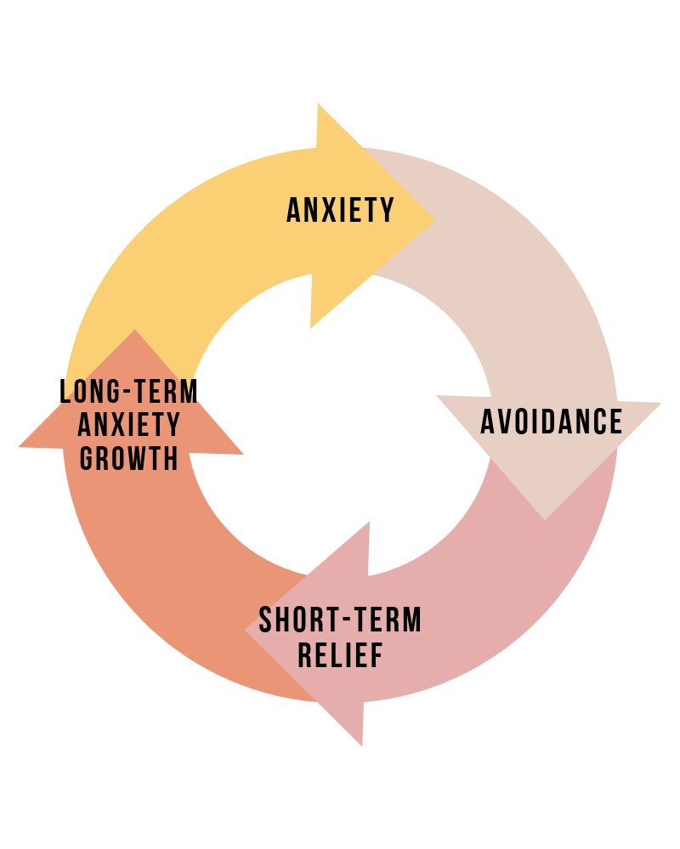
LREs in the Digital Classroom
“…a distinct overall emotional tone that differs from traditional educational settings.” (Stephan, 2019)
More boredom & anxiety
Less enjoyment
Cognitive Load → Boredom → Participation
Anxiety → ↑Cognitive Load, resulting in mental fatigue
(Tzafilkou et al, 2021)

Slide 22
What can we do?

Slide 23
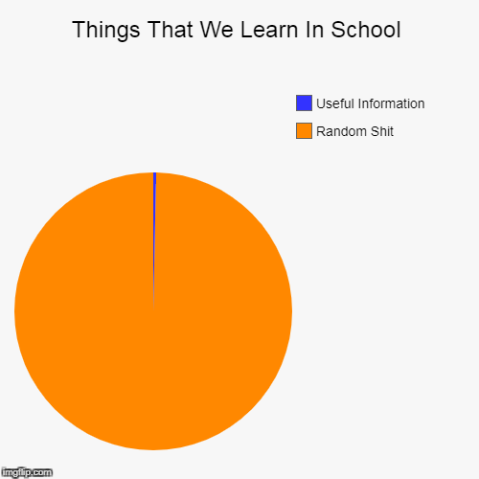
1) Get Our Priorities Straight
Realign objectives with realities of labor market demands in terms of:
  Content
  Skills
  Platforms/modalities
Integrate soft skills training
  Provide varied learning experiences,
  Incorporate real-world scenarios
  Cultivate a community of support and advice

Slide 24


2) Hug the Delete Button
“Less but better” – achievable, useful, pleasant
Guiding Questions for content:
  What is most important and relevant for today?
  Could this be more visual or simplified?
  If this is subtracted, will anything essential be missing?
Optimize screen real estate: principles for design
  F-pattern (for text), Z-pattern
  Visual hierarchy
    Size & scale, color & contrast
    Headings & bulleted lists
Differentiate between compulsory and self-study materials
contrast

Slide 25
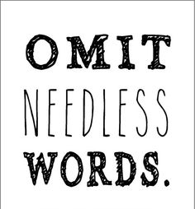
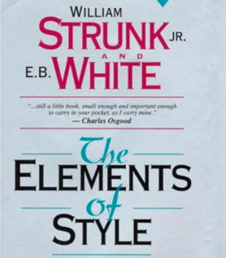
A N Y T H I N G

Slide 26
Standard Burger Basket Standard Burger (Burger bun, hamburger patty, cheddar cheese, crispy onions, special sauce, red sauce) + Your choice of side + canned drink | Wonderful Burger Basket Wonderful Burger (Burger bun, hamburger patty, fried mozzarella cheese, cheddar cheese, caramelized onions, picked cucumbers, crispy onions, special sauce, red sauce) + Your choice of side + canned drink | Super Burger Basket Super Burger (Burger bun, 270 gr hamburger patty, cheddar cheese, crispy onions, special sauce, red sauce) + Your choice of side + canned drink | Boss Burger Basket Boss Burger (Burger bun, hamburger patty, cheddar cheese, crispy onions, smoked beef, sautéed mushrooms, pickles, special sauce, red sauce) + Your choice of side + canned drink

Slide 27
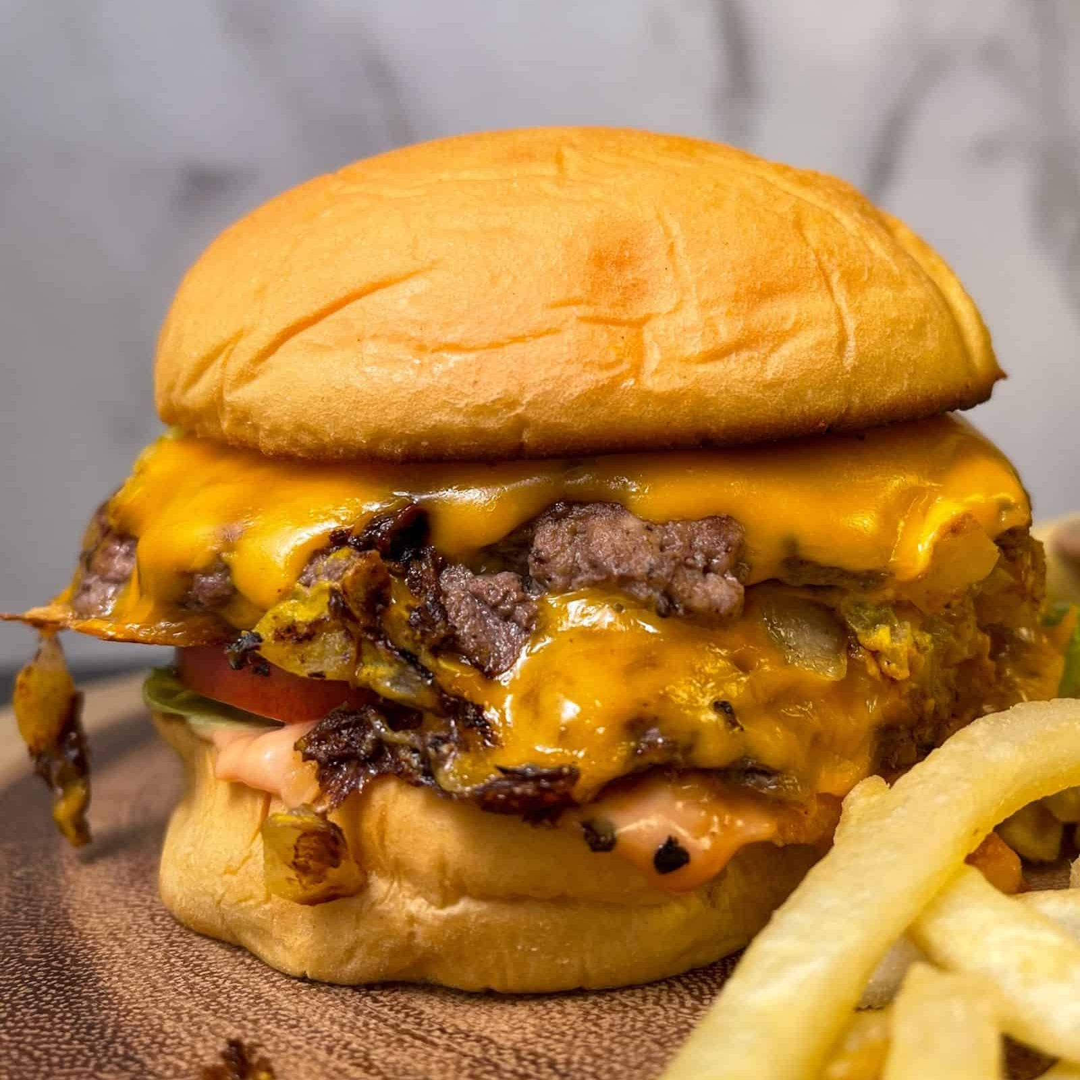
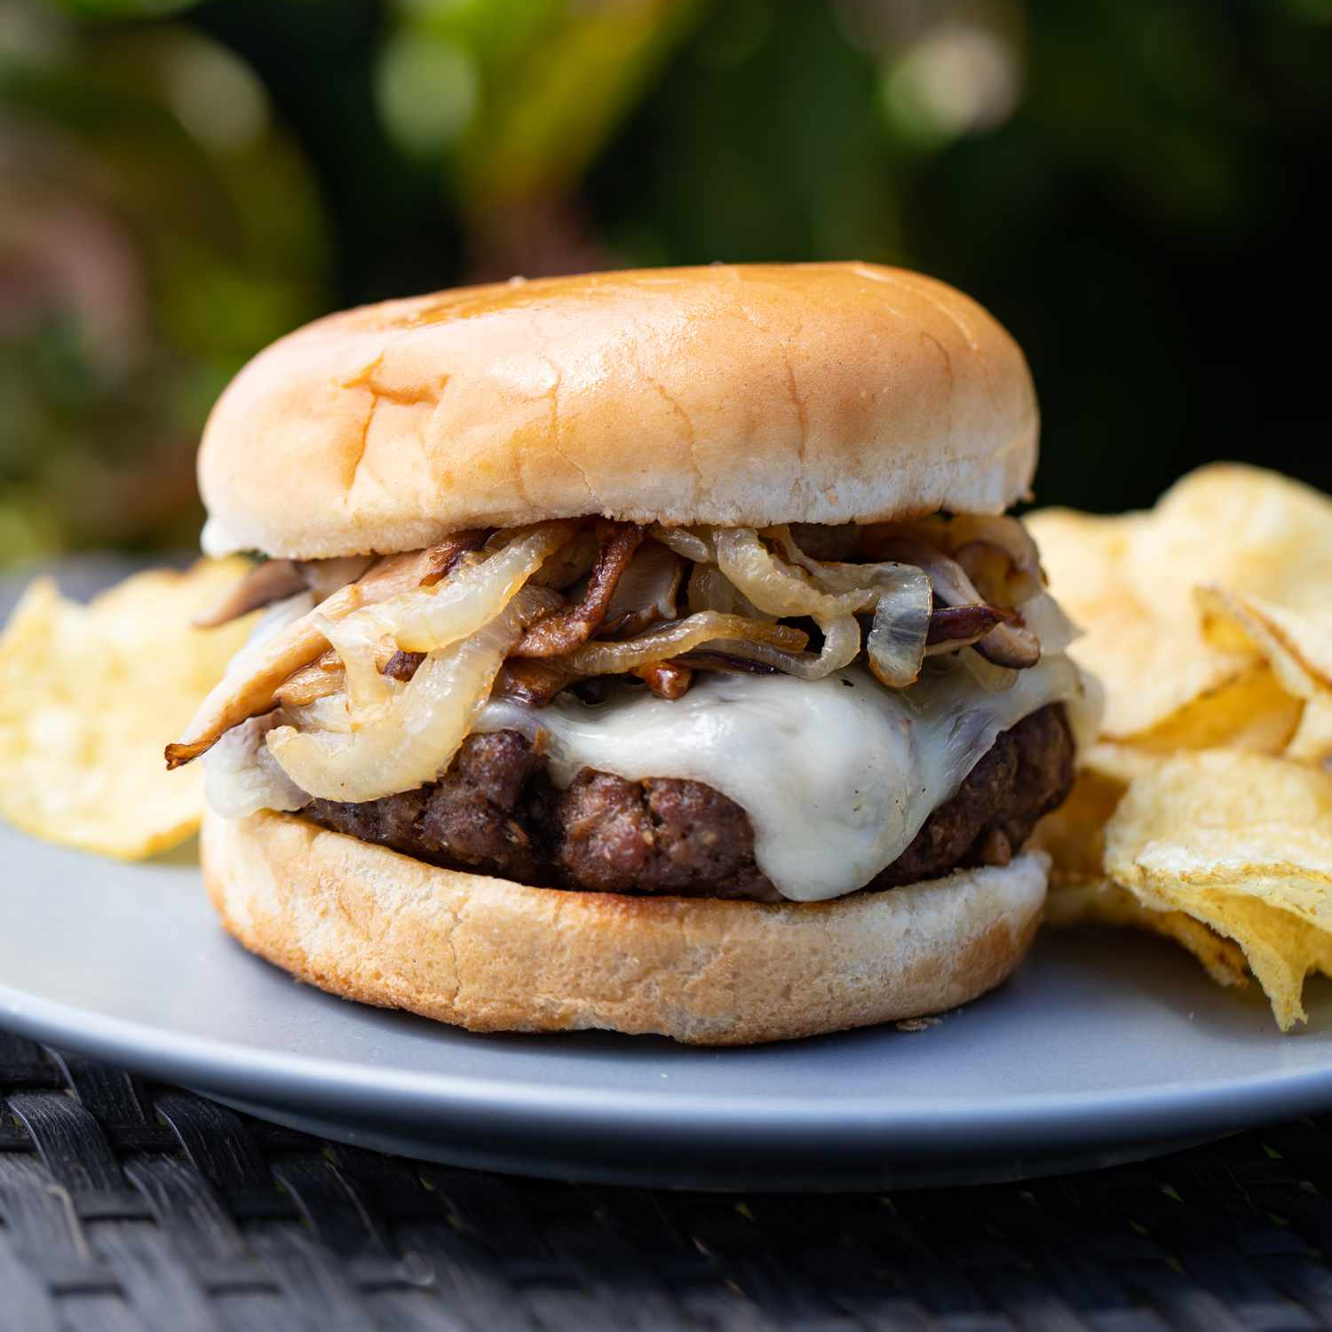
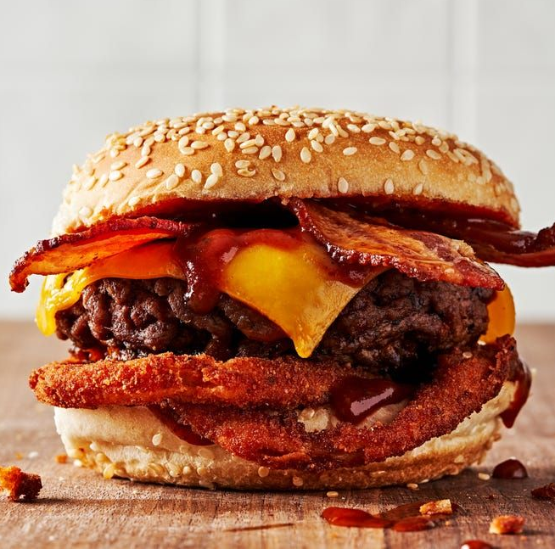
Burger Baskets All served on a bun with cheddar cheese, crispy onions, and our special red sauce. Comes with your choice of side and drink.
Standard Just the basics *Supersize (270 gr) for £2 | Wonderful Fried mozzarella, caramelized onions, and pickled cucumbers | Boss Smoked beef, sautéed mushrooms, pickles

Slide 28

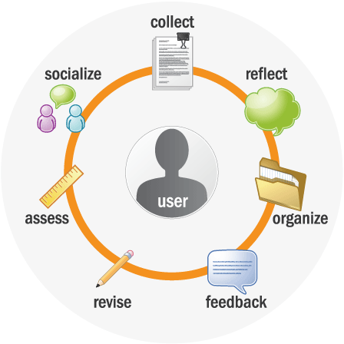
3) Slow Your Roll
“Once appropriate information is stored in long-term memory, the capacity and duration
limits of working memory are transformed and indeed humans are transformed.
Tasks that previously were impossible or even inconceivable can become trivially simple.”
(Sweller et al, 2011)
Time-release information (e.g., in-class material, announcements)
  What does my students’ reality look like right now?
  How are they likely to receive this information and/or take action?
Build in opportunities for rehearsal and reflection
  Spaced strategic repetition & feedback
  E.g., eportfolios – for tracking progress over time

Slide 29

4) Break Down Complex Tasks
Divide into smaller meaningful units
  Schema activation (pre-, during, & post-activities for inputs)
  Scaffolding to engage students in higher-ordered thinking
Distribute through collaborative groupwork
  “collective working-memory effect”
  E.g., jigsaw readings, interactive tools
More active engagement & critical thinking

Slide 30
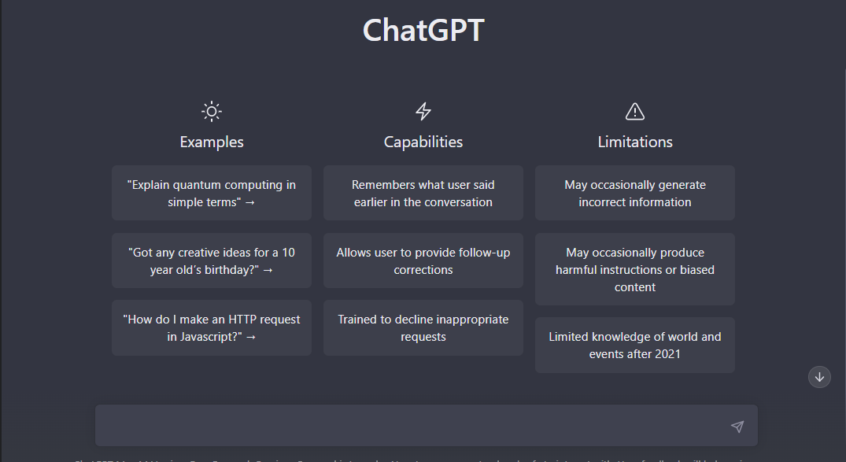
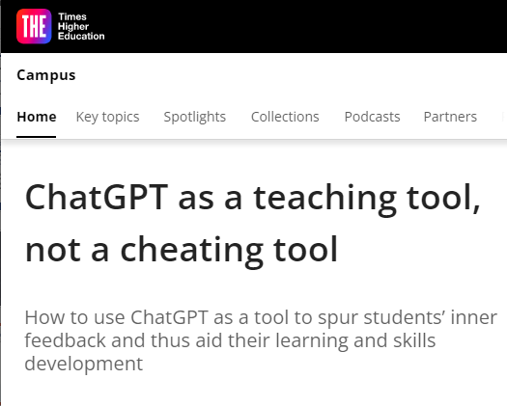
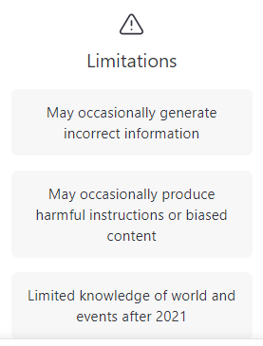
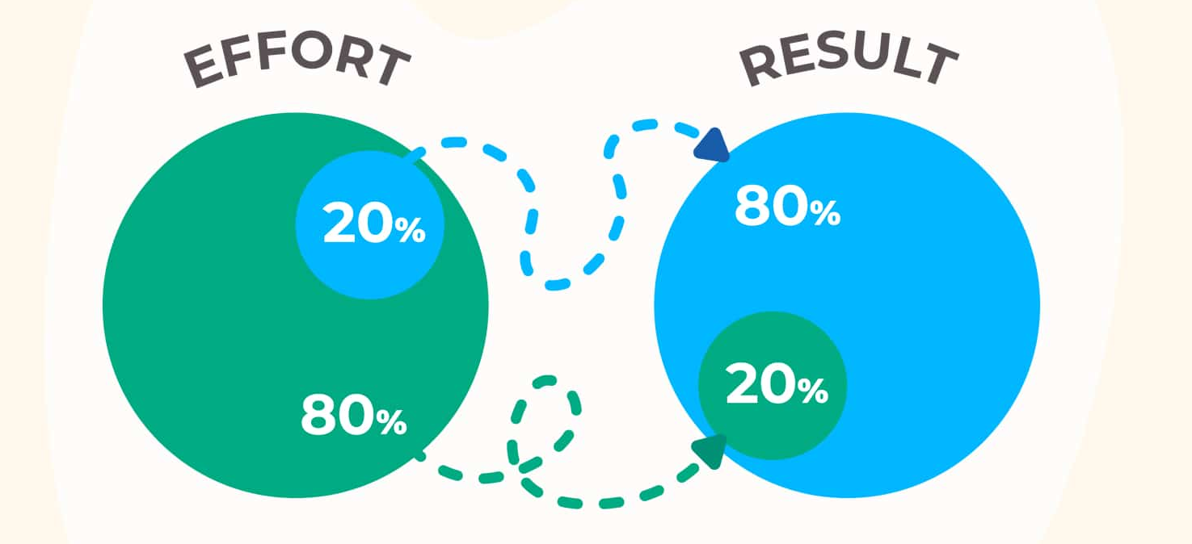
5) Train Students to Collaborate Effectively with New Technologies to 80/20 the Load

Slide 31

Keep an Open Mind

Slide 32
References
American Psychological Association. (2022). Information Overload. In APA Dictionary of Psychology. Retrieved March 16, 2022, from https://dictionary.apa.org/information-overload
Deloitte. (2022). The Deloitte Global 2022 Gen Z and Millennial Survey. https://www.deloitte.com/global/en/issues/work/genzmillennialsurvey.html.
Atkinson, R.C. & Shiffrin, R.M. (1968). Human memory: A proposed system and its control processes. In Spence, K.W.,& Spence, J.T. The psychology of learning and motivation, (vol. 2, pp. 89-195). New York: Academic Press.
Miller, G. A. (1956). The magical number seven plus or minus two: Some limits on our capacity for processing information. Psychological Review 63, 81-97. https://doi.org/10.1037/h0043158
Newport, C. (2016). Deep work: Rules for focused success in a distracted world. Grand Central Publishing.
Pekrun, R. (2006). The control-value theory of achievement emotions: Assumptions, corollaries, and implications for educational research and practice. Educational Psychology Review 18, 315-41. doi:10.1007/s10648-006-9029-9
Shrivastav, H. & Hiltz, S.R. (2013). Information overload in technology-based education: A meta-analysis. Proceedings of the Nineteenth Americas Conference on Information Systems, Chicago, IL, 1-10.
Sweller, J., Ayres, P., & Kalyuga, S. (2011). Cognitive load theory. Springer.
Tzafilkou, K., Perifanou, M., & Economides, A. A. (2021). Negative emotions, cognitive load, acceptance, and self-perceived learning outcome in emergency remote education during COVID-19. Education and Information Technologies 26, 7497-7521. https://doi.org/10.1007/s10639-021-10604-1

Slide 33

🙏 Thank you!
Kasssandra Robertson
Sabancı University, Istanbul Turkey
kassandra.robertson@sabanciuniv.edu

