Slide 1

Janine McNair, MSc, MRes, MA Hons, PGCE.
Lecturer, tutor, PhD researcher

Slide 2
Learner Agency
Collaborative Learning
Learning as an ongoing process
Enhancing student-to-student spoken interaction to impact collective knowledge construction, (Gunawardena et al., 1997)
Notes:
© Copyright Showeet.com

Slide 3

Introduction and background
Practical Task and Reflection
Exploration of theory
Summary of project
Future development and implementation

Slide 4
Exploratory Practice
Professional practice
Research into students’ spoken interaction
Observe and reflect on daily action
Discover theory, engage with scholarship
Notes:
© Copyright Showeet.com

Slide 5
Currency of the Study
HE settings due to large group sizes. Teamwork- 21st century skill (Schwarz & Baker, 2017)
Provide support to both practitioners and scholars within the fields of EAP, ESOL, linguistics
Online delivery- challenges to sector- currently little published research into student-to-student spoken interaction.

Slide 6
Now, do a short task together
Mentimeter- image/concepts task- LINK- https://www.menti.com
Discuss in groups of 3 or 4, reach a consensus and submit answer
* 75 seconds per question
Notes:
© Copyright Showeet.com

Slide 7
Jot down a few words about your group’s experience of doing the task. Use these categories to help you:
Balance of talking
Change in views
Increased understanding
Notes:
© Copyright Showeet.com

Slide 8
Stahl (2006) transactivity = contributions where explicit reasoning is displayed + reference to rationales offered by other interactants.
TRANSACTIVITY
Explicitness
Operating on each other's output
Notes:
© Copyright Showeet.com

Slide 9

The task description
The students work in groups of 4 to complete a True/False statement task.
Recording of the task, and self-reporting data used by researcher in line with the University of Glasgow ethics procedure.

Slide 10
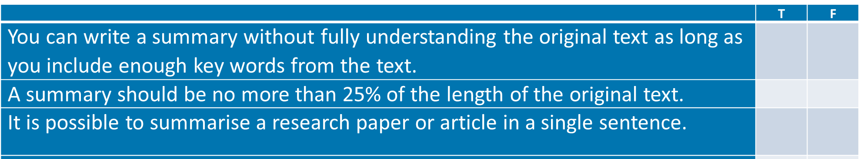
Task Sample

Slide 11
Methodology
Conversation Analysis- “understanding understanding” (Sacks, 1992)
Jeffersonian transcripts allow examination of linguistic features and prosody.
Notes:
© Copyright Showeet.com

Slide 12
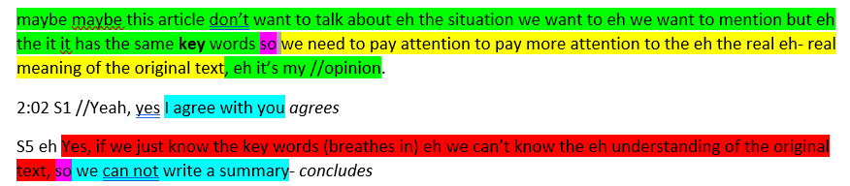
Sample of data – colour coded
Notes:
© Copyright Showeet.com

Slide 13
Discussion…
In our own teaching environments,
Can we get students to develop each other’s ideas… to be more explicit… should we aim to raise their consciousness of their speaking style?
Notes:
© Copyright Showeet.com

Slide 14
Takeaway points
Timing and physical issues
Group size, dynamic, leader (roles)
Participation crucial to avoid fragmented conversations (Mercer, 2019)
Routine and regularity- build normalisation
Specific task, consensus
Task should link to week/day/unit’s work
Demonstrate by taking part
Notes:
© Copyright Showeet.com

Slide 15
Key References
Berkowitz, M. W., & Gibbs, J. C. (1983). Measuring the development of features of moral discussion. Merrill-Palmer Quarterly, 29.
Borge M., & Rosé, C. (2021). Quantitative Approaches to Language in CSCL. In: Cress, U., Rosé, C., Wise, A.F., Oshima, J. (Eds.) International Handbook of Computer-Supported Collaborative Learning. CSCL Series.
Dewey, J., & Bentley, A. F. (1949). Knowing and the known. Boston: Beacon Press
Howley, I., Mayfield, E., & Rosé, C. P. (2013). Linguistic analysis methods for studying small groups. In C. Hmelo-Silver, A. O’Donnell, C. Chan, & C. Chin (Eds.), International handbook of collaborative learning. New York, NY: Taylor and Francis.
Miyake, N. (1986). Constructive interaction and the iterative process of understanding. Cognitive Science, 10, 151–177.
Roschelle, J., & Teasley, S. D. (1995). The construction of shared knowledge in collaborative problem solving. In C. O’Malley (Ed.), Computer supported collaborative learning (pp. 69–96). Springer.
Sacks, H. (1992). Lectures on conversation (Vol. 2). Blackwell.
Schwarz, B. B., & Baker, M. (2017). Dialogue, argumentation and education: history, theory and practice. CUP.
Stahl, G. (2006). Group cognition: Computer support for collaborative knowledge building. Cambridge, MA: MIT Press.
Stahl, G., & SpringerLink (Online service). (2009). Studying virtual math teams. Springer.
Trognon, A. (1993). How does the process of interaction work when two interlocutors try to resolve a logical problem? Cognition and Instruction, 11(3-4), 325-345.
van Heijst, H., de Jong, F. P. C. M., van Aalst, J., de Hoog, N., & Kirschner, P. A. (2019). Socio-cognitive openness in online knowledge building discourse: Does openness keep conversations going? Int. Journal of CSCL, 14(2), 165-184.
Vygotsky, L. (1934/1986). Thought and language. Cambridge, MA: MIT Press.
Notes:
© Copyright Showeet.com

Slide 16

Thank you for participating!
ANY QUESTIONS?
Janine.mcnair@glasgow.ac.uk

