Slide 1
A Storm in a Teacup or a New Horizon for EAP?
Implications of the Office for Students Directive on SPaG
Liz Molyneux & Eliot Wright

Slide 2
Session overview
What is the SPaG directive?
Why was it created?
The EHU response & next steps

Slide 3
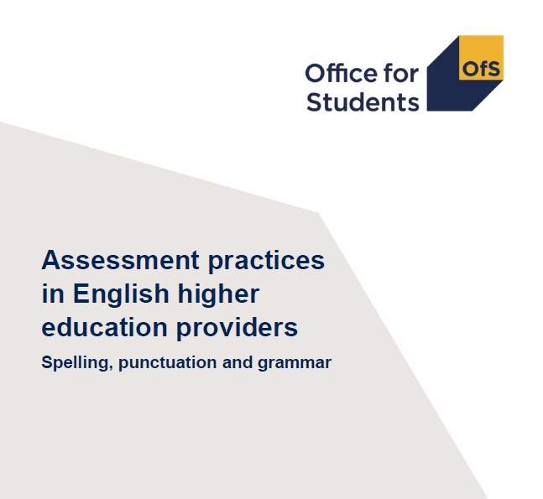


What is the SPaG directive?
Assess accuracy of spelling, punctuation and grammar/ technical proficiency in English of all students on all courses with very few exceptions
Assess technical proficiency of English only when it is a learning outcome
Deduct marks only where errors impede communication
Assess English in line with graduate outcomes e.g. demonstrating effective communication skills, conveying information clearly for different purposes and audiences
(OfS, 2021b)

Slide 4

What if universities don’t implement the SPaG directive?
Technical proficiency in English is a B1/quality and B4/ assessment condition of registration (OfS, 2022)
OfS instructed to begin an ‘inspections regime’ of quality (Zahawi & Donelan, 2022)
Assessment of technical proficiency in English is one of three ‘strategic priorities’ for inspection of quality (Zahawi & Donelan, 2022)
Sanctions for breaches of quality conditions: monetary penalties, revocation of degree awarding powers, deregistration (Williamson, 2021)

Slide 5
What is the Office for Students' remit?
Arm’s length regulator for HE in England receiving annual guidance from the DfE
Established by the Higher Education and Research Act 2017:
  2 (1) In performing its functions, the OfS must have regard to-
  (a) the need to protect the institutional autonomy of English higher education providers…
(8) In this Part, “the institutional autonomy of English higher education providers” means—
(a) the freedom of English higher education providers within the law to conduct their day-to-day management in an effective and competent way,
(b) the freedom of English higher education providers—
(i) to determine the content of particular courses and the manner in which they are taught, supervised and assessed
‘We work with higher education providers to make sure that students succeed in higher education’ (OfS, 2023)

Slide 6

What is the need for the SPaG directive?
Higher Education and Research Act 2017:
  2 (1) In performing its functions, the OfS must have regard to -
  (g) so far as relevant, the principles of best regulatory practice, including the principles that regulatory activities should be -
  (i) transparent, accountable, proportionate and consistent, and
  (ii) targeted only at cases in which action is needed.

Slide 7
What is the need for the SPaG directive?
‘There is some evidence to suggest that employers are struggling to recruit students with the right skills’ (OfS, 2021b)
CBI and Person (2019)
No mention of spelling, punctuation or grammar; no mention of university assessment practices
No recommendations relating to literacy; literacy not mentioned in the key findings
Kuczera et al. (2016)
OECD report on functional literacy, not SPaG
Prioritise interventions in early years
Universities should not graduate students with poor literacy; ‘[leave] institutions to work out how to deliver that outcome’ (2016: 14)

Slide 8

Why did the OfS feel compelled to go beyond its statutory powers?
2018-2021
Assessment of SPaG not on the HE agenda
10 April 2021
Fury as education regulator tells universities that marking students down for bad spelling is ELITEST
Academics have been told that insisting on good written English discriminates
Some universities have been adopting so-called 'inclusive assessment' systems
Regulator wants to reduce gap between white and black student attainment rate
(Henry, 2021)

Slide 9
Why did the OfS feel compelled to go beyond its statutory powers?
2018-2021
Assessment of SPaG not on the HE agenda
10 April 2021
Fury as education regulator tells universities that marking students down for bad spelling is ELITEST
Academics have been told that insisting on good written English discriminates
Some universities have been adopting so-called 'inclusive assessment' systems
Regulator wants to reduce gap between white and black student attainment rate
(Henry, 2021)

Slide 10
Why did the OfS feel compelled to go beyond its statutory powers?
2018-2021:
Assessment of SPaG not on the HE agenda
10 April 2021
University students will not be marked down for bad spelling because it would be ELITIST
Academics have been told that insisting on good written English discriminates
Some universities have been adopting so-called 'inclusive assessment' systems
Regulator wants to reduce gap between white and black student attainment rate
(Henry, 2021)

Slide 11
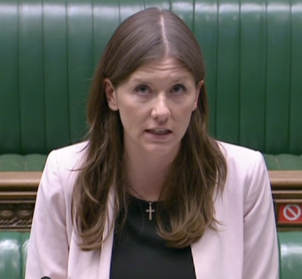
Why did the OfS feel compelled to go beyond its statutory powers?
15 April 2021
I am appalled by the decision of some universities to drop literacy standards in assessments—that is misguided and it is dumbing down standards. That will never help disadvantaged students. Instead, the answer is to lift up standards and provide high-quality education… we will act on this (Donelan, 2021)
Parliament TV

Slide 12
Why did the OfS feel compelled to go beyond its statutory powers?
10 April – Inclusive assessment practices receive negative press (Henry, 2021)
15 April – Minister for Universities promises action (Donelan, 2021)
23 June 2021 – OfS launches review of assessment practices (OfS, 2021a)
7 October 2021 – OfS review of SPaG is published, establishing requirement to assess accuracy (OfS, 2021b)
22 March 2022 – Guidance letter from DfE to OfS, SpaG is a 'strategic priority' (Zahawi & Donelan, 2022)
24 November 2022 - Technical proficiency in English written into regulatory framework (OfS, 2022)

Slide 13
How can we respond to poor regulation?
Universities' collective call for a regulator which is 'fit for purpose' (Bradshaw et al., 2023)
Policy impact is influenced by the wider political context and the local institutional ecology
  'there is little evidence of practitioners mechanically responding to [policy] in simple and predictable ways’ (Steer et al, 2007: 187)
  Institutions can ameliorate or exacerbate the impact of policy:
    Provide shielding from the worst excesses of bureaucracy
    Hide concerns about the effects of policy levers
    Demonstrate strategic or ingenious compliance whilst acting in accord with professional values and judgement (Steer et al, 2007)
Strategic compliance from EAP?
  Blur the distinction between so-called ‘home’ and ‘international' students; provide language and academic support to all students who need it (Jones, 2017)

Slide 14
Pathway Programmes
STEM Foundation Programme.
Arts, Humanities & Social Sciences Foundation Programme.
English Language Teaching & Training
MA TESOL.
Teacher Training in ELT.
Foreign Languages & BSL
Mandarin
Arabic
French
German
Italian
Spanish
Japanese
Pre-sessional courses for UG and PGT students.
Pre-sessional course for PGR students.
English language development courses (summer schools).
British Sign Language
Academic language & literacy support for students on/off campus (in-sessional support).
Teaching refugees & asylum seekers.
Fastrack (7-week widening access course).
Foreign languages & cultures lectures & conversation clubs.

Slide 15
Implementation Timeline
Academic Quality Enhancement Committee
June 2022
Quality
Major Modifications
September 2022
Faculty Management Group
Discussion
October 2022
Learning & Teaching Committee
November 2022
Email to Heads of Departments
August 2022

Slide 16
English Proficiency and Assessment
It has been agreed to include English proficiency as a programme learning outcome under transferable skills for each level of study.
Action:
Programme leaders to identify modules that have significant written assessments per level of study that can be mapped against the additional programme learning outcomes.
Module Leaders: Ensure that assessment criteria for written assignments include an element on academic writing and language worth 5% of the total marks. What has become known as a sliding scale.

Slide 17
Needs to go to Academic Board
What is technical English proficiency?
Why Spelling, Grammar & Punctuation?
Not all lecturers can mark for this.
We aren’t doing it.
Questions
&
Comments
Assessment rubrics written / contain this.
What support is available?
What exactly constitutes a written assessment ?
What about students whose 1st language is not English?
What about students with SpLDs?

Slide 18
The Response / Support Offered
Info/CPD sessions provided by the Centre for Learning and Teaching Covering:
1-2-1 English language advising sessions.
The Language Centre’s Padlet of academic literacy.
Use of Academic Marker: a self-guided e-learning platform for developing academic English proficiency.
University of Manchester’s Academic Phrase bank

Slide 19
The Response / Support Offered
SpLD Support
Disability Support
Assistive technologies including: Microsoft Immersive Reader; Read aloud feature in word; Spelling & Grammar check in word, and word editor feature.
SP&G Guide
Uniskills (Guides & Toolkits), classroom sessions, workshops & 1-2-1 appointments
Proofreading & Referencing Toolkit

Slide 20


Conclusion
The OfS and poor regulation
Opportunities for strategic compliance
Enhanced provision of academic literacy support
Boosted prominence of the Language Centre
Increased resources for student support
Accelerated uptake of assistive technologies

Slide 21
References
Bradshaw T, McKenzie G, Hewitt R and Wlison V (2023) Letter to Robin Walker MP, Chair of the Education Select Committee [Open Letter]. Available at https://russellgroup.ac.uk/news/higher-education-mission-groups-call-for-inquiry-into-the-office-for-students/ (accessed 29 March 2023).
CBI and Pearson (2019) Education for the Modern World: Report, CBI and Pearson Education and Skills, UK, November.
Donelan M (2021) University Students: Compensation for Lost Teaching and Rent, Hansard: House of Commons Debates, 15 April, 692, c. 483. Available at https://hansard.parliament.uk/Commons/2021-04-15/debates/4AA7E147-B9DA-4E7F-BE59-DD93DB98DAD4/UniversityStudentsCompensationForLostTeachingAndRent#contribution-2FB046BC-2A6D-43E0-9A16-DD5FE0246577 (accessed 16 March 2023).
Henry J (2021) University students will not be marked down for bad spelling because it would be ELITIST. Mail Online, 10 Apr. Available at https://www.dailymail.co.uk/news/article-9457171/Fury-education-regulator-tells-universities-marking-students-bad-spelling-ELITIST.html (accessed 14 March 2023).
Higher Education and Research Act (2017) c. 29. Available at https://www.legislation.gov.uk/ukpga/2017/29/contents/enacted (accessed 31 March 2023).
Jones E (2017). Problematising and reimagining the notion of ‘international student experience’. Studies in Higher Education, 42(5), 933-943. https://doi.org/10.1080/03075079.2017.1293880
Kuczera M, Field S and Windisch HC (2016) Building Skills for all: A Review of England. Report, OECD Skills Studies.
Office for Students (2021a) Office for Students to Examine Assessment Practices. Office for Students. Available at https://www.officeforstudents.org.uk/news-blog-and-events/press-and-media/office-for-students-to-examine-assessment-practices/ (accessed 30 March 2023).

Slide 22
References
Office for Students (2021b) Assessment Practices in English Higher Education Providers: Spelling, Punctuation and Grammar. OfS 2021.43, 7 October. Available at https://www.officeforstudents.org.uk/media/1482/assessment_practices_english_higher_education_providers.pdf (accessed 30 March 2023).
Office for Students (2022) Securing Student Success: Regulatory Framework for Higher Education in England. OfS 2022.69, 24 November. Available at https://www.officeforstudents.org.uk/media/1231efe3-e050-47b2-8e63-c6d99d95144f/regulatory_framework_2022.pdf (accessed 30 March 2023).
Office for Students (2023). Office for Students About us. Available at https://www.officeforstudents.org.uk/about/#:~:text=We%20work%20with%20higher%20education,students%20succeed%20in%20higher%20education (accessed 29 March 2023).
Steer R, Spours K, Hodgson A, et al. (2007) 'Modernisation' and the role of policy levers in the learning and skills sector. Journal of Vocational Education & Training 59(2): 175-192.
Williamson G (2021) Guidance to the OfS: Secretary of State’s strategic priorities (February 2021). Office for Students. Available at https://www.officeforstudents.org.uk/advice-and-guidance/regulation/guidance-from-government/ (accessed 30 March 2023).
Zahawi N and Donelan M (2022) Guidance to the OfS on strategic priorities for financial year 2022-23 (March 2022). Office for Students. Available at https://www.officeforstudents.org.uk/advice-and-guidance/regulation/guidance-from-government/ (accessed 30 March 2023).

