Slide 1
Using a spatial storytelling tool to map EAP positionality in English universities
Sharon Riddle, Durham University
sharon.l.riddle@durham.ac.uk

Slide 2
Outline
The study
The Spatial Storytelling tool
What Spatial Storytelling has revealed
Reflections on using the tool
Notes:
My name is Sharon Riddle and I’m currently doing a PhD at Durham University.
In this presentation, I aim to tell you tell you a little about the study I’m doing, and then focus on how a multimodal approach is being used to gather data.
So I’ll explain what my Spatial Storytelling tool is, share some of the results and reflect on the value of the tool. In the middle of all of that, I’ll be giving you the chance to experience Spatial Storytelling yourself. So, grab a pen and paper and let’s go.

Slide 3
The study
How does the position of English for Academic Purposes (EAP) in English universities shape EAP practice and the identity and agency of practitioners?
Two case studies
Participants – EAP practitioners, managers and academic colleagues

Slide 4
The Spatial Storytelling tool
What is Spatial Storytelling?
Inspiration
What it involves
Mapping task from the Genders at Work project (Carruthers Thomas, 2019)
Notes:
What I mean by Spatial Storytelling
Visual research method.
It’s about storytelling - In the study, each map tells a story, and provokes stories. These could be stories of belonging or isolation, stories of collaboration or separation, stories of past and future change, stories that explain who the individual is and how they relate to others. These stories can be seen as spatial as they …. , and they use spatial terminology as people talk about their journeys and trajectories.
The stories and the maps are the perceptions of each participant. Each is different and each represents a moment in time. If they produced their maps again, they would be different.
You’ll see examples of how participants have done this
Inspiration
Dr Kate Carruthers Thomas, Genders at Work (Carruthers Thomas, 2020). She used the theories of Massey and developed a tool which has inspired this.
Use as image – Kate’s tool
What it involves
The tool was used within a semi-structured interview, about two thirds of the way through. So, rather than trying to explain how the tool works, we’re going to have a try.

Slide 5
Let’s have a try…
Take a piece of paper and draw a shape which best represents the university for you.
Think about the position or positions of English for Academic Purposes in the university and add EAP to the map.
Think about your own position in the university and add that to the map.
Think of links that you have or that the EAP has – internal links within the university, and external national and international links. Now draw these on the map.
Notes:
If you’d like to find a pencil and some paper, we can have a try.
If you like to feel free to hold up your ‘maps’ to the camera.
So what does all of this mean? I’ll be analysing the maps and the using the theories of Doreen Massey.

Slide 6
Doreen Massey (3 January 1944 – 11 March 2016)
Professor of Geography at the Open University.
Work focused on feminist geography, space, place and power
Photographe de la Ville de Saint-Dié-des-Vosges, dans le cadre de sa mission ; scan par Ji-Elle, CC BY-SA 4.0, via Wikimedia Commons
Notes:
Doreen Massey was a British geographer, who was based at the Open University. She was influenced by Marx, and worked in areas such as globalisation, urban and regional development, feminist geography and space, place and power. I’ve found that her concepts are really valuable when looking at EAP in the university. Here are some of them…

Slide 7
Doreen Massey’s concepts
Space and place
Space is a
Product of interrelations
Sphere of multiplicity
Always under construction (Massey, 2005, p. 9)
Place is “constructed out of a particular constellation of social relations, meeting and weaving together at a particular locus” (Massey, 1994, p. 154)
Activity space
the “spatial network of links and activities, or spatial connections and locations, within which a particular agent operates” (Massey, 1995, p. 54).
Throwntogetherness
"the question of our living together in the sense of juxtaposition" (Massey, 2005, p. 187)
Power-geometry
Each place has a “geography of power within it” (Massey, 1993, p. 55)
Notes:
Space and place
Space – the product of interrelations and interactions at every scale, the sphere of multiplicity and many different trajectories and finally always under construction. Place is where these trajectories meet. The EAP world with all its connections and differences can be thought of as the EAP space, and this comes together in a place – an EAP unit.
Activity space
- can be used to focus on the social relations of individuals and groups such as EAP centres. This refers to the “spatial network of links and activities, or spatial connections and locations, within which a particular agent operates” (Massey, 1995, p. 54).
Throwntogetherness
Where multiple trajectories and ‘stories so far’ come together in one place - each with different temporalities and rhythms. Throwntogether places are unique, complex, messy and creative. The concept of throwntogetherness can be applied to an EAP unit – lots of different people with different trajectories and experience coming together.
Activity space
- can be used to focus on the social relations of individuals and groups such as EAP centres. This refers to the “spatial network of links and activities, or spatial connections and locations, within which a particular agent operates” (Massey, 1995, p. 54).
Power geometry
Each place has a “geography of power within it” (Massey, 1993, p. 55). We can see this in the universities we work in. Some of us are close to the power structures and are able to initiate action, others have no power.

Slide 8
The maps…

Slide 9
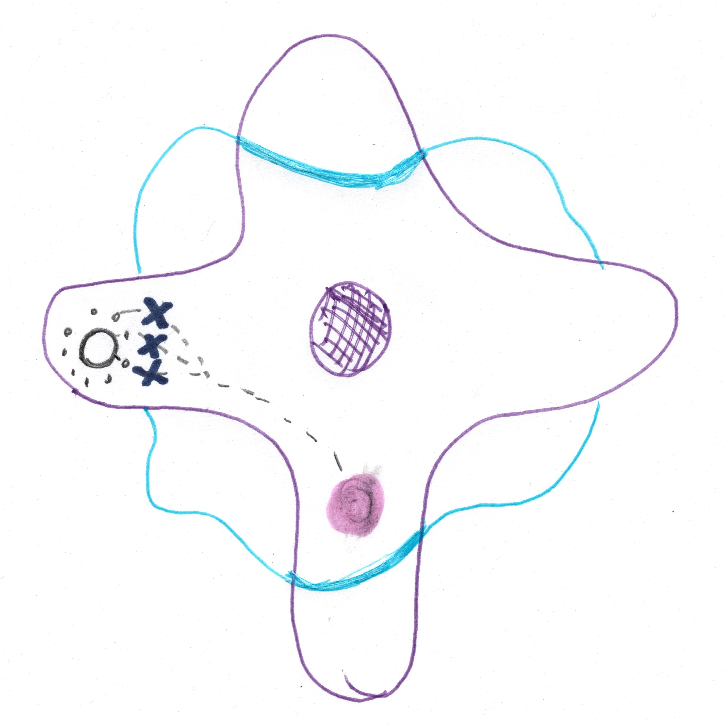
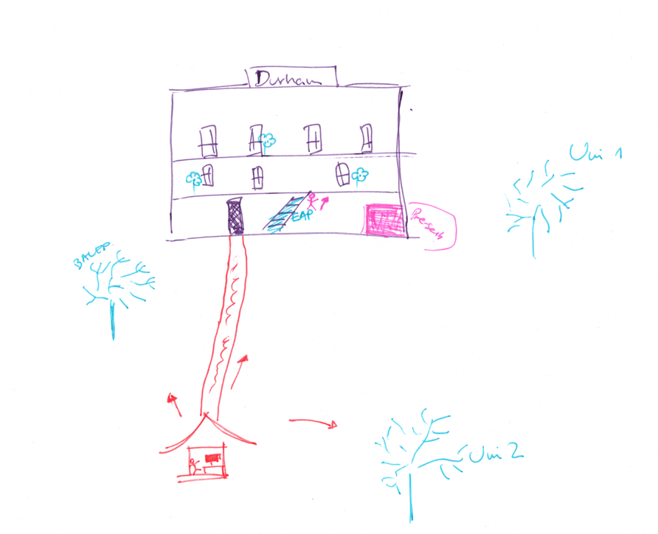
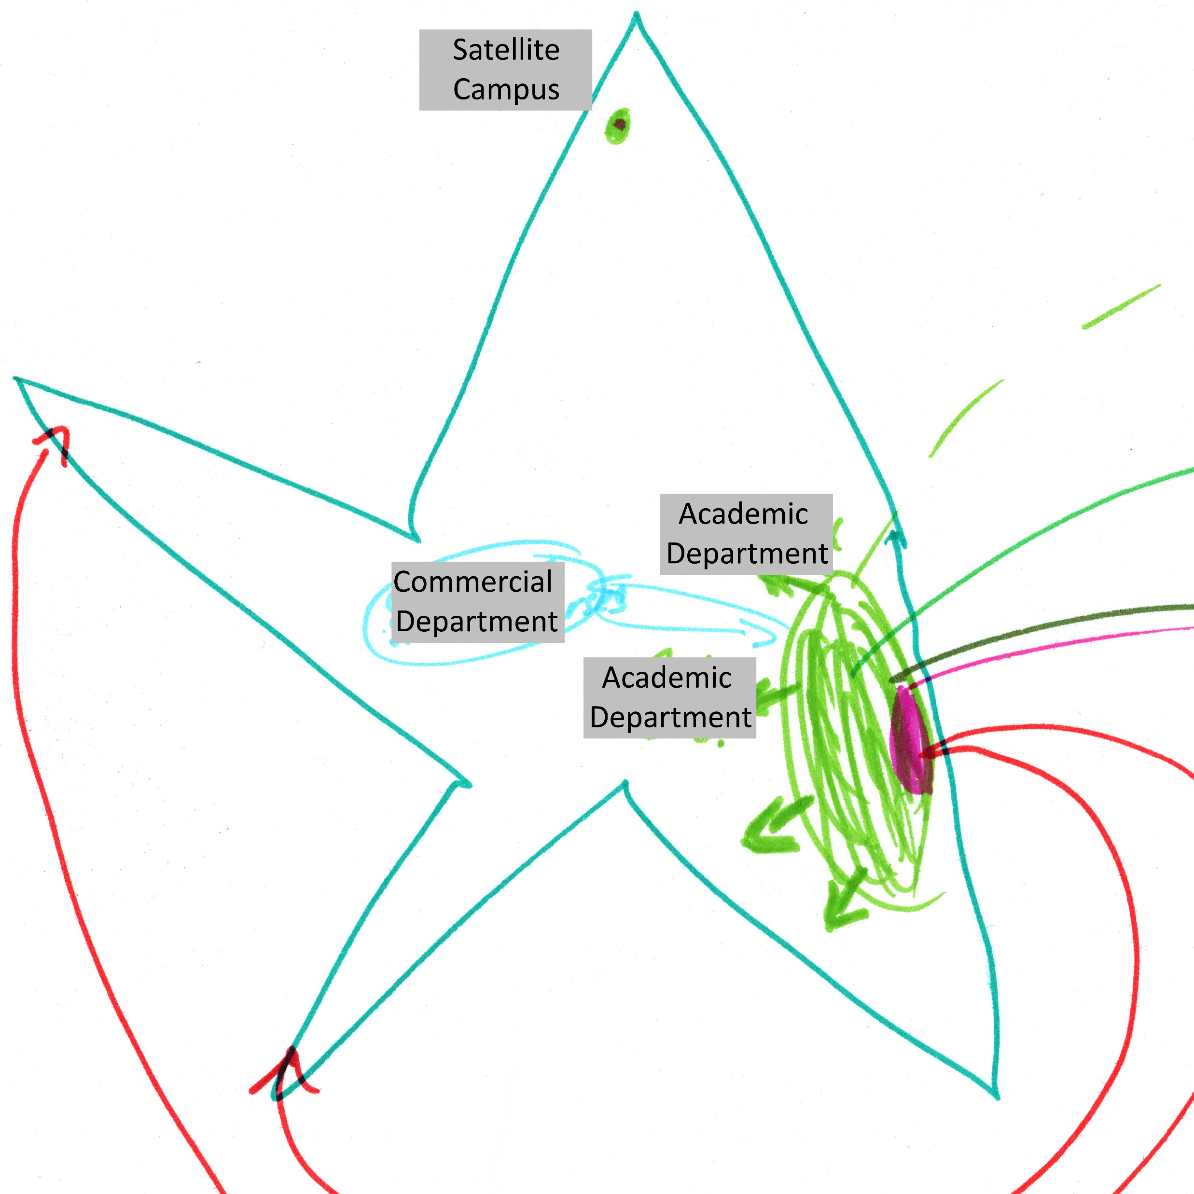
The maps…
Notes:
Some of these concepts will be seen in the maps that you’ve done. I’ll also go through some of the maps which have been produced as part of this project and try and illustrate where Massey’s theories fit in.
First of all, all the maps in the project were completely different – resembling maps, mind maps, more abstract shapes and pictures. And all of them in some way represent the university space as an activity space, which represent the sphere where the activities of individuals and groups operate.
These activity spaces are made up of a mixture of smaller activity spaces, which could be individuals and groups, and they also connect to larger activity spaces – all of them influencing each other. Here we have 3 activity spaces with linkages, individuals, groups – all of which interconnect.

Slide 10
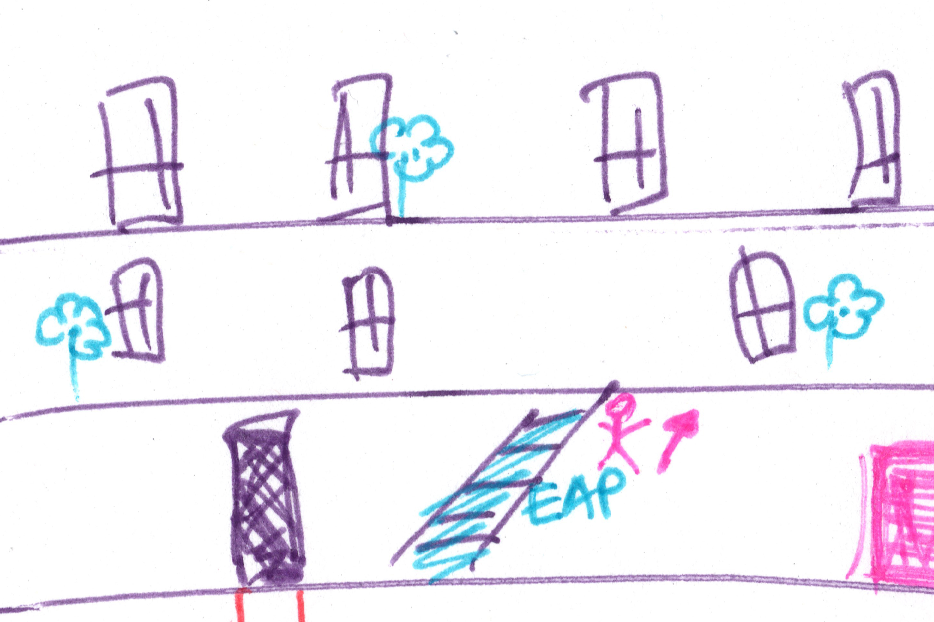
Links and connections
“a space of loose ends and missing links. For the future to be open, space must be open too.“ (Massey, 2005, p. 12)
Notes:
On your maps you will see links and connections – internal and external. Here we see two different maps which demonstrate this.
The first map shows many links between EAP and other parts of the university. Some are very strong, and others are dotted. For this participant, these represented one-way links – one-way traffic through students who come for one-to-one consultations.
On the second map the links and connections between EAP and departments are represented by plants and trees in different stages of development. In the words of Massey, “a space of loose ends and missing links. For the future to be open, space must be open too.“ (Massey, 2005, p. 12)

Slide 11
Power relations
“The big bubble is, I've called it the power, which I mean, like the VC and the kind of, the people who hold the reigns of power […] and then the next band, I've put […] professional services like the international office, academic office […] because geographically, they are close to the power, they're all together in [location], so I think in my head, they're all very closely interrelated, interlinked.”
(A-M1)
Notes:
On your maps, you may be able to see where you and the EAP unit is positioned in relation to power in the university.
Massey says:
The geometry of power reveals how power is related to how individuals and groups are positioned in relation to flows of communication, movement and capital across space. In EAP this can be seen in the committees that people sit on, the links they have with those in powerful positions, the joint projects that EAP works on, and it impacts on the opportunity to be proactive and initiate change.
Power relations change however, and some of you may work closer to ‘the power’ at different times, for example during Covid to problem-solve in relation to moving pre-sessional courses online and language entry requirements.

Slide 12
Position and identity
“I think it's changing. I get the impression it’s changing […] I think it's different in different Schools […] I think it varies from School to School, and I would even guess that it varies from lecturer to lecturer.”
(B-EP3)
Notes:
On your maps, you will see where you feel that EAP is positioned, and where you are.
This may be influenced by the physical geography of the university or it could be more metaphoric.
Here, EP3 made it clear the position of EAP on her map was related to the physical position of the EAP unit, and when asked about the metaphorical position of EAP, she thought it was changing in a positive way… (click), varying between different academic departments and different lecturers.
Thinking about identity, Massey says that a place is “constructed out of a particular constellation of relations, articulated together at a particular locus” (Massey, 1993, p. 67). It is a throwntogether place. It is not only made up of individuals, each with a different trajectory and story, it also has many links and connections. Here we see different departments with links to EAP, and off the picture there are other external links like other universities, projects and BALEAP. As a feminist geographer, Massey was keen to emphasise that a place isn't constructed by placing boundaries around it, defining identity in relation to difference - ‘us and them’, but identity is constructed through the mix of links and interconnections that go 'beyond’ – boundaries between places are therefore open and porous. In universities, this could refer to boundaries between inside and outside the university, departments, projects or individuals. The keyword here seems to be open – open space, leading to an open future.

Slide 13
Position and identity
“That's me, sort of leaping across rather than straddling. Yeah, like a balancing act, so I’m sort of in the [Academic Department], lecturing with the [course] ... this year I'm here, but a year ago I was there.”
(B-EP1)
Notes:
On your maps you may get a sense of how you see your own identity.
Here we have someone who leaps between the EAP unit and an academic department. As the identity of a place is constructed out of the links and connections, and trajectories, the identity of individuals is also constructed out of their trajectory and experience. Here we see how the participant’s experience of the academic department and EAP may form his identity and be a valuable … to the EAP unit. Most of the participants had EFL experience, which can shape the identity of the unit and also provide a useful resource for the university.

Slide 14
The value of a multi-modal approach
Fun and social.
A moment in time "it won't be the same 'here' when it is no longer now" (Massey, 2005, p. 139).
Participants are empowered and have agency.
Makes things visible – thoughts, perceptions, things which are unconscious or hidden.
Thoughts are externalised, and participants can step back and reflect.
It reveals how people and groups are positioned in relations to one another: distance, connections, gaps, weak links and power.
“I think it was a good thing to do, because I think it visualizes in some sort of way the number of people, areas, departments, projects, etc, that you are involved in, and it's quite good to see it on a piece of paper like that, and I suppose you realize your impact or your connections a little bit more, it seems a bit more concrete”.
(B-M2)
Notes:
Looking at visual research methods from a multi-modality perspective… do images and mapping provide something that words don’t?
The exercise was good fun and social.
Massey’s concept of space emphasised that space must be conceptualised with time. This means that space is always changing. Therefore, the maps produced in any exercise like this are not set in stone. Spatial relationships, power relationships are always changing.
Participants are empowered and have agency.
Makes things visible – thoughts, perceptions, things which are unconscious or hidden.
Enables us to externalise thoughts, step back and reflect – almost having a conversation with what we have drawn. When I did my map, I found myself asking why I had placed myself in a particular place, was it what I truly felt or was I merely following.
Thoughts are externalised, and participants can step back and reflect.
It revealed how people and groups are positioned in relations to one another: distance, connections, gaps, weak links, power …

Slide 15
Value to practitioners?
Enables us to externalise thoughts, step back and reflect
Creates a record of perceptions of positionality
Gives everyone a voice
Possible to focus on places or groups of different
Activates the sociological imagination
Notes:
I wonder whether this would be a useful tool for EAP units? You would be in a better place than me to answer that, but it strikes me that there could be a value in teams doing this exercise. It could reveal current links, potential links, areas where the unit needs to find ways to get a better position in the power geography of the university, and could illuminate how the throwntogetherness of EAP units can be capitalised on.
Creates a record of perceptions of positionality – to reflect on, discuss, use for evidence, compare, inform decision making
Gives everyone a voice – each map represents that person’s perspective, they can be heard
Possible to focus on places or groups of different
Activates the sociological imagination – using a visual method can help us think differently about the world. For example, going back to one of the images, we may reflect that we need a building full of plants, they should be bigger, may be with different colours to represent different versions of EAP. What needs to be done to achieve this?
From multimodality – what does images and mapping enable that words don’t. Reflections on the value of doing it this was
Multimodal perspective.
Making it external – mediator of thinking. Further thoughts. Enables different kind of thinking. Extends thinking. Enbles richer insights and does doemsting for them – crical about position. Have to think differently.Make decisions about where things are. From research perspective practitioner perspective.
So what…
Maybe visual insights – mapping may inform decision making, discoussions

Slide 16
References
Carruthers Thomas, K. (2019). Genders at work: Gender as a geography of power in the academy. In G. Crimmins (Ed.), Strategies for resisting sexism in the academy: Higher education, gender and intersectionality (pp. 187-206). Springer International Publishing.
Massey, D. (1993). Power-geometry and a progressive sense of place. In B. John, C. Barry, P. Tim, & T. Lisa (Eds.), Mapping the futures: Local cultures, global change (pp. 60-70). Routledge.
Massey, D. (1994). Space, place and gender. Polity Press.
Massey, D. (1995). The conceptualization of place. In D. Massey & P. Jess (Eds.), A place in the world? Places, cultures and globalization (pp. 45-85). Open University in association with Oxford University Press.
Massey, D. (2005). For space. SAGE Publications.

Slide 17
Thank you! Any questions or comments?
All images are from pixabay.com and participants of the study

