Slide 1
The multimodal affordances of Exploratory Practice
Laura Richards, Lecturer in EAP
University of Leeds
BALEAP PIM: Multimodality in EAP
3rd November 2023

Slide 2
Aims of this presentation
Introduce the concept of Exploratory Practice (EP) as a pedagogic approach
Contextualise EP as a pedagogic choice at Leeds
Evidence the multimodality inherent in EP
Invite EAP professionals to consider EP as a framework for inclusive multimodal teaching and learning

Slide 3
Overview
Multimodality in UK HE
Challenges of intermediate multidisciplinary EAP
The multimodality of EP
EP in practice, with examples of posters
Implications and application

Slide 4
Defining multimodality
“[...] the ability to successfully engage with texts that integrate different semiotic resources.”
(Crawford Camiciottoli and Campoy-Cubillo, 2018, p.1)
“Multimodal pedagogies [in EAP] encourage the use of a range of modes (such as talk, writing, music, images) and a range of resources (including multilingual, experiential, embodied, and technologically-driven).”
(Archer, 2022, p.545)

Slide 5
Multimodality in (UK) HE
Ubiquitous
(Archer and Breuer, 2016)
Result of ‘digital revolution’
(Trimbur and Press, 2015)
Cross- and inter-disciplinary
(Bezemer and Kress, 2016)

Slide 6
The University of Leeds context
ELU0101 Academic English for Postgraduate Studies (AEPS) Level 1
Year round PGT (University of Leeds, 2023)
IELTS entry level 5.0, spikey profiles
Multidisciplinary

Slide 7
Challenges for AEPS Level 1
Tension between disciplinary expertise, linguistic competence and contextual familiarity
Disciplinary representation (Swales, 2009)
Time constraints of pre-sessional courses
Uptake of extracurricular opportunities
Competing external demands*
*See recent changes to visa regulations for PGT students

Slide 8
EP as a pedagogic approach
7 principles (Allwright, 2003)
Potential Exploitable Pedagogic Activities (Hanks, 2017)
Sociomaterial endeavour (Lacković and Popova, 2021)
Consensus and cooperation building (Hanks, 2021)
Practitioner motivation (Consoli, 2021)
Notes:
Principles of EP
Principle 1: put ‘quality of life’ first
Principle 2: work primarily to understand language classroom life
Principle 3: involve everybody.
Principle 4: work to bring people together
Principle 5: work also for mutual development
Principle 6: integrate the work for understanding into classroom practice.
Principle 7: make the work a continuous enterprise

Slide 9
The multimodality of EP
“[…] using multimodal methods to explore their puzzles, and posters or ‘sticky objects’, to disseminate their work, learners are potent agenda-setters, investigators and theorisers […]”
(Hanks, 2021, p.463)

Slide 10
EP in practice
Collaborating
Puzzling
Planning
Investigating
Presenting
Reflecting
Navigating and selecting appropriate communicative modes and social settings
Considering experience of language learning including interaction with texts
Using graphic tools to visualise and plan the project; working with timelines and dates
Collecting primary and secondary data; exploring findings through varies textual methods
Selecting and presenting data in a poster presentation and report.
Reflecting on the EP process as a screencast*
* New addition

Slide 11
Example 1
Shared with permission.

Slide 12
Example 2
Shared with permission.

Slide 13
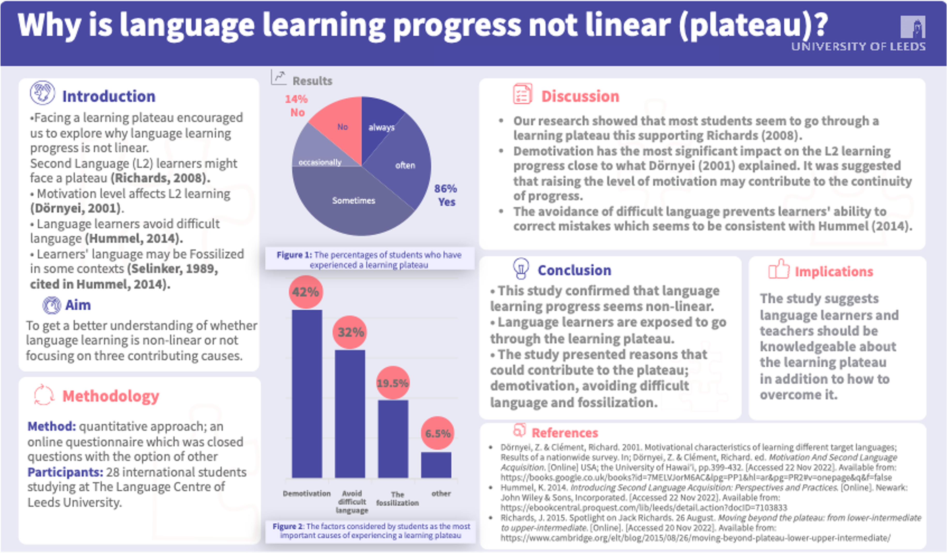
Shared with permission.

Slide 14
Implications and application
The journey versus the destination
Agency and autonomy (Allwright, 2003;Hanks, 2015; Hanks 2021)
Relevance to learners
The digital dimension (Kim et al. 2023)
Flexibility and adaptability
Notes:
Why EP over any other research frameworks?

Slide 15
Thank you
Thank you for listening.
There will be an opportunity to ask questions in the live Q & A during the PIM.
Alternatively, you are welcome to email me.
L.E.A.Richards@leeds.ac.uk

Slide 16
References
Allwright, D. 2003. Exploratory Practice: rethinking practitioner research in language teaching. Language teaching research: LTR. 7(2), pp.113–141.
Archer, A. 2022. A multimodal approach to English for academic purposes in contexts of diversity. World Englishes. 41(4), pp.545–553.
Archer, A. and Breuer, E. 2016. Introduction. A Multimodal Response to Changing Communication Landscapes in Higher Education. In: Fidalgo, R. and Olive, T. (series eds.) and Archer, A. and Breuer, E. O. (volume eds.), Studies in Writing: Vol. 33, Multimodality in Higher Education. Leiden, Netherlands: Brill. pp.1-17.
Bezemer, J.J. and Kress, G.R. 2016. Multimodality, learning and communication : a social semiotic frame. London: Routledge, Taylor & Francis Group.
Crawford Camiciottoli, B. and Campoy-Cubillo, M.C. 2018. Introduction: The nexus of multimodality, multimodal literacy, and English language teaching in research and practice in higher education settings. System. 77, pp.1–9.
Consoli, S. 2022. Practitioner research in a UK pre-sessional: The synergy between Exploratory Practice and student motivation. Journal of English for academic purposes. 57, article no.101108 [no pagination].
Hanks, J. 2017. Exploratory Practice in Language Teaching: Puzzling about principles and practices. Palgrave Macmillan.
Hanks, J. 2021. Co-production and multimodality: learners as co-researchers exploring practice. Educational action research. 29(3), pp.462–482.
Kim, Y., Belcher, D. and Peyton, C. 2023. Comparing monomodal traditional writing and digital multimodal composing in EAP classrooms: Linguistic performance and writing development. Journal of English for academic purposes. 64, article no: 101247 [no pagination]
Lacković, N. and Popova, B. 2021. Multimodality and socio-materiality of lectures in global universities’ media: accounting for bodies and things. Learning, media and technology. 46(4), pp.531–549.
Lea, M. R., and Street B, V. 2006. The ‘Academic Literacies’ Model: Theory and Applications. Theory Into Practice. 45(4), pp. 368–77.
Swales, J.M. 2009. When there is no perfect text: Approaches to the EAP practitioner’s dilemma. Journal of English for academic purposes. 8(1), pp.5–13.
Trimbur, J. and Press, K. 2015. When was multimodality? Modality and the Rhetoric of Transparency. In: Archer, A. and Breuer, E.O. (eds.). 2015. Multimodality in writing : the state of the art in theory, methodology and pedagogy. [Online]. [Accessed 20 October 2023]. Leiden, Netherlands: Brill. pp. 19-41.
University of Leeds. 2023. Postgraduate pre-sessional English. [Online]. [Accessed 23 October 2023]. Available from: https://www.leeds.ac.uk/presessional

