Slide 1
Exploring the role of multimodal artefacts (PPT slides made by students) in preparing to discuss theory/practice relations in academic reading circles
Judith Gorham
Notes:
My talk is about students preparing for seminar discussions, where they needed to identify and understand theory/practice relations in an academic text. They made slides to prepare for these discussions and it’s these slides that I’m interested in.

Slide 2
Aims of my talk
Re-thinking pre-sessional English: academic reading circles
Understanding how the preparation of visuals contributed to building knowledge of theory + practice
Considering slides from two reading circles:
week 2: Intercultural groupwork
week 3: Sponge City (a way for cities to absorb excess rainwater through green spaces)
Using semantic gravity (Legitimation Code Theory, LCT) to analyse the slides
Notes:
I’d like to start by giving some background to how we designed these discussions and then show you some of the multimodal artefacts/slides made by students to support their discussions. The analysis is the part I’d really welcome feedback on. I needed a way to analyse what was happening, how the text and visuals together were being used. I thought about different ways of analysing the text and images in the slides but the analysis I’m going to show you uses semantic gravity from LCT

Slide 3
Needs analysis: talking to lecturers
“When students read academic texts, they don’t see the theory and how it’s being applied in context. They struggle to think about applying the theory to a different context.”
Business lecturer
“Some students remain silent in tutorials and would benefit from more confidence/willingness to interact with their peers and lecturer.”
Actuarial Science lecturer
Notes:
Back in 2021 we were redesigning our pre-sessional English courses and we talked to lecturers. The Business lecturer here was frustrated by Master’s students’ inability to even see theory and how it was being applied, let alone apply a theory to a different context. The Actuarial Science lecturer was expressing a frustration felt by many lecturers, that students are uncomfortable in interacting.

Slide 4
Academic Reading Circles for building knowledge about theory
“the use of reading to build knowledge of and about theory, therefore, acquiring the threshold concept of ‘theory knowledgeability’” (Cowley-Haselden 2020a)
“EAP pedagogy could benefit from a greater focus on reading. Not just reading as an aid to writing, but, the use of reading as social practice to build knowledge.” (Cowley-Haselden 2020b)
Notes:
Around the same time, there was a lot of talk in BALEAP about reading circles and I became familiar with Susie Cowley-Haseldon’s PhD work on them. She had used reading circles to support students to build knowledge about theory through social practice and this seemed to fit perfectly with what our lecturers had asked for. Students can be asked to identify theory in the text and look at how it is applied in a particular context. They could also think about applying it in other contexts, perhaps ones they know well.

Slide 5
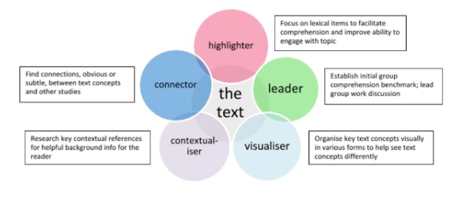
Academic Reading Circles
Tyson, 2016, p.16
Notes:
The Tyson Seburn book published in 2016 is the starting point for a lot of current work using these reading circles. He stipulates these 5 roles, so students prepare to discuss a text according to their role. For example, the discussion leader asks questions and summarises the discussion, and the visualiser organises key text concepts visually in various forms to help see text concepts differently. It was the visualiser role that first caught my attention but actually all students made slides, no matter their role.

Slide 6
ARCs in our PSE
Academic Reading Circle (ARC) Roles
discussion leader: Create 3 discussion questions to help the group understand the text. Create 3 discussion questions to help the group discuss how theory relates to practice Connector: Consider ways that points in this text connect to information from other texts, familiar events + personal experiences. Visualiser: create or source visuals of two different types that help to understand theory/practice in the text. 4. Highlighter: identify 5 key noun phrases. Identify language which indicates writer stance. 5. Contextualiser: identify 3 contextual references used by the writer in the text (which are not explained in the text), research them and be prepared to explain them. adapted from Seburn, 2016
Task Rationale:
to develop and practise strategies for reading academic texts
to explore the link between theory and practice
to use oral interaction to think critically
to practise finding connections within a text and between the text and outside of it
How does the role of the visualiser contribute to the discussion?
Notes:
We introduced the Academic Reading Circles in 2022. The task rationale was composed of these 4 parts: practising reading, linking theory and practice, using oral interaction for thinking and finding connections within and without texts to think critically about them. The roles are on the right and these are the instructions that students were given. They swapped roles each week and gave advice to the next person to do the role.

Slide 7
ARCs in our PSE
Week 1 | Gender + covid
Week 2 | International groupwork in higher education
Week 3 | Sponge City
Week 4 | Zero Waste
Chan, F. K. S., Griffiths, J. A., Higgitt, D., Xu, S., Zhu, F., Tang, Y. T., ... & Thorne, C. R. (2018). “Sponge City” in China—a breakthrough of planning and flood risk management in the urban context. Land use policy, 76, 772-778.
Notes:
These are the four formative tasks. Following this, in week 5 there was a summative task. Today we’ll look at example slides from week 2 and week 3. You can see one group of 5 students discussing in week 3 with some slides they had prepared. I was initially interested in how the slides enabled the discussion but then became more interested in the choices around text and images in the slides. These slides can be a way for students to work things out, not a finished assessed product.

Slide 8
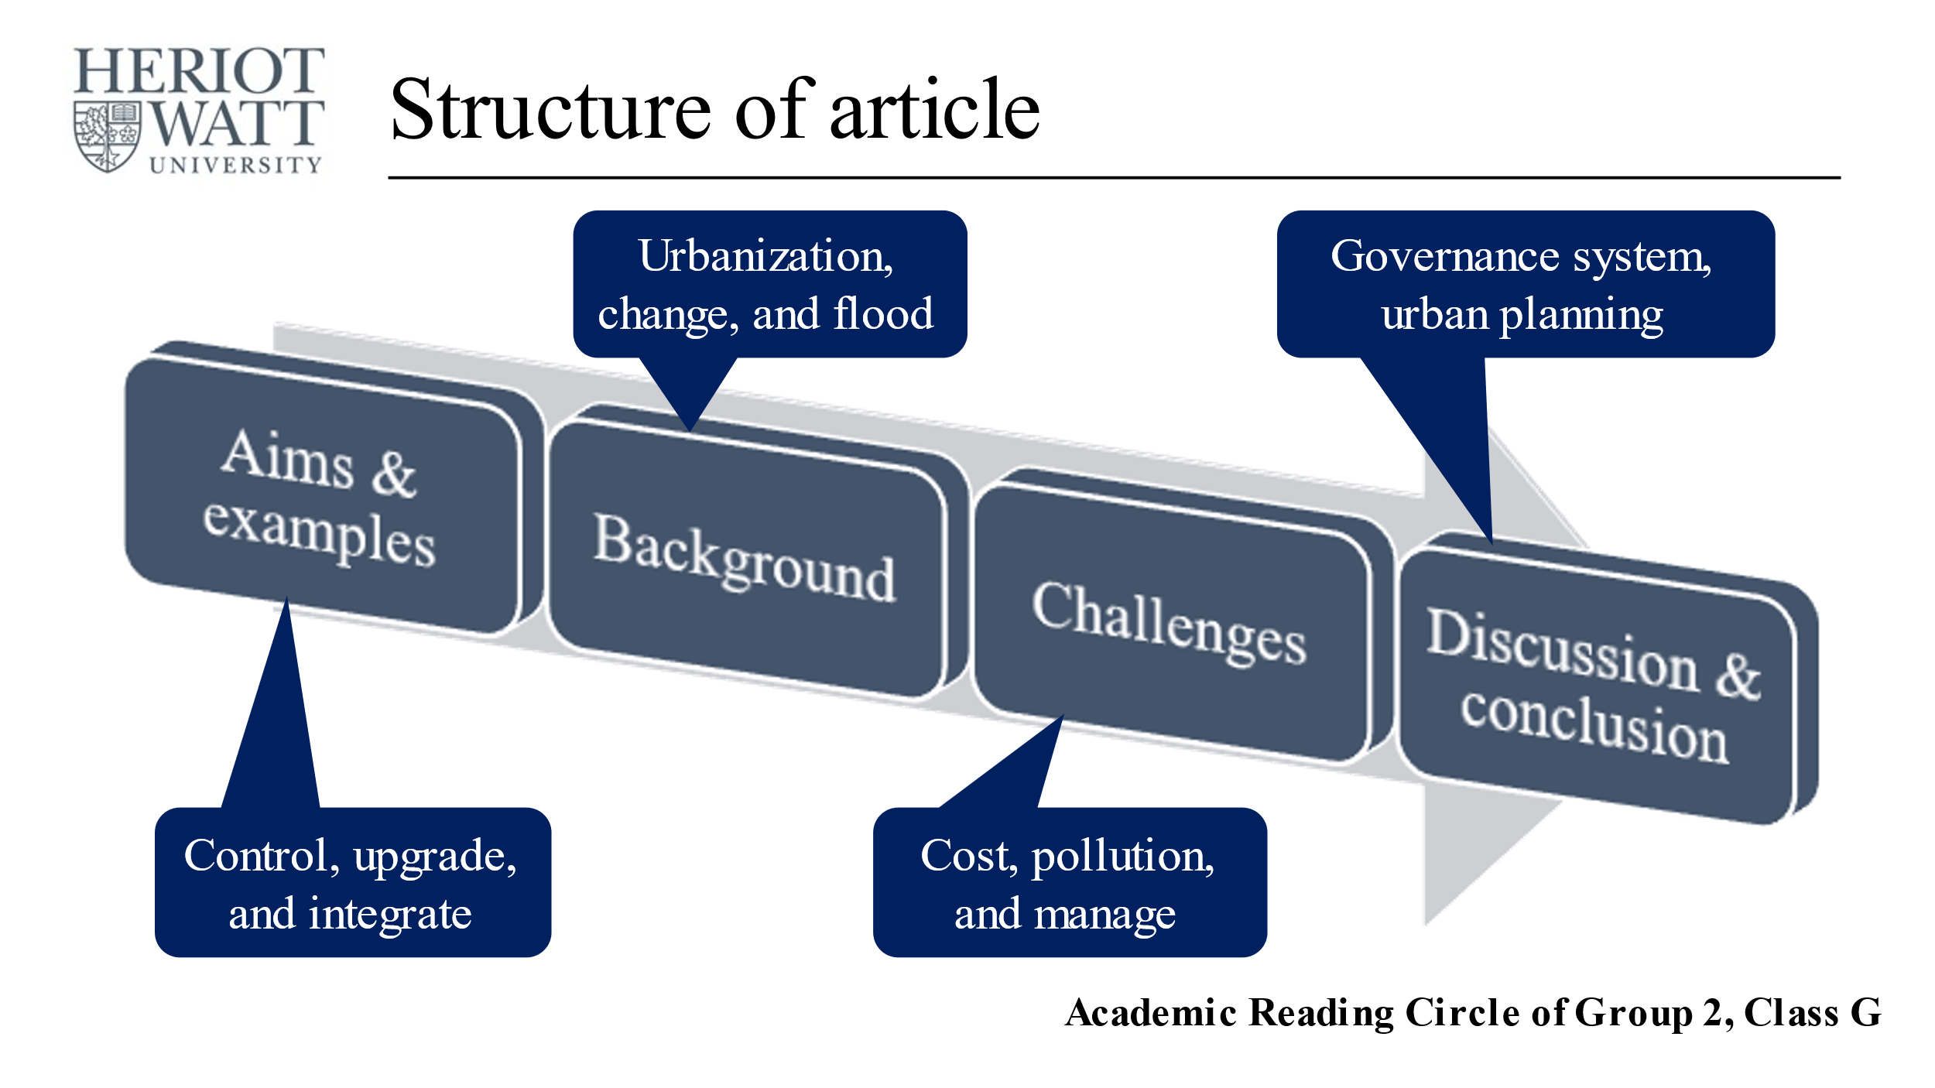
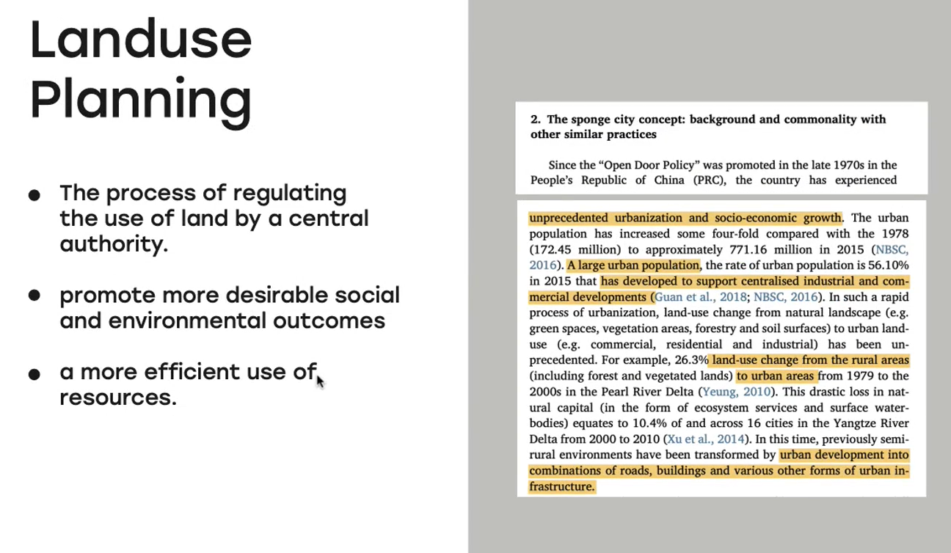
How do these texts/images support knowledge building about theory – practice?
(Do we need to intervene in this?)
Notes:
It turned out that most students were preparing pictures or slides, and this seemed to be a way for them to understand the texts independently as well as a way to help them share their understanding. Here there are 4 examples of slides made by students in preparation for the seminar discussions about sponge city. Most of them contain information from the text with the student’s comments on the slide. The bottom right slide shows a new context for sponge city, chosen by the student. The questions in my mind were How do these texts/images show knowledge building about theory – practice? I needed a way to analyse what was happening, how the text and visuals together were being used.

Slide 9
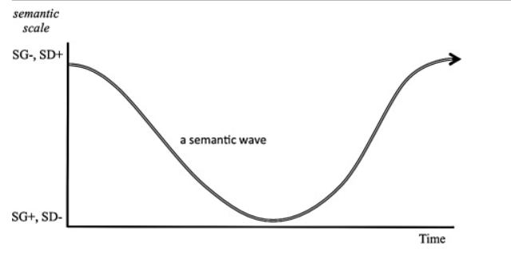
Legitimation Code Theory (LCT): Semantic Gravity
SG-
SG+
Macnaught et al., 2013
Notes:
I thought about different ways of analysing the text and images in the slides but the analysis I’m going to show you here uses semantic gravity from LCT. This was because semantic gravity is a way of thinking about how abstract and conceptual something is or how context-dependent it is, how far it’s about the real world and examples.
I included this image of the wave because it’s seen quite frequently in EAP contexts nowadays. We can look at how a text ‘waves’ from abstraction (weak semantic gravity) down to real-world examples (stronger semantic gravity) and then back up again. However the idea of waving in this diagram requires time. In my analysis of the slides I was not looking at how the students talked about their slides over time, but in how they showed understanding in the preparation phase of the reading circles.

Slide 10
Translation device
SG- SG+ | Abstraction
 | Generalisation
 | Judgement
 | Interpretation
 | Summarising description
 | Reproductive description
SG- SG+ | Theory/ concepts | Student is analysing a theory
 |  | Student identifies related concepts/theories
 |  | Student is describing a theory
 |  | Student is connecting the theory to a context Student finds a new context for the theory Student finds a connection with a previous article
 |  | Student restates the operationalisation of the text and comments/attempts to distil meaning
 |  | Student is mapping the whole article
 | context | Student is analysing a context
 |  | Student is describing a context
 |  | Student is repeating the text detail on a slide
Maton, K. 2013
Notes:
On the left we see Maton’s idea of how semantic gravity could begin to be operationalised, with abstraction at the top (weak SG) and reproductive description about context at the bottom (strong SG). On the right is my translation device. Following a study by Georgiou, Maton + Sharma 2014, I used three layers and 3 colours. As with the 2014 study, red is about theories and concepts, yellow is about contexts and green is connections between the other two layers. The 2014 study was analysing students’ verbal responses to Physics questions, where they tried to connect Physics concepts to real-world examples. Because of the timeframe of spoken answers, students were likely to move between layers, from red to green and so on. In my study, the static nature of the slides meant I needed more subdivision in the 3 layers. In my table, each layer is subdivided into 3. The top band of each colour is where they bring most to the text in terms of their own experience, where they demonstrate the most knowledge building. The bottom layer of each colour is where students repeat information from the article.

Slide 11
SG- SG+ |  | Coded content | visual | text
 | Theory/ concepts | Student is analysing a theory | Representing the theory in diagram form (may be from the article) AND attempting to distil key ideas | attempting to distil key ideas/commenting critically Questions that lead the group to think critically around the theory
 |  | Student identifies related concepts/theories | Identifying other sources and describing related concepts | Identifying other sources and describing related concepts Questions that ask about related theories
 |  | Student is describing a theory | Representing the theory in a diagram form (may be from the article) using coloured lines to map structure of article, circling the parts where theory is discussed | Highlighting the theory in the original text Writing the name of the theory
 |  | Student explores the theory in context /finds a new context for the theory /finds a connection with a previous article | Find images and uses own words | Questions that lead the group to think critically around the theory and think critically about the limitations for practice
 |  | Student restates the theory in context and comments/attempts to distil meaning | Breaks the concept down (as article) and distils key ideas
 |  | Student is mapping the whole article | Mapping the whole article with no emphasis on any part
 | context | Student is analysing a context | Provides information about another context Blocks of highlighted text accompanied by own notes | Questions that ask about data from this context Questions that ask about another context
 |  | Student is describing a context | Putting a graph/diagram from the article on a slide Illustrative photos/images from google
 |  | Student is repeating the text detail on a slide |  | Blocks of highlighted text
Notes:
Here is the translation device in more detail, with examples of visuals and written text on the slides. Where possible there is just one descriptor for both visuals and text, in line with my objective of not separating them in two separate analyses.

Slide 12
Week 2
Student is describing a theory
Student is analysing a theory
Poort, I., Jansen, E., & Hofman, A. (2019). Intercultural group work in higher education: Costs and benefits from an expectancy-value theory perspective. International Journal of Educational Research, 93, 218-231.
Notes:
This is how I used my translation device. On the left the student has highlighted the section of the text that presents the theory and put that on an attractive background. On the rights, the student has reworked the same information into bullet points, then identified the modification that this particular research made. There is more understanding of how a theory is applied and modified on the right.

Slide 13
Week 4
Student is attempting to distil key ideas
Student finds a new context for the concepts
Chan, F. K. S., Griffiths, J. A., Higgitt, D., Xu, S., Zhu, F., Tang, Y. T., ... & Thorne, C. R. (2018). “Sponge City” in China—a breakthrough of planning and flood risk management in the urban context. Land use policy, 76, 772-778.
Notes:
These slides are from week 3. The text this time was about sponge city. On the left the student still uses a small section of the original text but adds their own thinking about what the sponge city concept means. On the right, the writing mentions the purpose and the photos show new contexts found by the student, in an attempt to link ideas and new contexts.

Slide 14
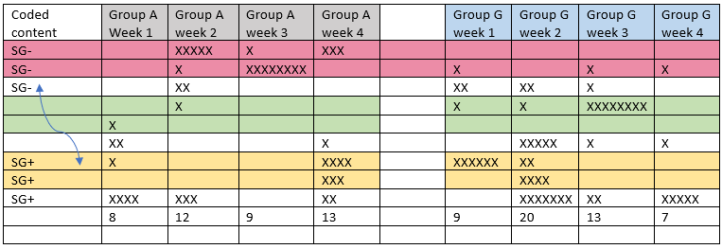
Notes:
This is an overview of progress from week 1 to week 4 for two groups. Group A was slightly bigger, composed of different nationalities and with a generally lower language level. Group G was smaller and more homogeneous but with a slightly higher language level. Group G produced more professional looking slides and spent a lot of time on preparation – evident in the quantity of slides. It’s interesting that the green band, where theory connects with context is the most empty.

Slide 15
Summary and next steps
The best slides are not the most visually attractive, but where the student has used the visuals/text to think around the academic article and the research it talks about.
Slides are more likely to be SG- and SG+, not a combination.
How do the slides support the discussion?
How does this differ in online discussions?
How does the approach to slide preparation indicate the approach to discussion?
How can this way of working (students making text/image artefacts) help build knowledge outside of academic reading circles?
Notes:
These are my takeaways so far. The best slides are not the most visually attractive, but where the student has used the visuals/text to think around the academic article and the research it talks about. The best slides function a bit like notes, where the student is re-working the notes to make meaning/build knowledge from them. This is an active thing, not just repeating the original text.
Slides are more likely to be SG- and SG+, not a combination. The green layer is least common in the slides and this could be addressed by a teacher asking questions about these links.
The obvious next step is to think about how students use the slides when they discuss. My initial impression is that good slides do not always lead to a fruitful discussion. It’s more complicated than that. It’s also worth comparing the way visuals support a discussion online, where they’re much easier to see and in a classroom situation. Online it’s much easier to monitor what people are looking at.

Slide 16
References
Cowley-Haselden, S. (2020a), ‘Analysing Discourse in the Liminal Space: Talking Our Way Through It’ in JA Timmermans & R Land (eds.), Threshold concepts on the edge, Brill Sense, Leiden.
Cowley-Haselden, S. (2020b). Building knowledge to ease troublesomeness: Affording theory knowledgeability through academic reading circles. Journal of University Teaching & Learning Practice, 17(2), 1-14. Retrieved from https://ro.uow.edu.au/jutlp/vol17/iss2/8
Georgiou, H., Maton, K., & Sharma, M. (2014). Recovering knowledge for science education research: Exploring the “Icarus effect” in student work. Canadian Journal of Science, Mathematics and Technology Education, 14, 252-268.
Macnaught, L., Maton, K., Martin, J.R. and Matruglio, E. (2013) ‘Jointly constructing semantic waves: Implications for teacher training’, Linguistics and Education, Volume 24, Issue 1, Pages 50-63,
Maton, K. (2013). Knowledge and knowers: Towards a realist sociology of education. Routledge.
Seburn, T. (2016) Academic Reading Circles, theround.

Slide 17
Week 2
Student is analysing a context
Student is describing a context
Poort, I., Jansen, E., & Hofman, A. (2019). Intercultural group work in higher education: Costs and benefits from an expectancy-value theory perspective. International Journal of Educational Research, 93, 218-231.
Notes:
The researcher explored the theory in a university context, and on the left we have some attempt to understand what that context would include. On the right we have a banal image of students taken I suppose from google. The image is a distraction while the writing contributes some description from the article.

Slide 18
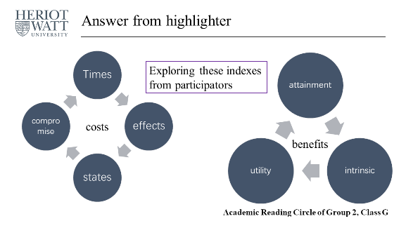
Week 2
Student is describing a theory
Student is mapping the whole article
Poort, I., Jansen, E., & Hofman, A. (2019). Intercultural group work in higher education: Costs and benefits from an expectancy-value theory perspective. International Journal of Educational Research, 93, 218-231.
Notes:
Here are two examples from the same week 2 preparation. Both fulfil only the weakest pink and green criteria – on the left there is a repetition of the concepts in nice circles but the layout seems to be transported in from SmartArt. The grey arrows are actually incorrect, as the article doesn’t mention anything about one cost or benefit influencing another. On the right we have a very lovely and elegant image that simply shows a very careful and detailed reading of the article.

