Slide 1
Assessment by portfolio: using Padlet as a multimodal interspace Dr Dorothy Glenn Mr Paul Morgan

Slide 2
Outline
Background
Context
Assessment Challenges
Response to Challenges
Padlet Portfolio
Student & Teacher Feedback

Slide 3
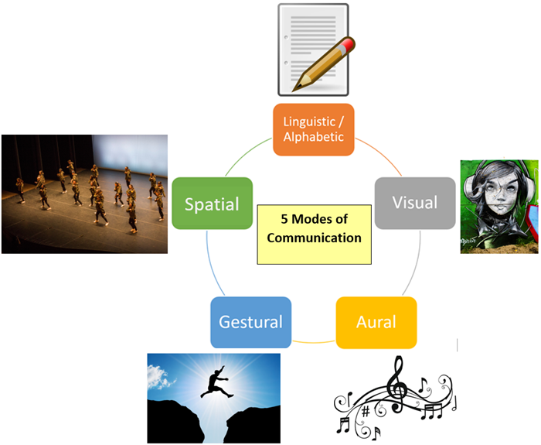
Multimodality
'a must for academic contexts, as the purpose of EAP is to prepare learners for academia' (Sezgin, 2023)
'establishes a direct relationship between the subject and real life, since multimodality is present at all levels in life' (Lirola, 2018); 'all interaction is multimodal' (Hauck, Kurek & Satev, 2021)
A multimodal pedagogy necessitates a means of discourse which includes a range of semiotic modes and a more integrative approach to learning, teaching and assessment
E-portfolios offer the 'space' for such discourse and allow for a focus on the process of learning as much as on the final product.

Slide 4
Transnational Education Partnership
University in Northern China (Liaoning Province)
Approximately 190 students in each year group (Accounting or Finance majors)
Centre for English Language Teaching (CELT) at Ulster responsible for English language provision during Year 2
Students need to achieve mid-high B2, minimum IELTS equivalent 6.0 to progress to Year 3
Students study mostly Ulster modules during Years 3 and 4

Slide 5
Challenges 22-23
Teachers delivering modules remotely from and to multiple locations (2021-2023)
Students in classroom / dormitory / at home
Need to respond quickly to local covid restrictions
Assessments to be revisited

Slide 6
Assessment Semester 3: 22-23
To avoid ongoing uncertainty and unforeseen changes in 22-23, agreed with partner institution to adopt continuous assessment via Padlet portfolio for Semester 3.
Agreed assessment weightings:
Sem 3:
L&S portfolio: 20% of total marks for the module for the year
R&W portfolio: 20% of total marks for the module for the year

Slide 7
Focus for Semester 3: 22-23
To promote the learning process with a focus on formative (rather than summative) feedback
To establish a virtual space for genuine interaction and construction of meaning between student(s) and teacher
To facilitate and foster multimodal meaning-making and interaction between different semiotic forms
To encourage & recognise engagement / independence / autonomy / creativity / risk-taking
To foster a sense of achievement through the 'final' product

Slide 8
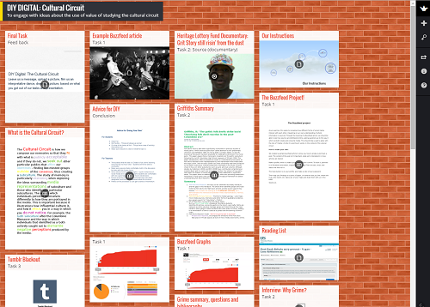
Why Padlet?
21-22 experience: no firewall issues; user-friendly
Can host variety of modes / individual and group work
Comments function encourages both synchronous and asynchronous dialogue
Suitable for formative assessment / tracking student progress
Provides a permanent record ('immortal walls')
Infinite wall size
(20 MB limit file size free version)
'Allows users to asynchronously pin multimodal messages on a virtual wall' (Hauck, Kurek & Satev, 2021)
Allows for multiple layers and modes of communication, creativity and reflection.
'Research indicates that Padlet-mediated learning is convenient and beneficial for improving students' engagement' (Rajiah, 2018 cited in Albarqi, 2023)
Lirola (2018) highlights the relationship between multimodality, evaluation through portfolio and independent learning.
Megat Mohd. Zainuddin et al (2020) claims Padlet improves learning by 'intensifying engagement'.

Slide 9
Assessment by portfolio
Assessment tasks divided into 4 categories:
Starred tasks (example in next slide)
Set tasks
Optional tasks
Independent work
Incorporated into teaching schedule
Checklist for students and teachers.
Assessment criteria:
Reward engagement and completion
Scoring shared with students from the outset.

Slide 10
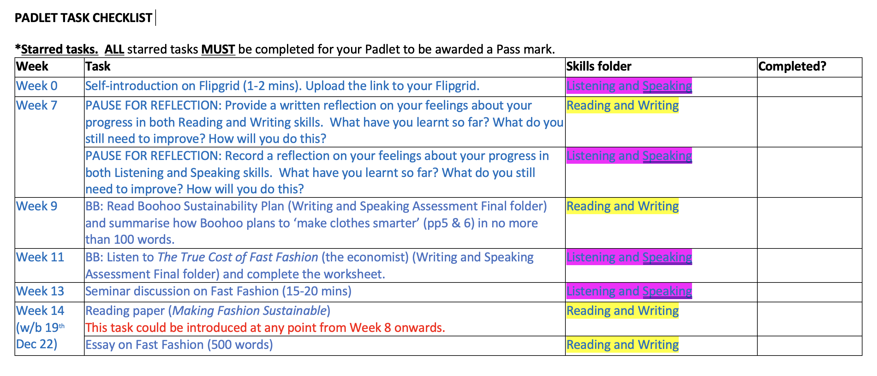
Padlet Tasks

Slide 11
Independent tasks: guidance
Examples of independent study could include:
reading and paraphrasing/summarising sections from relevant academic texts and highlighting/evaluating the writer’s stance;
listening to additional TED talks (short talks / lectures) and recording your opinion;
comparing aspects of various cultures based on selected appropriate sources;
extending your vocabulary / grammar independently;
reflecting on what you have read / written / created.
This is an opportunity for you to experiment and take risks, using whatever tools (writing / audio / video / music / graphics / colour / animation etc) you think best helps you convey your message.
You can work on your own or in pairs / groups. It is up to you, but at least some of your independent work should show evidence of creativity / critical thinking / evaluation / independent thought.
*Changes for 23-24 highlighted in red

Slide 12
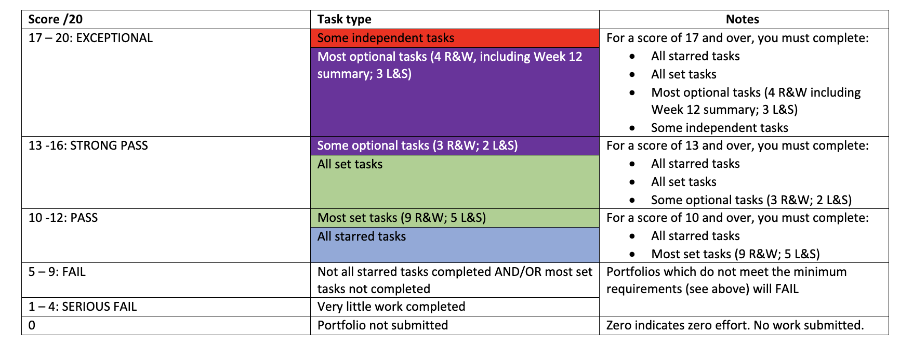
Scoring

Slide 13
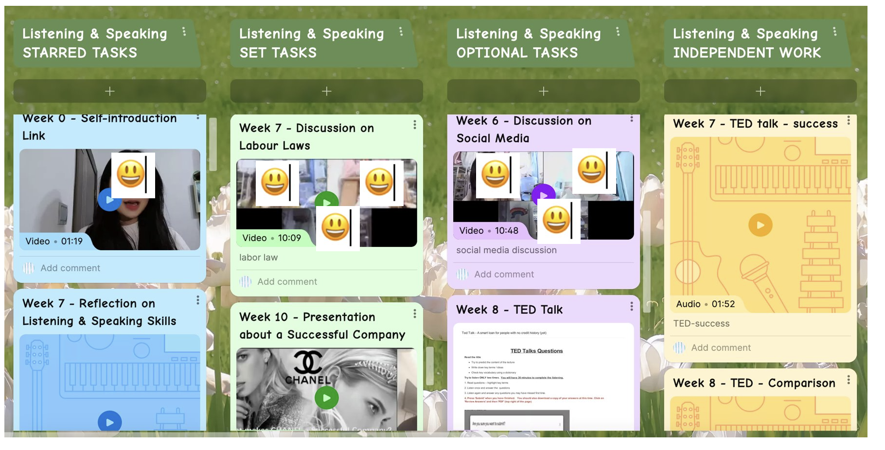
Example L & S Portfolio

Slide 14
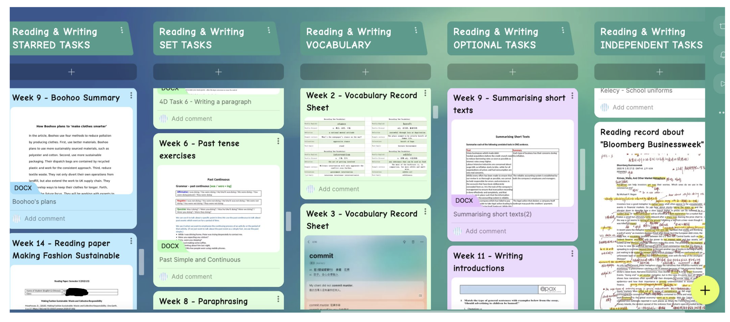
Example R & W Portfolio

Slide 15
Portfolio results

Slide 16
Student feedback: questions
All Year 2 students surveyed through Microsoft Forms questionnaire.
Completion rate: approximately 28%.
Questions 1-4 (using 5-point Likert scale):
I found Padlet an effective platform/tool to share/discuss my work with my teacher.
2. I liked the fact that the focus of Year 2, Semester 3 was more on learning than assessment.
3. I liked Year 2, Semester 3 assessment having a range of set, starred and optional tasks.
4. I liked the fact that my portfolio comprised a wide range of task types. For example...
Questions 5-8 (open questions):
5. How effective did you find Padlet for the different modes of assessment listed in Q4? For example...
6. How beneficial did you find the opportunity to work on independent tasks?
7. How did you use the feedback provided to you to develop as a learner?
8. Any other comments?

Slide 17
Results from Feedback: Q1-4
I found Padlet an effective platform/tool to share/discuss my work with my teacher.
I liked the fact that the focus of year 2, Semester 3 was more on learning than assessment.
I liked year 2, Semester 3 assessment having a range of set, starred and optional tasks.
I liked the fact that my portfolio comprised a wide range of task types.

Slide 18
Results from Feedback: Q5 How effective did you find Padlet for the different modes of assessment listed in Q4?
Key themes: 1. Easy to use / convenient (terms used synonymously) (x 25); 2.Effective / helpful / useful / clear (x10); 3.Sensational / good / yes / 1 (x15); 4.Interesting (x1); 5.Recommend (x5)
I think Padlet is good for students to share their homework, plans and discussions etc. It was not so difficult for me to upload those things. Therefore, I would like to recommend Padlet as a learning platform.
I think recording and uploading discussions/presentations is very convenient. I think it's easy to get and respond to teacher's verbal and written feedback, which is great! I would recommend Padlet as your learning and evaluation platform because it is very interesting.
It is easy and convenient for Padlet to record and upload discussions or audio, and it is also a convenient platform for us to browse past submissions.

Slide 19
Results from Feedback: Q5
Key themes: 1.Connectivity issues (x3); 2.Issues with longer videos (x2); 3.No notification for comments (x1)
I think there is a not a big problem, but sometimes there is a internet connection problem.
Longer video uploads are not easy.
It's easy for students to upload video and discussion. Some students can't assess to the website sometimes. It's also a little difficult for student to get feedback from the teachers since the platform doesn't have a reminder* when we get comments.
*Students now reminded to turn on comment notifications in their settings, which will send students an email when their teacher has left comments.

Slide 20
Results from Feedback: Q6
Q6: How beneficial did you find the opportunity to work on independent tasks?
Key themes: 1. Improve English (x9); 2. Improve skills/ability (x5); 3. Improve knowledge (x5); 4. Critical thinking (x5); 5. Independence/own interests (x6); 6. Flexibility (x2); General positivity (x15)
It can help me to develop a critical thinking method.
Promote us to doing self-study
It’s a good way to think deeply.
In the process of completing independent tasks, we often have the opportunity to learn more different and rich content, which can effectively improve our ability.
It is difficult to do high-quality independent work on my own initiative.

Slide 21
Results from Feedback: Q7
Q7: How did you use the feedback provided to you to develop as a learner?
Key themes: 1. Correct mistakes (x13); 2. Improve in future (x18); 3. Practice (x3); 4. Discuss with teacher (x3); 5. Think more (x1)
Ask for help from teachers and learn from classmates by leaving messages and comments.
I carefully read feedbacks and communicate with my teacher during tutorials.
I will adjust and modify in time according to feedback.
The feedback after each task enables me to find my mistakes in reading or listening in time and correct them in subsequent learning
I use feedback to better correct my homework and get more effective suggestions to help me do better.

Slide 22
Feedback from teachers
Padlet portfolio:
Very effective for language acquisition.
Encouraged students to try new things and take risks
Helped to develop student autonomy
I think it (the portfolio) should have been given more weight.
This Photo by Unknown author is licensed under CC BY-SA-NC.

Slide 23
Next steps?
Promote more collaborative engagement
Retain Padlet as platform for portfolio
Review integration of modes
Encourage more creative use of multimodal resources
his Photo by Unknown author is licensed under CC BY-SA-NC.

Slide 24
References
Albarqi, G.A. (2023) Padlet as a formative assessment tool in the online language classroom, in Innovation in Learning-Oriented Language Assessment, pp.181-199. doi:10.1007/978-3-031-18950-0_11
Hauck, M., Kurek, M., Satar M. (2021) Where multimodal literacy meets online language learner autonomy: 'Digital resources give us wings' in Carolin Fuchs, Mirjam Hauck and Melinda Dooly, ed. Language Education in Digital Spaces: Perspectives on Autonomy and Interaction. Cham: Springer, 2021, pp.85-111.
Lirola, M. M. (2018) Multimodal teaching evaluation with a portfolio in a tertiary education language classroom, Argentinian Journal of Applied Linguistics, 6 (1) 25-43
Megat Mohd. Zainuddin, N., Mohd Azmi, N. F., Mohd Yusoff, R. C., Shariff, S. A. and Wan Hassan, W. A. (2020) “Enhancing Classroom Engagement Through Padlet as a Learning Tool: A Case Study”, International Journal of Innovative Computing, 10(1). doi: 10.11113/ijic.v10n1.250.
Rashid, A. , Yunus, M. and Wahi, W. (2019) Using Padlet for Collaborative Writing among ESL Learners. Creative Education, 10, 610-620. doi: 10.4236/ce.2019.103044.
Sezgin, H. (2023) Multimodality in EAP objectives and coursebooks, The Literacy Trek https://doi.org/10.47216/literacytrek.1279935

Slide 25
Any questions?

