Slide 1
Assessing transcultural communication: handing over to the students
Victoria Jack
BALEAP PIM Leeds, June 2022

Slide 2
Outline:
A tiny bit of context: the conversation
Building assessment criteria
Sharing and reflection

Slide 3
What is transcultural communication?
Transcultural communication, in keeping with trans- perspectives, is characterised here as communication where interactants move through and across, rather than in-between, cultural and linguistic boundaries, thus, ‘named’ languages and cultures can no longer be taken for granted and in the process borders become blurred, transgressed and transcended.
Baker (2019: 472)
A medium for transcending cultural boundaries and dissolving power structures

Slide 4
Why assess TC?: the conversation
Staff/confident students: “My students/classmates don’t take part in seminars. It’s their English, can you help?”
Me: Can I observe?......(later), it’s not their English, it’s everyone’s lack of transcultural communication competence.
Staff: Can you teach that? Can you do a module on it?
Me: I think so.

Slide 5
Why evaluate it?
Module requirement: theory into practice
Group Discussion (15 mins): 33%- 3 module participants and 3 guests
Student generated task (example):
The University is interested in encouraging students from all different backgrounds to socialise and study together (integration).
Discuss your experiences of socialising and studying with students from other backgrounds here at the university. Have you mixed with students from other countries, cultures, social backgrounds? To what extent?
Then, suggest some things the university could do to improve integration.
Self evaluation & reflection on performance in group discussion: 33% 1750 words
Group evaluation 34% 1750 words: analysis of other participants’ performance in the group discussion

Slide 6
Handing over to the students
Question: What is effective transcultural communication?
The answer: Ask the student
How:
Echo the process of departmental criteria development
Participant collaboration and negotiation

Slide 7
How it’s done in the module
Individually: students complete an assessment grid with categories and descriptors at “strong pass” and “fail” levels
In pairs, then groups of four and then eight, students agree categories
In groups of three or four, students write the descriptors for one category at “strong pass” and “fail” levels
A different group then writes descriptors at 2:1, 2:2 and 3rd levels
A different group then checks across the levels to ensure consistency
IT TAKES A WHILE….2-4 hours

Slide 8
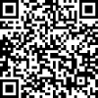
Your turn: Categories
Think individually about communication in groups of people from diverse backgrounds. What constitutes “good” or “bad” communication?
Which categories would you use to assess transcultural communication?
Add them to the assessment grid
bit.ly/JunBALEAP

Slide 9
In pairs: Categories
Share which categories you have
chosen to assess transcultural communication?
Are they the same/different?
Can you conflate them?
Do they change as you are now
involved in TC
In fours: Categories
As above
In groups of eight: bit.ly/JunBALEAP
As above

Slide 10
Your turn: Descriptors
Using your categories, share them between group member (so each group member has a category) and each write a descriptor for a 1st and a fail for each category
bit.ly/JunBALEAP

Slide 11
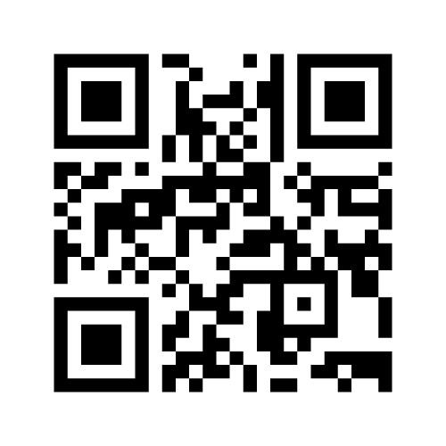
FEEDBACK
Which categories did you choose?
Add them to the menti

Slide 12
FEEDBACK
Which categories did you choose?
Add them to the menti
REFLECTIONS
What are your thoughts/experiences

Slide 13
LINK to criteria generated by the 2019 cohort
 | Listening | Engagement | Openness/Sensitivity | Clear communication
70+ First Class | Consistently uses appropriate eye contact Consistently uses engaged and open body language. Appropriate and consistent use of gestures and nodding Concise understanding of reading the room and awareness of not interrupting when it disrupts communication Consistent use of turn taking and adapting to others’ contributions to create a balanced conversation | Consistently asks relevant and appropriate questions to the group When contributing, consistently and appropriately contributes meaningfully with detailed content. Effectively builds on points presented in the discussion | Consistently ready to communicate with others Always open for correction Consistently accepting of linguistic and grammatical errors Consistently accepts difference in individual personal values and culture differences Consistently shows great interest in other cultures | As speaker: Consistently speaks clearly and at an appropriate pace Consistently doesn't use idiomatic (exclusive) language As listener: Consistently requests clarification when needed and does not move on when not understanding something

Slide 14
Shameless plug/plea
My PhD research: 35 assessment grids into 1
The need to establish its usefulness
Use of the grid to evaluate and standardise
victoria.jack@york.ac.uk

Slide 15
Thank you for listening

Slide 16
Useful resources:
Altbach, P & Knight, J. (2007) The Internationalization of Higher Education: Motivations and Realities, Journal of Studies in International Education Fall/Winter 2007 vol. 11 no. 3-4 290-305
Baker, W., & Sangiamchit, C. (2019). Transcultural communication: Language, communication and culture through English as a lingua franca in a social network community. Language and Intercultural Communication, 19(6), 471-487. https://doi.org/10.1080/14708477.2019.1606230
Bloxholm, S. & Boyd, P. (2007) Developing Effective Assessment in Higher Education: A Practical Guide, Maidenhead: OUP McGraw Hill Education
Bloxham, S. & West , A. (2004) Understanding the rules of the game: marking peer assessment as a medium for developing students' conceptions of assessment, Assessment & Evaluation in Higher Education Volume 29 , Issue 6 , 2004, pgs 721-733
Elwood , J. & Klenowski , V. (2002) Creating Communities of Shared Practice: The challenges of assessment use in learning and teaching, Assessment & Evaluation in Higher Education, Volume 27 , Issue 3 , 2002 pgs 243-256 Higher Education Academy (HEA), A Marked Improvement, Transforming assessment in higher education. Available at https://www.heacademy.ac.uk/sites/default/files/a_marked_improvement.pdf, accessed March 22nd 2016. Hyland, F., Trahar, S., Anderson, J. and Dickens, A. 2008. A changing world: The internationalisation experiences of staff and students (home and international) in UK higher education (ESCalate & LLAS report). Retrieved February 23, 2010, from: http://escalate.ac.uk/downloads/5248.pdf
Rust, C. , Price, M. and O’Donovan, B., (2003) Improving Students' Learning by Developing their Understanding of Assessment Criteria and Processes, Assessment & Evaluation in Higher Education, 28:2, 147-164, DOI: 10.1080/02602930301671

