Slide 1
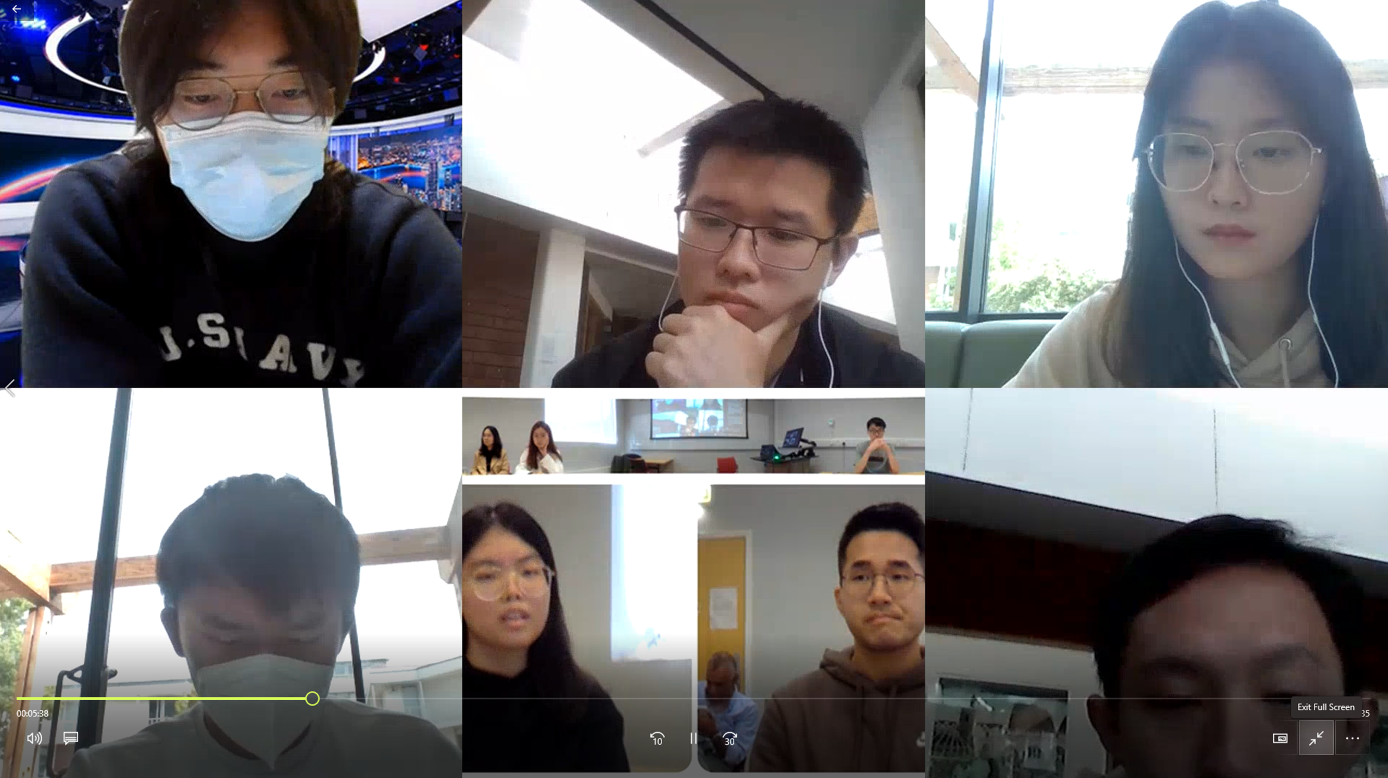
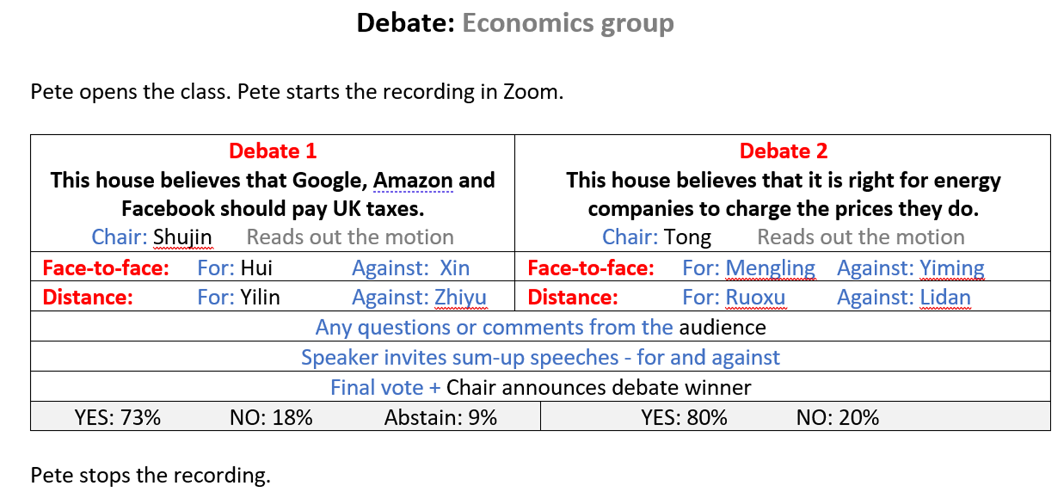
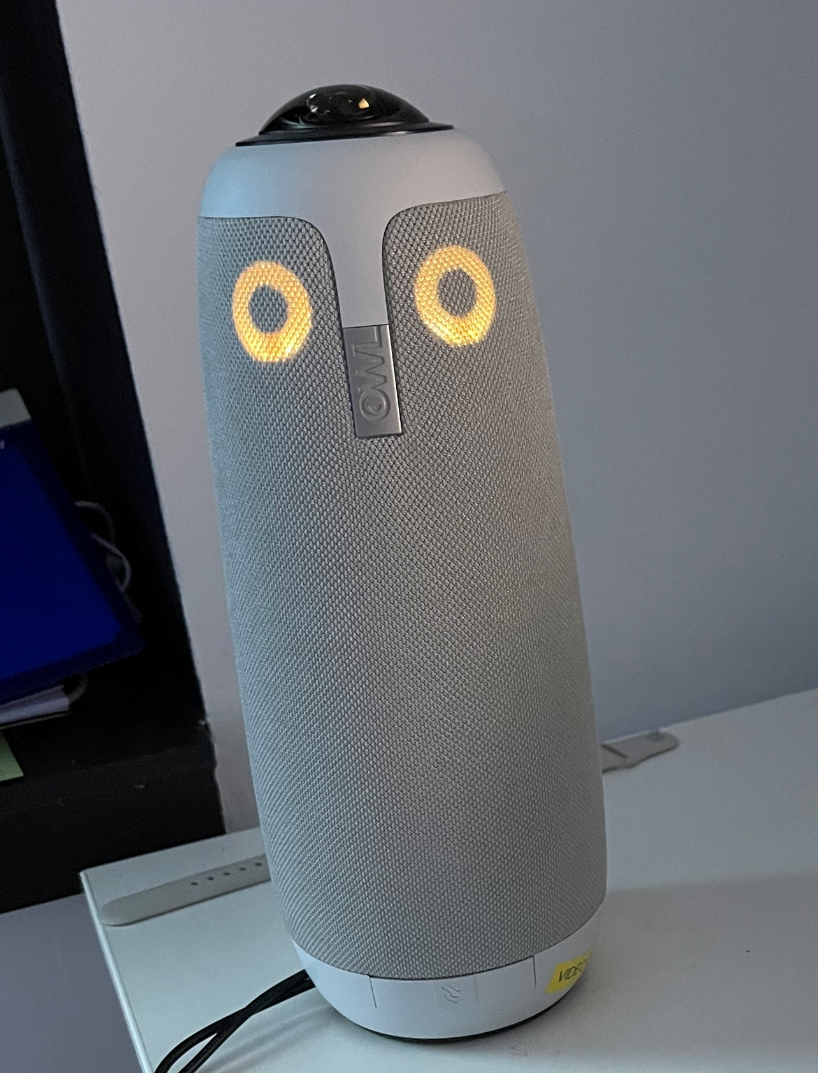
Hybrid in EAP: a personal journey
to heaven……or hell?
Pete Sharma
1 Background
Blended Learning aimed at combining the best of face-to-face classroom teaching with online delivery
originally, the term hybrid was used to describe a 50% - 50% BL course
the pandemic (2020) accelerated the use of digital tools / materials - many teachers forced to move online
much teaching was ERT – ‘emergency remote teaching’ – wholly different from DL (distance learning)
at Warwick, the traditional 6-week PSE (Pre-sessional English) course was adapted for online delivery
2 Theory
the term ‘hybrid’ applied to a lesson taught in a classroom and also attended remotely (Kiddle et al 2020)
“an instructional approach that combines face-to-face (F2F) and online learning. Each class session and learning activity is offered in-person and synchronously online” (Educause 2020).
also known as Hybrid-Flexible (Hy-Flex) and co-modality learning
major driver - ‘inclusion’: allows students who are isolating to attend classes, so that distance learners are not disadvantaged i.e. offers equal opportunities
much of the literature uses the terms ‘hybrid’ and ‘blended’ interchangeably
challenges to delivering hybrid:
technological – the audio set-up must be robust enough to allow remote attendees to both hear and contribute
classroom management – how a teacher attends to both sets of participants
At this stage, I wouldn’t wish to teach hybrid and have no experience of doing so…..!
3 Practice one (reactive)
Summer 2022 – the catalyst: “from tomorrow, classes are to be offered to students isolating!”
laptop to be attached to the projector; open MS Teams and start a class in the relevant channel
positive side: appreciated by the students able to attend a class
negative side: doubled the preparation as materials need to be uploaded / hooking up the laptop before class / familiarisation with equipment / moving outside one’s comfort zone
reflection: this kind of hybrid class is ‘reactive’. Planning is somewhat problematic as the number of students who will attend online is unknown
dissatisfaction led me to want to plan and execute a ‘proactive’ session
4 Practice two (proactive)
an Owl (video conferencing unit with speaker and revolving 360-degree camera) was booked (see photo)
students divided into those who will come to classroom, and those who will disperse around the campus and join the class online
a debate planned, based on topics during the course (see lesson plan) / students voted using Slido
students complete post lesson evaluation questionnaire (see extract)
5 Reflections
it was positive to follow up reading the literature – theory- with actual practice
I’m still wondering about the desirability of running hybrid classes…i.e. the extent to which hybrid is a desirable format for teaching
who wishes for it: the institution….. the teacher? What is the pedagogical justification?
I’d be interested in hearing from institutions who feel their roll-out of ‘hybrid’ is successful
I’d be interested in hearing your recommendations for EAP practitioners
please email with questions or comments if I miss you at the PIM
Bio
Pete Sharma is a teacher trainer, pre-sessional lecturer in EAP and a regular conference presenter. He is co-author of the Vocabulary Organizer (Collins) and has a Masters in Educational Technology.
He is co-author of Best Practices in Blended Learning (Pavilion Publishing & Media Ltd).
P.K.Sharma@Warwick.ac.uk
References
Educause. (2020) 7 Things You Should Know About the HyFlex Course Model Retrieved from https://library.educause.edu/resources/2020/7/7-things-you-should-know- about-the-hyflex-course-model
Kiddle, T., Farrell, C., Glew-O’Leary, J. and Mavridi, S. (2020) A survey of instances of, and attitudes to, Hybrid Learning in Language Teaching Organisations around the world as a response to the Covid-19 pandemic [Research Report]. Retrieved from: http://bitly.ws/gesr Report on Hybrid Learning in Language Teaching Organisations – DIGITAL PEDAGOGY (sophiamavridi.com)

