Slide 1
Developing positive Global Attitudes in a TNE environment, a first step towards Global Graduates
BALEAP PIM – June 2022
Matt Thurston
University of Leeds
edmth@leeds.ac.uk

Slide 2
Global Graduates & Intercultural Communicative Competence

Slide 3
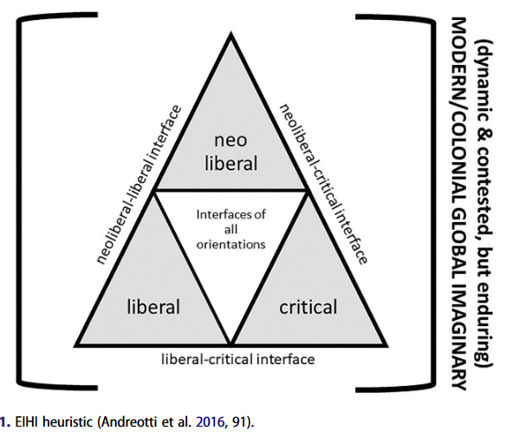
Global Graduates & ICC
Neo-Liberal – economic
Liberal – universal values
Critical – changing the status quo
Global Citizenship Education
(Andreotti et al. 2016, 91)

Slide 4
Common themes
Knowledge –
Knowledge of others
Knowledge of global issues
Skills –
Communication & Collaboration
Reflection
Attitudes –
Openness to other cultures
Openness to other perspectives
Interest in global issues

Slide 5
Global Graduates in the UK

Slide 6
The University of Central Lancashire
Graduate Attributes
Culturally Intelligent with a Global Outlook
Resilient & Reflective
Adaptable & Future Ready
Creative & Enterprising
Knowledgeable & Analytical

Slide 7
The University of Central Lancashire
Culturally Intelligent with a Global Outlook
Students will be able to gather knowledge, understanding and/or experience of local, regional and global perspectives. They will have the ability to be curious and open to new and diverse perspectives and will be able to make informed and ethical decisions by being able to reflect on and be aware of their own and other’s biases and emotions. Ability to communicate and collaborate with people from diverse backgrounds with integrity and confidence.

Slide 8
The University of Central Lancashire
So, UCLan graduates should:
Be curious and open to new perspectives
Make informed and ethical decisions based on self-knowledge of biases
Be able to communicate and collaborate with people from diverse backgrounds

Slide 9
Global Graduates and TNE

Slide 10
Global Graduates and TNE
How to develop global graduates in TNE?
mono-cultural student body (often)
less diverse teaching staff
few overseas opportunities
Foundation programmes have flexibility
Attitudes are a good place to start

Slide 11
Global Attitudes
Why Attitudes?
Skills and knowledge are developed over a whole programme (lifelong learning?)
Attitudes are core, without a positive view of the global community, global knowledge and global skills are less likely to develop
Positive attitudes lead to greater motivation

Slide 12
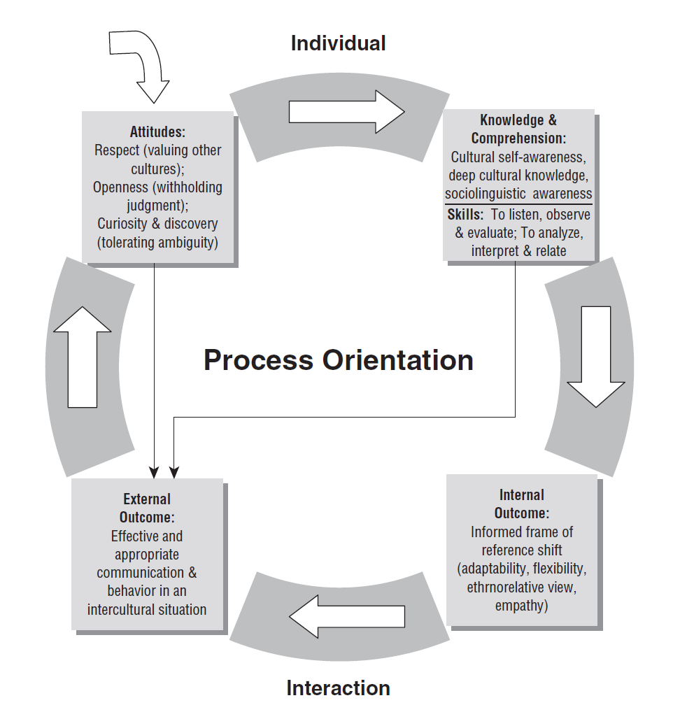
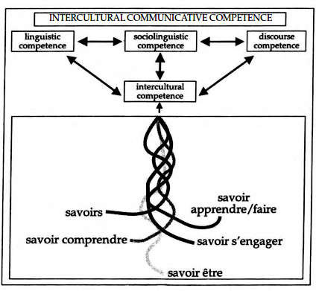
Attitudes in ICC
Deardorff, 2006
Byram, 1997

Slide 13
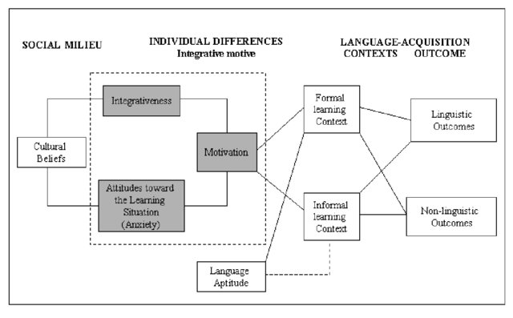
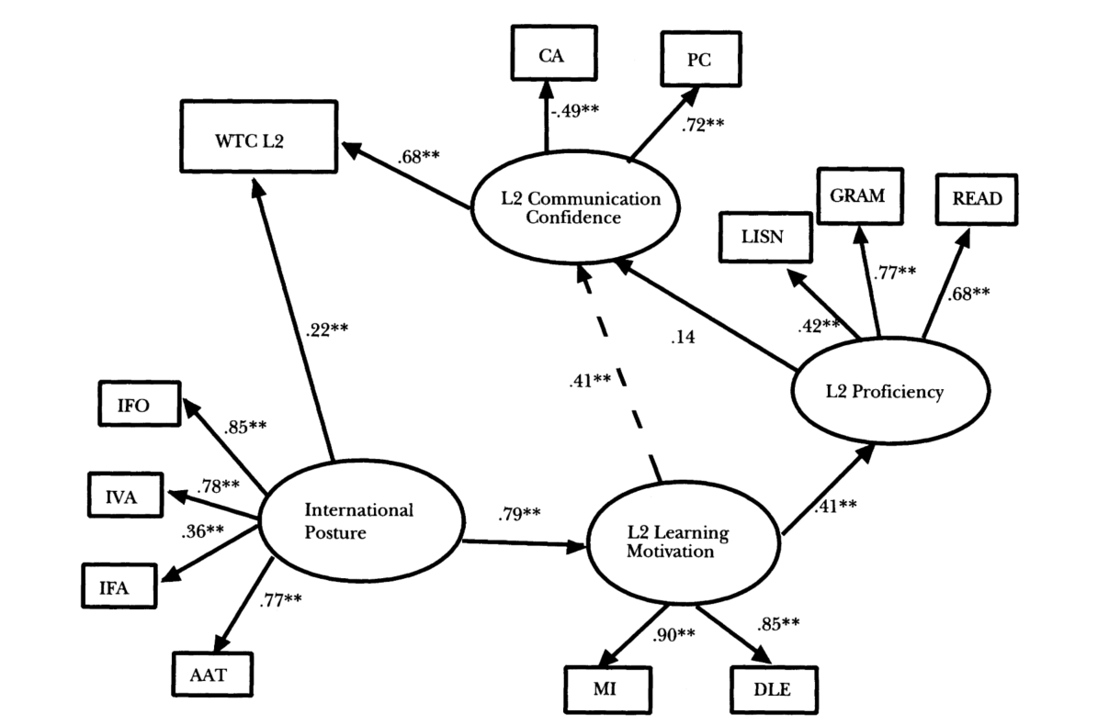
Attitudes in Language Learning Motivation
Specific links of positive attitudes to the international community and motivation
Yashima, 2002
General links of attitude to language learning motivation
Gardner, 1985

Slide 14
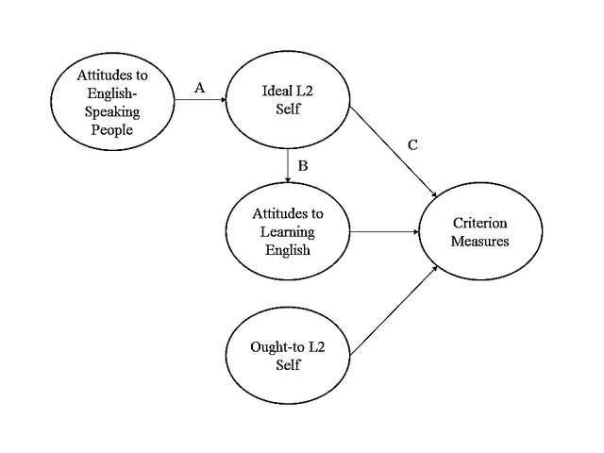
Attitudes in Language Learning Motivation
Positive views of Global Future Selves driving motivation to become this future self
Dörnyei’s L2 Motivational Self System
(Taguchi et al. 2009)

Slide 15
The Planned Intervention

Slide 16
Learning Context
Two joint programmes at mid-high ranking public universities in China
4+0 structure, 1 year Foundation + 3 year BA/BSc
Dual degrees
Sports Science
Arts and Media

Slide 17
The Planned Intervention
Aim
To enable students to develop positive global attitudes through the course of a Foundation year
Attitudes targeted
A positive view of other cultures and openness to different perspectives
A positive view of the global community and their place within it

Slide 18
The Planned Intervention
Intervention Structure
Embedded in two existing Foundation modules
Semester 1 – Developing Academic Skills
Project-based learning exploring intercultural topics whilst developing academic skills
Semester 2 – Professional Communication Skills (ESAP)
Developing ESAP through exploring future global selves

Slide 19
The Planned Intervention
Quasi-experimental
Students will be divided into control and experimental groups
Research Questions
Do students develop more positive views of other cultures and openness to other perspectives?
Do students develop a more positive view of the global community and their role within it?
Is there a correlation between global attitudes and academic motivation

Slide 20
Measuring Global Attitudes
A work in progress!
The focus will be on quantitative surveys, but with additional qualitative elements

Slide 21
Measuring Global Attitudes
Self-report Questionnaires
Students will complete self-report questionnaires at the start of Semester 1, end of Semester 1 and end of Semester 2.
These questionnaires will be developed for the study, but will draw upon the literature of ICC, global competencies, and language learner motivation.
They will cover both attitudes and academic motivation.

Slide 22
Measuring Global Attitudes
Global Future Selves exercises
Students will complete an in-class exercise at the start of Semester 1 and end of Semester 2 to elicit views about their future global selves
Semi-structured Interviews
Interviews of selected students to further explore trends identified in the surveys and in-class exercises

Slide 23
Questions…?

Slide 24
Questions I have!
Am I right to focus on attitudes?
- Is this focus theoretically sound?
Are there any better/alternative measures I could use?
Will such an intervention achieve significant results?
MThurston@uclan.ac.uk

