Slide 1
Internationalisation of the Curriculum: What does it mean for EAP?
Liz Molyneux
PIM Intercultural Communication and English for Academic Purposes
University of Leeds, 17th June 2022

Slide 2

Outline
Internationalisation of the Curriculum: Conceptual framework
Interpreting global, national, regional and institutional contexts
Application to EAP
Internationalisation for all

Slide 3
‘Internationalization of the curriculum is the incorporation of international, intercultural, and/or global dimensions into the content of the curriculum as well as the learning outcomes, assessment tasks, teaching methods, and support services of a program of study.’
(Leask, 2015, p.10)

Slide 4
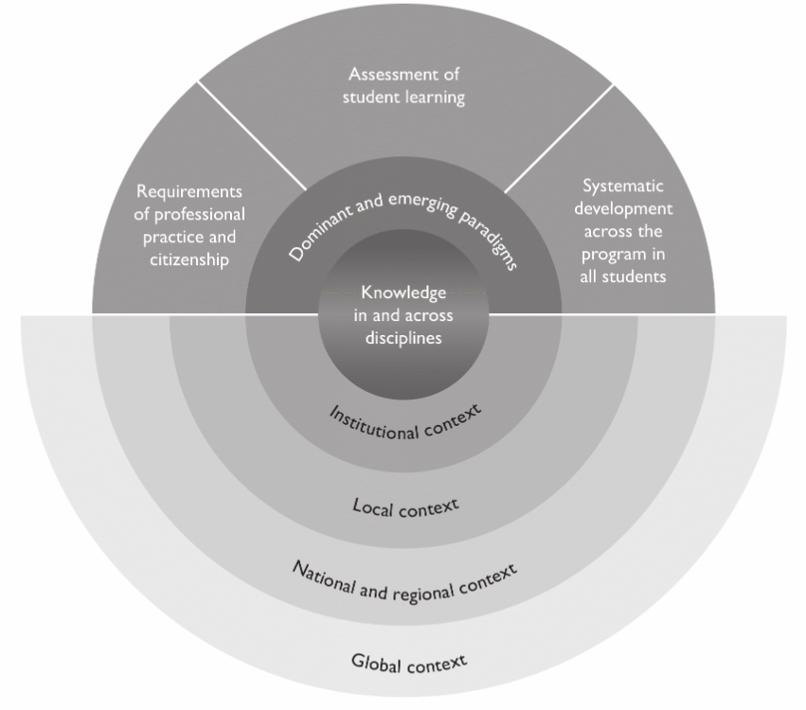
A conceptual framework for IoC
(Leask, 2015, p. 27)

Slide 5






The Global/ National Context
‘[T]he current anti-global, anti-immigration, and inward-looking political climate’ (Knight & de Wit, 2018, p. 3)
Less collaboration, more competition, e.g. for students, funding, rankings, status (de Wit, 2019)
https://www.ft.com/content/e315f100-1de9-42c4-a5a3-8a1245664641
https://www.humanium.org/en/the-millennium-development-goals/
https://quizzclub.com/trivia/when-was-the-single-european-currency-the-euro-introduced/
Johnny Silvercloud/Shutterstock

Slide 6


The National/ Institutional Context
Two competing conceptualisations (Harrison, 2015):
The global worker
Graduates for the global labour market
Cultural intelligence and intercultural competences to transact successfully across boundaries
Individual positionality
The global citizen
Graduates with responsibility and agency to initiate change, e.g. in addressing climate change
Intercultural competence plus tolerance, respect, empathy re. cultural difference
Linking the global to the local
https://careerbright.com/career-self-help/thriving-in-the-global-workplace
https://www.pearson.com/international-schools/british-curriculum/pearson-global-citizenship.html
https://qizzclub.com/trivia/when-was-th-single-european-currency-the-euro-introduced/

Slide 7
The National/ Institutional Context
National context
The benefits of internationalisation for students (Advance HE, 2020):
Widen their horizons and networks and promote learning and future employability in rapidly changing geopolitical contexts
Provide the global knowledge, intercultural skills and global world view needed to critically engage with and assist in addressing global issues (such as inequalities and sustainability), challenging personal beliefs, assumptions, and values, and helping the development of global citizenship
Institutional context
Internationalisation strategy
Mission, vision and values statements
Graduate attributes
https://careerbright.com/career-self-help/thriving-in-the-global-workplace
https://www.pearson.com/international-schools/british-curriculum/pearson-global-citizenship.html
https://qizzclub.com/trivia/when-was-th-single-european-currency-the-euro-introduced/

Slide 8

IoC and EAP - Opportunities
Inclusion of international, intercultural or global dimensions in course content
National and cultural diversity within student body to draw from as a resource
Effective communication skills prioritised – considerations of audience, purpose, context including IC aspects
Attention given to the development of groupwork skills
International experiences/ perspectives of EAP teachers

Slide 9

IoC and EAP – Possible Tensions
Promotion of English language proficiency vs
Avoidance of English language hegemony (Svensson & Wihlborg, 2010)
Introduction to UK academic conventions (e.g. citing, referencing & epistemology) vs
Avoidance of epistemicide (Santos, 2017)
Transition to (and integration with?) UK HE culture vs
Avoidance of assimilation/ subsumption to majority culture (Lewis, 2021)
Illustration by Louise Mézel

Slide 10
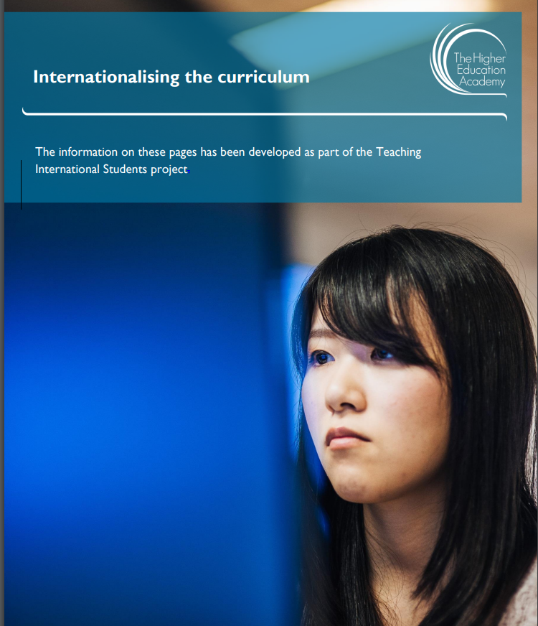
Is internationalisation only for international students?
Beware the deficit narrative framing of the international student (Mittelmeier & Lomer, 2020)
(HEA, 2014)

Slide 11

Internationalisation of the Curriculum at Home
Internationalisation at Home (IAH):
Diversity as a resource; international ≠ intercultural (Harrison, 2015)
International and intercultural learning for all (Leask, Jones & de Wit, 2018):
Move away from reliance on mobility
Links to decolonising the curriculum
Internationalising HE (Advance HE, 2020):
Involves both IoC and IAH
Global learning designed for the whole student cohort
How can EAP support IoCAH?
Multicultural Britain by Fimbis

Slide 12

Conclusion
Internationalisation of the Curriculum: What does it mean for EAP?
What is your context? Consider global, national, regional, institutional
Are you preparing students to be a global worker or a global citizen?
How could you incorporate international and intercultural dimensions in the curriculum (formal, informal and hidden)?
How could you support efforts to internationalise the curriculum for all students?
https://depositphotos.com/stock-photos/the-way-forward.html

Slide 13
References
Advance HE (2020) Essential Frameworks for Enhancing Student Success: Internationalising HE. https://www.advance-he.ac.uk/knowledge-hub/essential-frameworks-enhancing-student-success-internationalising-he
de Wit, H. (2019). Internationalization in higher education, a critical review. SFU Educational Review, 12(3), 9-17. https://doi.org/10.21810/sfuer.v12i3.1036
Harrison, H. (2015). ‘Practice, problems and power in ‘internationalisation at home’: critical reflections on recent evidence’. Teaching in Higher Education, 20 (4), pp. 412-430. https://doi.org/10.1080/13562517.2015.1022147
HEA (The Higher Education Academy) (2014). Internationalising the curriculum. https://www.advance-he.ac.uk/knowledge-hub/internationalising-curriculum
Leask, B. (2015) Internationalizing the Curriculum. New York: Routledge.
Leask, B., Jones, E. & de Wit, H. (2018, Dec 7). Towards inclusive intercultural learning for all. University World News. https://www.universityworldnews.com/post.php?story=20181205093157690
Lewis, L. (2021). Assimilation as ‘false consciousness’: Higher education immigrant students’ acculturation beliefs and experiences. International Journal of Intercultural Relations, 83, 30-42. https://doi.org/10.1016/j.ijintrel.2021.04.012
Lomer, S., & Mittelmeier, J. (2021). Mapping the research on pedagogies with international students in the UK: a systematic literature review. Teaching in Higher Education, 1-21. https://doi.org/10.1080/13562517.2021.1872532
Knight, J., & De Wit, H. (2018). Internationalization of higher education: Past and future. International Higher Education, (95), 2-4. https://doi.org/10.6017/ihe.2018.95.10715
Santos, B. D. S. (2017). Epistemologies of the South: Justice against epistemicide. Alberta law review, 54, 4.
Svensson, L. and Wihlborg, M. (2010) ‘Internationalising the content of higher education: the need for a curriculum perspective’. Higher Education, 60(6), pp.595-613. https://doi.org/10.1007/s10734-010-9318-6

