Slide 1

IOE, UCL’s Faculty of Education and Society
Fostering intercultural competence in and beyond EAP classes in UK higher education Jim McKinley
IOE, UCL’s Faculty of Education and Society, BALEAP PIM Conference, University of Leeds, 17 June 2022

Slide 2





University internationalization strategy - ”diversity”

Slide 3
Internationalization & intercultural communication
Intercultural communication literature is part of the problem (Piller, 2017)
Commodified intercultural training courses often reproduce cultural myths and negative stereotypes.
i.e., They often perpetuate the problems that they purport to solve!

Slide 4
What this means for EAP & intercultural communicative competence
Research gap: Successful intercultural communication is seen as a prerequisite to effective learning in internationalized HE…
  Bringing together students from a range of different cultural backgrounds in UK EAP classes allows for lingua franca encounters, posited as new spaces for communication, where ‘language and culture are created in each instance of communication, and are fluid and unfixed’ (Galloway & Rose, 2015, p. 229).
  But “it is not good enough for a university to simply rely on the organic nature of participation in various communities, and … engagement should be actively promoted at programme design level” (McKinley et al., 2019, p. 16)

Slide 5

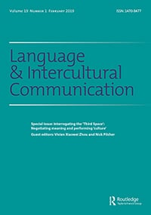
The study (Dunworth et al., 2021; McKinley et al., 2019)
Language and the development of intercultural competence in an ‘internationalised’ university: staff and student perspectives
RQ1: What are students’ and tutors’ perceptions of intercultural competence ? [tensions/issues?]
RQ2: Which current teaching and learning practices inhibit the development of intercultural competence?
RQ3: Which current teaching and learning practices enhance the development of intercultural competence? [resolve tensions/issues?]

Slide 6
Three recommendations (McKinley et al., 2019)
1) to build a wider community through interdisciplinary collaboration in and beyond the classroom;
2) to make objective activities concrete through institutional engagement possibly in the form of extracurricular objectives and required professional development for teaching staff; and
3) to revise curricula to better target transferable skills for students’ future lives.

Slide 7

What this means concerning EAP revised curricula & the ‘wider community’
  EAP students participate in a range of disciplinary events/ workshops across the university
  Diversifies participating student profile
  Allows EAP students to engage in a range of different academic cultures

Slide 8

Concrete activities for EAP student extracurricular objectives & EAP teacher PD
  Students: EAP beyond the EAP classroom?
    Local culture – friends and family… unrealistic?
  Teachers: More required PD?
    Workload issues…
  Nothing concrete!

Slide 9
Highlights from the ‘ten top tips’
Emphasise tension in a space that everyone is comfortable to address.
  Do not attempt to eliminate tensions
  Students and teachers can learn how to deal with tensions so that solutions can be found
  Tensions are in themselves a productive way of learning
  Tensions are expected, but disappointment arises with the expectation that there would be facilities and strategies in place that would address them

Slide 10
Highlights from the ‘ten top tips’ (cont’d)
Reduce choice.
  Lack of choice in classes (e.g., in forming groups) may be positive as a variety of practices within the classroom is beneficial.

Slide 11
Highlights from the ‘ten top tips’ (cont’d)
Make content relevant to students’ real lives.
  Shift from concept-heavy to ‘real life’ content
  Draw on students’ expertise
  Relate ‘academic’ content to professional requirements
  Openly identify and consciously address tensions

Slide 12
Highlights from the ‘ten top tips’ (cont’d)
Acknowledge stereotypes and discuss them.
  Stereotypes and generalisations are unavoidable
  How they are managed and treated illustrates and strengthens intercultural communicative competence

Slide 13
Highlights from the ‘ten top tips’ (cont’d)
Engage directly with culture and intercultural communication.
  Projects like this are helpful in raising awareness of and simply engaging with the topic of cultures and intercultural competence
  Increase focus across the campus to embed EAP-focused intercultural communication within the university structures to promote discussion, debate, pedagogy and curriculum
  ‘Embedded’ intercultural competence should be discussed in forums that include:
    Professional development courses
    Policy documents
    Committee structure
    University promotional material

Slide 14
To conclude
Follow recommendations for developing intercultural competence that allow both EAP students and teachers to co-construct the processes of representation, identity construction and negotiation of meaning.
Recognize that these processes are always going to be open-ended to allow the competences to be sustainable beyond the EAP classroom, and to allow for continued development.

Slide 15
References
Dunworth, K., Grimshaw, T., Iwaniec, J., & McKinley, J. (2021). Language and the development of intercultural competence in an ‘internationalised’ university: staff and student perspectives. Teaching in Higher Education, 26(6), 790-805.
Galloway, N., & Rose, H. (2015). Introducing Global Englishes. Routledge.
McKinley, J., Dunworth, K., Grimshaw, T., & Iwaniec, J. (2019). Developing intercultural competence in a ‘comfortable’ third space: Postgraduate studies in the UK. Language and Intercultural Communication, 19(1), 9-22.
Piller, I. (2017). Intercultural communication: A critical introduction. Edinburgh University Press.

Slide 16
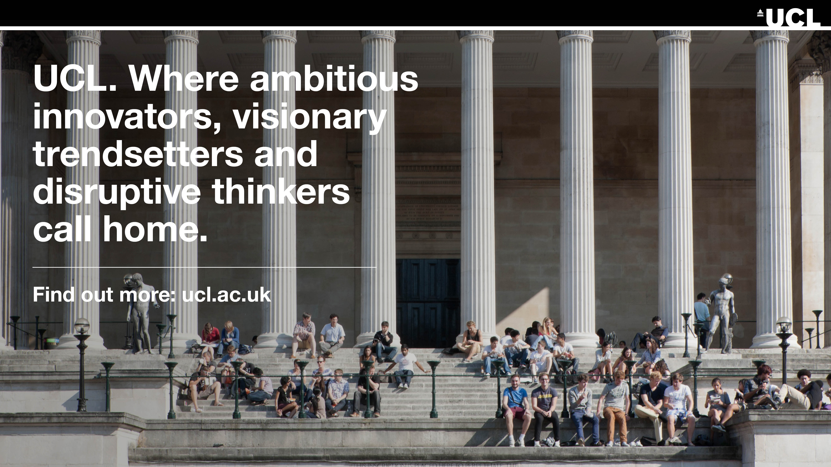
Thank you
Jim McKinley
j.mckinley@ucl.ac.uk

