Slide 1
(Ethical) Considerations When Designing An MA TEAP
Bee Bond and Alex Ding (University of Leeds)

Slide 2
MA TEAP
Cert Modules
Knowledge, Politics and Cultures in Academia
Dip Modules
Text analysis
MA Modules
Portfolio
Participants, Practices and Pedagogies in Academic Communication
Academic Leadership
Principles of curriculum and assessment design
Practitioner Development & Scholarship
Ethics and malpractice in HE
Intercultural Communication in HE
Dissertation

Slide 3
Principles
Knowledge of disciplinary cultures and values; a form of knowledge which is essentially sociological or anthropological.
Knowledge of the epistemological basis of different disciplines; a form of knowledge which is philosophical in nature.
Knowledge of genre and discourse, which is mainly linguistic in nature.
(Ferguson, 1997, p. 85)

Slide 4
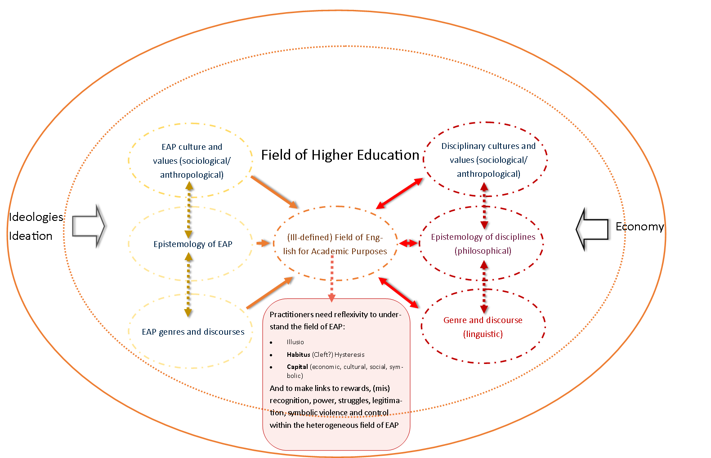
Principles

Slide 5
Ethics/Ethos: The Real And The Ideal
Assimilation
Parochial
Orthodoxy
Experience/authority
Commentary
Marketisation/profit
Practical
University procedures and processes
UK-centric
Employability
Generalist
Digital ideologies/practices
Coherence
Transformation
Global
Heterodoxy
Scholarship
Critique
Access
Theoretical
Subverting rules
Decolonisation
Academic integrity
Specialist
(Pedagogical) Principles
Collaboration

