Slide 1
An ecological approach to teacher development Maxine Gillway and Lisa Hanson BALEAP PIM Sheffield Nov 2022

Slide 2
Beliefs in different contexts
Teacher cognition ‘an often tacit, personally-held, practical system of mental constructs held by teachers and which are dynamic – that is defined and refined on the basis of educational and professional experiences throughout teachers’ lives’ (Borg, 2006, p. 40).

Slide 3
Beliefs are
a strong influence on teacher behaviour
(Brown, Harris and Harnett, 2012)
a filter through which new phenomenon are interpreted (Van den Bergh, Ros and Beijaard, 2014)
instrumental in defining tasks and decision making (Basturkmen, 2012)
often unconscious operators (Borg, 2006)
resistant to change
(Evans, 2013)
a limit to development (Gamlem, 2015)
held in multiple systems or clusters which may conflict with each other (Buehl and Beck, 2015)
dynamic, situated and emergent in line with socio-constructivist views of education in general (Skott, 2015)
a key factor in student engagement
(Price, Handley and Millar, 2011)

Slide 4
Surfacing our beliefs
4-word pedagogies
Help others help themselves
Let go, create opportunities

Slide 5
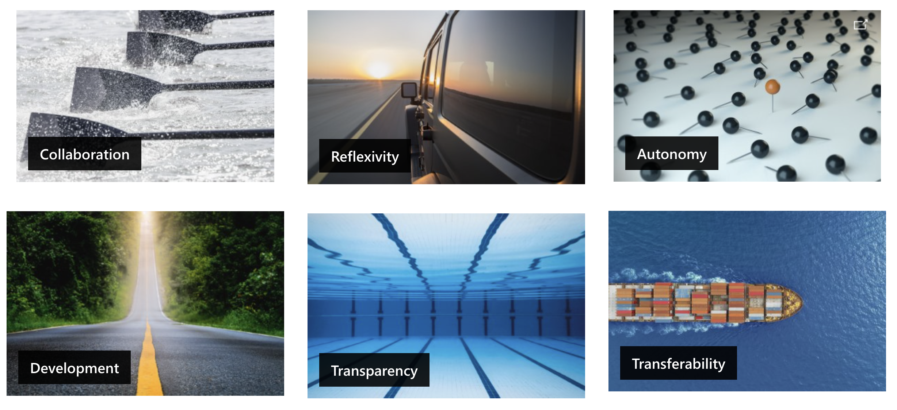
Context: The Centre’s Principles
Notes:
We ask people to hook their 4-word pedagogies to the Centre principles (which were being developed in away days back in 2014-16 when we first started looking at 4-word pedagogies) emphasising the why
Hopefully you will see these evidenced in Lisa's part of the presentation

Slide 6
Context: The Centre’s Vision
Our vision
To be a cutting-edge Centre that works with all individuals to develop their communication in academic contexts.
Developing and sharing expertise
Transforming individuals
Communicating across boundaries
Informing research and research-informed
Putting our principles into practice
Notes:
The other part of our context is the Centre's vision (which came after the principles)

Slide 7
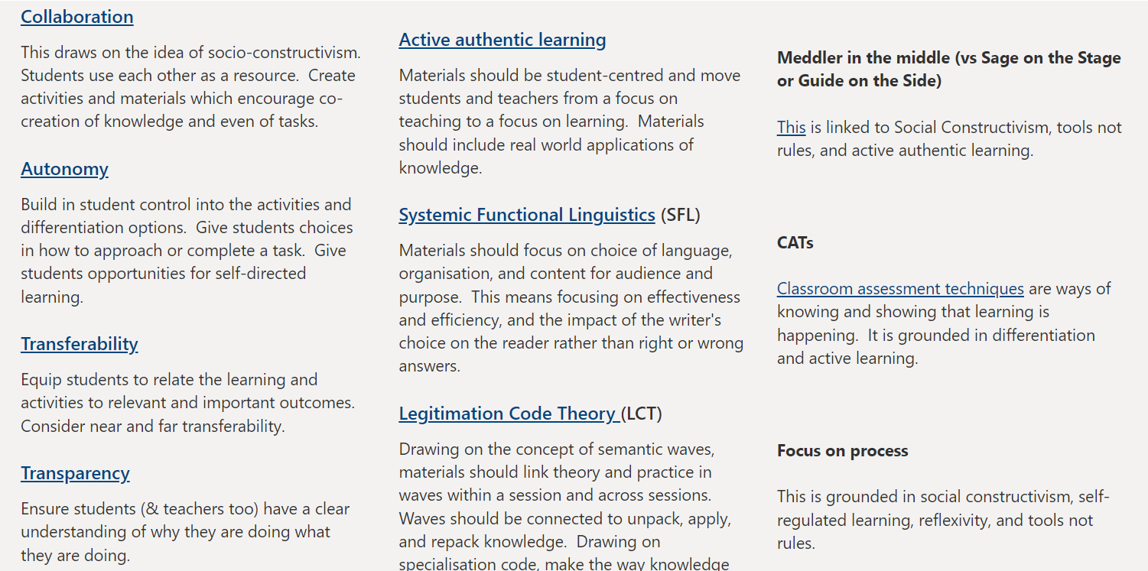
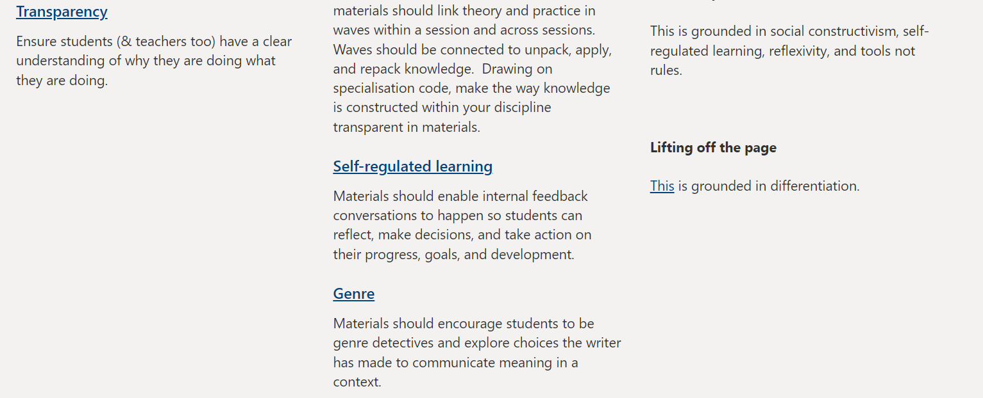
Principled eclecticism
Choice of
activities,
modes,
theories,
time,
strands,
interactions

Slide 8
Strands (coherence)
Special Interest Groups (SIGs)
Teaching with Technology
Staff suggestions & requests – to feed into all strands
Materials Development (& Delivery - 'catch all')
Accreditation
Assessment & Feedback
Scholarship aka Research & Publications
Learning Leadership
Wellbeing

Slide 9
External opportunities
Within the University:
Teaching & Learning
Digital Educaton
HEA Accreditation
Outside the University:
Professional Organisations
Conferences & workshops
Formal courses

Slide 10
Strands (coherence)
Special Interest Groups (SIGs)
Teaching with Technology
Staff suggestions & requests – to feed into all strands
Materials Development (& Delivery - 'catch all')
Accreditation
Assessment & Feedback
Scholarship aka Research & Publications
Learning Leadership
Wellbeing

Slide 11
The CPD “programme” - approach
Autumn term
info gathering & planning stage for the Centre
Runs from Jan-Dec each year
Includes the Pre-sessional (programme & tutors) as well as IFP and Insessional
Autumn term peer observations
Optional Spring term peer observations
Summer observations
Sept Staff Review
SIG (re)formation / evaluation /plan
Jan staff review
check in
May staff review check in
Teaching & Learning Committee, programme reviews, project needs
SIG events

Slide 12
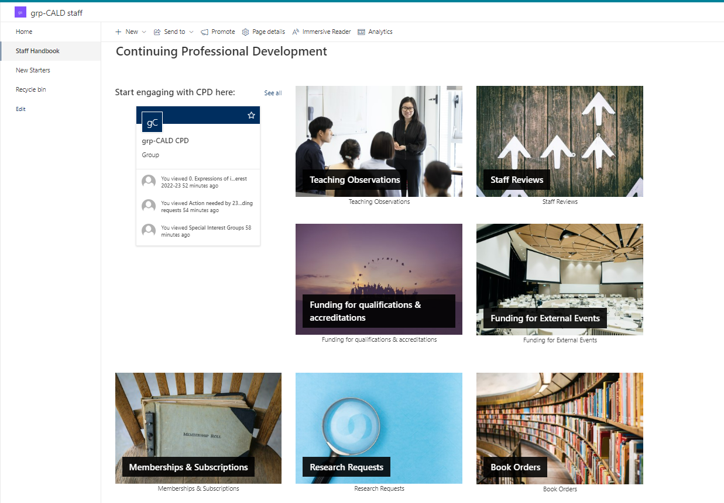
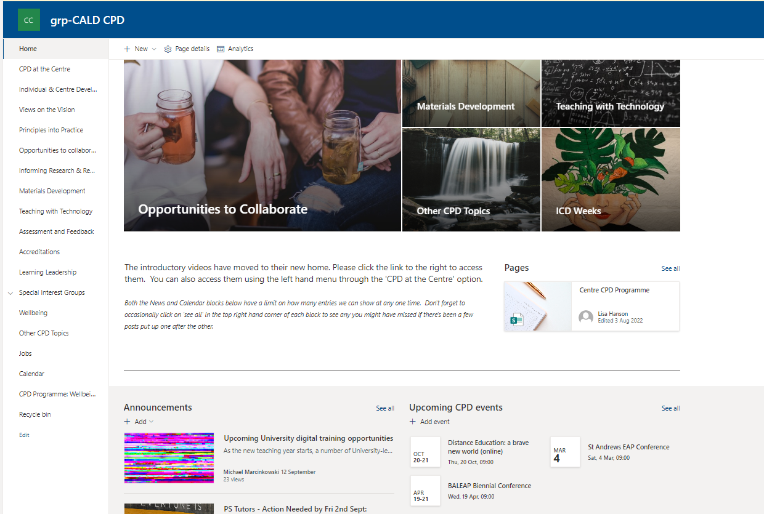
Two main resources

Slide 13
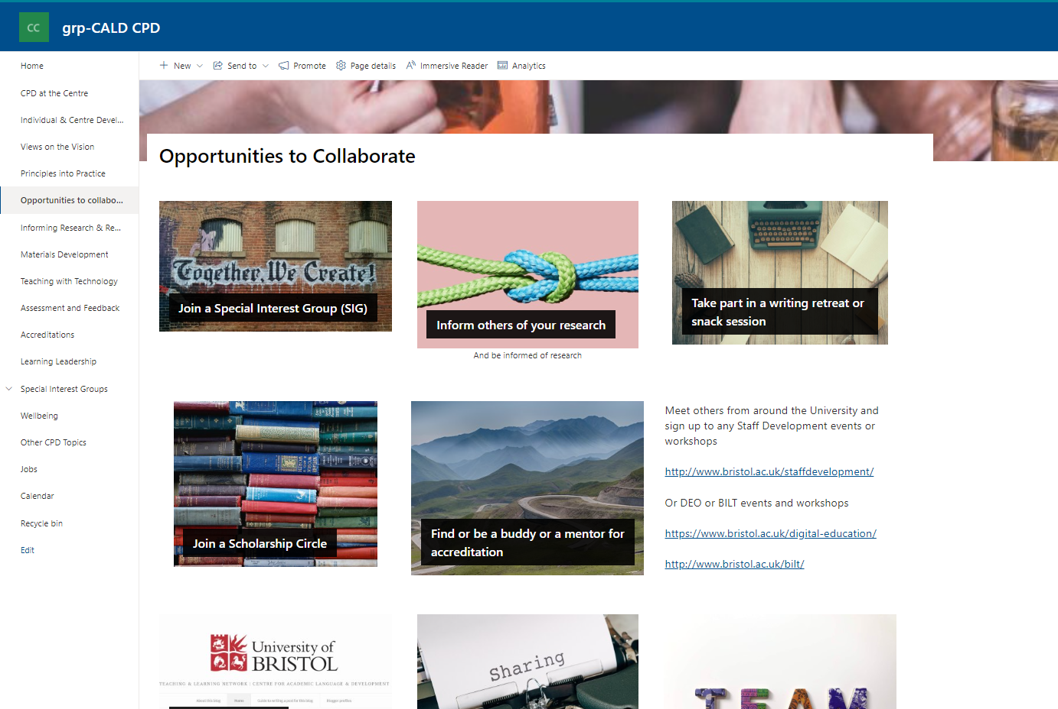
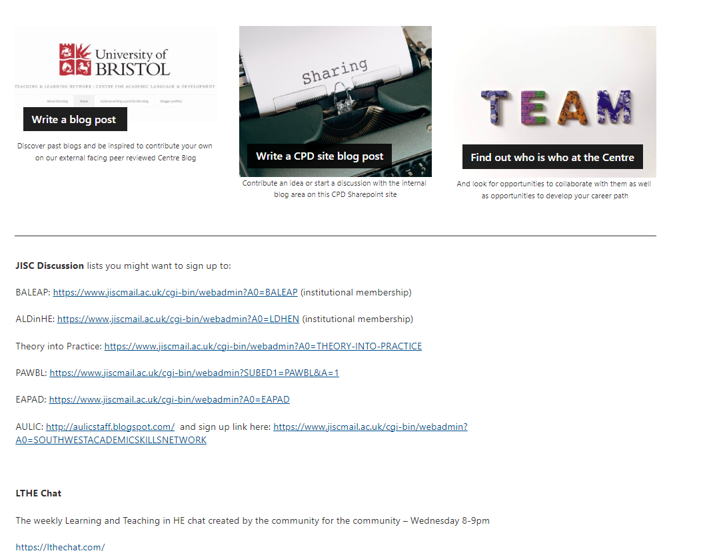

Slide 14
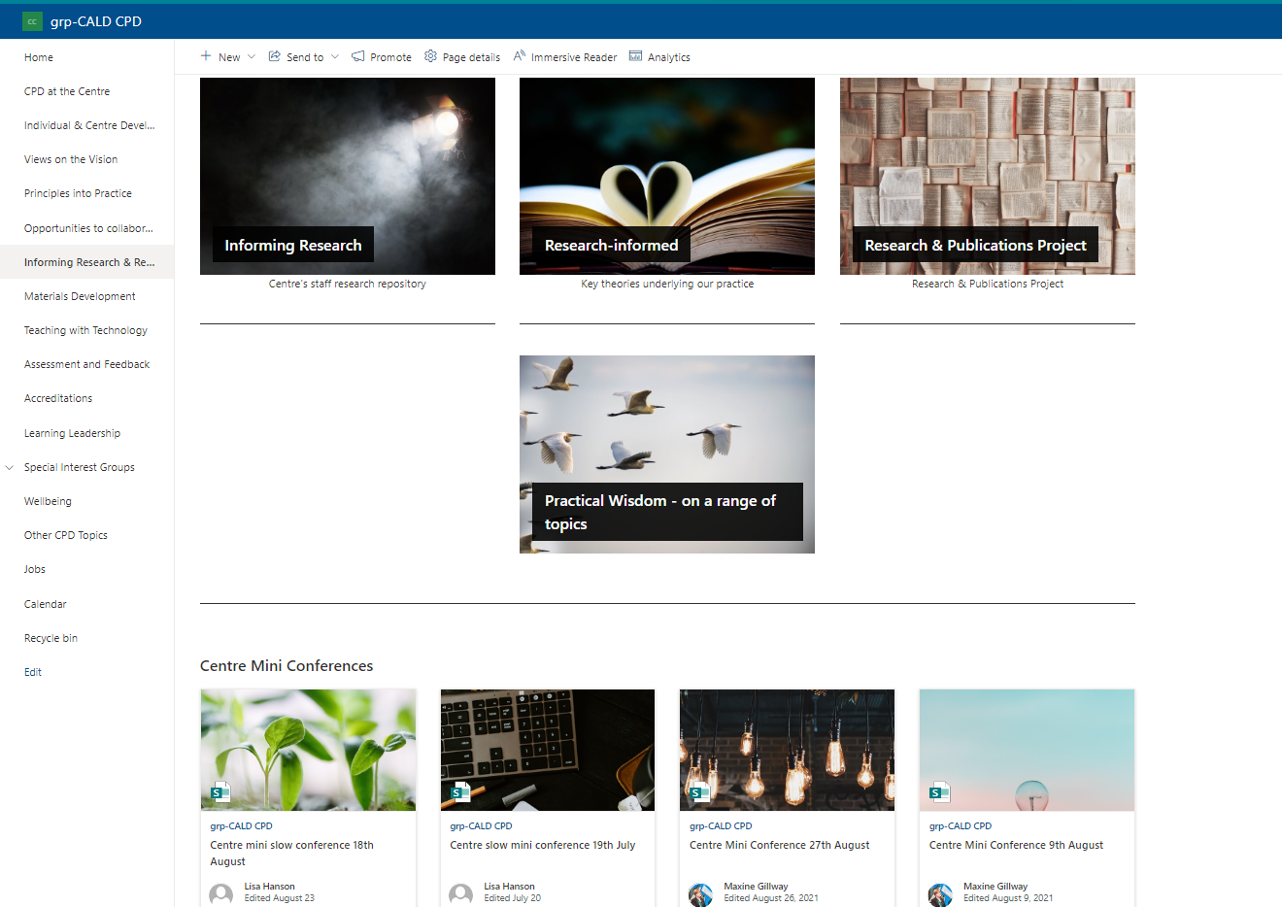
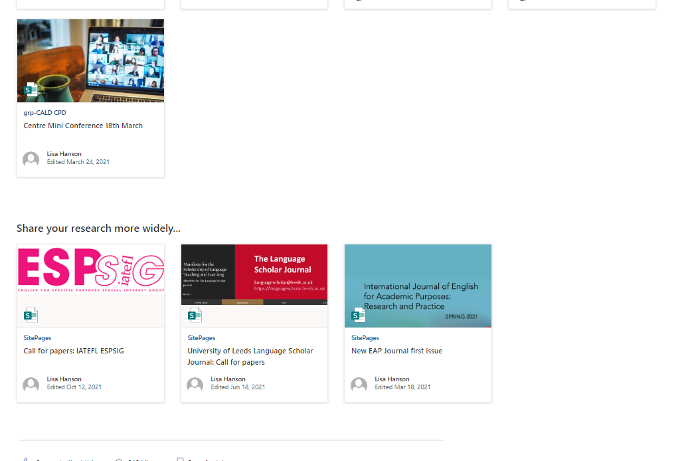

Slide 15
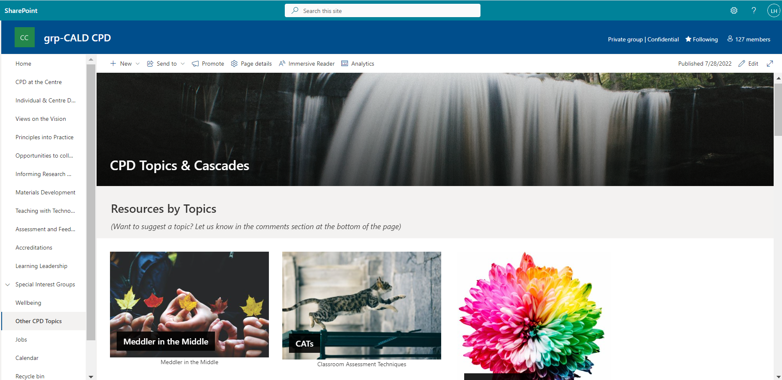
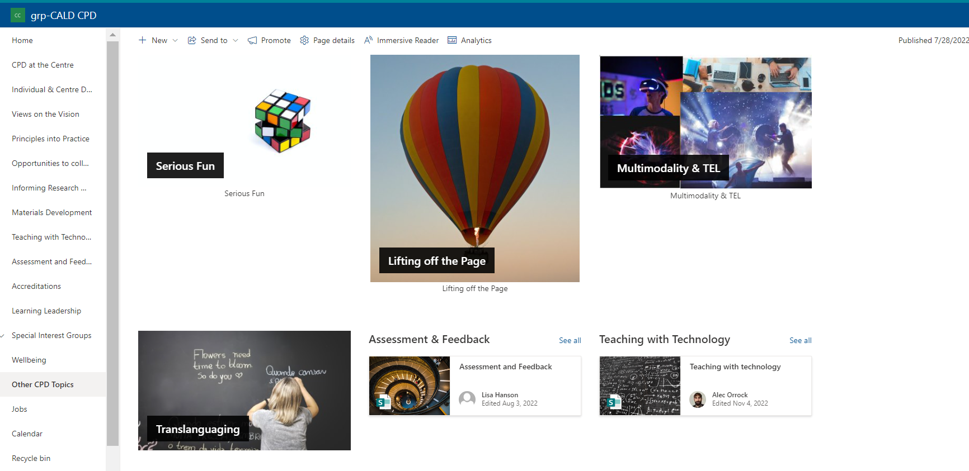

Slide 16
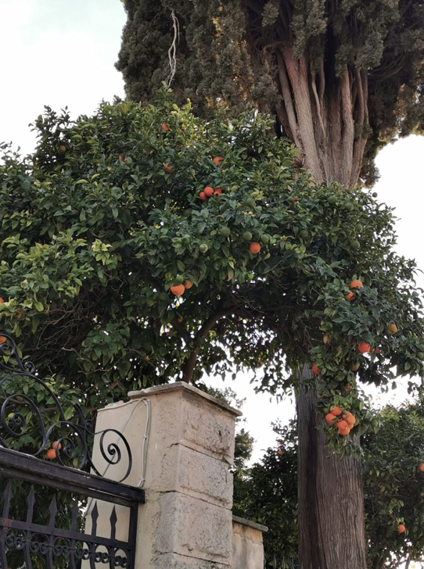
Which best reflects CPD in your institution?

Slide 17
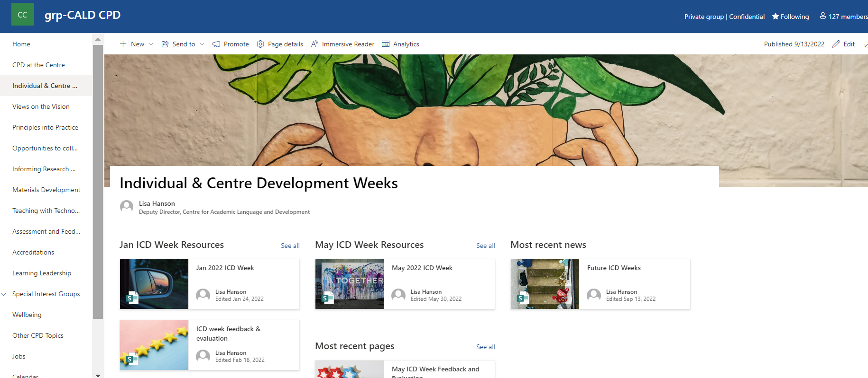

Slide 18
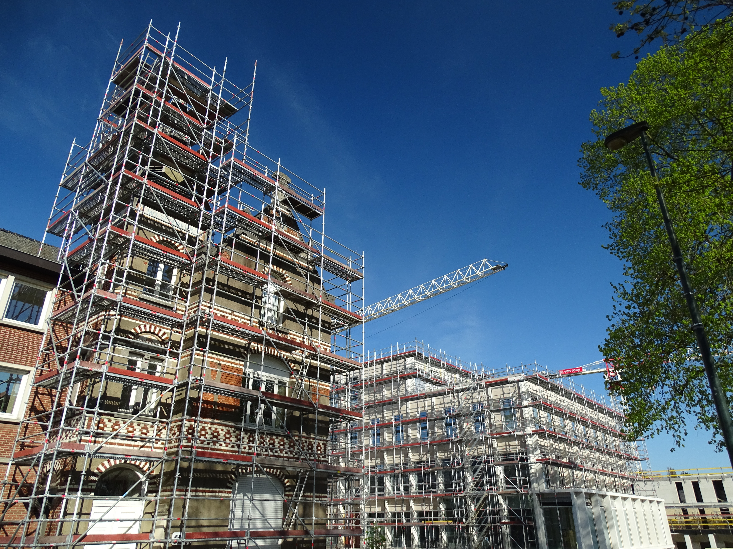

Slide 19
Culture: Incline and Enable
Time: 13/30%
Needs Analysis
ICD weeks
SIGs
Choice
CPD Hub
Facilitators
Inclusive: timing, mode, participation
Financial

Slide 20
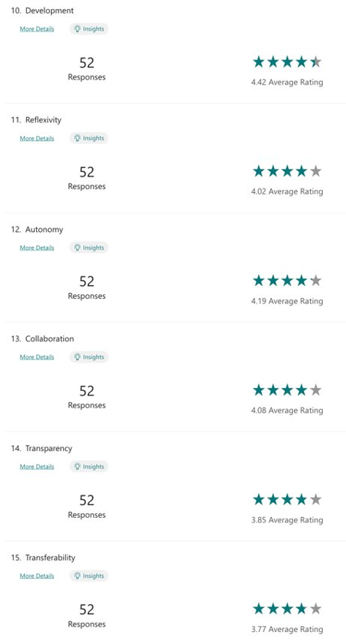
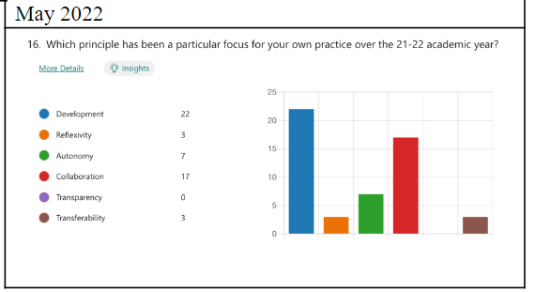
What teachers value

Slide 21
Some questions to ponder/discuss
What are your underlying beliefs?
Can you articulate a 4-word pedagogy?
Is it visible in your practice as an EAP teacher?
Does it transfer to your practice as an EAP Teacher Educator?
Have you come across anything in this session that chimes with/clashes with your underlying beliefs that you would(n't) like to start integrating into your practice?

Slide 22
References
Basturkmen, H. (2012) ‘Review of research into the correspondence between language teachers’ stated beliefs and practices’, System, 40(2), pp. 282–295. doi: 10.1016/j.system.2012.05.001.
Borg, S. (2006) Teacher cognition and language education research and practice. London ; New York, NY: Continuum.
Brown, G. T. L., Harris, L. R. and Harnett, J. (2012) ‘Teacher beliefs about feedback within an assessment for learning environment: Endorsement of improved learning over student well-being’, Teaching and Teacher Education, 28(7), pp. 968–978. doi: 10.1016/j.tate.2012.05.003.
Buehl, M. M. and Beck, J. S. (2015) ‘The Relationship between Teachers’ Beliefs and Teachers’ Practices’, in International Handbook of Research on Teachers’ Beliefs. New York: Routledge, pp. 66–84.
Evans, C. (2013) ‘Making Sense of Assessment Feedback in Higher Education’, Review of Educational Research, 83(1), pp. 70–120. doi: 10.3102/0034654312474350.
Gamlem, S. M. (2015) ‘Feedback to support learning: changes in teachers’ practice and beliefs’, Teacher Development, 19(4), pp. 461–482. doi: 10.1080/13664530.2015.1060254.
Pajares, M. F. (1992) ‘Teachers’ Beliefs and Educational Research: Cleaning up a Messy Construct’, Review of Educational Research, 62(3), pp. 307–332. doi: 10.2307/1170741.
Price, M., Handley, K. and Millar, J. (2011) ‘Feedback: focusing attention on engagement’, Studies in Higher Education, 36(8), pp. 879–896. doi: 10.1080/03075079.2010.483513.
Skott, J. (2015) ‘The promises, problems and prospects of research on teachers’ beliefs’, in International Handbook of Research on Teachers’ Beliefs. New York: Routledge, pp. 13–30.
Van den Bergh, L., Ros, A. and Beijaard, D. (2014) ‘Improving Teacher Feedback During Active Learning: Effects of a Professional Development Program’, American Educational Research Journal, 51(4), pp. 772–809. doi: 10.3102/0002831214531322.

