Slide 1
“We make ‘the grey’ white”:
A critical lens on proofreading services in the UK academic settings
Xuanhong Guo (Grace)
Qiongyue Xu (Alice)

Slide 2
Outline
Introduction
Research background
Methodology
Findings and discussion
Conclusions and pedagogical implications

Slide 3
Introduction: background information
The recruitment of more and more international students at UK universities has resulted in an increasing number of students who need various language support. It is still not sure how much help nonnative student writers should be permitted regarding their assessed written assignments (Harwood, Austin & Macaulay, 2009)
Students’ writing skills in the UK academic context are not satisfactory (Newman, 2007)
Other areas regarding students’ academic writing have been explored, while the area of proofreading services for student writing has not been thoroughly investigated (Harwood, Austin & Macaulay, 2012).

Slide 4
Introduction: background information
One study focusing on proofreading in student writing reveals that in the UK university context, proofreading has been unregulated. Specifically, anyone could claim themselves as a qualified proofreader no matter whether they have relevant qualifications, experience, knowledge, or training. (Harwood, 2019)
For example, Harwood points out that much proofreading is done by institutional outsiders. These outsiders may have little knowledge of university proofreading policies and specifically, the degree to which the institution permits the proofreaders to intervene (Harwood, 2019).
He further claims that such variation in proofreaders’ interventions in student writing raises ethical issues: if proofreaders’ interventions are at different levels, student writers may receive help to different extent. This could affect their final grades of their assessed assignments (Harwood, 2019).

Slide 5
Research gaps and the originality of our study
Research on proofreading services has not gained much attention
Previous studies have not involved more than three different aspects
Our study involves four different perspectives: students, EAP teachers, lecturers and proofreaders
The uniqueness of our student participants: Chinese students as the largest international sub-group which needs further investigation. Within this sub-group, students have different backgrounds regarding EAP learning experience.
The dual role of our EAP teacher and proofreader participants

Slide 6
Definition of proofreading
Definition of proofreading in student writing: “third-party interventions (that entail some level of written alteration) on assessed work in progress” (Harwood, Austin & Macaulay, 2012).
More traditional, restricted definition of proofreading for publication: “a process of identifying typographical, linguistic … or positional errors or omissions” (Society for Editors and Proofreaders 2005, p. 4).
Actually, there are different terms that proofreaders use to introduce their services, such as ‘proofreading’, ‘editing’ and ‘error correction’, though ‘proofreading’ has been the most popular one (Harwood, Austin & Macaulay, 2012).

Slide 7
Review of previous studies
Turner & Scott, 2007; Turner & Scott, 2008; Turner, 2010:
Ethical issues in proofreading services should be solved by the faculty or the university.
The term ‘proofreading’ is not related to changing content or meaning, but not all proofreaders and students are aware of this restriction.
It is challenging for international students to achieve the standards required by lecturers or markers. Some form of collaborative or consultative services or help should be involved.
They even suggest that inappropriate interventions may result in students’ loss of ownership of their own work.

Slide 8
Review of previous studies
BALEAP (lively email exchange) (Harwood, Austin & Macaulay, 2010):
Reservations about the ethics of proofreading:
proofreading “serves to mask deﬁciencies” of students at UK universities while these students are required to communicate proficiently in English.
Students are responsible for identifying and correcting errors in their writing. The predominance of proofreading services may cultivate a “dependency culture”. Student writers may seek “a false sense of security” from these services.
Proofreaders may be “incompetent” or “intervene in an ethically inappropriate manner by altering content” .
Focusing on surface-level problems (grammar and syntax) may give students the impression that these problems are more important than problems at the level of content or argumentation.
In favour of proofreaders:
It is understandable for international students to seek proofreading services if universities ask for linguistically perfect or error-free texts.
Supervisors may offer their help to their students at different levels.
When students are struggling with the language, proofreaders are their only choice for help.
Universities should help their students solve linguistic problems or challenges because they accepted these students onto their programmes.

Slide 9
Review of previous studies
Baty (2006):
reports the case of Sean McGeogh, a politics module leader at Coventry, who owns a business aiming to offer “one-to-one tuition to students and promises to improve their grades”, which has been condemned by university authorities as “inappropriate” and “exploitative”.
McGeogh points out that his business “is a legitimate response to the poor-quality teaching oﬀered by overcrowded and underfunded universities, who leave students ‘to drift’ unsupported in their rush to recruit ever-larger numbers”.

Slide 10
Review of previous studies
Buell & Park (2008) (cited in Harwood, Austin & Macaulay, 2012):
The proofreading system at the European University Institute in Florence:
Aim: the process is formative; students play an active role in reshaping their text
Strategies:
correction is done by hand, so that students cannot accept changes immediately.
Students need to attend a face-to-face tutorial to discuss the tutor’s interventions.
There are guidelines for this tutorial:
(1) clarify any doubts or questions with the correction or problem areas that have emerged in the text;
(2) develop strategies for learning from students’ errors;
(3) provide exercises and/or discuss areas for further language revision;
(4) assist in setting up a plan for the next phase of the writing process (http:// www.eui.eu/LINGUE/Correction%20Service/Guidelines.shtml).

Slide 11
Review of previous studies
McNally & Kooyman (2017):
One service provided by Academic Language and Learning (ALL) institutions across Australia is “allowing students with low levels of written proficiency to ask for feedback on theirs drafts of assignments prior to submission”.
“The task of the ALL advisor is to suggest how an assignment could be improved, identify common errors, and highlight weaknesses without materially altering the student’s work”.
“It is important that proofreading as a type of support is not viewed as heretical, but as a valid pedagogical offering supported by clear institutional agreement on what constitutes acceptable proofreading”.

Slide 12
Methodology
Semi-structured interview
Interview participants:
6 students, 5 lecturers/EAP teachers, 3 proofreaders

Slide 13
Participants
Profiles of interviewees
Student | Postgraduate major | Undergraduate background | EAP training experience
Student 1 | TESOL | Undergraduate of an ordinary university | No
Student 2 | Gender | Undergraduate students of Sino British Joint Universities | Yes, in undergraduate
Student 3 | Literature | Undergraduate students of Sino British Joint Universities | Yes, in undergraduate
Student 4 | TESOL | Undergraduate of an ordinary university | Yes, in pre-sessional course
Student 5 | Human resources | Undergraduate students of Sino British Joint Universities | Yes, in undergraduate
Student 6 | TESOL | Undergraduate of an ordinary university | No, but worked as an IELTS teacher for six years in Shanghai

Slide 14
Teacher | Job | Work experience | Proofreading experience
Teacher 1 | Linguistics professor | Supervisor for PhD and masters students | Has done some for her PhD students
Teacher 2 | EAP teacher | Lead the in-sessional course and one to on consultations; Supervisor for masters students | Never, only provide proofreader lists if students ask
Teacher 3 | Lecturer in MA TESOL | Supervisor for masters students | Have done proofreading services, not limited in the academy, but also in the area of copy-editing
Teacher 4 | Lecturer in MA TESOL | Leader of pre-sessional course | Did it once
Teacher 5 | Lecturer in MA AL and TESOL | worked as an EAP teacher; Supervisor for PhD and masters students | Never, but suggested once
Proofreader | Proofreading experience | Previous work experience | Qualification | Contact method
Proofreader 1 | 5 years | Pre-sessional teacher at UK universities; English teacher in different countries; IELTS examiner | Master degrees in linguistics-related fields; studied at a PhD level but has not finished it | Advertisement at University
Proofreader 2 | 5 years | Former university teacher | Get a proofreader qualification; run workshops for proofreaders and universities | On the proofreader list that Durham University provides
Proofreader 3 | More than 20 years | Freelance lecturer; pre-sessional teacher; MBA programmes manager; | Master of Education, PGCE teaching ESL/EFL/Literacy | On the proofreader list that Durham University provides

Slide 15
Findings and discussion (1): definition of proofreading
Matches:
Sentence level correction
Clarity of writing
Advice from the second eye
Mismatches:
Comments on the structure
8 categories of proofreading services (based on Harwood, 2019):
Adding words to the writer’s text;
Removing words;
Replacing shorter stretches of the writer’s text;
Repositioning the writer’s words or sentences;
Replacing longer parts of the writer’s text;
Combining of one or more sentences, or division of longer sentences into shorter ones;
Changes to punctuation, spelling and formatting;
Addressing questions, comments or suggestions to the writer.
Whether proofreader services should be defined as a service that levels up students’ writing proficiency

Slide 16
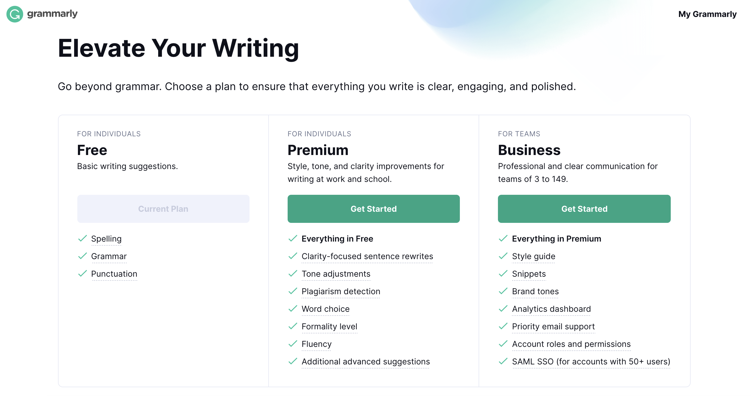
Findings and discussion (1):
Grammarly vs Proofreaders
Proofreaders:
Grammarly with a soul

Slide 17
Findings and discussion (2):
The relationship between ethics and proofreading
Ethical problems of proofreading services come from rewriting and suggestions related to content.
Student participants in our research do not expect proofreaders to comment on their content.
Proofreaders respond differently regarding what they do during proofreading:
Proofreader 1 said, if he found he is specialised in the subject area of students’ writing, he would ask whether the student need him to comment on the content.
Proofreader 3 said, she would alert students if they fail to address the essay question.
It is the proofreader who pushes the limits of proofreading and makes it a grey area and unethical.

Slide 18
Findings and discussion (2):
The relationship between ethics and proofreading:
Different opinions on the academic integrity in the improvement of students’ language after using profreading services:
Students: texts should be understood well by markers. However, most student participants do not realise the relationship between ethics and proofreading services if their language is levelled up by proofreaders.
Two students: Academic integrity depends on the creativity of the content
Proofreaders: opposite opinions on whether proofreaders should level up students’ writing.
Proofreader 3: it is proofreaders’ job
Proofreader 2: proofreaders should not proofread work written by students with low written proficiency
Lecturers: tolerance of students’ language regarding marking criteria:
The language should not impede the understanding of the message
Ethical issues:
Assignments which have been proofread do not reveal students’ language ability
Fairness: it is unfair for students who do not ask for proofreading services

Slide 19
Findings and discussion (2)
The reasons why proofreading emerge and become prominent
Mark or grade pursuit: mismatch between students and lecturers -> lecturers: students want higher marks vs students: do not lose marks
Pressure: from parents or society
Competition: among peers who seek proofreading services

Slide 20
Findings and discussion (2)
Deeper reasons:
Students who got IELTS 6 or 7 are not competent in the areas of English, academic writing and academics
1. University entry requirements ?
IELTS 6 or 7 cannot ensure students to be competent on their programmes
2. University English language support?
One-to-one consultation appointments are not sufficient.
Universities should take more responsibilities

Slide 21
Findings and discussion (3)
EAP teachers/one-to-one consultants vs proofreaders:
Students expect to learn from EAP teachers’/one-to-one consultants’ feedback; students do not trust proofreaders.
Communication between students and EAP teachers/one-to-one consultants is a dialogue; feedback from proofreading is always a monologue
Proofreading works on the writing, which is the product, while English language support works on the writer, which is the person, the student.
Proofreaders as helpers and some students think they can learn from proofreaders

Slide 22
Conclusion
Our current study has conducted interviews to attempt to define proofreading;
Investigate the reasons that cause the emergence and features of proofreading services;
Explore the relationship between proofreading and ethics in academic writing;
Hoping to build foundations for providing some possible solutions in terms of proofreading services.

Slide 23
Specific solutions
Three aspects: School, proofreaders and students
School: policy about the permission of proofreading
A union of proofreading services;
Involve four parties – proofreaders, students, supervisors and regulators;
Proofreading services as a separate department at universities and recruit qualified proofreaders;
Proofreaders and one-to-one consultants can work together to develop students' ability in academic writing
Pre-sessional courses should be open to all candidates as no one is a native of academic writing
One-to-one consultations should have more appointments and more consultants.
EAP teachers should not only teach students norms of academic writing, but also focus on basic English language teaching or specific academic literacy if the students need.

Slide 24
Specific solutions
Proofreaders:
Get proofreading qualifications or join a professional body
EAP teachers can be trained to be proofreaders
Students:
have a clear understanding of proofreading service;
Should be aware of relevant university policies

Slide 25
References
Baty, P. (2006). Lecturer admits role in tutor ﬁrm. Times Higher Education(20 October),
< https://www.timeshighereducation.com/cn/news/lecturer-admits-role-in-tutor-firm/206120.article > Accessed 18.11.21
Buell, M.Z., and S.J. Park. 2008. Positioning expertise: The shared journey of a South Korean and a North American doctoral student. In Learning the literacy practices of graduate school: Insiders’ reflections on academic enculturation, ed. C.P. Casanave and X. Li. Ann Arbor, MI: University of Michigan Press.
Harwood, N., Austin, L., & Macaulay, R. (2009). Proofreading in a UK university: Proofreaders’ beliefs, practices, and experiences. Journal of Second Language Writing, 18(3), 166-190.
Harwood, N., Austin, L., & Macaulay, R. (2010). Ethics and integrity in proofreading: Findings from an interview-based study. English for Specific Purposes, 29(1), 54-67.
Harwood, N., Austin, L., & Macaulay, R. (2012). Cleaner, helper, teacher? The role of proofreaders of student writing. Studies in higher education, 37(5), 569-584.
Harwood, N. (2019). ‘I Have to Hold Myself Back from Getting into All That’: Investigating Ethical Issues Associated with the Proofreading of Student Writing. Journal of Academic Ethics, 17(1), 17-49.
McNally, D., & Kooyman, B. (2017). Drawing the line: views from academic staff and skills advisors on acceptable proofreading with low proficiency writers. Journal of Academic Language & Learning, 11, A-145–A-158.
Newman, M. (2007). ‘Appalling’ writing skills drive tutors to seek help. Times Higher Education(16 March), <http://www.timeshigher-education.co.uk/story.asp?sectioncode=26&storycode=208242> Accessed 18.11.21.
Society for Editors and Proofreaders. 2005. Code of practice. http://www.sfep.org.uk/pdocs/ sfepcop.pdf (accessed 18.11.21).
Scott, M., & Turner, J. (2008). Proofreading: The contemporary backdrop. Paper presented at the 3rd International Santa Barbara Conference on Writing Research, Santa Barbara, CA.
Turner, J., & Scott, M. (2007). English as a lingua franca and the rise of proofreading in the academy. Paper presented at the BALEAP Conference, Durham, UK.
Turner, J. 2010. Supporting Academic Literacy: Issues of Proofreading and Language Proficiency. In: George Blue, ed. Developing Academic Literacy. Bern: Peter Lang, pp. 39-51.

Slide 26
Thank you

