Slide 1
The role of EAP practitioner in a university-wide project to address contract cheating
Walter Nowlan and Martin Seviour

Slide 2
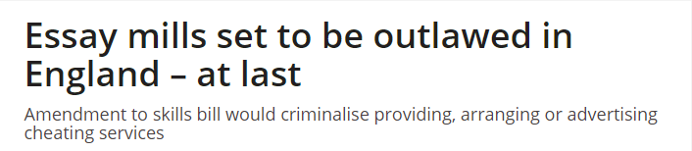
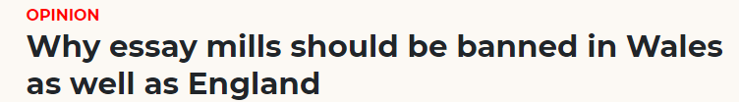
Contract cheating in the news!
McKie, A. 2021. Essay mills set to be outlaws in England – at last. Times Higher Education Supplement [Online]. Available at:https://www.timeshighereducation.com/news/essay-mills-set-be-outlawed-england-last. [Accessed 15 November 2021].
Edwards, H, 2021. Why essay mills should be banned in Wales as well as England. Nation Cymru [Online]. Available at: https://nation.cymru/opinion/why-essay-mills-should-be-banned-in-wales-as-well-as-england/ [Accessed 15 November 2021].
First blood for Australian contract cheating law
Court orders telecommunication companies to take ‘assignment help’ service offline
Ross, J. 2021. First blood for Australian contract cheating law. Times Higher Education Supplement [Online]. Available at:https://www.timeshighereducation.com/news/first-blood-australian-contract-cheating-law [accessed 16 November 2021].

Slide 3
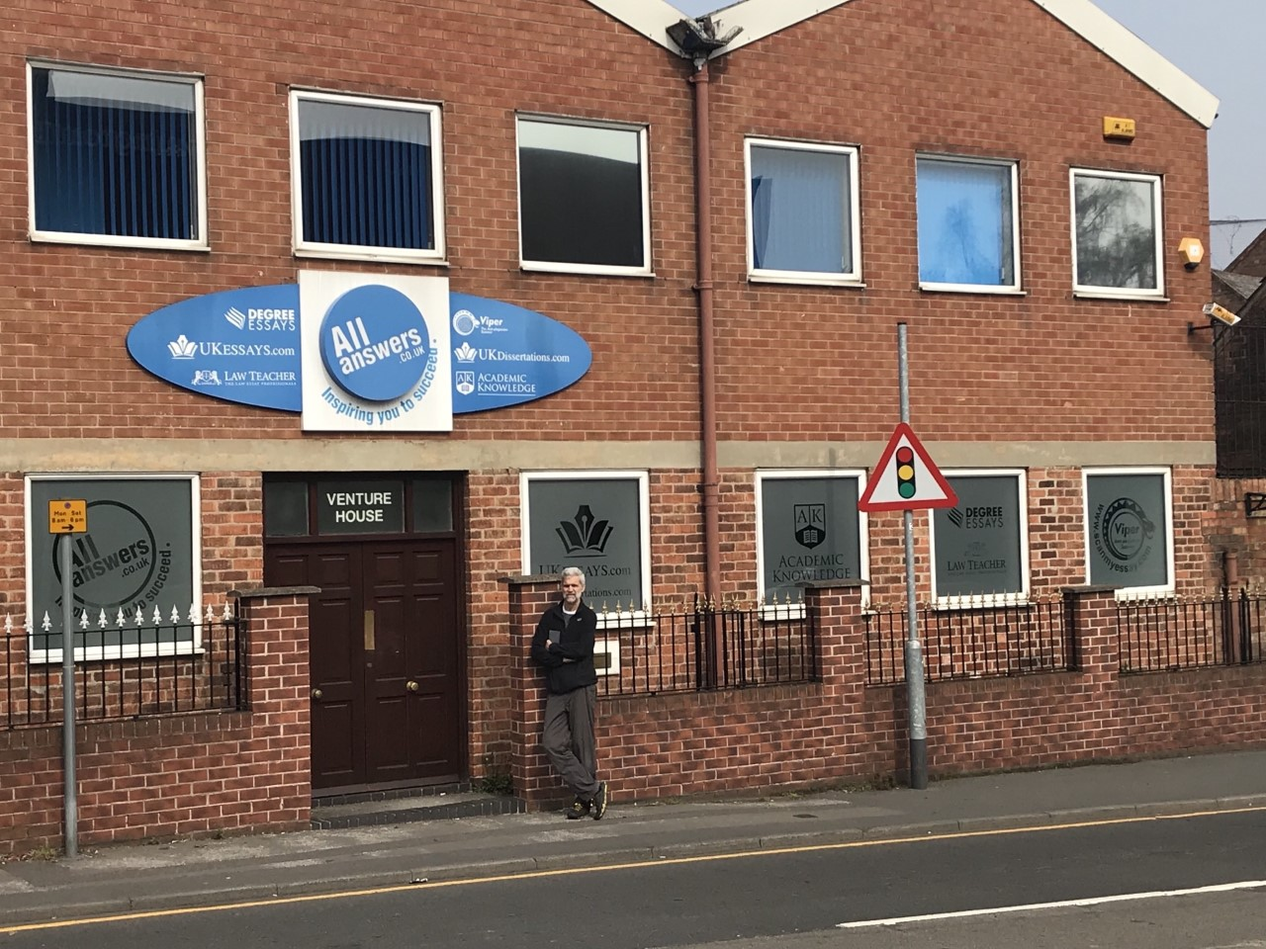
Essay mills don't only exist online!

Slide 4
Legislation may disrupt the contract cheating industry but ….
Scale - 932 contract cheating websites operating in the UK in early 2021 (QAA, 2021)
Worth - £100- £200 million per year (Lancaster, 2016)
Prevalence – around 1% (Newton, 2018), but offenders likely to reoffend (Curtis and Clare, 2017)
Influence of COVID-19 – increased prevalence (Hill et al, 2021)
So, we need to better understand and then address the causes and motivations behind contract cheating behaviour.

Slide 5
The NTU Sabbatical Team
Made up of;
Academics including EAP practitioners
Quality manager
AI panel members
Students Union rep
Library rep

Slide 6
Overview of Sabbatical
STAGE 1 – LITERATURE / CONTEXT REVIEW
STAGE 2 – OUTPUTS
STAGE 3 – DISSEMINATION
STUDENT UNION
Info re: support for students
LIBRARY
Update learning resources to include contract cheating
EAP
Teaching materials for delivery by teaching staff / CERT Mentors
LECTURERS
Guide for staff on preparing for contract cheating panels

Slide 7
Literature Review
Overview: definitions; prevalence, types; contract cheating websites
Predictive variables: demographics; behaviour; theories
Information for staff: prevention and deterrence strategies (including assessment design)
Information for staff: detection and academic integrity panels

Slide 8
Overview
Main types of contract cheating (Lancaster, 2014, see Lancaster and Clarke, 2016: 652):
Essay writing services
Friends, family and other students
Private tutors
Copyediting services
Agency websites (people bid to produce work for students)
Reverse classifieds (students advertise online that they need work creating)
Sharing behaviours (e.g. buying/selling/trading notes, providing assignments) much more prevalent compared to buying essays (Bretag et al., 2018).
Definition: ‘the phenomenon through which students employ or use a third party to undertake their assessed work for them’ (Lancaster & Clarke, 2016: 640)
Choose term carefully - students may not associate informal outsourcing as 'contract cheating’ (Awdry & Ives, 2020).

Slide 9
Who engages in contract cheating?
Students most likely to engage in contract cheating:
Younger students (Harris et al, 2019)
Males (Bretag et al, 2018)
Second language users (Bretag et al, 2018; Bretag et al, 2020; Awdry and Ives, 2020):
  lack of familiarity with UK genres and assessment types (Walker and Townley, 2012)
  more likely to outsource from other students (Awdry and Ives, 2020) and from essay mills if more risk averse (Rigby et al, 2015).

Slide 10
Motivations
Not understanding the topic
Running out of time
Perceived lack of support
Too many assignments / pinch points
Don’t see the purpose / benefit of the task
Don’t want to study the module but it is compulsory
Fear of failure
Wanting a higher grade
(Králíková et al., 2019)

Slide 11
Motivations
Reasons given by students in solicitations for contracted work (Amigud and Lancaster 2019):
Lack of perseverance - giving up as too difficult to finish
Academic aptitude - skills gap; difficulty with task / understanding material; need help
Self-discipline - lack of will power, procrastination, laziness; not able to start work on their own - need collaboration/coaching to get started.
Personal issues – medical problems; tiredness; intoxication.
Competing objectives - inability to prioritise due to no. of subjects studied, family priorities, work obligations.

Slide 12
Who to target and how
Favourable Self Concept (see Rigby et al, 2015, p.15)
Will cheat if there are rewards to be had
PARTIALLY DISHONEST
Will only cheat if rewards outweigh costs and risks and they maintain self-perception
Will not cheat under any circumstances
REMOVE GAINS –
IMPROVE DETECTION
WILL LOOK FOR JUSTIFACTIONS
(e.g. no time, no support, poor teaching)
SAFE – but can enrol as advocates to create culture of integrity
NEED TO CHANGE PERCEPTION OF RISK, REWARD (and effort) to make offending less logical (Baird and Clare, 2017).
CHALLENGE JUSTIFICATIONS

Slide 13
Prevention strategies
Involve students and have strategic touchpoints rather than frontload (QAA, 2020)
Develop a culture of integrity (McCabe et al, 2006, see Ma et al, 2013:172) that focuses more on learning than grades (Heckler & Forde, 2015)
Help students navigate the 'sharing economy' (Bretag et al, 2018:1850)
“A lot of suggestions about preventing contract cheating are resource intensive. More beneficial use of resources to focus on developing good practices in the majority and encourage honesty (rather than focussing all time/energy on the cheats).” (Walker & Townley, 2012:42).
“a failure to address the underlying motivation of students who use paid third parties (or, indeed, who commit any form of academic misconduct) will fundamentally undermine any attempts to deal with it” (Newton & Lang, 2016, see Foltýnek & Králíková, 2018:9).

Slide 14
Games as prevention/teaching tools for AI training
Online games already exist Bradley (2015) Out-dated; deal more with plagiarism and source use; more ‘surface’ learning.
European Network for Academic Integrity (ENAI) – developing game-based materials for university students, but not yet available (see Khan et al, 2021).
Possibility of using competitive quiz platforms (e.g. Kahoot, Mentimeter) to create blended learning opps. (White, 2020). Yes, but perhaps is not the best tool for drawing out nuances.
Any games should be a "vehicle for important conversations about expectations around academic integrity and enrich the socialization process". (White, 2020).

Slide 15
Outputs
3 PARTS – 20 minutes each.
Mythbusting – to challenge false justifications
Scenarios – to elicit behaviours from students; allow students to explore the ethics of contract cheating
Policy for the group – to develop a culture of integrity that comes from the students
Considerations in materials design:
Student-centred
Accessible for any level of study
Easy for any subject lecturer / personal tutor / CERT mentor to deliver

Slide 16
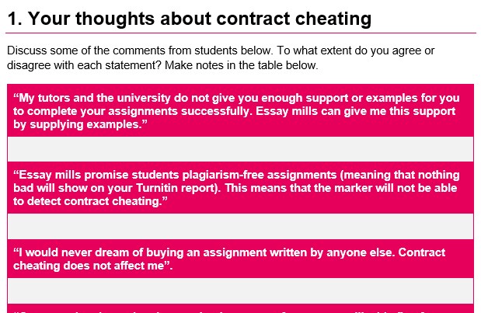
Myth-busting
Students discuss some statements and then compare against a guide

Slide 17
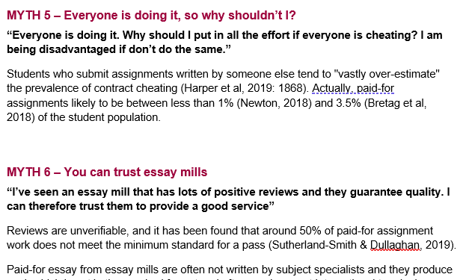
Myth-busting

Slide 18
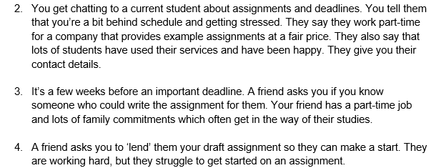
Scenarios

Slide 19
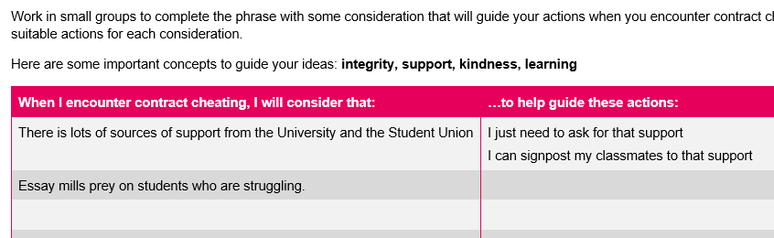
Group Guidelines

Slide 20
Role of EAP practitioners
Let's use our expertise in teaching and researching academic literacy to:
advise on AI policy and procedures
help subject staff integrate academic literacy within their own teaching
argue for embedding ourselves in subject teams
share knowledge and resources through workshops/conferences, AI days, etc.
become involved in AI panels to ensure correct outcomes
lobby for an institution wide approach (e.g. sign theQAA's AI charter!)
https://www.qaa.ac.uk/about-us/what-we-do/academic-integrity/charter

Slide 21
Amigud, A., and Lancaster, T. 2019. “246 Reasons to Cheat: An Analysis of Students’ Reasons for Seeking to Outsource Academic Work.” Computers & Education. 134, pp.98–107. DOI: https://doi.org/10.1016/j.compedu.2019.01.017.
Awdry, R. and Ives, B. 2020. Students cheat more often from those known to them: situation matters more than the individual. Assessment & Evaluation in Higher Education. DOI: https://doi-org.ntu.idm.oclc.org/10.1080/02602938.2020.1851651.
Baird, M., and J. Clare. 2017. “Removing the Opportunity for Contract Cheating in Business Capstones: A Crime Prevention Case Study.” International Journal for Educational Integrity. 13(6):1–15. DOI:10.1007/s40979-017-0018-1.
Bradley E. 2015. Using computer simulations and games to prevent student plagiarism. Journal of Educational Technology Systems 44. pp.240–252. DOI: https://doi.org/10.1177/0047239515617653.
Bretag, T., Harper, R. Burton, M., Ellis, C., Newton, P. and Rozenberg, P. 2018. Contract Cheating: a survey of Australian university students. Studies in Higher Education. 44 (11), pp.1837-1856. https://doi.org/10.1080/03075079.2018.1462788.
Bretag, T et al. 2020. Contract cheating in Australian higher education: a comparison of non-university higher education providers and universities, Assessment & Evaluation in Higher Education, 45 (1), 125-139, DOI: https://doi.org/10.1080/02602938.2019.1614146.
Foltýnek, T., and Králíková, V. 2018. Analysis of the Contract Cheating Market in Czechia. International Journal for Educational Integrity 14(4), 1-15.
Harris, L., Harrison, D., McNally, D. and Ford, F. 2019. Academic Integrity in an Online Culture: Do McCabe’s Findings Hold True for Online, Adult Learners? Journal of Academic Ethics. 18, pp.419-434.
Heckler, N. and Forde, D. 2015. The Role of Cultural Values in Plagiarism in Higher Education. Journal of Academic Ethics. 13 (1), pp.61-75. DOI: https://doi.org/10.1007/s10805-014-9221-3.
Hill, G., Mason, J. & Dunn, A. 2021. Contract cheating: an increasing challenge for global academic community arising from COVID-19. RPTEL 16, 24 DOI: https://doi.org/10.1186/s41039-021-00166-8

Slide 22
Khan, Z.R., Dyer, J., Bjelobaba, S. et al. 2021. Initiating count down - gamification of academic integrity. International Journal for Educational Integrity. 17 (6), pp.1-15. https://doi.org/10.1007/s40979-020-00068-0.
Králíková, V., Foltýnek, T., Dannhoferová, J., Dlabolová, D. and & Turcínek, P. 2019. Global Essay Mills Survey in Czechia: Insights into the Cheater’s Mind. In Towards Consistency and Transparency in Academic Integrity, edited by S. Razı, I. Glendinning and T. Foltýnek (eds.), pp.185-198. Berlin: Peter Lang.
Lancaster, T., and R. Clark. 2016. “Contract Cheating: The Outsourcing of Assessed Student Work.” In Handbook of Academic Integrity, edited by T. Bretag, pp.639–654. Singapore: Springer.
Ma, Y., McCabe, D.L. & Liu, R. 2013. Students’ Academic Cheating in Chinese Universities: Prevalence, Influencing Factors, and Proposed Action. Journal of Academic Ethics. 11, 169–184.
QAA. 2020. Contracting to Cheat in Higher Education: How to Address Essay Mills and Contract Cheating (2nd ed.) [Online]. Available at: https://www.qaa.ac.uk/docs/qaa/guidance/contracting-to-cheat-in-higher-education-2nd-edition.pdf (Date Accessed: 15 November 2021].
Rigby, D., Burton, M., Balcombe, K., Bateman, I. and Mulato, A. 2015. Contract cheating & the market in essays. Journal of Economic Behaviour & Organization. 111, pp.23-37.
Ross, J. 2021. We’ll write for you, plagiarism-free: essay mills’ latest ploy. Times Higher Education Supplement [Online]. 17 November 2021. Available at: https://www.timeshighereducation.com/news/well-write-you-plagiarism-free-essay-mills-latest-ploy [Accessed 17 November 2021].
Walker, M. and Townley, C. 2012. Contract cheating: a new challenge for academic honesty? 2012. Journal of Academic Ethics. 10, pp.27–44. https://doi.org/10.1007/s10805-012-9150-y.
White, A. 2020. Interactive approaches to learning about academic integrity: the role of fun and games. In: Bretag, T (ed) A Research Agenda for Academic Integrity. Edward Elgar Publishing, pp 86–99.

