Slide 1
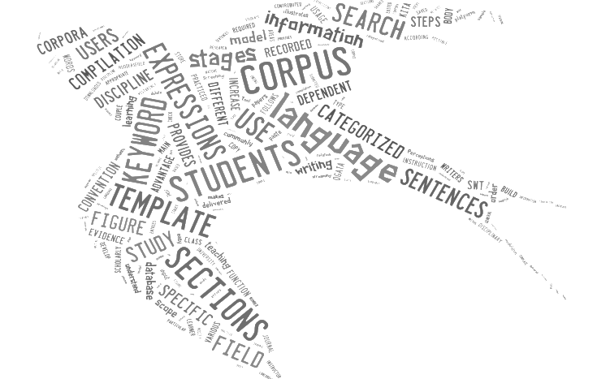

Using corpora in teaching constructing argument and expressing writers’ voice
Tatyana Karpenko-Seccombe
University of Huddersfield

Slide 2


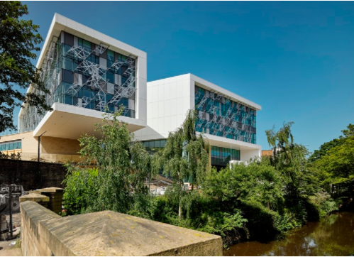
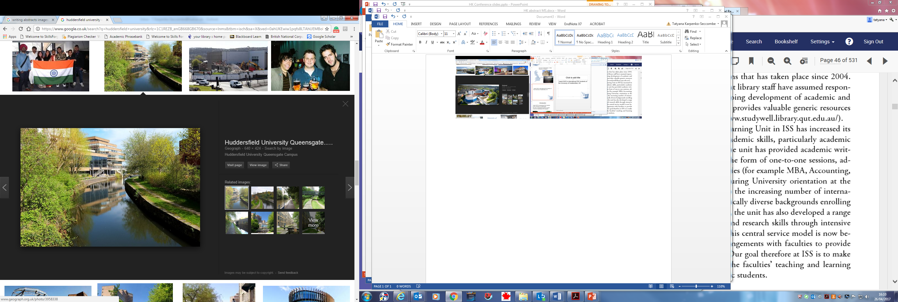
I teach EAP to international PhD students at the University of Huddersfield

Slide 3
Carter & McCarthy’s ‘3 Is’ strategy:
Illustration: examining real data … relative to context and use
Interaction: discourse-sensitive activities which focus on interpersonal uses of language and the negotiation of meanings… through observation and class discussion
Induction: encouraging learners to draw conclusions about the interpersonal functions of different lexicogrammatical options
McCarthy &M. Carter, R. 1995:217.

Slide 4
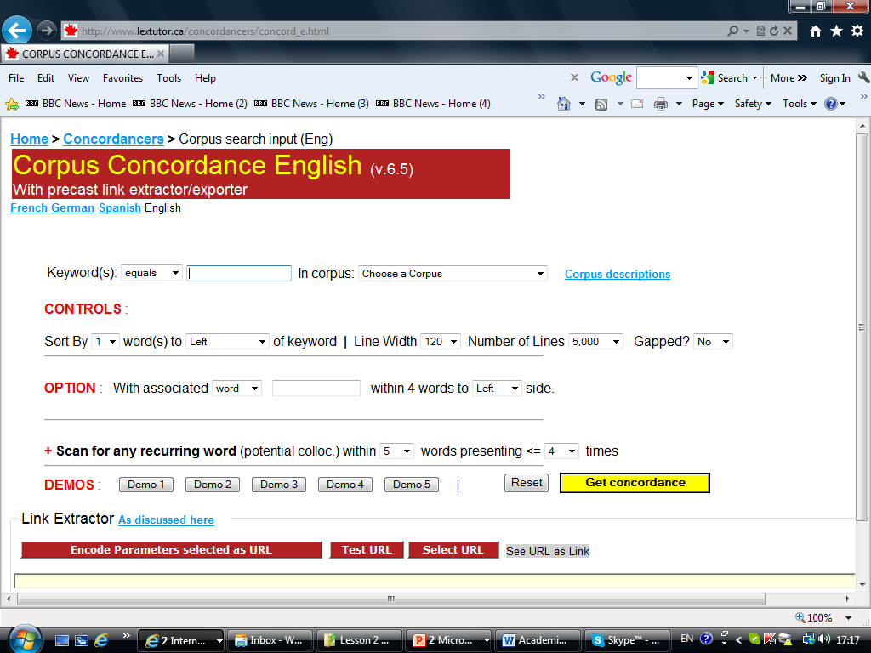
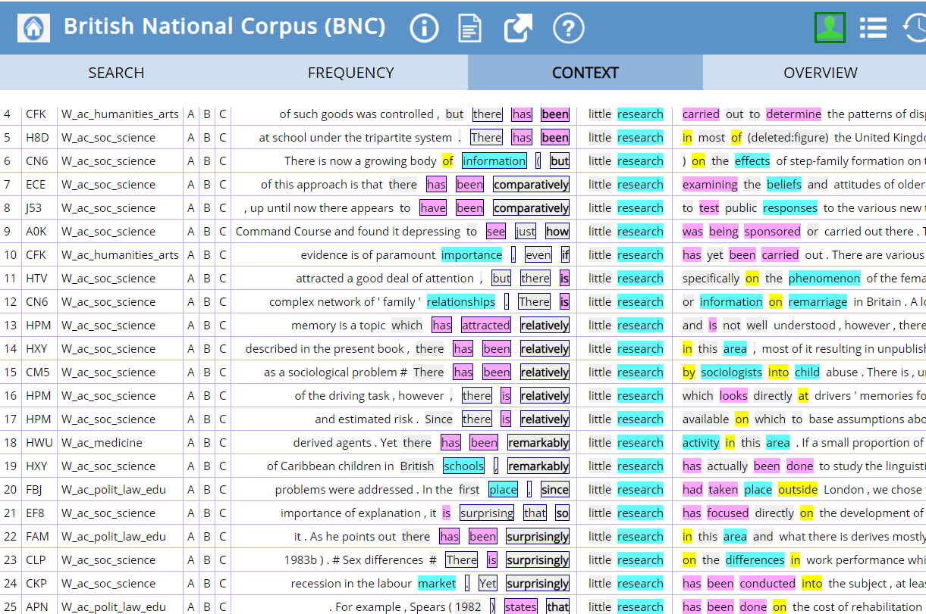
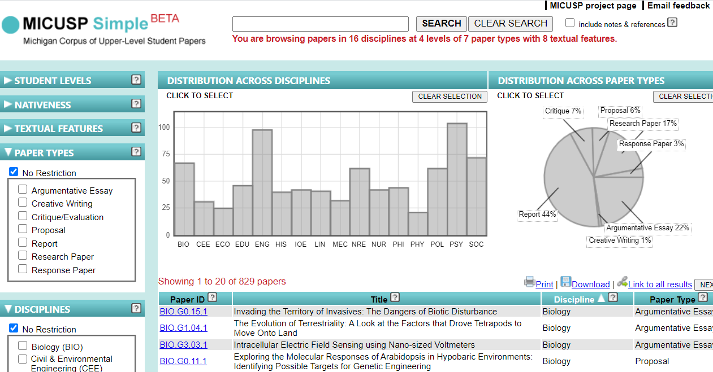
Corpus tools
All of these tools are
free,
open,
easily accessible
and user-friendly

Slide 5
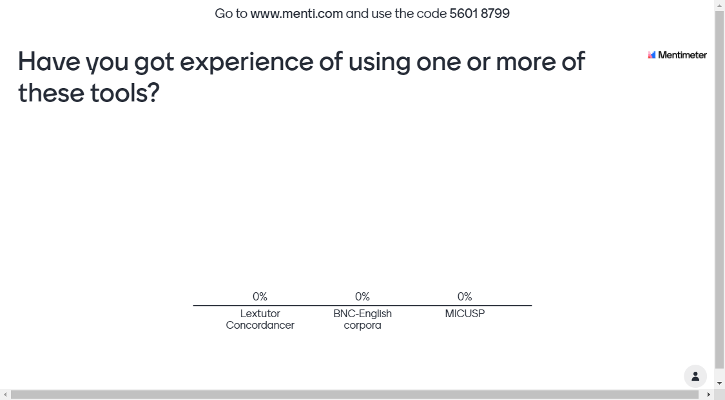

Slide 6
Argumentation
Starting point – establishing importance and identifying a gap or a problem
Presenting the claim
Supporting claims
Argument or problem?
Patterns of counter-argumentation

Slide 7
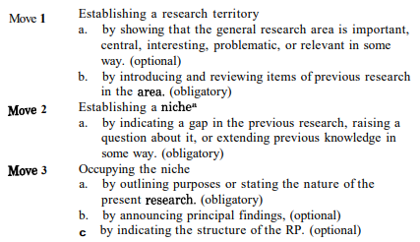
Rhetorical moves in argumentation
Swales, J. M., & Feak, C. B. (2009). Academic writing for graduate students: Essential tasks and skills Ann Arbor, MI: University of Michigan Press, p 244

Slide 8
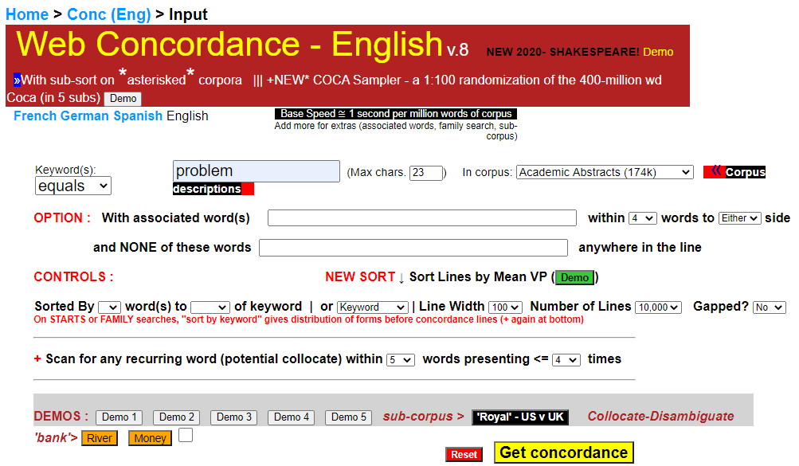
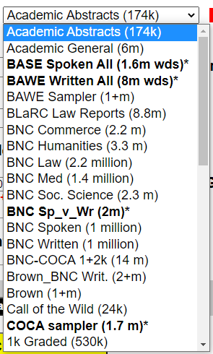
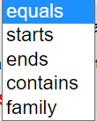

Lextutor: How does it work?
https://lextutor.ca/conc/eng/
Nesi, Gardner, Thompson & Wickens, BAWE British Academic Written English corpus coventry.ac.uk/bawe
Enter the word
Choose a Corpus
Choose the word form
important
Choose right
Lextutor Concordancer is a small part of the Compleat Lexical Tutor, a web-based language resource for data-driven second-language learning, developed by Tom Cobb of the University of Montreal

Slide 9
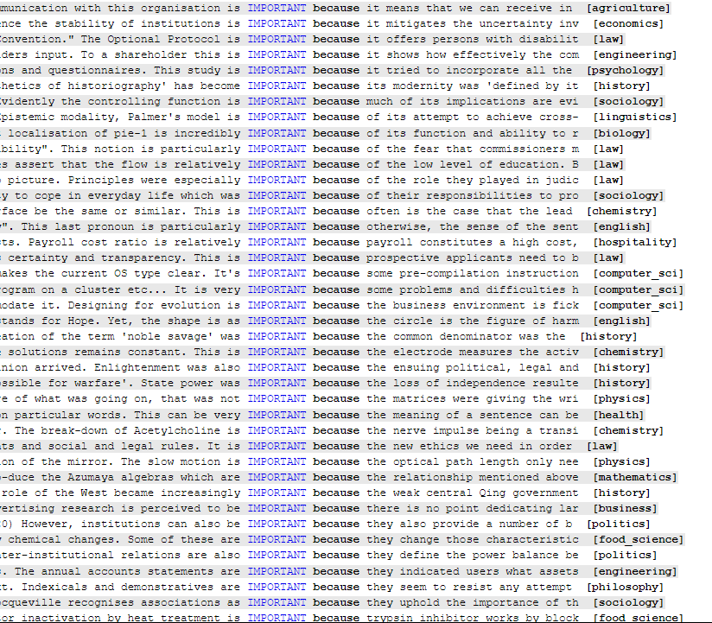
Establishing importance: Supporting claims (Lextutor, BAWE)

Slide 10
Establishing importance: Avoiding overstatements (Lextutor, BAWE)
Enter the word
Choose a Corpus
Choose the word form
the most
Choose left

Slide 11
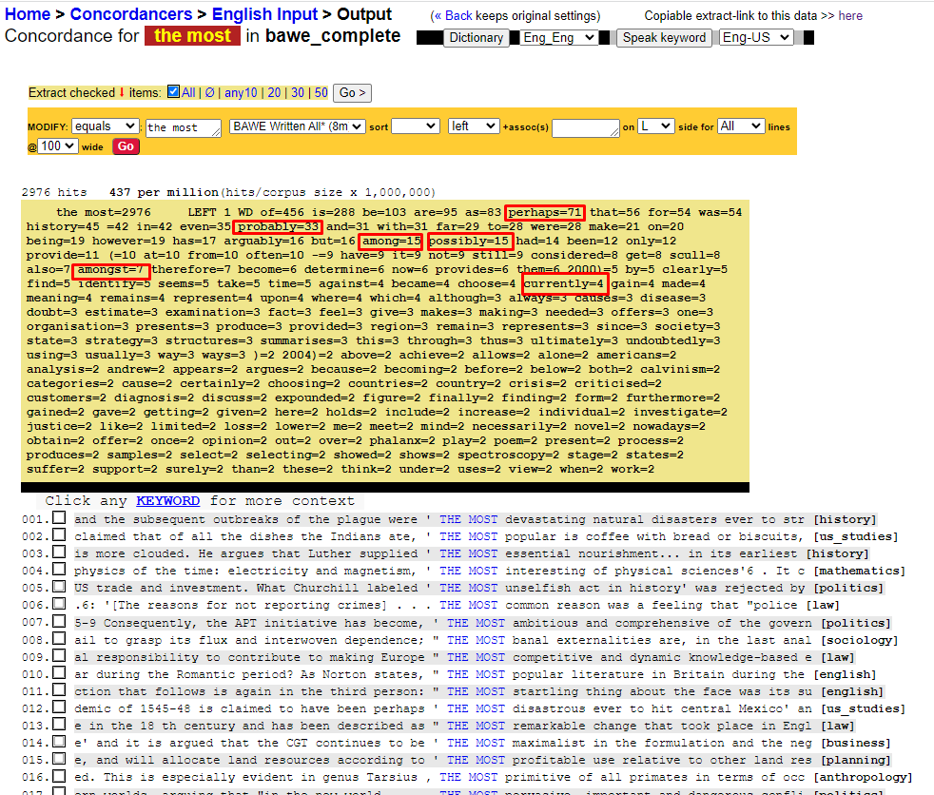
Establishing importance: Avoiding overstatements (Lextutor, BAWE)
perhaps, among, probably, amongst, arguably,
some of the most, one of the most

Slide 12
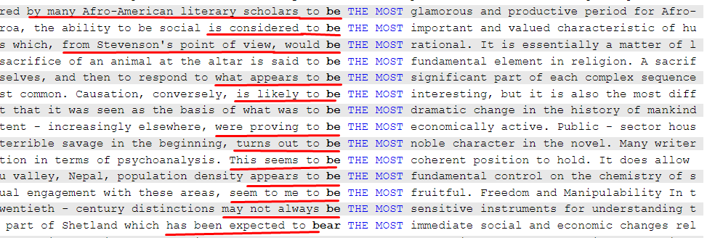
Establishing importance: Avoiding overstatements
Hedging: is considered to be, were proving to be, is likely to be, seems to be, appeared to be + quotes or indirect statements attributed to other authors, e.g. considered by many Afro-American literary scholars to be the most, from Stevenson’s point of view would be the most

Slide 13
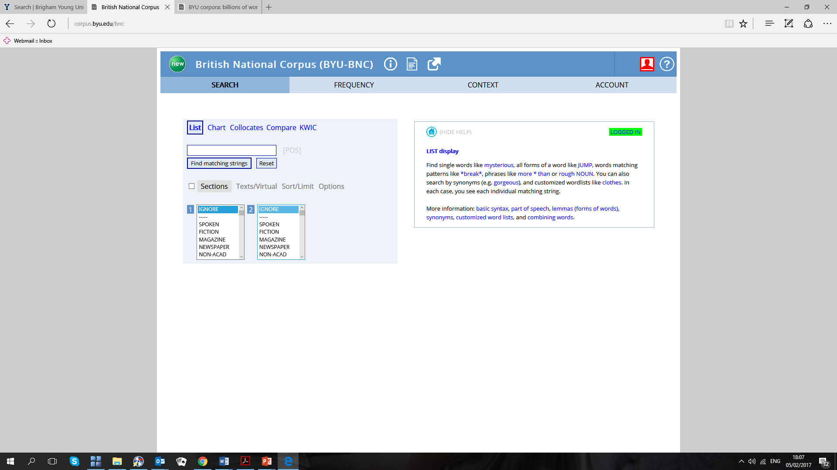
British National Corpus: How does it work? https://www.english-corpora.org/bnc/
The British National Corpus (BNC, Davies, 2004, originally created by Oxford University Press) is a 100 million word corpus of British English texts.
It represents a variety of genres: newspapers, fiction, spoken language. For academic writers the most relevant part is its 15 million word section of academic English.
BYU-BNC is a very rich resource which has a wide variety of functions.

Slide 14
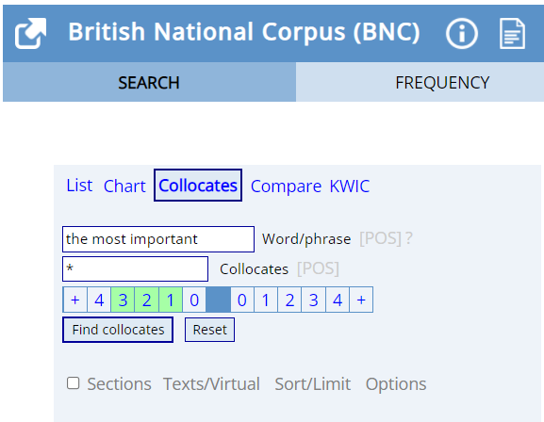
Collocates search of the phrase the most important in BNC-English corpora

Slide 15
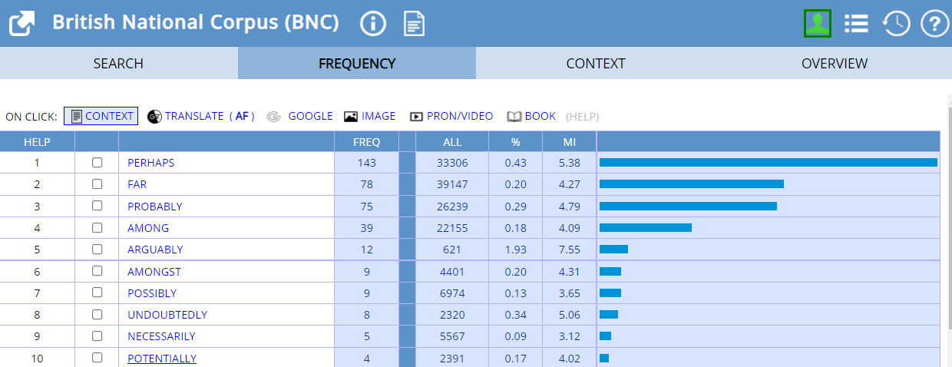
Collocates of the phrase the most important in BNC-English corpora in order of frequency

Slide 16
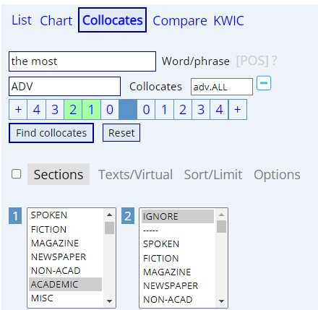
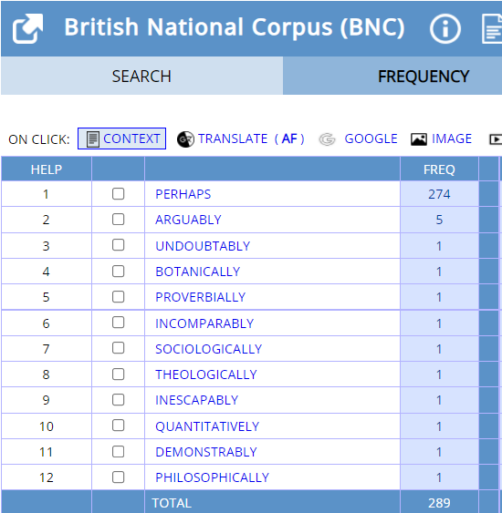
Collocates of the most in BNC in the order of frequency

Slide 17
Rhetorical moves in argumentation
Swales, J. M., & Feak, C. B. (2009). Academic writing for graduate students: Essential tasks and skills Ann Arbor, MI: University of Michigan Press, p 244

Slide 18
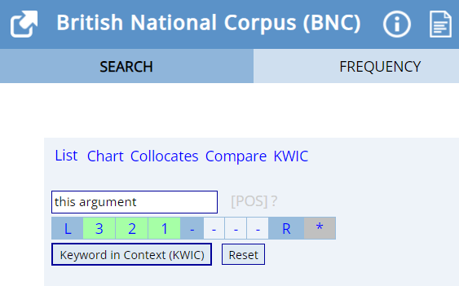
Engaging with other authors’ arguments:
BNC-English corpora, this argument,
KWIC search

Slide 19
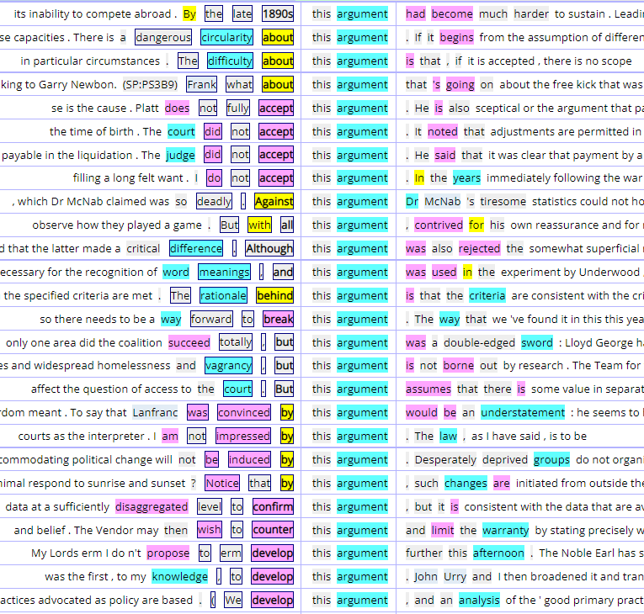
Engaging with other authors’ arguments:
BNC-English corpora, this argument search
There is dangerous circularity about this argument
The difficulty about this argument
Platt doesn’t fully accept this argument
There needs to be a way to break this argument
…was not impressed by this argument
wish to counter this argument
The rationale behind this argument
…was convinced by this argument
…to confirm this argument
We develop this argument
this argument had become much harder to sustain
this argument was rejected
this argument is not borne out by research

Slide 20
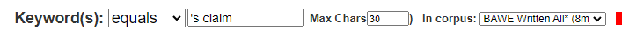
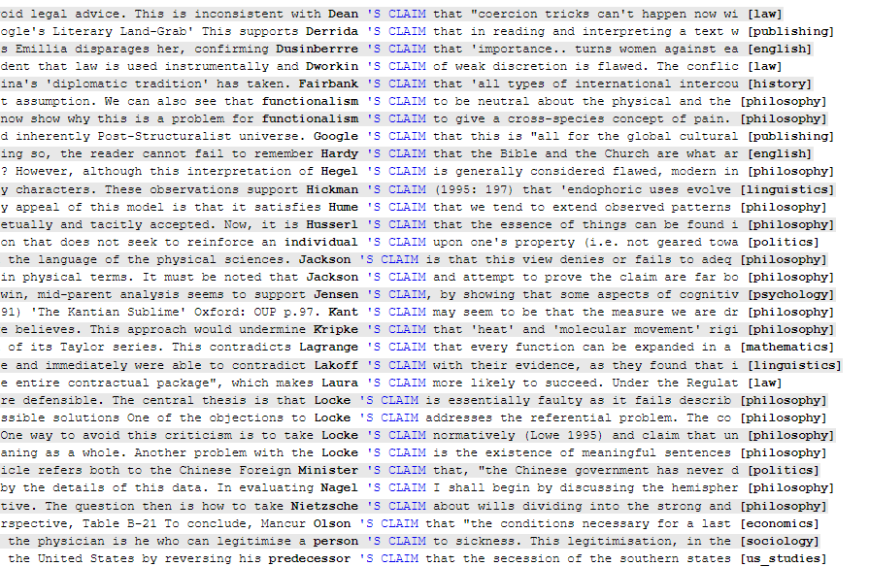
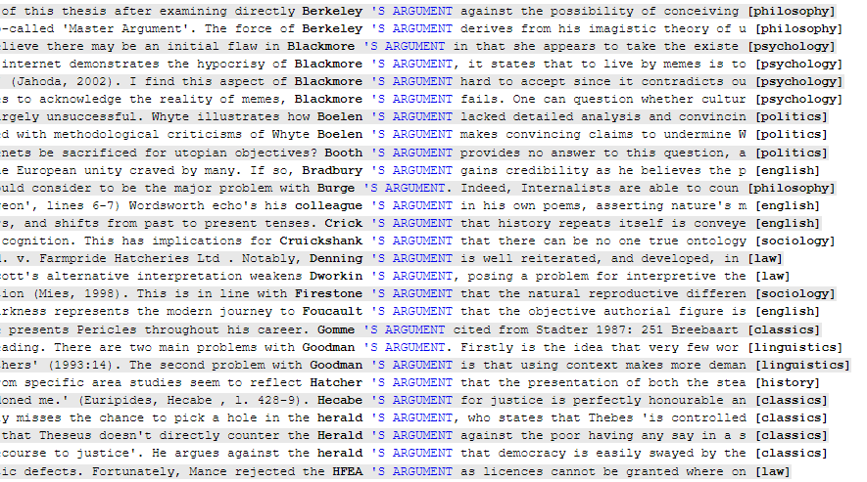
Engaging with other authors’ arguments:
Lextutor ‘s argument, ‘s claim search
Click on a keyword to see extended context

Slide 21
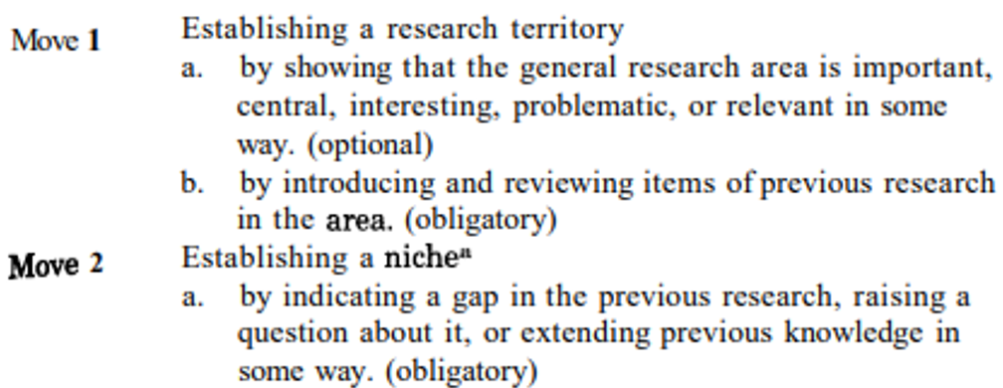
Transition between Move 1 and 2: from stating the importance/presenting previous research to establishing the gap

Slide 22
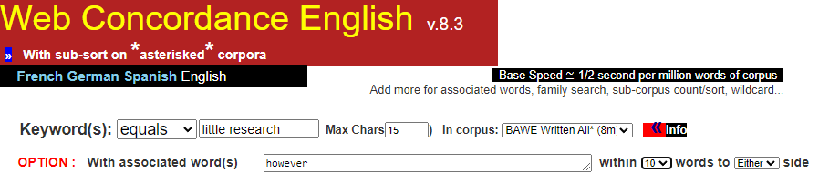
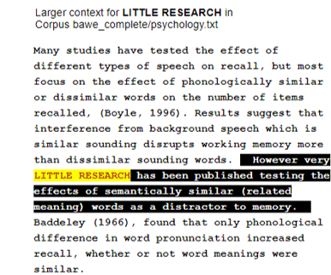
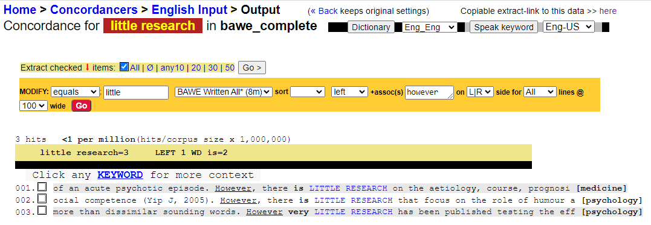
Click on a keyword to see extended context
Many studies have tested the effect of different types of speech on recall, but most focus on the effect of phonologically similar or dissimilar words on the number of items recalled (Boyle, 1996)… However, little research has been published testing the effects of semantically similar words as a distractor to memory.

Slide 23
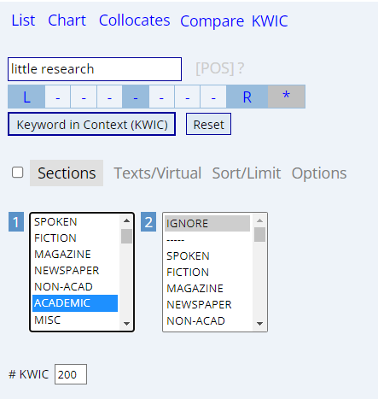
Establishing a niche or identifying a research gap little research: BNC KWIC (key word in context) search

Slide 24
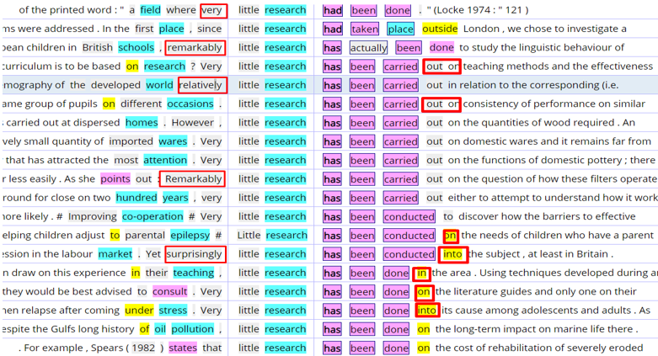
Establishing a niche or identifying a research gap: little research

Slide 25
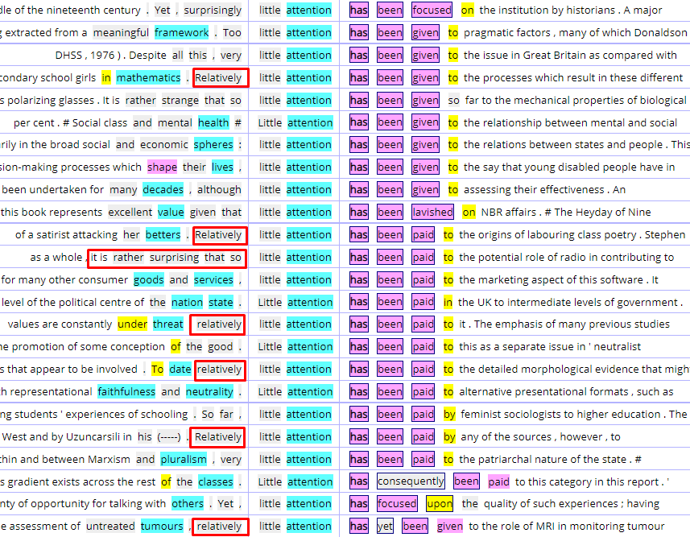
Identifying a research gap: alternative search little attention

Slide 26
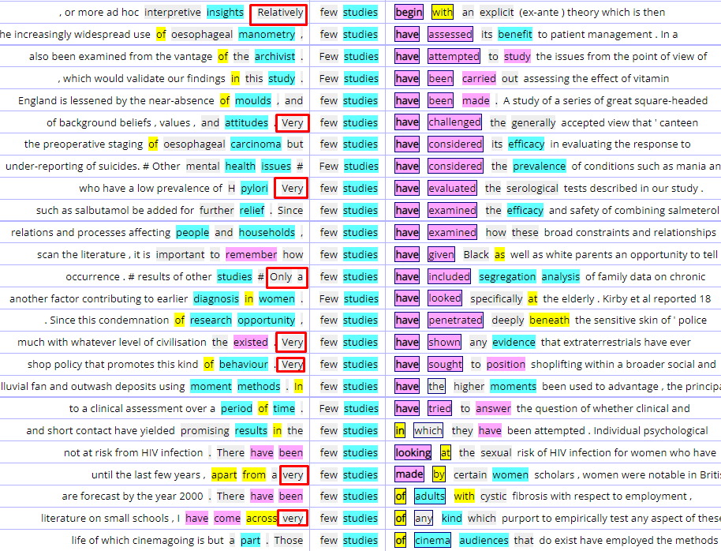
Identifying a research gap: alternative search few studies

Slide 27
Transition between Move 2 and 3: from establishing the gap to presenting the writer’s own research

Slide 28
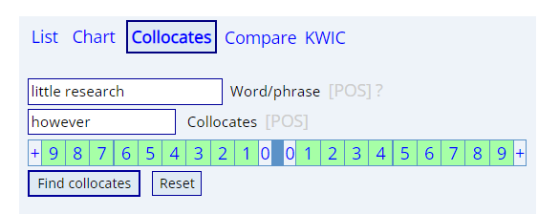
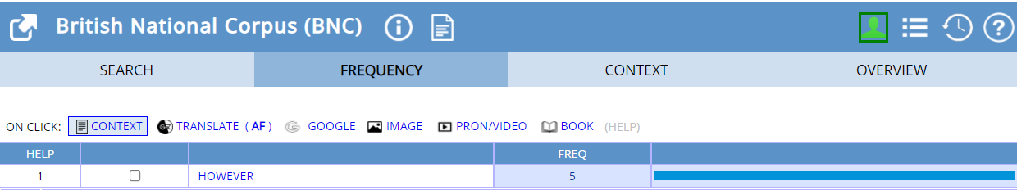
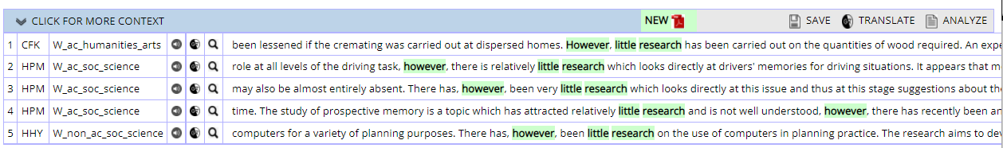
Transition between Moves 2 and 3

Slide 29
Transition between Moves 2 and 3 : from establishing the gap to presenting the writer’s own research
Evidence suggests a significant growth has occurred in the use of computers for a variety of planning purposes. There has, however, been little research on the use of computers in planning practice. The research aims to develop the work and findings of an earlier project (Bardon and Stothers 1982) by: (1) extending and deepening the investigation of computer applications in UK local authority planning departments…
BNC-English corpora

Slide 30
Making connections between Move 2 and 3: lexical and semantic sharing (Swales, 2011: 60)
Little research has been conducted in relation to the field of Machine Translation (MT). The purpose of this research work is to determine the feasibility of using MT techniques for CLTR. Lextutor, Academic General
In the first place, since little research had taken place outside London, we chose to investigate a provincial city. BNC-English corpora, KWIC search
3. There has been much investigation in Mathematics into how to solve the problem efficiently as well as optimally. My original algorithm provides a quick and intuitively simple method for solving the problem.

Slide 31
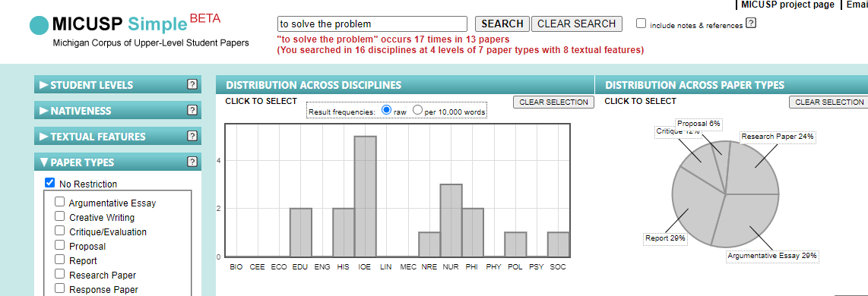
Argument, claim or problem?
MICUSP Michigan Corpus of Upper-level Student Papers https://elicorpora.info/
MICUSP contains 829 A grade papers (about 2.6 million words) of University of Michigan graduate and senior undergraduate students which can be searched for words and expressions in four subject areas: Humanities and Arts, Social Sciences, Biological and Health Sciences and Physical Sciences. You can search this corpus selecting student level, discipline, paper type and textual features.
You can access whole papers, which can be useful for academic writers.

Slide 32
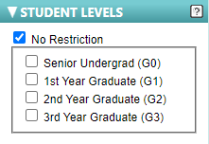
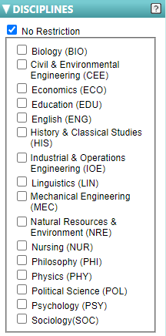
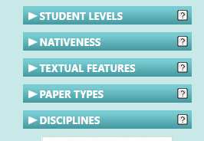
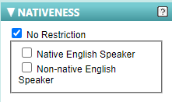
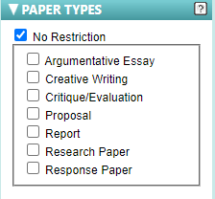
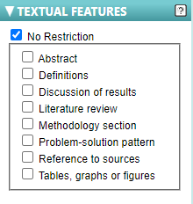
MICUSP: How does it work? https://elicorpora.info/

Slide 33
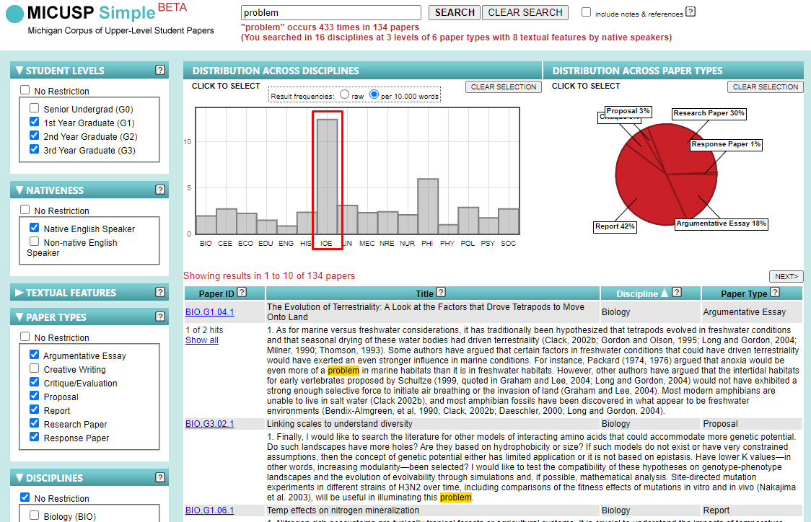
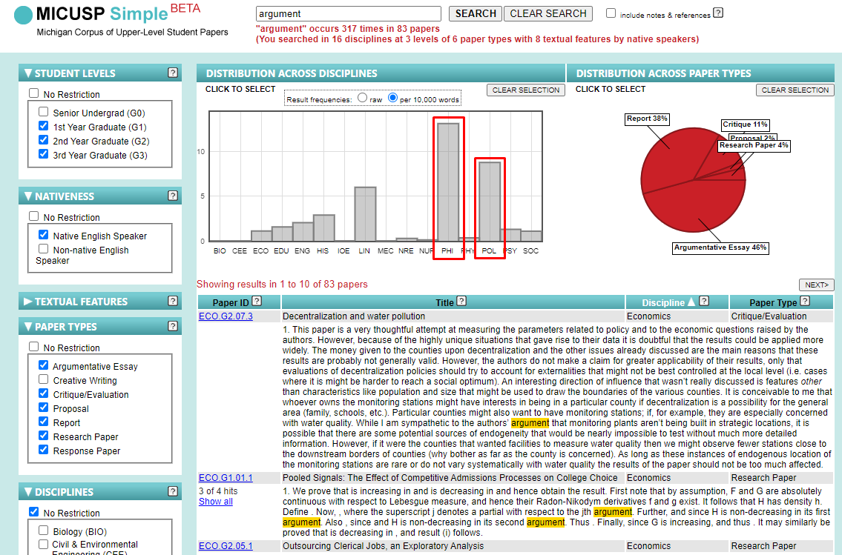
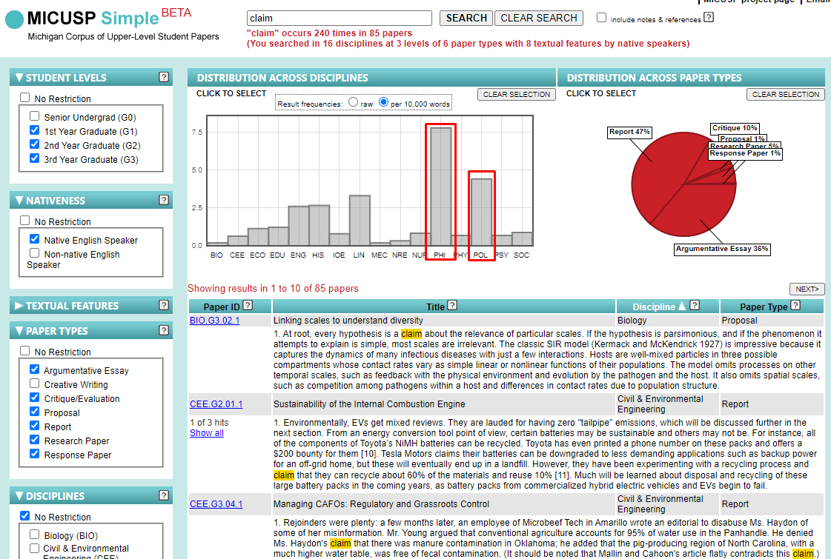
Argument, claim or problem?
problem: Industrial engineering
claim: philosophy
politics
argument: philosophy
politics

Slide 34
Counter-argumentation
‘Successful research writers construct texts by taking a novel point of view toward the issues they discuss while anticipating readers’ imagined reactions to those views’ (Hyland, Jiang 2016 p 251).
In dealing with the latter, the line of reasoning followed by the author will commonly incorporate two main moves (plus signalling):
considering possible opposing views or counterarguments
contesting or refuting the counterarguments

Slide 35
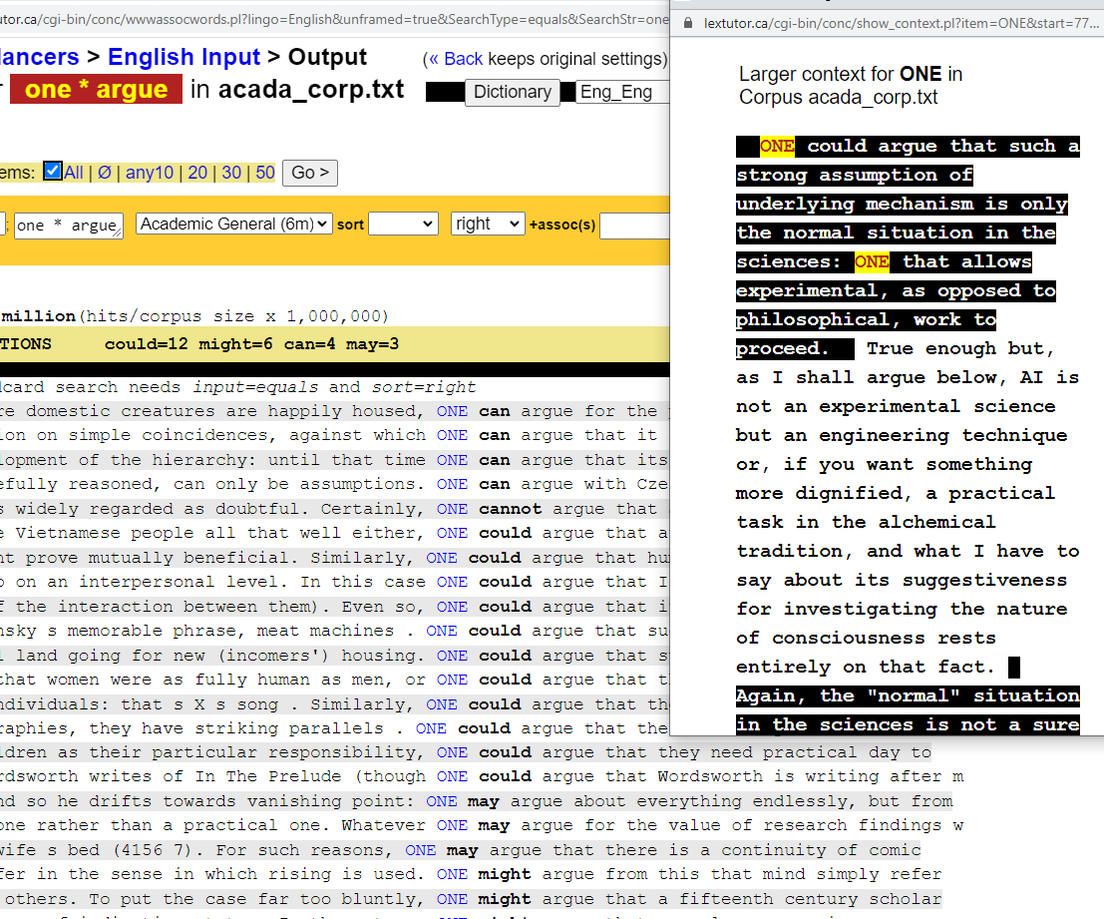
Patterns of counter-argumentation one * argue
Wild card search
Click on a keyword to see extended context

Slide 36
Even though one can argue that some of these choice criteria are not really a safeguard for public investment at all, the reality is that a practice has a slim chance of securing the job in this way unless it has a proven track record (BAWE Architecture, Lextutor).
Patterns of counter-argumentation (Lextutor): one can argue
… one can argue that some of these choice criteria are not really a safeguard for public investment at all | presenting a possible counterargument
Even though… the reality is that | signalling the author’s disagreement and refutation to follow
a practice has a slim chance of securing the job in this way unless it has a proven track record. | refuting the counterargument

Slide 37
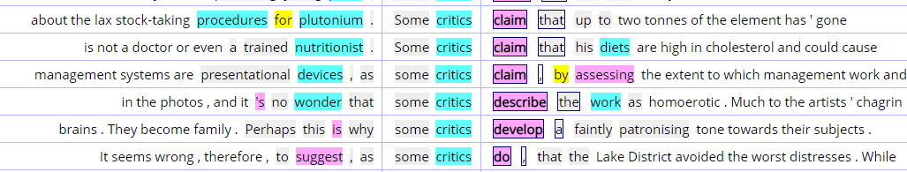
Patterns of counter-argumentation (BNC, KWIC): some critics claim
Click on a keyword to see extended context
… It seems wrong, therefore, to suggest, as some critics do | Refuting the claim
, that the Lake District avoided the worst distresses. | Presenting the counter-argument
there is plenty of evidence of rural depopulation in the later years of the eighteenth century. | refuting the counterargument
This was because the system of land tenure was remarkably different from other areas… | Giving reason

Slide 38
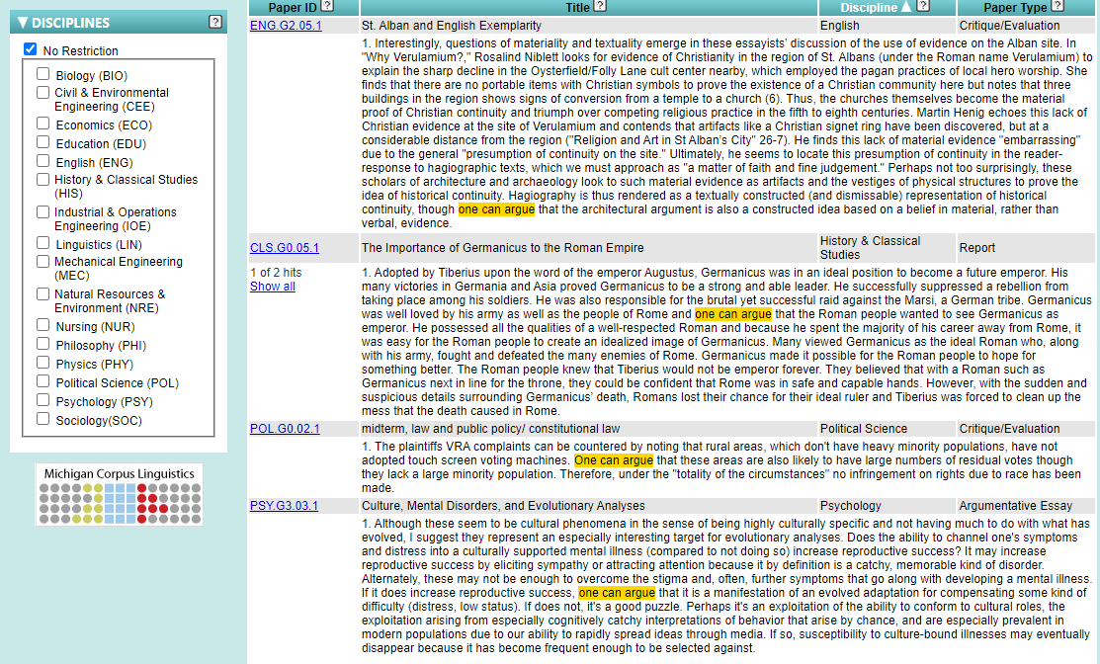

Slide 39
Authorial voice
Evaluative language
Strength of claim (hedges and boosters)
Self-mention

Slide 40
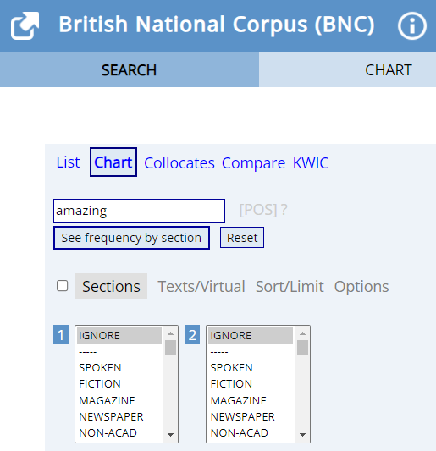
Evaluative vocabulary: word choice
BNC-English corpora: chart

Slide 41
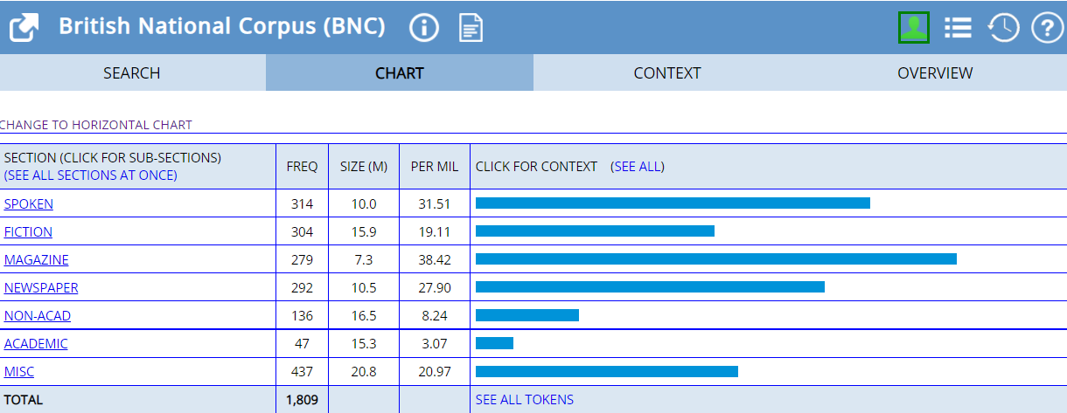

Evaluative vocabulary: word choice amazing and horrendous
amazing
horrendous

Slide 42
Evaluative vocabulary: word choice
Introductory it patterns in learner and expert academic writing
it is ADJ to-infinitive and it is ADJ that-clause
Less experienced … writers often use introductory it patterns to express strong emotions and personal opinions. …and appear more characteristic of speech
more experienced writers ‘use introductory it as a means of evaluation’
(Romer, 2009, p 158)

Slide 43

Evaluative vocabulary: Introductory it patterns. BNC List, wildcard search it is * to

Slide 44


Introductory it pattern:
BNC It is * to; Lextutor BAWE it is * that

Slide 45

Strength of claim. Hedging: the best

Slide 46

Strength of claim. Hedging always
not, almost, nearly, probably, apparently, can, cannot, could

Slide 47

Strength of claim: Boosters definitely
in BNC English corpora
Chart search: distribution by genre

Slide 48

Boosters: patterns of usage
Definitely – not! BNC KWIC

Slide 49
Boosters: definitely frequencies in different corpora (Lextutor)
Frequencies per million | Academic abstracts | Law reports | BNC Commerce | Academic General | BAWE | Learner student
definitely | 0 | 4 | 7 | 10 | 22 | 140
How can you explain these differences in frequency?

Slide 50




Strength of claim: Evaluating results
Lextutor, Academic Abstracts
Find examples where the writer
evaluates the results: highlight the significance
evaluates the results: suggesting treating results with caution
compares results with previous research

Slide 51

Varying strength of claim: solution
definitive
critical
convincing
credible
successful
desirable
acceptable
suitable
perfect
workable
perceived
unexplored
temporary
tentative
unsatisfactory

Slide 52
Varying strength of claim: solution
critical
successful
convincing
credible
definitive
desirable
perfect
acceptable suitable
workable
perceived
tentative
temporary
unexplored
unsatisfactory
What evaluative language is used with solution to reduce the certainty of statements?
Could you suggest why strength of contribution may vary?

Slide 53
Perfect solution?
Working out patterns of usage
Academic General
BAWE
BNC Medicine

Slide 54

Writer’s voice: Self-mention
Results of the search in MICUSP using ‘I’ as a search term in all the available disciplines.
‘I’ is most frequently used in papers in Sociology, followed by Education, with lowest frequencies in Mechanical Engineering, Civil & Environmental Engineering and Physics.

Slide 55

These and similar tasks can be found in my recent book containing over 200 various off-the-shelf tasks for teachers

Slide 56

Thank you
Tatyana Karpenko-Seccombe
University of Huddersfield
t.karpenko-seccombe@hud.ac.uk

Slide 57
References
Cobb, T. (2010). Instructional uses of linguistic technologies. The Procedia – Social and Behavioral Sciences, 3, 14-23.
Flowerdew, L. (2003). A combined corpus and systemic-functional analysis of the Problem-Solution pattern in a student and professional corpus of technical writing. TESOL Quarterly, 37 (3), 489–511
Hyland, K., & Jiang, F. (2016). Change of attitude? A diachronic study of stance. Written communication, 33(3), 251-274.
Karpenko-Seccombe, T. (2020). Academic Writing with Corpora: A Resource Book for Data-driven Learning. Routledge
McCarthy, M., & Carter, R. (1995). Spoken grammar: what is it and how can we teach it?. ELT journal, 49(3), 207-218.
Römer, U. (2009). The inseparability of lexis and grammar: Corpus linguistic perspectives. Annual Review of Cognitive Linguistics, 7(1), 140-162.
Swales, J. M., & Feak, C. B. (2009). Academic writing for graduate students: Essential tasks and skills Ann Arbor, MI: University of Michigan Press, p 244
Cobb, T. Lextutor concordancer. Available at lextutor.ca/conc/eng/
Davies, Mark. (2004-) British National Corpus (from Oxford University Press). Available online at https://www.english-corpora.org/bnc/
Nesi, Gardner, Thompson & Wickens, BAWE (used in Lextutor) British Academic Written English corpus, developed at the Universities of Warwick, Reading and Oxford Brookes coventry.ac.uk/bawe
MICUSP Michigan Corpus of Upper-level Student Papers (2009). Ann Arbor, MI: The Regents of the University of Michigan. Available at micusp.elicorpora.info/
SkELL (Sketch Engine for Language Learning) Baisa, Vít a Vít Suchomel. SkELL – Web Interface for English Language Learning. In Eighth Workshop on Recent Advances in Slavonic Natural Language Processing. Brno: Tribun EU, 2014, pp. 63-70. ISSN 2336-4289. Available at https://skell.sketchengine.co.uk/run.cgi/skell
Corpus tools and corpora

