Slide 1
Nissenbaum, 2004, p.143
“In this era of rapid transformations due to computing and information technologies, changes are thrust upon people and societies frequently without the possibility of careful deliberation over potential harms and benefits, over whether we want or need them. Practices shift almost imperceptibly but, over time, quite dramatically, and in turn bring about shifts in conventional expectations.”

Slide 2
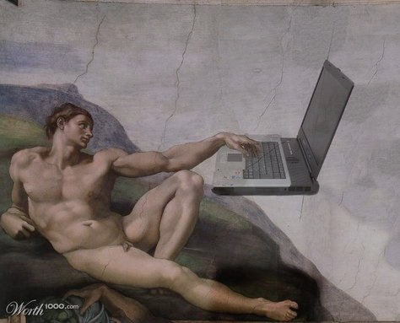
BALEAP PIM, Nov 2021
Translation Software and AI: Implications for Assessment, Academic Integrity and Policy.
Dr Stephen Gow (stephen.gow@york.ac.uk)

Slide 3
What can AI do now?
AI doesn’t “know” or “understand”: it calculates. JISC (2021, p. 10)
Chess: Deep Blue - AlphaGo
Impact on HE
Spinning Software
Translation software
Open AI GPT-3 - ShortlyAI
Bots*
*SRHE - Cox, A. (2021). The coming “intelligent university”?

Slide 4
Research: Machine Translation
Increasingly advanced - HK students example (Stapleton & Leung Ka Kin, 2019)
Problems for ab initio and weaker students (Organ, 2019)
Problems for EMI and EAP (Groves & Mundt, 2016)
Increasing the gap between high and low performing students (Lacore-Martin, 2019)
Simplicity of use aids translingual plagiarism (Sousa-Silva, 2013/2017)
Google is NOT free - we are training it with our intellectual property (Zuboff, 2018)

Slide 5
UoY Policy
Guide to Assessment 4.1 Language of assessment: Assessed work should not be translated prior to marking.
York Academic Misconduct Policy - (a)Breach and/or (b) Cheating failure to comply with the rules of an assessments e.g. unauthorised access to materials in a closed assessment/use of software in open assessment which has been specifically prohibited in the assessment specifications.

Slide 6
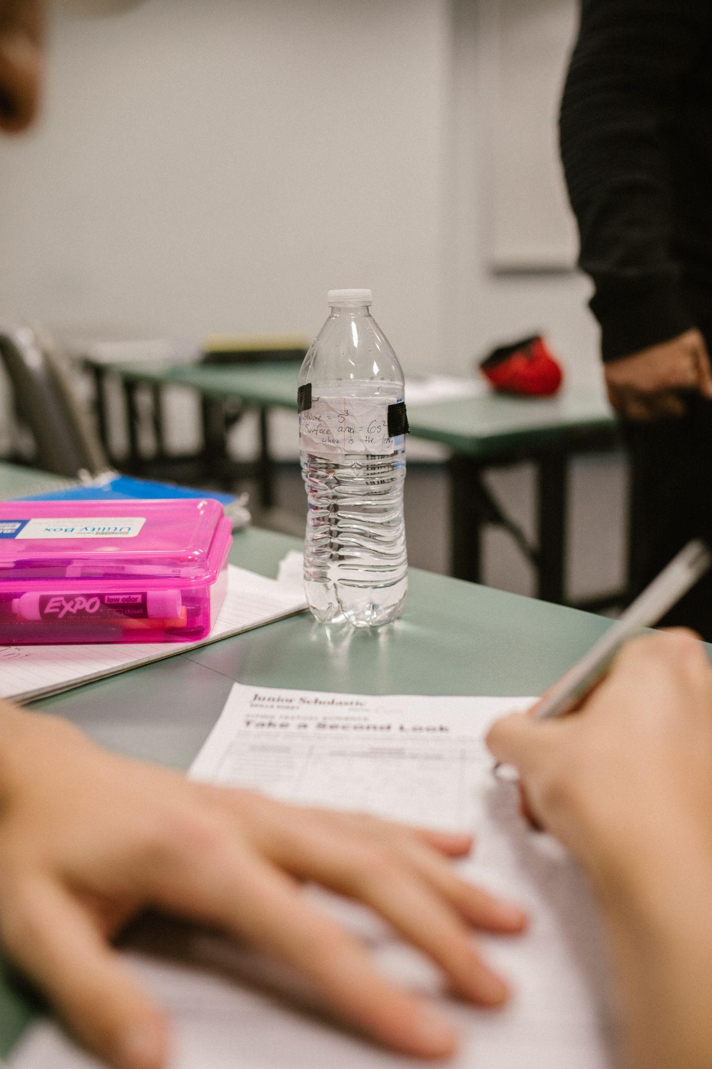
Academic
Integrity
Authorship
Misconduct

Slide 7
Assessment
Covid - rapid shift to online assessment
Who or what are you assessing?
Varied assessment approaches (Organ, 2019)
Outdated assessments (Cope, Kalantzis & Searsmith, 2021)

Slide 8
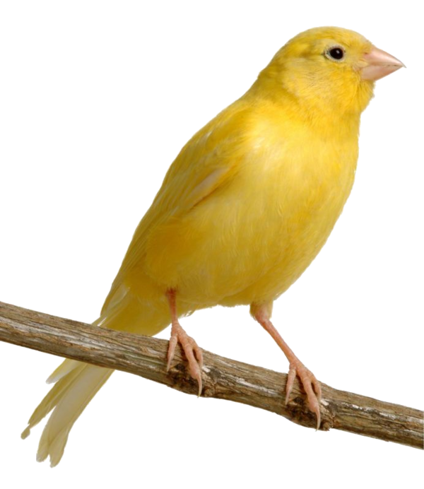
Implications
Languages: the canary in the coalmine (Ryan and Carroll, 2005)
Disruption: Utopian or Dystopian?
Impact: administrative tasks and specific areas
Integrity: Lack of trust in assessment and awards...
Resource: Resource implications for development
Economics: Higher education funding model dependent EMI -
Is it still necessary to speak English to study abroad?
Ethics, inclusivity and equality...

Slide 9
Potential solutions
Careful deliberation over potential harms and benefits...
Focused reflection on assessment and new technologies
Dialogue between students, staff and administration
Guidance and Policy: Institution - Departmental - Module level
Academic integrity: Balance between trust and detection
Curriculum and Assessment development: long term
Recommend: JISC (2021) A pathway towards responsible AI. & Groves, M., & Mundt, K. (2021). A ghostwriter in the machine?

Slide 10
Any questions/comments?
Thanks to Alison Organ, Maria Muradas-Taylor and Thomas Jochum-Critchley

Slide 11
References I
Bretag, T. (Ed.). (2020). A research agenda for academic integrity. Edward Elgar Publishing.
Chubb, J., Cowling, P. & Reed, D. (2021) Speeding up to keep up: exploring the use of AI in the research process. AI & Society. https://doi.org/10.1007/s00146-021-01259-0
Cope, B., Kalantzis, M. & Searsmith, D. (2021) Artificial intelligence for education: Knowledge and its assessment in AI-enabled learning ecologies, Educational Philosophy and Theory, 53:12, 1229-1245, https://doi.org10.1080/00131857.2020.1728732
Cox, A. (2021). The coming “intelligent university”? Exploring the potential impact of artificial intelligence (AI) and robots on UK Higher Education. SRHE. https://srhe.ac.uk/wp-content/uploads/2021/01/Andrew-M-Cox-FinalReport-SRHE.pdf
Groves, M., & Mundt, K. (2021). A ghostwriter in the machine? Attitudes of academic staff towards machine translation use in internationalised Higher Education. Journal of English for Academic Purposes, 50, 100957.
Hartmann, J. (2012). Garry Kasparov is a cyborg, or What ChessBase teaches us about technology. in B, Hale (Ed.). Philosophy looks at chess. p. 39. Open court.
Hutson, M. (2021). Robo-writers: The rise and risks of language-generating AI. Nature, 591(7848), 22-25. https://www.nature.com/articles/d41586-021-00530-0
JISC (2021). A pathway towards responsible AI. Oct 2021. https://repository.jisc.ac.uk/8548/1/a-pathway-towards-responsible-ethical-ai.pdf
Kharya, P. & Alvi, A. (2021). Using DeepSpeed and Megatron to Train Megatron-Turing NLG 530B, the World’s Largest and Most Powerful Generative Language Model. IDeveloper blog, NVIDIA, 11/10/21. https://developer.nvidia.com/blog/using-deepspeed-and-megatron-to-train-megatron-turing-nlg-530b-the-worlds-largest-and-most-powerful-generative-language-model/

Slide 12
References II
Lacore-Martin, E. (2019). The elephant in the room: Rethinking language assessment in the times of Google Translate. Translation Technology in Education – Facilitator or Risk? Conference July, 2019. University of Nottingham.
Li, T. (2021). IBM's Deep Blue vs Google's AlphaGo & Gary Kasparov. https://blog.rebellionresearch.com/blog/ibm-s-deep-blue-vs-google-s-alphago-gary-kasparov
Mundt, K., & Groves, M. (2016). A double-edged sword: the merits and the policy implications of Google Translate in higher education. European Journal of Higher Education, 6(4), 387-401.
Nissenbaum, H. (2004). Privacy as contextual integrity. Wash. L. Rev., 79, 119.
Organ, A. (2019). L’éléphant dans la salle / la pièce / le salon? Student use of Google Translate for L2 production: student and staff attitudes, and implications for university policy. Translation Technology in Education - Facilitator or Risk? Conference July, 2019. University of Nottingham
Ryan, J., & Carroll, J. (2007). ‘Canaries in the coalmine’: International students in Western universities. In Teaching international students (pp. 15-22). Routledge.
Sousa-Silva, R. (2017). Detecting translingual plagiarism and the backlash against translation plagiarists. Linguagem e Direito, 1(1).
Stapleton, P. and Kin, B.L.K., 2019. Assessing the accuracy and teachers’ impressions of Google Translate: A study of primary L2 writers in Hong Kong. English for Specific Purposes, 56, pp.18-34.
Zuboff, S. (2019). The age of surveillance capitalism: The fight for a human future at the new frontier of power. Profile Books.

Slide 13
Images
https://en.chessbase.com/post/garry-kasparov-on-how-it-all-started
Slide 3 Photo by Pavel Danilyuk from Pexels
Photo by KoolShooters from Pexels
Photo by RODNAE Productions from Pexels

