Slide 1
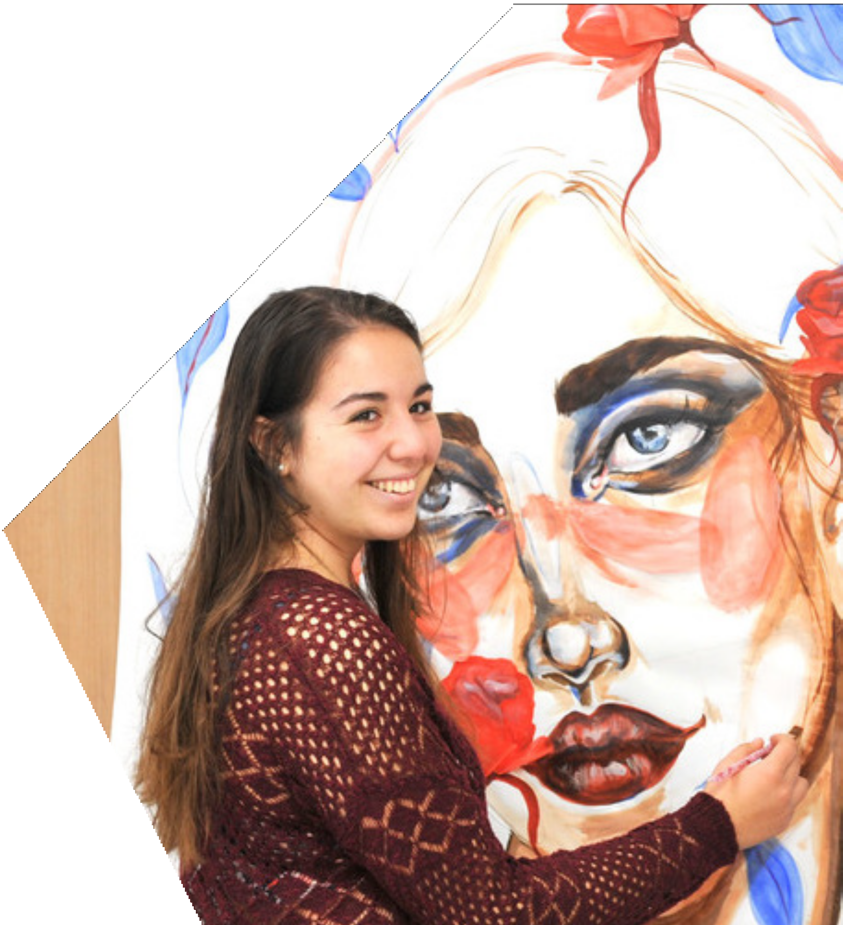
Finding your voice: a multi-faceted approach to originality and similarity in student writing
Heather McClean
Head of EAP
uca.ac.uk

Slide 2
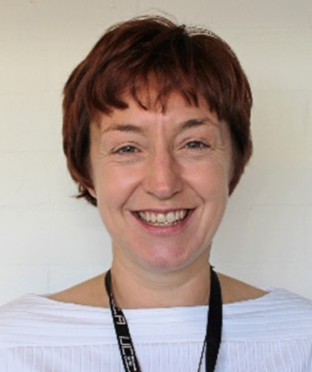
MA Applied Linguistics & TESOL, SFHEA
Head of EAP Programmes
University for the Creative Arts, Farnham, Surrey
heather.mcclean@uca.ac.uk
https://www.linkedin.com/in/heathermcclean/
Core Competencies:
Language Teaching
Intercultural Communication
Tutor Training
Programme Management
Course Design
English for Specific Purposes: Creative Disciplines
Heather McClean

Slide 3
University for the Creative Arts Four campuses: Farnham, Epsom, Rochester, & Canterbury University status granted 2008 Approx. 6,000 students Approx. 30% students with English as L2
uca.ac.uk

Slide 4
Challenges
Began process of internationalisation much later than other HEIs – no history of EAP
Staff less familiar with working with international students
Smaller scale therefore limited resources
Resources spread across four campuses
Rapid growth in number of international students from 2017 to 2019 without appropriate support systems in place
Continuing rising numbers of international students from unfamiliar academic contexts, e.g. South Asia

Slide 5
Opportunities
No history of EAP – freedom of scope
Creative Arts & Industries staff: open to EAP team support and collaboration
EAP team viewed as having valuable expertise, providing high quality, professional support for staff and students
Knowledge exchange: EAP team: academic literacy and language expertise vs. academic staff: discipline-specific and industry knowledge

Slide 6
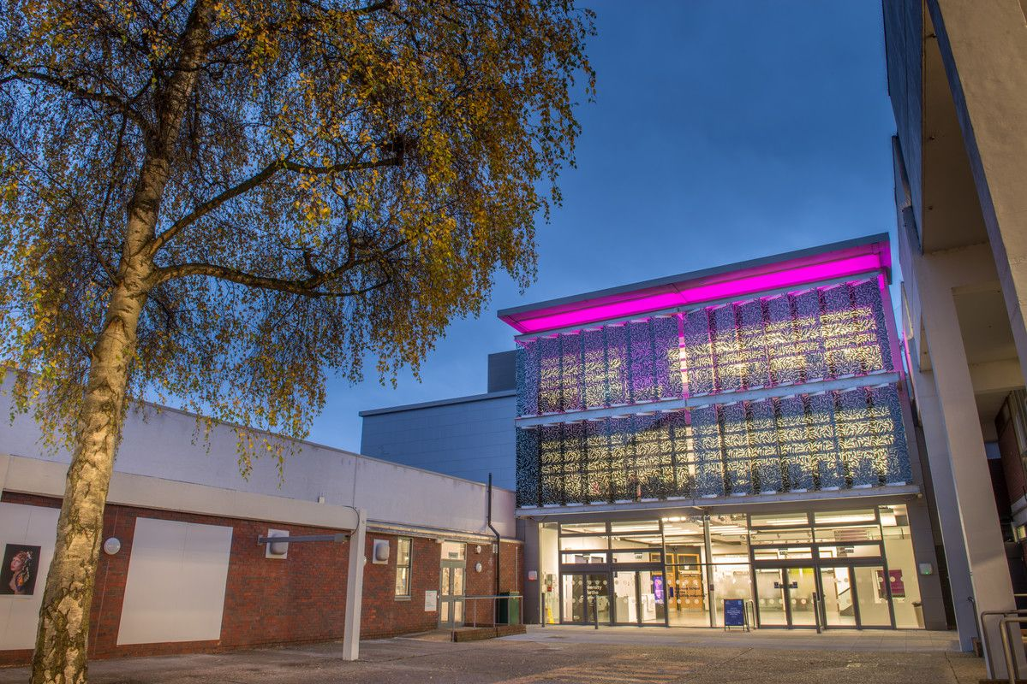
TODAY’S PRESENTATION Part 1: A Multi-Faceted Approach to Improving Academic Integrity Part 2: Adapting and Enhancing Assessment Methods to mitigate against essay mills: trends and successes Part 3: Collaboration between EAP tutors and academic staff to assist students with developing their own academic voice
uca.ac.uk

Slide 7
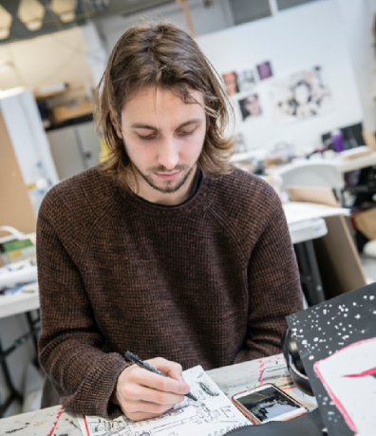
Part 1: A Multi-Faceted Approach to Improving Academic Integrity
uca.ac.uk

Slide 8
Context
Frequent instances of plagiarism, particularly among Asian and South Asian students
Complex language of Academic Misconduct Policy:
Lack of awareness among academic staff of consequences of plagiarism charges and penalties
Students unaware of policy and of consequences of plagiarism – especially for student visas
Students being withdrawn who possibly hadn’t fully understood the consequences of plagiarism

Slide 9
Rationale for Approach: What does the literature say?
“A genuinely holistic approach would involve promoting integrity in every aspect of the academic enterprise: including university mission statements and marketing, through admissions processes, to nuanced and carefully articulated policy. It must include assessment practices and curriculum design, information provided during orientation, and frequent and visual reminders on campus. There must be embedded and targeted support in courses and at every level for students, professional development for staff and research training. Finally, the use of new technologies to both assist students to avoid academic integrity breaches, and as a tool to detect breaches when they occur, must be adopted (Bretag, 2013)

Slide 10
Rationale for Approach: What does the literature say?
“a proactive approach, based on pedagogical principles, can have a positive impact on the improvement of student writing skills when compared to a retributive justice approach reliant on a student’s ability and initiative in accessing internet support resources.” (McCarthy and Rogerson, 2009)
“the complexity of plagiarism requires an equally sophisticated and multi-pronged approach, which is both targeted and context-specific.” (Bretag, 2013)
“a university-wide systematic approach with an educative focus may have a greater impact on improving students’ understanding of academic misconduct, as opposed to an expectation that students read the policy.” (Gullifer and Tyson, 2014)

Slide 11
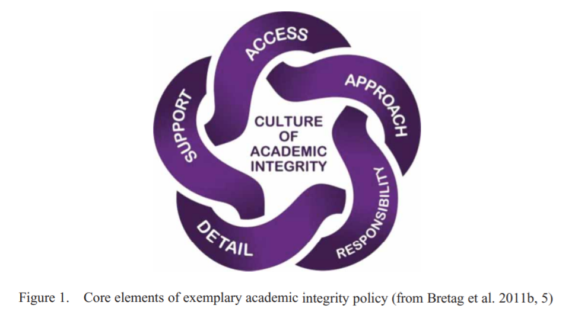
Theoretical Framework: Culture of Academic Integrity

Slide 12
Theoretical Framework
Access: Ensure Academic Misconduct Policy is clear and easy to understand
Approach: Establish collaborative working group to improve all aspects of communicating and implementing Academic Misconduct Policy
Responsibility: Define roles of support staff, academic staff and students
Detail: Provide clear, well-structured documentation and information for students and staff
Support: Provide a variety of strategies and tools to engage and inform students

Slide 13
Academic Integrity Working Group
Clarify Academic Misconduct Policy – create quick guide for staff and students
Create e-learning Academic Integrity Toolkit for students – with printable certificate to be downloaded and added to unit assessments
Improve student induction workshops – spelling out consequences of plagiarism for student visa
Introduce intervention workshops for first offences: giving guidance for improvement and allowing resubmissions with no penalties
Introduce integrated workshops – collaborative assessment between academic staff and EAP tutors

Slide 14
Academic Integrity Toolkit: Creation
Collaborative Working Group:
Librarians
EAP tutors
Learning Development Tutors
Student Advisors
Campus Registry Staff
Academic Staff
https://ucreative.libguides.com/academicintegrity

Slide 15
Academic Integrity Toolkit: Application
Introduction to Academic Staff – short presentation at weekly staff meeting; email to all staff
Aim: Make proof of completion certificate an integral part of assessment submissions
Implementation phase 1: autumn 2021

Slide 16
Academic Integrity Workshops Level 1: Student Induction
Two compulsory workshops:
Consequences of plagiarism – understanding the Academic Misconduct Policy
Using Turnitin to correct referencing and avoid plagiarism

Slide 17
Academic Integrity Workshops Level 2: Intervention
An alternative to plagiarism charges for first offences
Use Similarity Reports to examine plagiarised work and explain the consequences of plagiarism
Demonstrate how to correct referencing and improve paraphrasing
Allow resubmission of corrected work with no penalty on marks
Four pilot workshops with a total of 26 students proven successful, leading to improved referencing in all student re-submissions

Slide 18
Academic Integrity Workshops Type 3: Integration
Academic tutor sets formative assessment to be uploaded to Turnitin
EAP tutor runs two formative assessment workshops:
Workshop 1: Understanding Turnitin: use of highlighting and similarity reports
Workshop 2: Using real examples from students’ formative assessments to demonstrate and correct referencing issues
Pilot workshops proving successful – high levels of student engagement as offers tangible benefits

Slide 19
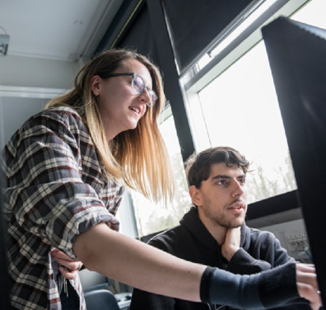
Part 2: Adapting and Enhancing Assessment Methods to Mitigate Against Essay Mills: Trends and Successes
uca.ac.uk

Slide 20
Challenges With Student Submissions
Students’ work shows:
Limited engagement with research into the topic
Lack of necessary depth of analysis (particularly at PG level)
Lack of engagement with academic/professional sources
Limited/lack of primary research – therefore limited/no original work
Focus on secondary research – no original research being conducted

Slide 21
Review of Assessment Submissions
WHAT are students being asked to submit?
HOW can we evidence research/coursework in final submissions?
WHAT is the research equivalent of an artist’s sketchbook?

Slide 22
Current Trends in Assessment Submissions
Examples of new, mandatory submissions connecting student research with final written assignments:
A reflective blog, completed weekly
Reflective research notes showing engagement with the topic
A stand-alone, wrap-around reflective learning journal unit
Reflective report: 500-word critical reflection based on feedback received from two peer reviews
Mini annotated bibliographies
Use of templates/frameworks to steer students towards critical reflection

Slide 23
Reflections on Effectiveness of Assessment Trends
More integrated approach – aligned with creative disciplines (final outcome + sketchbooks)
Some students still copy + paste research notes
More labour-intensive assessment process of cross-referencing research notes with final submission
Not yet BSCI or UCA-wide – various approaches being trialled by certain academic staff
More submissions needed to prove primary research has been conducted, e.g. interview consent forms, questionnaires, interview transcripts, etc.

Slide 24
Part 3: Collaboration between EAP Tutors and Academic Staff to Assist Students with Developing Their Own Academic Voice
uca.ac.uk

Slide 25
Context
Students from diverse academic backgrounds
Unfamiliar academic context
Little to no previous experience of primary research
Little to no previous expectation of having/expressing own opinions
Little to no previous expectation of critical analysis
Entry requirements of IELTS 6.0 (UG) and 6.5 (PG)

Slide 26
Rationale for Approach
“…embedded and targeted support in courses and at every level for students” (Bretag, 2013)
“…provide a range of hands-on, engaging activities, repeated and reconfigured in various media and forums throughout the student programme.” (Bretag et al. 2014)

Slide 27
Embedded In-Sessional EAP
Weekly or bi-weekly EAP support sessions for all UCA students
Lessons designed specifically around current units and submission requirements
Co-created syllabus focuses on:
1. developing primary and secondary research skills
2. developing critical analysis and synthesis skills
3. scaffolding language for academic writing (to help develop academic voice)

Slide 28
Embedded In-Sessional EAP
Develop primary and secondary research skills:
Identify primary and secondary research methods
Evaluation of sources
Awareness of genre
Explicit teaching of research process
Modelling research skills

Slide 29
Embedded In-Sessional EAP
2. Developing critical analysis and synthesis skills
Paragraph analysis - identifying features of academic writing
Creating templates for paragraph writing
‘Reading into Writing’ assignments – comparing theories and giving own opinion
Referencing skills: citations and paraphrasing

Slide 30
Embedded In-Sessional EAP
3: Scaffolding language to develop academic voice
Pointing out instances of scaffolding in academic texts
Recognising bias in academic texts
Teaching ‘Lexical Bundles’ (Bieber and Barbieri, 2007) (Escobar and Fernandez, 2017)
Sentence stems and discourse organisers
Showing stance: expressing own opinions and attitudes
Hedging language: showing caution/distance

Slide 31
Implications for Pre-Sessional and In-Sessional Course Design
Pre-Sessional syllabus designed to reflect UCA UG & PG syllabi
Focus on academic integrity and developing own opinions
Focus on developing research skills
Focus on critical analysis and synthesis
Introduction of compulsory Critical Analysis and EAP units for level 5 and 6 direct entry students in autumn 2021

Slide 32
Reflections
Requires a high level of trust/collaboration between academic staff and EAP team - requires time to develop strong working relationship
Complexities around making e-learning toolkit mandatory – what unit to embed it in and implications of non-submission
Need for e-learning module for academic staff – complexities around implementation/making mandatory/ownership
EAP Team resource limitations – how many tutors needed to replicate across all campuses and to provide adequate levels of 1:1 support?

Slide 33
Bibliography
Anderson, S.L. and Rosser-Majors, M.L., 2018. The case of the plagiarized paragraph: a practical exercise to develop academic voice. Integrating writing into the college classroom: strategies for promoting student skills, p.65.
Biber, D. and Barbieri, F., 2007. Lexical bundles in university spoken and written registers. English for specific purposes, 26(3), pp.263-286.
Bretag, T., Mahmud, S., Wallace, M., Walker, R., James, C., Green, M., East, J., McGowan, U. and Patridge, L., 2011. Core elements of exemplary academic integrity policy in Australian higher education. International Journal for Educational Integrity, 7(2).
Bretag, T., 2013. Challenges in addressing plagiarism in education. PLoS medicine, 10(12), p.e1001574.
Bretag, T., Mahmud, S., Wallace, M., Walker, R., McGowan, U., East, J., Green, M., Partridge, L. and James, C., 2014. ‘Teach us how to do it properly!’ An Australian academic integrity student survey. Studies in higher education, 39(7), pp.1150-1169.
Duff, A.H., Rogers, D.P. and Harris, M.B., 2006. International engineering students—avoiding plagiarism through understanding the Western academic context of scholarship. European journal of engineering education, 31(6), pp.673-681.

Slide 34
Bibliography
Escobar, C.C.F. and Fernández, L.C., 2017. EFL learners’ development of voice in academic writing: Lexical bundles, boosters/hedges and stance-taking strategies. GIST–Education and Learning Research Journal, (15), pp.96-124.
Gullifer, J.M. and Tyson, G. A. , 2014. Who has read the policy on plagiarism? Unpacking students' understanding of plagiarism. Studies in Higher Education, 39 (7), pp. 1202-1218.
McCarthy, G. and Rogerson, A., 2009. Links are not enough: using originality reports to improve academic standards, compliance and learning outcomes among postgraduate students. International Journal for Educational Integrity, 5 (2).
Power, L. G., 2009. University students’ perceptions of plagiarism. The Journal of Higher Education, 80(6), pp. 643-662.
Robbins, S.P., 2016. Finding Your Voice as an Academic Writer (and Writing Clearly), Journal of Social Work Education, 52 (2), pp. 133-135
Snowball, T., Silvey, V. and Do, T., 2015. Beyond plagiarism: utilising Turnitin as a tool to develop students’ academic voice. Academic Skills and Learning Centre (ASLC), pp.1-5.
Taylor, Z.W. and Bicak, I., 2019. Academic honesty, linguistic dishonesty: Analysing the readability and translation of academic integrity and honesty policies at US postsecondary institutions. Journal of Academic Ethics, 17(1), pp.1-15.

