Slide 1
Exploring professionalism, academic integrity and voice in STEM
Anna Murawska and Jane Templeton
University of Leeds
a.murawska@leeds.ac.uk
j.templeton@leeds.ac.uk

Slide 2
Overview – 3 explorations
How AI in our context differs from our EAP understanding
  Anna: four nano case studies followed by “lessons learnt & implications”
How professionalism may be a useful lens through which to explore AI in Engineering
  Jane: discussion of models of engineering thinking
Your experiences and ideas

Slide 3
Case 1: Technical definitions
Medical engineering
Marker’s feedback: ”I have used the TurnItIn report as the similarity score was 35%. For the final version it is very important that all of the text you submit is your own words and your own work”
Case 2: “We wouldn’t expect engineers to cite”
Advanced Mechanical Engineering
Marker’s feedback: we don’t need to see a reference but explanation in students’ own words
Case 3: What’s the point?
Language for Engineering (pre-sessional)
Formative literature review.
Summative portfolio: Tissue-specific research portfolio
Summative open book exam. Example questions:
Reflection: at odds with hierarchy of academic malpractice in our department (plagiarism vs malpractice)
Reflection: student understands the “currency” of referring to sources, but does not see the point of paraphrasing
Marker’s feedback: academic malpractice. Sources acknowledged but used verbatim.
Student’s response: “Why do I have to change the words if I provided a citation?”
Case 4: Sharing code
Mechatronic and robotics
Task: summative programming task
Student: “I worked really hard on this code and it solves real life problems so I uploaded it onto a website so everyone can download it and use it”
Reflection: It sounds noble, and exactly what a professional programmer would do, but is this allowed? Is it my place to comment on it?
Submission 1: ppt slides with definitions / tissue description (shoulder ligament)
Reflection: unsure what to advise. How to paraphrase definitions of technical terms?
Describe and explain two different ways in which Design 1 might be problematic.
Consider the principles of display design.

Slide 4
Lessons & implications: students
AI guidelines perceived as arbitrary, tasks as academic pursuit → explicit exploration of professional standards seems more meaningful
  “Perhaps researchers should be exploring how STEM students can be encouraged to view themselves as budding professionals who feel a sense of responsibility to strong internal values, colleagues and mentors, their field of study, and society.” (Gilmore et al., 2016: 742)
  “responsibility” to colleagues and the public more prominent in engineering code of conduct than in institutional definitions (Pimple, 2002; Gilmore et al., 2016)
Students unprepared to deal with actual AI dilemmas → pre-sessional provision should better reflect the reality of future courses
  Critical look at AI materials in STEM EAP: e.g. “In your academic work, you should refer to the work of others to support the points that you make”
  “Interventions that educate students to negotiate ethical boundaries between collaborative laboratory participation and the production of individually submitted work (e.g., the completion of a “lab report”) are sorely needed.” (Gilmore et al., 2016: 742)

Slide 5
Lessons & implications: tutors
Support needed for EAP practitioners transitioning to STEM
Research and collaboration with receiving departments needed
  STEM fields grouped together though field-specific academic integrity issues likely to exist; technology, maths hardly studied (Gilmore et al., 2016)
  Discipline specific education about AI as part of discipline enculturation (Bretag, 2016)
Subject lecturers AI literacy
Assessment literacy/design → tasks/questions conducive to malpractice
Building relationships & encouraging conversations to support lecturers & to inform EAP provision

Slide 6
Exploration 2: professionalism as useful lens?
Key challenges for EAP teachers helping students develop AI literacy:
  Significant differences in understanding of AI between EAP and STEM
  Inconsistency across tasks and tutors – no (explicit) common understanding
Solution: making explicit links between academic literacies and professional attributes, contexts and standards (Gilmore, 2016, p.49)​ - students as "budding professionals"
Links between assessment tasks and professionalism
  Curriculum informed by professional bodies -> tasks should resemble professional outputs/processes
  Framing core literacies in professional terms = effective in helping understanding​​
Links between AI, voice and understanding of assessment tasks​​​
If we can help students avoid AI issues by helping them understand their tasks & find appropriate voice
And we can help students understand their tasks by linking to professional contexts
Then could professionalism be a useful lens for approaching AI, and EAP in STEM in general?​​​

Slide 7
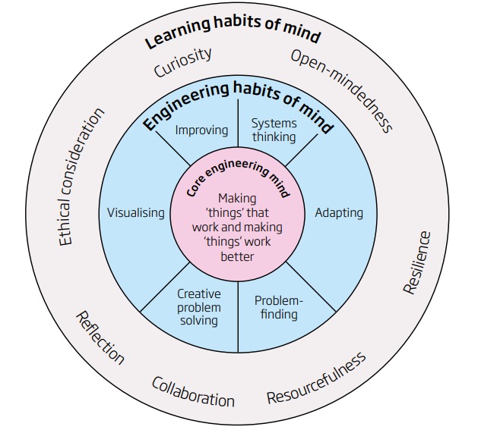
Thinking like an engineer
Engineering habits of mind (Lucas et al., 2014, p.29)
Graduate attributes (University of Leeds, 2021)
Communication skills
Team Working
Leadership
Creative Problem Solving
Commercial Awareness
Flexibility
Initiative
Planning & Organisation
Analytical Skills
Research Skills
Critical Thinking
Independent Working
Time Management

Slide 8
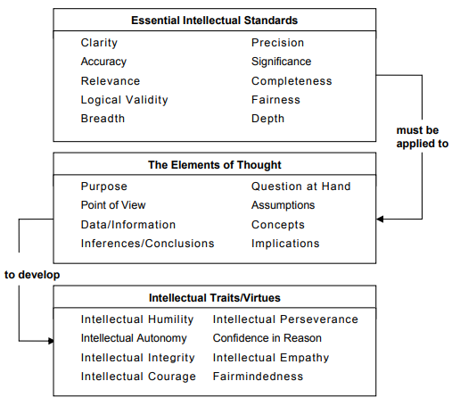
A Critical Thinking Model for Engineers
Fundamental elements of thinking (Paul et al., 2006, p.9)
Whenever we think, we think for a purpose, within a point of view, based on assumptions, leading to implications and consequences.
To answer a question or solve a problem, we use data, facts and experiences to make inferences and judgements based on concepts and theories.
Important questions implied by these structures:
What is my fundamental purpose?
What is my point of view with respect to the issue?
What assumptions am I using in my reasoning?
What are the implications of my reasoning (if I am correct)?
What is the key question I am trying to answer?
What information do I need to answer my question?
What are my most fundamental inferences and conclusions?
What is the most basic concept in the question?
(Niewoehner, 2006, p.3, adapted from Paul et al., 2006)

Slide 9
Intellectual traits / virtues
Trait | Intellectual integrity | Intellectual empathy | Confidence in reason
What it means | = holding yourself to the same intellectual standards you expect others to honor (no double standards). | = accurately reconstructing the viewpoints and reasoning of our opponents and to reason from premises, assumptions, and ideas other than our own. | = using standards of reasonability as the fundamental criteria by which to judge whether to accept or reject any proposition or position.
Questions to foster it | To what extent do I expect of myself what I expect of others? To what extent are there contradictions or inconsistencies in the way I deal with technical issues? To what extent do I strive to recognize and eliminate self-deception or self-interest when reasoning through engineering issues? | Do I listen and seek to understand others' reasoning? Do I accurately represent viewpoints with which I disagree? Do I accurately represent opponents' views? would they agree? Do I recognize and appreciate insights in the technical views of others and prejudices in my own? | Am I willing to change my position when the evidence leads to a more reasonable position? Do I adhere to technical principles and evidence when persuading others of my position or do I distort matters to support my position? Do I encourage others to come to their own technical conclusions or do I try to coerce agreement?
(Niewoehner, 2006, pp. 3-5)

Slide 10
Reflections
Conversations required – need to be two-way. EAP teachers and students have a lot to contribute to collective understanding of AI
Culture change possibly required – away from conceptualisations of student deficit & AI as done-not-learned to these conversations
Professionalism as useful basis for approaching conversations?

Slide 11
Exploration 3 - over to you!
What critical incidents / surprises / "Oh? Ah!" moments have you had about AI? (in STEM or other disciplines)
What resources have you found useful in exploring AI in STEM?
What are your thoughts on using professional attributes as a basis for exploring core literacies?
Padlet: https://padlet.com/amurawska/w26hdawkblmlyz4s

Slide 12
References
Bretag, T. (2016). Discipline-specific approaches to academic integrity: Introduction. Handbook of Academic Integrity, 1st ed.; Bretag, T., Ed, 673-675.
Gilmore, J., Maher, M., & Feldon, D. (2016). Prevalence, prevention, and pedagogical techniques: Academic integrity and ethical professional practice among STEM students. Handbook of academic integrity, 729-748.
Lucas, B., Hanson, J., and Claxton, G. (2014). Thinking like an Engineer. [Online]. Royal Academy of Engineering. [Accessed 18 July 2021]. Available from https://www.raeng.org.uk/publications/reports/thinking-like-an-engineer-implications-full-report
Niewoehner, R. J. (2006). A Critical Thinking Model for Engineering. 2nd International CDIO Conference, 13-14 June 2006, Linkoping, Sweden. [Online]. [Accessed 8 September 2020]. Available from http://wvvw.cdio.org/files/document/file/Niewoehner.pdf
Paul, R., Niewoehner, R. J., and Elder, L. (2006). The Thinker’s Guide to Engineering Reasoning. Sonoma, CA: Foundation for Critical Thinking.
Pimple, K. D. (2002). Six domains of research ethics: A heuristic framework for the responsible conduct of research. Science and Engineering Ethics, 8, 191–205.
University of Leeds. (2021). Graduate Attributes. Leeds for Life. [Online]. [Accessed 16 November 2021]. Available from https://classicleedsforlife.leeds.ac.uk/skills.aspx

