Slide 1


EAP for Social Justice SIG presents …
Visions of Social Responsibility in EAP
6th Nov
2020
@EAPforSJ

Slide 2

What is the EAP for SJ SIG?
put SJ on the agenda
broaden and strengthen evidence-base of SJ in EAP
develop wide networks – complexity and intersectionality
welcoming + active community of practice
https://eap4socialjustice.net
https://www.jiscmail.ac.uk/cgi-bin/webadmin?A0=SJ-SIG-BALEAP
@EAPforSJ
blogs and ‘long reads’
resources
webinars / events
Notes:
Been running since early this year
We established this SIG in order to …
Find out more about our work through our website, Twitter, JISCmail

Slide 3
Why discuss visions of social responsibility in EAP now?
Operating at the margins of academia is not without advantages. In a sense, this enables a certain freedom to define what we collectively and individually wish to commit to in our praxis, establish what our values are, begin to define what sort of academic identities we can strive for and then begin the collective task of reducing the gap from the real to the ideal. (Ding and Bruce, 2017:217)
time to gauge SJ interests of EAP-ers (e.g. future events, working groups) to identify which areas to focus most effort into
important to include SJ concerns in any conversation about visions for the future
turning point moment in history – COVID19, Black Lives Matter, rise of the far right, climate crisis …
An opportunity to re-define who we are, to re-claim our agency
Ding, A. & Bruce, I. (2017). The English for Academic Purposes Practitioner: Operating on the Edge of Academia. Cham, Switzerland: Palgrave Macmillan.
Notes:
Point 3+4 – as Alex Ding said in his plenary
‘collective’ – we can only achieve this sort of change together (limited capacity as individuals) + we want to be inclusive (not to prescribe what SJ is – we want to be inclusive and encourage ppl to embrace this lens)

Slide 4
What would EAP look like if social responsibility were to be placed at its core? How can we get there?
If social responsibility were placed at the core of EAP practice, how would this look to EAP students?
If social responsibility were placed at the core of EAP practice, how would this look to EAP practitioners? How might we get there?
Who would EAP practitioners be?
What role do you see the EAP for SJ SIG playing?
Who would EAP students be?
What knowledge and skills would be needed?
What support is needed?
Where would they be learning?
What would they be learning?
Notes:
We are focusing on collecting ideas at this stage (not having all the answers)

Slide 5
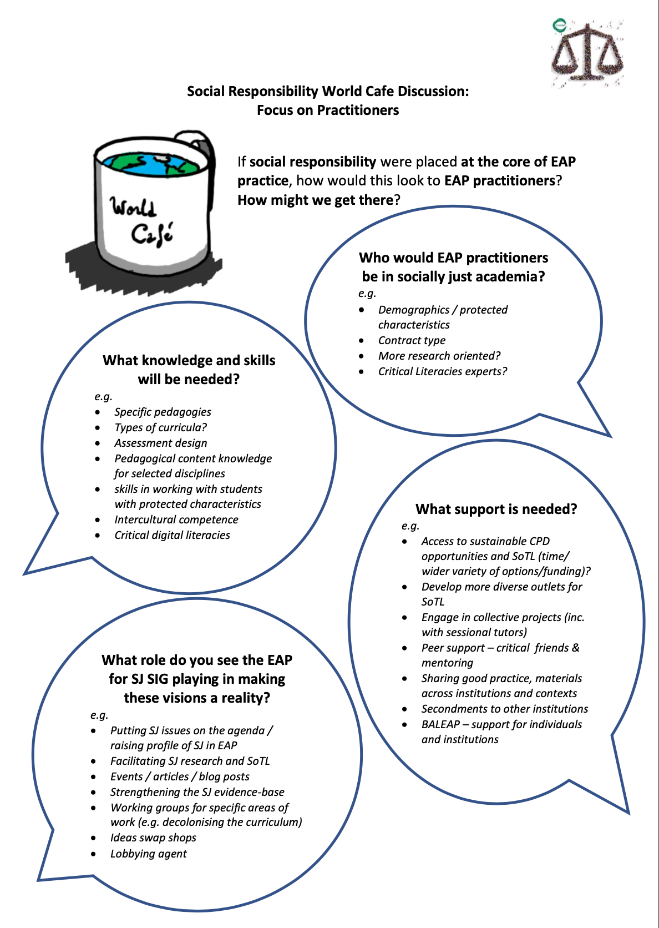
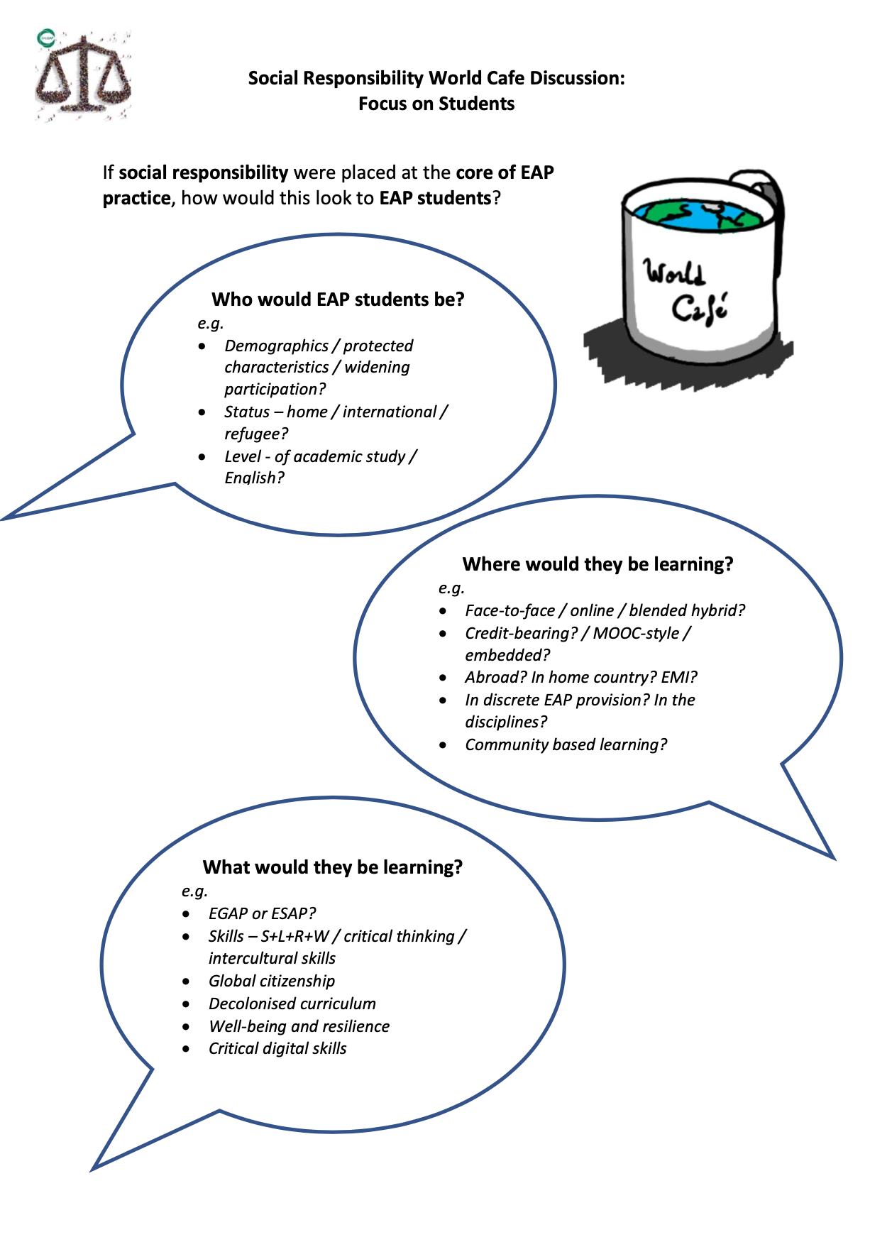
https://drive.google.com/drive/u/2/my-drive

Slide 6
Outline of session
Set up:
4 discussion groups / channels
One facilitator in each (taking notes – to be summarized, anonymised and posted on SJ SIG website)
  Group 1 – Aleks
  Group 2 – Iwona
  Group 3 – Michele
  Group 4 – Jo / Werokina
Timings:
Intro (10 mins)
In your group / channel:
  discuss ‘students’ prompts (20-25 mins)
  break (5 mins)
  discuss ‘practitioners’ prompts (20-25 mins)
Back in main room (15 mins):
  Feedback from groups
  Wrap-up and future directions
Discussion guidelines:
Prompts will be provided again, but link to doc is here: https://drive.google.com/drive/u/2/my-drive
Facilitator will take notes
Notes:
Point 3+4 – as Alex Ding said in his plenary

Slide 7
If social responsibility were placed at the core of EAP practice, how would this look to EAP students?
Who would EAP students be?
e.g.
Demographics / protected characteristics / widening participation?
Status – home / international / refugee?
Level - of academic study / English?
What would they be learning?
e.g.
EGAP or ESAP?
Skills – S+L+R+W / critical thinking / intercultural skills
Global citizenship
Decolonised curriculum
Well-being and resilience
Critical digital skills
Where
would they be learning?
e.g.
Face-to-face / online / blended hybrid?
Credit-bearing? / MOOC-style / embedded?
Abroad? In home country? EMI?
In discrete EAP provision? In the disciplines?
Community based learning?
Notes:
1-2 mins to read prompts

Slide 8
If social responsibility were placed at the core of EAP practice, how would this look to EAP practitioners? How might we get there?
What
support is needed?
e.g.
Access to sustainable CPD opportunities and SoTL (time/ wider variety of options/funding)?
Develop more diverse outlets for SoTL
Engage in collective projects (inc. with sessional tutors)
Peer support – critical friends & mentoring
Sharing good practice, materials across institutions and contexts
Secondments to other institutions
BALEAP – support for individuals and institutions
Who would EAP practitioners be in socially just academia?
e.g.
Demographics / protected characteristics
Contract type
More research oriented?
Critical Literacies experts?
What role do you see the EAP for SJ SIG playing in making these visions a reality?
e.g.
Putting SJ issues on the agenda / raising profile of SJ in EAP
Facilitating SJ research and SoTL
Events / articles / blog posts
Strengthening the SJ evidence-base
Working groups for specific areas of work (e.g. decolonising the curriculum)
Ideas swap shops
Lobbying agent
What knowledge and skills will be needed?
e.g.
Specific pedagogies
Types of curricula?
Assessment design
Pedagogical content knowledge for selected disciplines
skills in working with students with protected characteristics
Intercultural competence
Critical digital literacies
Notes:
Point 3+4 – as Alex Ding said in his plenary

Slide 9
Keeping in touch
SIG website: https://eap4socialjustice.net
JISCmail discussion list: https://www.jiscmail.ac.uk/cgi-bin/webadmin?A0=SJ-SIG-BALEAP
SIG email address: EAP4SocialJustice@baleap.org
Twitter: @EapForSJ
Notes:
Social justice concerns are fundamental to the education process

Slide 10

Upcoming events
https://eap4socialjustice.net/upcoming-events/
Webinar on Pedagogy of Compassion in EAP with Dr Theo Gilbert (planned for December 2020)
Notes:
Social justice concerns are fundamental to the education process

Slide 11
Getting involved / Next steps
Survey Monkey questions:
feedback on this session
what would you like to see in future sessions?
share your vision (if you didn’t have a chance to do so in this session)
what working groups would you be interested in joining / leading?
https://www.surveymonkey.co.uk/r/SCMQYNC
working groups focusing on specific areas of SJ in EAP (e.g. decolonising the curriculum)
look out for write up of this session on our website
open call for blog posts / long reads / vlogs for our website
Notes:
Social justice concerns are fundamental to the education process

Slide 12
Thanks!
Notes:
Social justice concerns are fundamental to the education process

