Slide 1



Leading a remote teaching team
International Study and Language Institute
Sarah Mattin
University of Reading

Slide 2
Leading a remote teaching team
Wellbeing at work: the Job Demands-Resource Model (Bakker and Demerouti, 2007)
UG Summer Pre-sessional: Applying the J-DR model to an online EAP teaching context
Leading a remote teaching team: Reflections and implications for the future
Notes:
In this talk I’m going to reflect on the experience of leading a remote teaching team with a particular focus on the teacher experience.
So these are the key areas I’ll cover today. I’m focusing on the specific context of this summer’s UG PSE course at the UoR

Slide 3
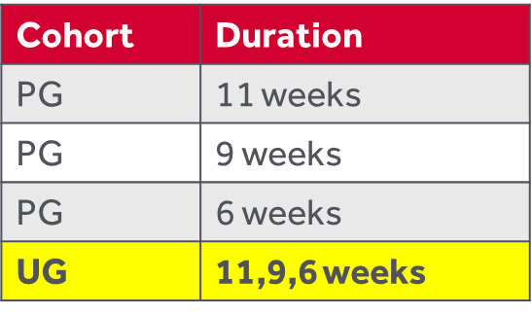
Summer Pre-sessional: 2020 Context
Head of EAP
Programme Director (Summer)
Director of TEL Projects
Course Directors , Assistant Course Directors, Senior Teachers, Teachers,
All courses fully online
Majority asynchronous teaching/learning
12 teachers (4 per intake)
175 students
Notes:
So just to give some very brief context – the UG course is part of a wider summer pre-sessional programme with 3 PG courses and a UG course
This summer we were fully online ,largely async
And you can see here in no particular order a brief overview of the academic team and Course Director is highlighted there just to show my role

Slide 4
Wellbeing at work
Demand-Control Model (Karasek, 1979)
Effort-Reward Imbalance Model (Siegrist, 1996)
Demand/Effort
Control/Reward
Models focus on specific demands/efforts etc.
= job strain
Notes:
Models of wellbeing at work often focus on balance so you can see here two of the best known models and the idea is that an imbalance towards the negative aspects will result in job strain
Simple models but focus on specific demands/efforts so not nec applicable in all settings

Slide 5
Job Demands-Resource Model
Job demands: can turn into job stressors
Physical, psychological, social, organisational aspects of job that require sustained physical and/or psychological effort or skills
Job resources: can help achieve work goals, reduce job demands/costs, stimulate personal growth, learning
(Bakker and Demerouti, 2007)
JD-R model assumes that any demand and any resource may affect employee health and well-being
Notes:
The JD-R model is similar in that it still has the idea of balancing factors
We can see here a brief definition of demands and resources
BUT unlike the previous two models, the JD-R model does not restrict itself to specific job demands or job resources. It assumes that any demand and any resource may affect employee health and well-being

Slide 6
Demands?
Summer Pre-sessional teachers
Resources?
Uncomfortable environment (sitting in front of screen all day)
New, unfamiliar technology
esp. for live teaching
Feeling of isolation
High volume of work- marking
Short deadlines
Uncertainty as to own role, tasks, what’s required when and how
‘just in time’ information
Training and support for tech
Mainly asynchronous teaching/learning
Support of CD & ACD (themselves supported by PD and Director TEL)
Induction session: working remotely: balancing work and life
Induction session: the role of the teacher
Mapping of workload – the working week!
Weekly teacher checklist- consolidating information
communication
Notes:
So in an ideal world I would have read about this before planning the summer PSE – but this isn’t what happened – but I’ve found it a useful tool for reflecting back on the summer and the planning
In planning the summer, we did think a lot about the teacher experience – we were very aware of the teacher workload- summer already v intensive and then we’re asking teachers to do sth v new
So, we started thinking about what I’m calling here Demands and Resources but at the time I suppose we were thinking perhaps more potential problems and solutions

Slide 7
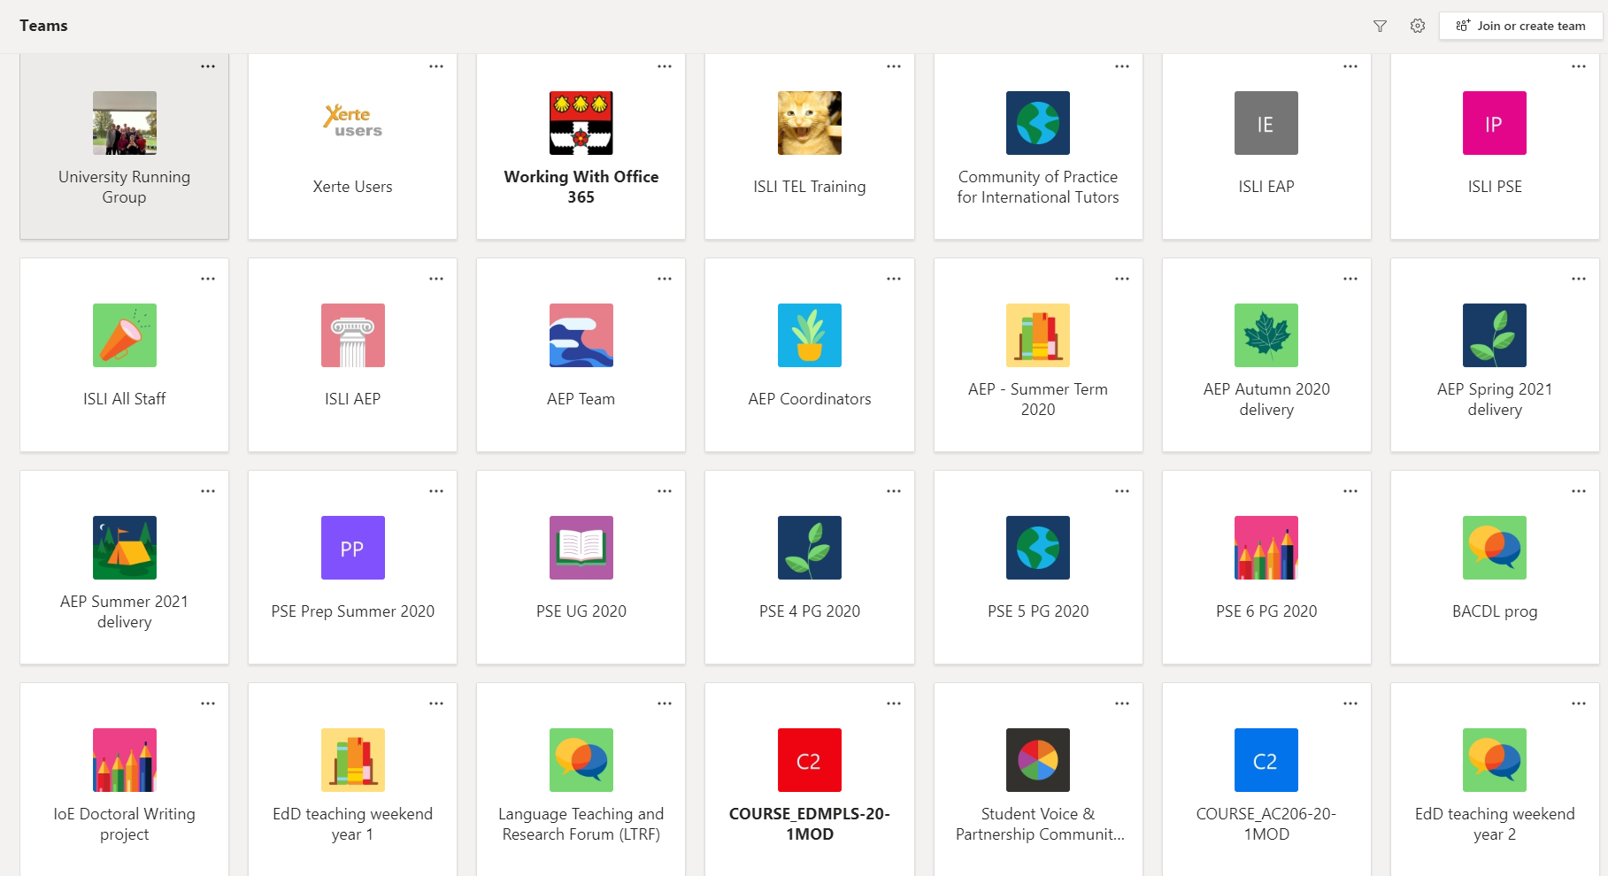
Communication
A good thing, but….can get out of hand online!
Constant communication = constant interruption
Perceived pressure to respond immediately
Online ‘chat’ availability perhaps starts to erode habits of forward planning in communication

Slide 8
Communication: Key principles
Teacher Induction
Sample Slide
Course-related communication via Teams
Think of Teams a bit like the ‘staffroom’ – you don’t need to always be there!
Check Teams and Email in the morning, at lunch (c. 1pm) and before you log off c.430pm
Manage your notifications (or close Teams) so that you’re not constantly disrupted during working time
BRIEF check-in meeting each morning to set focus and deal with questions (may decrease in frequency as the course goes on)
Weekly meeting 2pm Friday

Slide 9
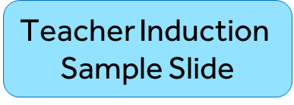
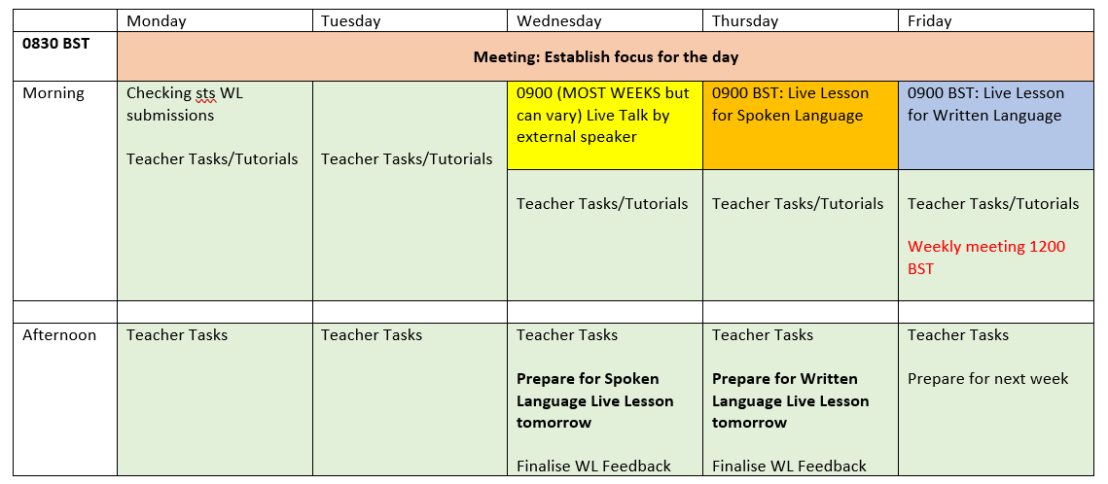
Weeks will vary!
Marking/Feedback on student work
Responding to tasks on Blackboard
Preparing for live sessions
Looking ahead at next week’s materials
Small group TUTORIALS

Slide 10
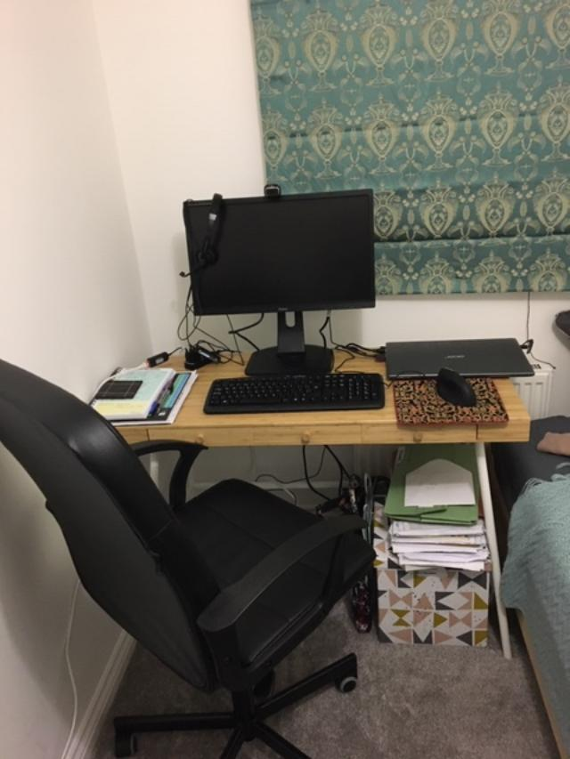
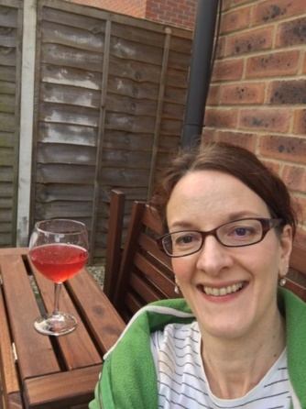
Your experiences so far?
Have you been working remotely?
What strategies have you used/ do you plan to us to balance work and life whilst working remotely?

Slide 11


Balancing work and life: Top tips
Make a daily schedule including breaks
Avoid having Email/Teams on your phone (or if you do have them, turn off notifications)
Things will take longer at first – try to mentally prepare for this!
Keep a list of what you have done and tick items off (v. satisfying!)
If you’re not sure, or need help with anything – please ask!

Slide 12
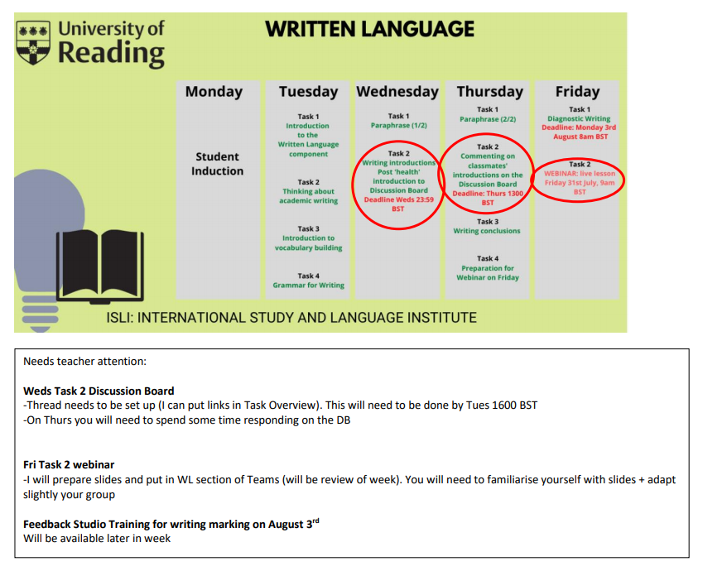
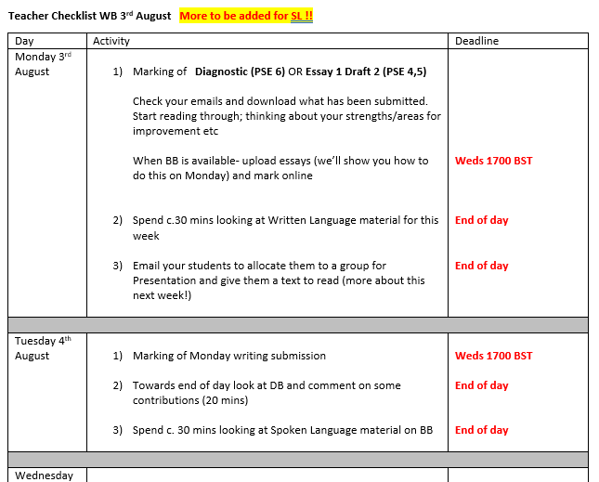
Sample Weekly Checklist

Slide 13
Teacher feedback
It was very manageable - a nice balance.
The workload for planning and marking was fine. I think I would have liked more contact time with the students.
I would rather we marked less online and spent more on spoken language with students. I realize that we need to teach them writing but the first thing we should do is that each student understands everything and feel safe in the new environment.
The working hours created a lot of space for flexibility (managing our work/life balance).
Conditions were fine. There was too much marking in relation to teaching time but circumstances gave no choice really.

Slide 14
Reflections
Job resources: can help achieve work goals, reduce job demands/costs, stimulate personal growth, learning
Communication ‘strategy’
Mapping of teaching workload each week
Autonomy/creativity – input into materials
Satisfaction of teaching – interacting with the students
Sharing – team teaching
Frontloading time to think about these aspects – very good investment of time
But still need to reduce the job demands!

Slide 15

Thank you for listening
Any questions?

Slide 16
References
Bakker, A. B., & Demerouti, E. (2007). The Job Demands-Resources Model: State of the Art. Journal of Managerial Psychology, 22, 309-328
Karasek, R.A. (1979), “Job demands, job decision latitude, and mental strain: implications for job design”, Administrative Science Quarterly, Vol. 24, pp. 285-308.
Siegrist, J. (1996), “Adverse health effects of high effort-low reward conditions”, Journal of Occupational Health Psychology, Vol. 1, pp. 27-41.

