Slide 1
BALEAP PIM: 2020 Visions: Looking back and looking ahead 6th November 2020

Slide 2
An In-Sessional English response to the ‘new normal’ Jeni Driscoll & Anna Fox Acting ISE Co-Directors & the ISE Team

Slide 3
Overview
Context – looking back
The ‘new normal’ – an ISE response
Observations/reflection
Looking ahead

Slide 4
The ‘old normal’
Discipline-specific classes (Academic Language & Skills, Dissertation Prep)
General Academic English
Credit-bearing modules: ENGL108 & ENGG596
1:1 Academic Writing Consultations
OSI/EU/XJTLU & some home students

Slide 5
The ‘old normal’
Usually ISE front-loaded
Usually ISE running fully throughout semester 1 and 2
Usually reduced provision in early summer
ISE teachers tend to move over to PSE teaching for summer

Slide 6
2020
ISE ran throughout semester 1 and 2 but provision significantly reduced compared to previous years
Plan to reduce provision in early summer
ISE teachers due to move over to PSE teaching for summer

Slide 7
The ‘new normal’
Response to lockdown
Response to changes in main course programmes and research, assessments, deadlines
Response to reduction in ISE support earlier in the academic year - ‘making good’

Slide 8
The ‘new normal’ 2020 Additional ISE provision
General Academic English during Summer
1:1 Academic Writing Consultations
Writing Classes & Retreats for PGRs & Postdocs
Bridging Programme (Nov/Jan/Feb starts)
Additional Language Provision (ex PSE students)
OSI/EU/XJTLU & more home students

Slide 9
The ‘new normal’ Observations
Attendance at General Academic Writing:
Late April to late May
Higher attendance early to late May
84 person IDs = 43 PhDs, 18 MA/MScs, 14 BA/BSc, 7 other (e.g. CPD Veterinary Science, Doctor of Dental Science, Cert Vet Professional Studies)
Mostly but not exclusively overseas students

Slide 10
The ‘new normal’ Observations
Attendance at Dissertation preparation:
June – August
DS and general
Attendance broadly steady throughout, with some lifts and lower attendance (but also repeat sessions) i.e. clearly viable
Mostly but not exclusively overseas students

Slide 11
The ‘new normal’ Observations
Evidence of engagement from PGRs higher than other cohorts
Evidence of successful cohort/level mixing, as in no obvious detriment on attendance when mixing BA/BSc →PhD in same EGAP classes
Increase in home students in EGAP academic writing

Slide 12
The ‘new normal’ Observations
Attendance at PGR Thesis Writing classes:
Late April to early May
Mostly but not exclusively overseas students
Increase in home students
Good attendance in earlier sessions but then dropped

Slide 13
The ‘new normal’ Observations
Attendance at PGR Writing Retreats:
Weekly May to September
Increase in home students
Mixture of students and staff
PGR students
Postdoc researchers
Early career researchers

Slide 14
The ‘new normal’ Observations
Sheffield model (Murray & Newton, 2009)
Feedback from PGR Writing Retreats:
Positive feedback in terms of fewer distractions and better focus
Positive feedback in terms of motivation, productivity
Themes/strands identified within the feedback are: improved writing process, improved writing output, emotional aspects such as nervousness, anxiety, enjoyment, encouragement and a sense of belonging/community/coming together with other writer
academic, emotional, social
care and compassion in the curriculum (Gerlbert, T, et al, 2018)

Slide 15
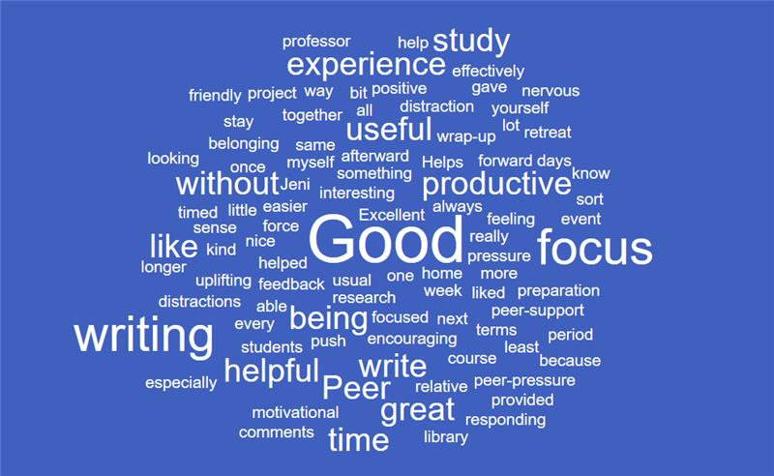

Slide 16
The ‘new normal’ Observations and requests 2020-21
Request for more peer and tutor feedback on writing (tutor ✓ via 1:1s, peer – to do)
Request for frequency no less than every 2 weeks (to do in spring/summer)
Request for year round writing retreats (to do)

Slide 17
The ‘new normal’: what next?
Staggered starts
Year round provision for 2020-21 and beyond
Bridging programme 2020-21 and beyond
More PGR support and collaboration with research staff
Moving towards EAP for all students

Slide 18
Effective ISE Provision
Department liaison
Integration
Materials
Course design & delivery
Collaboration opportunities
Notes:
Most successful model of ISE provision is where we:
Work closely with depts & tutors
Integral to the course by students (visible at induction/@ start of course, ISE provision is mentioned in handbooks, where ISE tutor has a folder on VITAL, where ISE tutor has access to course materials, assessment briefs/rubrics, exemplars of student work, reading lists, previous exam Qs, attends assessed presentations etc
ISE can be timetabled at key points in the course – may run just 2-3 weeks (ELEC 3rd year support for a specific assessment) or 8/10 weeks over 2 semesters, and/or with support over the summer – ties in closely with hand-in dates, field trips, reading weeks etc
Can be relatively wide-ranging over various academic language & skills areas (often predominantly writing, but also may focus on a particular need, e.g. reading large volumes of dense material (law), focusing on new skills (eg UG Life Sciences & essay writing skills) or quite focused (e.g. UG architecture – speaking)
Sessions can be TT’d before /after main lectures/seminars depending on the focus or co-taught (e.g. philosophy)
Really successful areas of collaboration have resulted - tutors working together to ensure assessment briefs are worded so they’re clear for OSIs, ISE tutors have shared question frameworks to evaluate assessments, & tutors have worked together on providing formative feedback to students and each other.

Slide 19
Monitoring Impact
Collecting evidence
Attainment gaps
Notes:
Currently working on trying to measure the impact of ISE provision. Difficult in light of the myriad factors that affect student performance & attainment.
Have anecdotal reports of the impact of courses on overall grades & colleagues in depts have done some investigation into scores in different years.
This year – Equality & Human Rights Commission Internal Inquiry & Working Group – looking at analysing attainment gaps

Slide 20
References
Gilbert, T., Martina Doolan, N. T. F., Beka, S., Spencer, N., Crotta, M. & Davari, S. (2018). Compassion on university degree programmes at a UK university. The neuroscience of effective Group work. Special Issue. Journal of Research in Innovative Teaching & Learning, 11 (1), 4-21. https://www.emerald.com/insight/content/doi/10.1108/JRIT-09-2017-0020/full/html
Kinchin, I.M. (2019) Care as a threshold concept for teaching in the salutogenic university. Teaching in Higher Education. https://doi.org/10.1080/13562517.2019.1704726
Murray, R. & Newton, M. (2009) Writing retreat as structured intervention: margin or mainstream?, Higher Education Research & Development, 28:5, 541-553,
DOI: 10.1080/07294360903154126 https://www.sheffield.ac.uk/rs/ecr/events/retreat

Slide 21
Thank you
Any questions?

