Slide 1


Centre for Languages and International Education
CLIE Online Pre-sessional Course 2020 – Response to COVID-19
^{Fiona Wallace}
^{Head of Pre-sessional}
^{f.wallace@ucl.ac.uk}

Slide 2
Centre for Languages and International Education
Outline
How we adapted our Pre-sessional course to the online environment
What we learnt from this experience
The changes we plan to implement

Slide 3
Centre for Languages and International Education
Student Induction
Week 0
Allow students time to access platforms and socialise online
https://www.gillysalmon.com/five-stage-model.html
Training in online platforms (UCL Digital Education) = BBC
Training in MS Teams (PS E-Learning Co-Ordinator)
Pre-sessional team produced videos inc how to navigate the course and what to expect individual skills components
Followed up by Q&A session

Slide 4
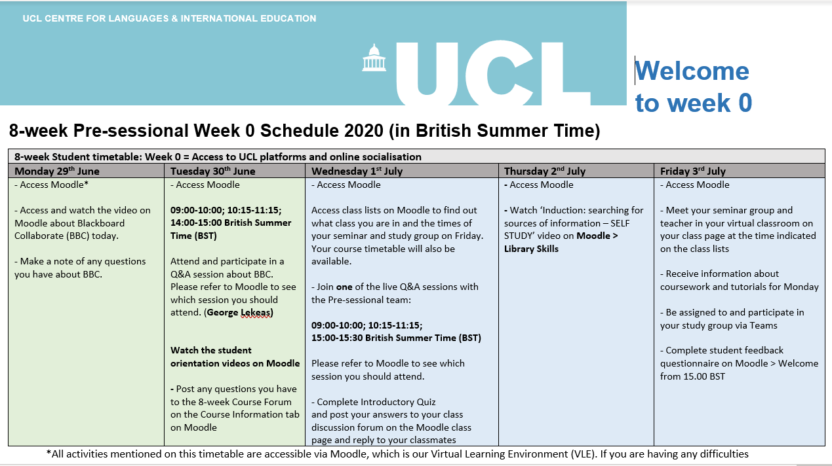
Centre for Languages and International Education

Slide 5
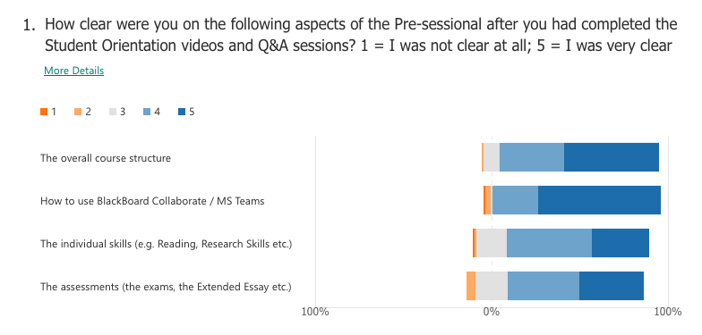
Centre for Languages and International Education
Notes:
8-week 0 feedback

Slide 6
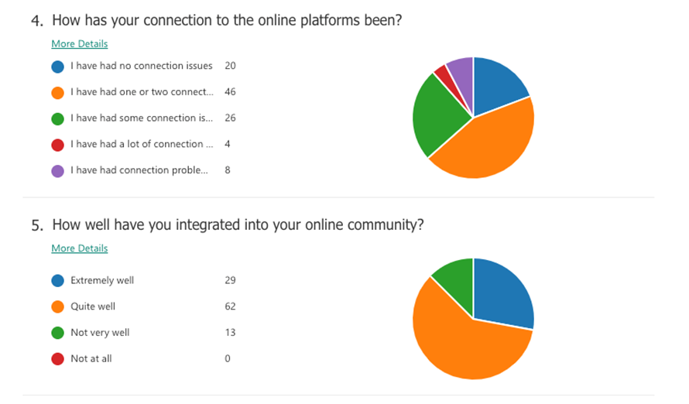

Slide 7
Centre for Languages and International Education
Challenges in Reimagining Course Structure
Face-to-face materials
Time zones
Revised assessment dates
Teacher and student experience and relationship with online environment
Resources

Slide 8
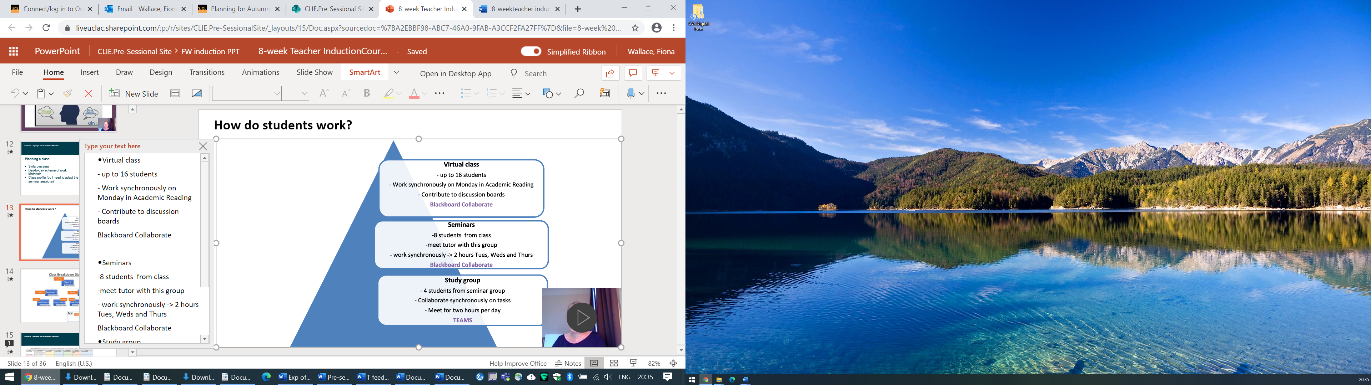
Centre for Languages and International Education
How students were
organised

Slide 9
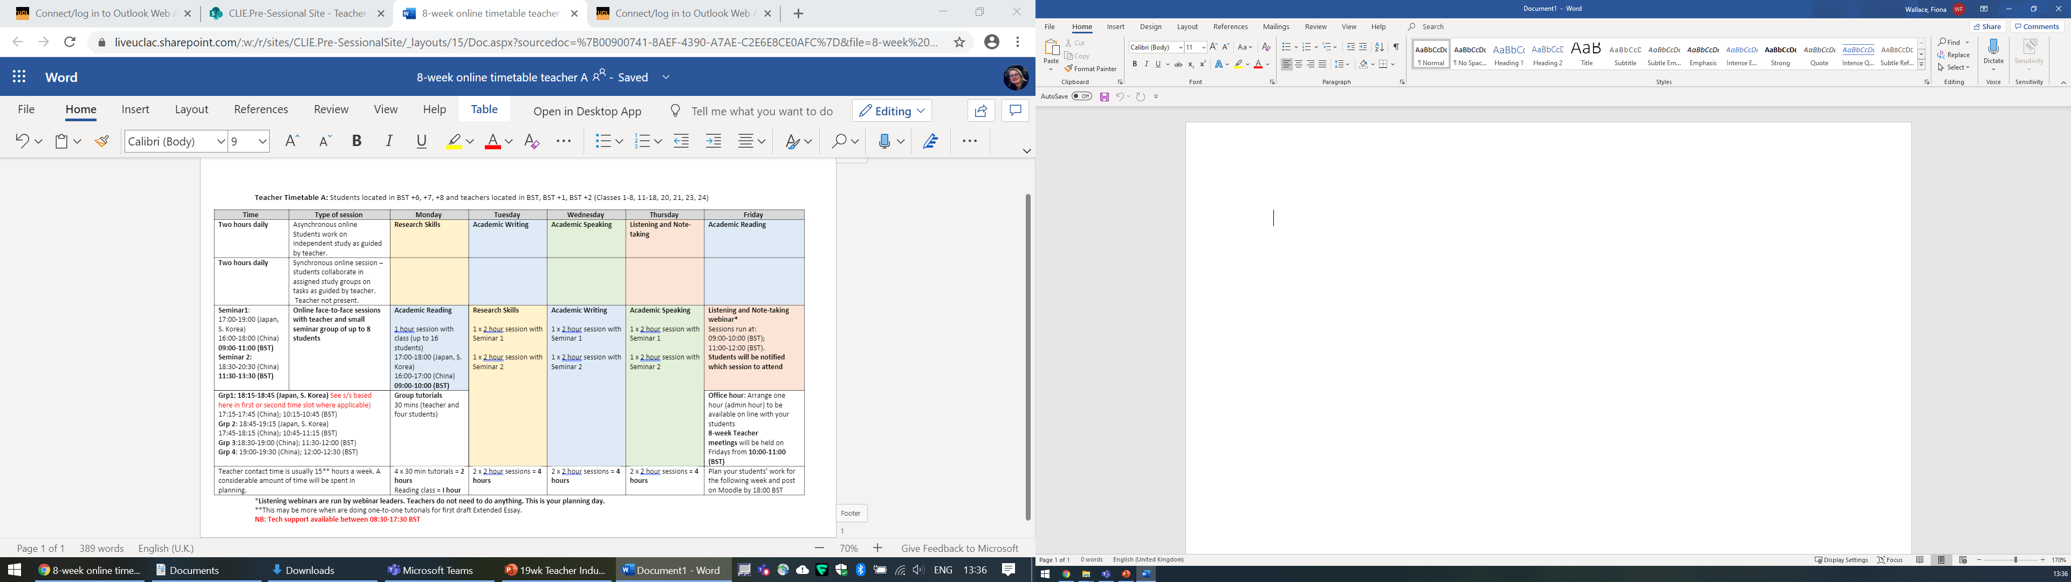
Centre for Languages and International Education

Slide 10
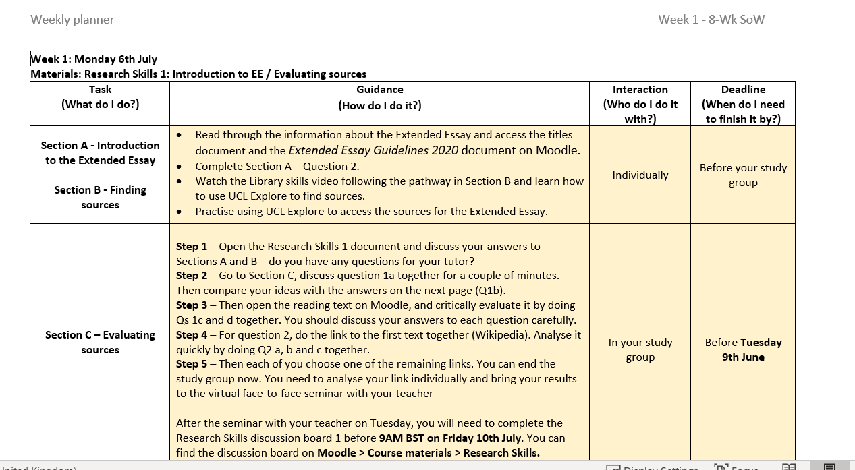

Slide 11
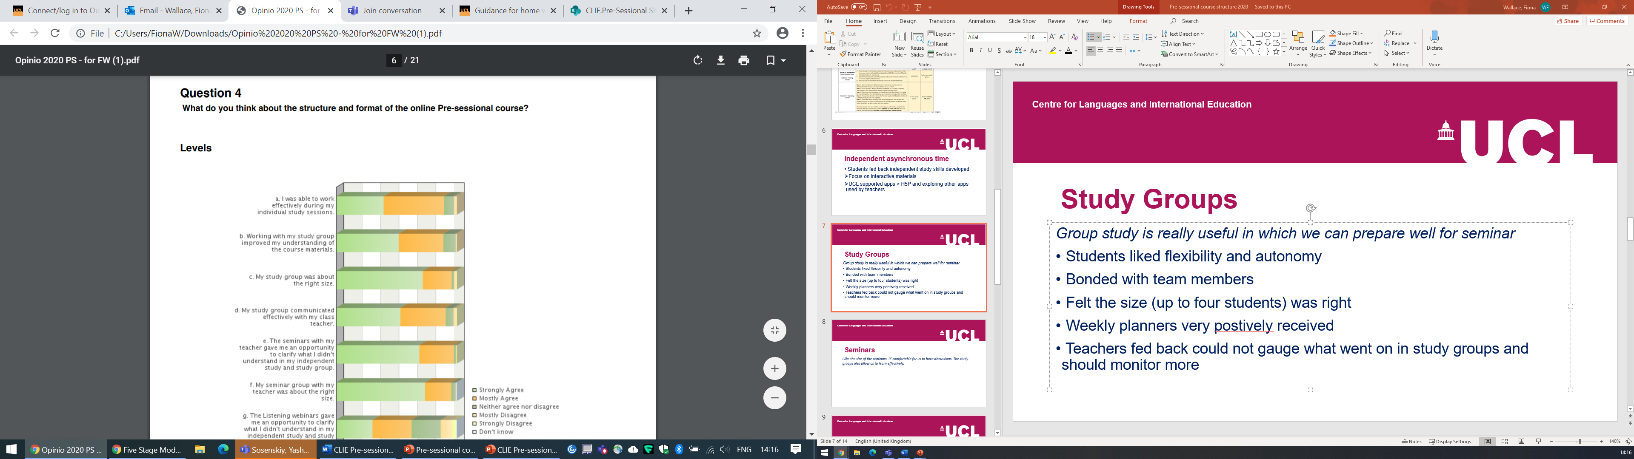
Centre for Languages and International Education
Student feedback
Via Opinio

Slide 12
Centre for Languages and International Education
I like the size of the seminars. It' comfortable for us to have discussions. The study groups also allow us to learn effectively.
Group study is really useful in which we can prepare well for seminar

Slide 13
Centre for Languages and International Education
Study groups - feedback
Students
Liked the flexibility and autonomy of the course structure allowed
Bonded with team members
Teachers
Fed back that it was difficult to gauge what went on in study groups and needed to be monitored more

Slide 14
Centre for Languages and International Education
Seminars
Some students commented that teachers only checked answers and didn’t explain during seminars
Some students complained others were not always prepared > links to engagement in Study Groups
Some teachers and students commented on lack of engagement in seminars

Slide 15
Centre for Languages and International Education
Recommendations for Online course structure 2021
Learner training in engaging in seminars
Develop materials for the online environment considering aims across the three modes of study
Allow for more fluidity in structure, e.g. review and consolidation in study groups as well as preview
Make the relationship between different modes of study explicit in the materials inc teachers’ notes, e.g. suggestions for discussion boards /forum posts
Notes:
A
Address engagement issues and teachers tending to check through the answers

Slide 16

Centre for Languages and International Education
Thank you

