Slide 1

Creating and sustaining a buzz around academic skills development, in discussion channels
Alison Leslie (module lead) and Denise de Pauw (co lead)
Language for Politics and Society 6 week summer pre-sessional at University of Leeds Language Centre

Slide 2
About the course
Aims-to prepare students for PG study in schools of Politics and International Studies and Sociology and Social Policy
Content led, with language and academic skills embedded
120 students- mostly from China
Platforms- TEAMS, Zoom, Flipgrid
Teachers- mix of new and experienced (EAP and institutional knowledge gap)
Notes:
Like many of our EAP community, we were tasked to adapt our pre-sessional course to online delivery this summer in response to the COVID19 pandemic. Although this was seen as emergency adaptation to remote teaching rather than a course designed to be online, we had the benefit of time and previous experience of online delivery to carefully consider how to use the digital platforms available to maximise student learning and a sense of community. One of the innovations we introduced was discussion channels for each of the academic skills (reading, writing, listening and speaking) through the use of Teams and Flipgrid. This presentation aims to reflect on how these discussion channels were one of the main successes of the course as they helped students to reflect on their skills development, develop their discussion skills, feel a sense of academic community and engage more critically with the theoretical content. In light of some of the literature on building discussions online, we will also share our thoughts on how and why we plan to include this form of asynchronous learning in future delivery of the course, even though this will potentially be a return to face-to-face learning.

Slide 3
Outline
Why we planned discussion channels for 4 skills
How we set these up; how we tried to encourage participation
Some examples
Our evaluations
Student evaluation-some examples of comments
Ideas for next year

Slide 4
Why we planned discussion channels for 4 skills
We wanted to:
create a space where skills development could be seen throughout the course:
- TEAMS reorganises discussion threads in channels and gets very confusing;
- content is king, and skills often get overlooked.
provide a sharper focus on listening and speaking, as there were fewer opportunities for this online;
help the students feel a sense of academic community, beyond the class groups.
“careful planning for online learning includes not just identifying the content to cover but also carefully tending to how you're going to support different types of interactions that are important to the learning process. This approach recognizes learning as both a social and a cognitive process, not merely a matter of information transmission.” (Hodges et al, 2020)

Slide 5
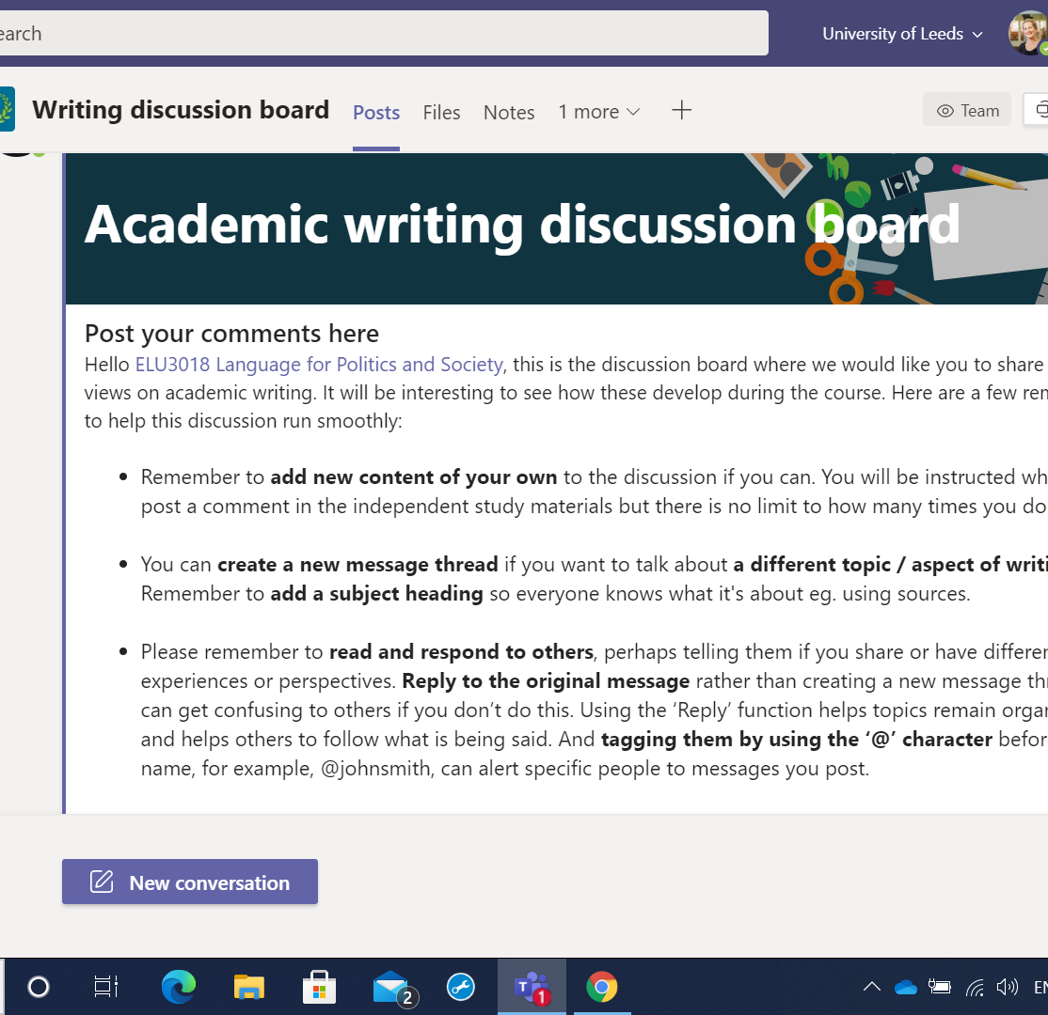
How we set it up to encourage participation
independent study materials instructed students to post and comment on one of the boards.
We included clear instructions, but needed to keep reminding students of these and the implicit expectations (Tomic et al, 2020).

Slide 6
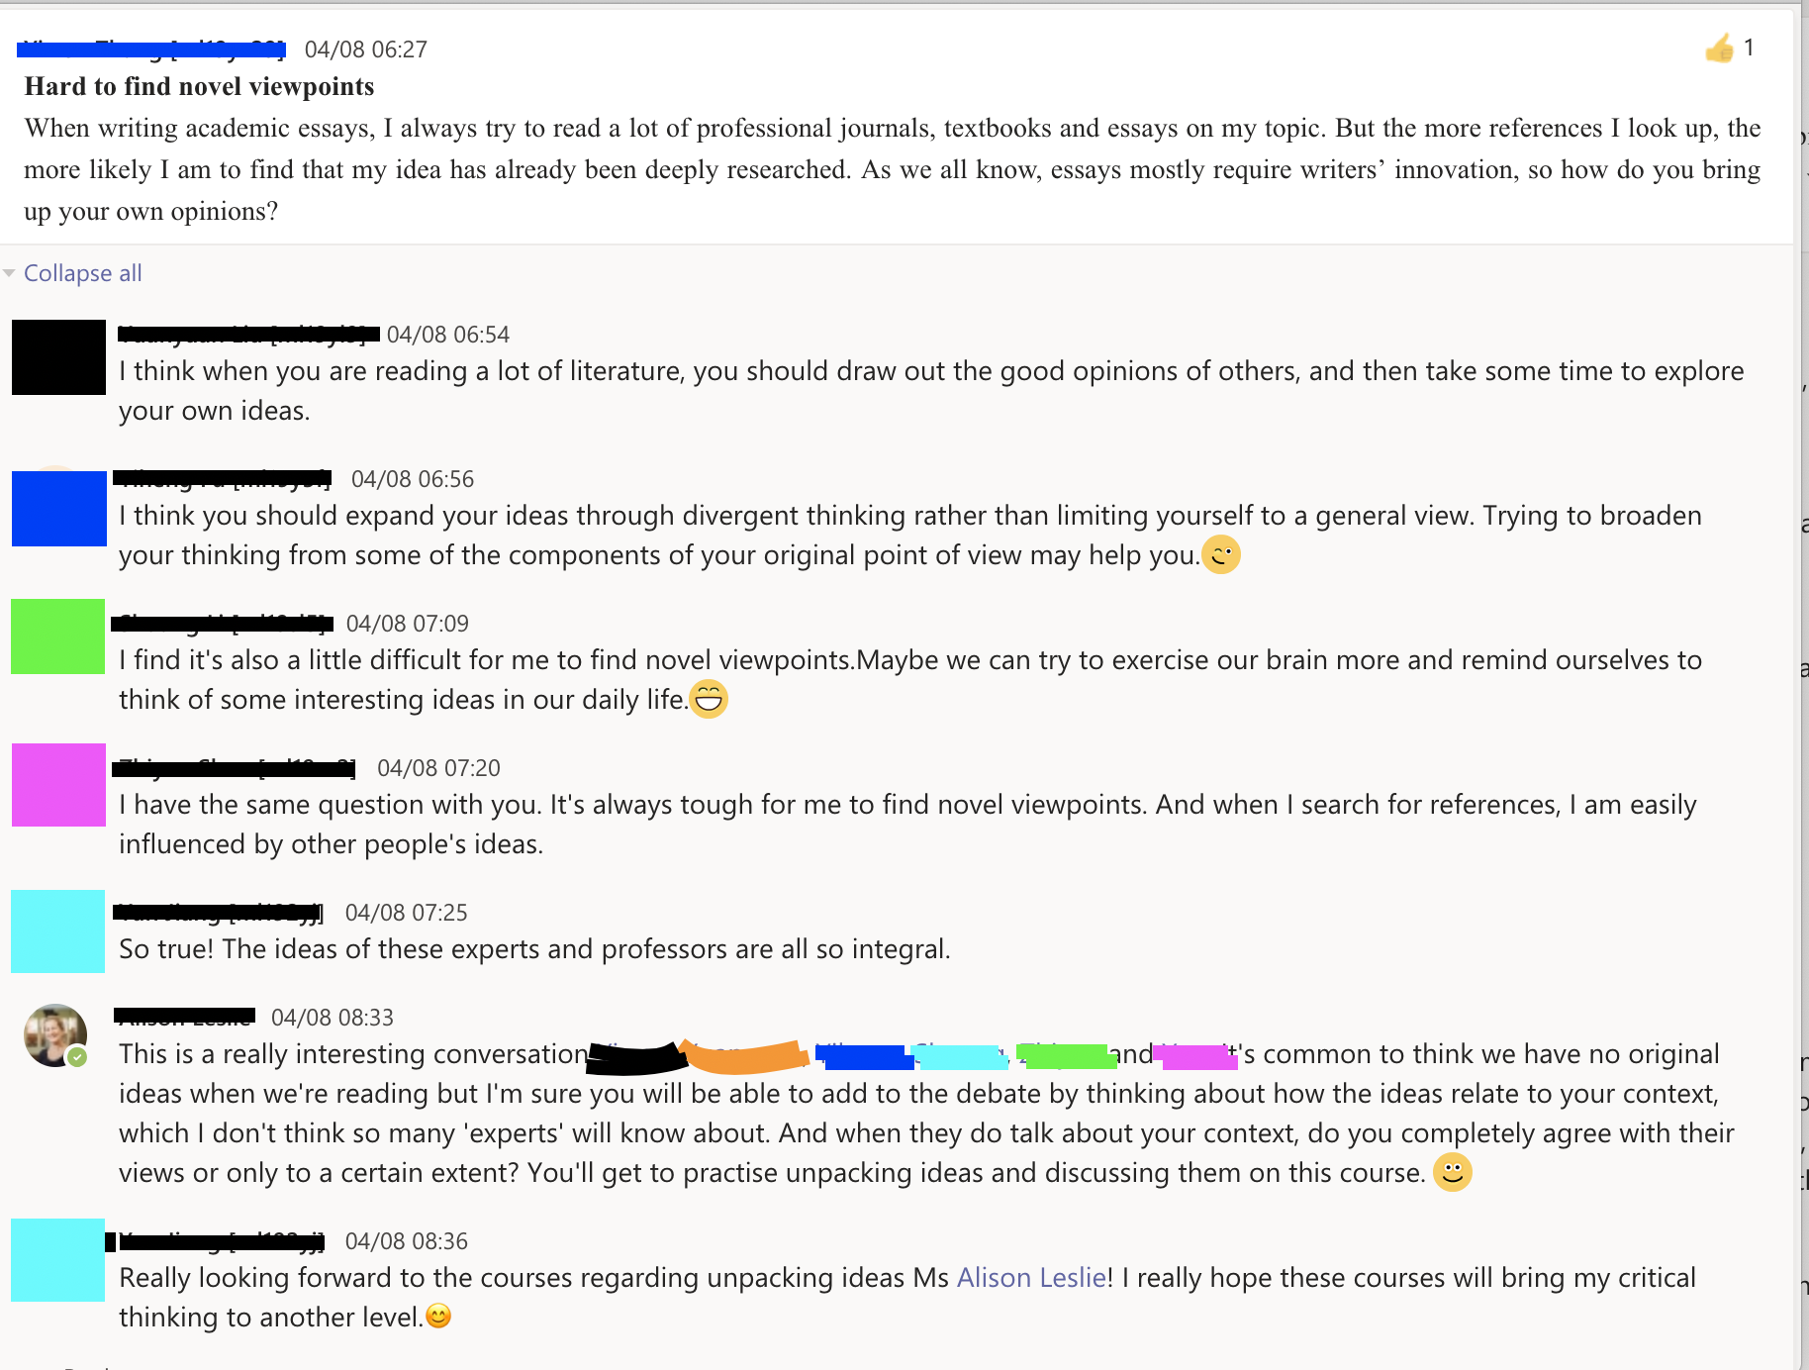
Example from writing discussion board
Balance of teacher presence and hyper-responsiveness (Tomic et al, 2020).

Slide 7
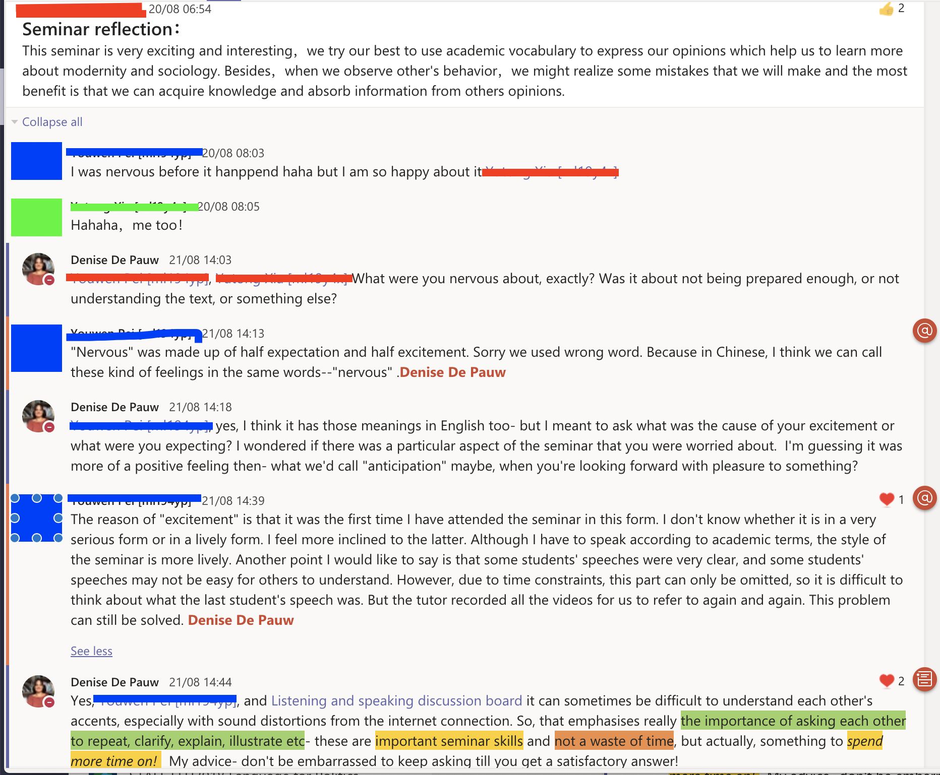
Examples from speaking and listening.

Slide 8
Limitations of Flipgrid
Not well integrated to the main platform;
Less than half of students posted their response to tasks;
Students did not comment on each other's posts- only 3 comments on whole course;
Many students watched videos up to 45 times;
Bandwidth problems;
However, lots of potential, e.g. downloading participation data for scrutiny; use of closed captions.

Slide 9
Our evaluation: much more useful than anticipated
Asynchronous format creates richer discussion and enables greater flexibility than the traditional seminar (Tomic et al, 2020):
To an extent, but not consistent.
Encouraging multiple formats helped students develop ‘a distinct online voice and personality’ (George-Briant and Brooks, 2020):
The students would need more time for this to bear fruit (6 week course)
Students could engage more critically with the (theoretical) content:
students have space to think (George-Briant and Brooks, 2020, Tomic, 2020).
Makes learning more transparent;
Gives us instant feedback (we could see how students and staff were engaging with materials);
Worthwhile as a tool for developing asynchronous discussion skills in their own right.

Slide 10
Student evaluation
Appreciation of opportunities for interaction but not a replacement for F2F:
“I think the best part is the setting of specialized boards for the students to share questions and suggestions.”
“In my opinion, the best part of the module is its strong interactivity. After class, there will be many sections, such as reading, writing and speaking, for me to practice.”
“There could be more face-to-face communication with more teachers rather than just post questions on discussion board? The effect of communicating through sending message is not so good.”
“I think more activities should be hosted, student can organise their group for specific topic and communicate with other groups, the topic like daily life, subject, writing skills and so on. Through that way maybe we can meet more new friends and also can exchange our mind. Not just typing in discussion board.”

Slide 11
Moving forward with online discussions
1. How can we engage more of the students more of the time?
Develop their reflectiveness, and criticality- active construction of knowledge- extend content discussions in classroom channels.
2. How to keep them focused on the skills development from start to finish?
  "build in interdependence of tasks"(Wang and Chen, 2017).
Make the academic skills much more explicit in the final project.
Get students to both set expectations and review their participation in discussion channels as part of this (Wang and Chen, 2017).

Slide 12
References
George-Briant, K. and Brooks, J. 2020. Online pedagogy: building learning communities. EAP in the North, May 2020.
Hodges, C., Moore, S., Lockee, B., Trust, T. and Bond, A. 2020.The Difference Between Emergency Remote Teaching and Online Learning. [online] https://er.educause.edu/articles/2020/3/the-difference-between-emergency-remote-teaching-and-online-learning
Tomic, S.; Roberts, E. and Lund, J. 2020. Designing learning and teaching online: the role of discussion forums. [online] https://www.advance-he.ac.uk/news-and-views/designing-learning-and-teaching-online-role-discussion-forums
Wang, Y. and Chen, D. 2017. Assessing Online Discussions: A Holistic Approach. Journal of Educational Technology Systems 46(2) pp.178–190

