Slide 1

Rethinking EAP teaching
Course design for quality learning online
Olwyn Alexander
Notes:
In these challenging times, we’ve had to respond very quickly to considerable changes in what and how we teach EAP. This is an opportunity to reflect on our recent and future practice based on general theories of education online.

Slide 2


The challenge
Sudden seismic shift in the way we were expected to deliver PSE
IELTS Centres in China closed in March
Institutions looked to their English units to help students meet their English condition
An opportunity in my case to raise the internal profile of PSE at my institution
Ian Jukes on Twitter @ijukes Oct 7

Slide 3


Shifting paradigm for course design
To this
Moving from this
We all use technology for teaching but it is a big leap to use ONLY technology for teaching.
Images retrieved 21.8.20 from https://medium.com/@donets.aleksey/online-communication-vs-offline-interaction-what-option-to-choose-883baf6c28be and https://www.facultyfocus.com/articles/effective-classroom-management/influencing-how-students-discuss-content/

Slide 4
Some more ready than others
The Open University L185 EAP Online http://www.open.ac.uk/courses/modules/l185
Coventry University Pre-sessional English Online (2018) https://www.coventry.ac.uk/study-at-coventry/online-learning/pre-sessional-english-online/
BALEAP discussion list – hugely supportive & generous community to share experiences and & approaches

Slide 5
Focus of this talk
  In this talk, I will refer to materials available in advance at
  http://eap-essentials.com/arguing-from-sources-with-writers-voice/
  Brief explanation of course design in my context followed by an overview of theories to support reflection.
  Not focusing specifically on technical issues and the dynamics of online classrooms.
  See David Read’s posts to the BALEAP discussion list for insights
  https://designingelt.com/a-few-things-weve-learnt-about-online-delivery-part-1/

Slide 6
Critical evaluation
The medium is not the message: the online platform is a means of delivery and not a driver of course design or teaching methodology.
Questions for reflection:
How well does your course design support learning?
  Are you teaching something or mainly practising skills?
How well does your course design support transfer to degree studies?
How well do your teachers understand your course design principles?
The intended outcome is to understand ways to evaluate online courses against more general theories of education.

Slide 7
Feedback on course design & delivery
  Nothing works perfectly first time round as this evaluation shows:
  Occasionally, the Collaborate [synchronous] slides were too close to the Prep [asynchronous] slides or were set up as answer keys making the teachers feel and appear to be superfluous. Teachers should be used more effectively than as biological answer keys.
  The design of the course prevented this teacher from teaching effectively
  We did not explain sufficiently well the underlying principles & how to use the materials

Slide 8
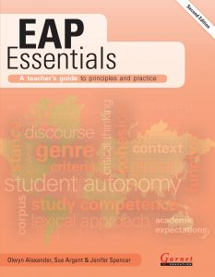
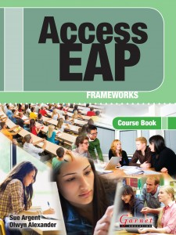
Underlying principles & practice
Early experience with Sue Argent & Jenifer Spencer on EAP course for distance learners in 2001-3
EAP Essentials chapter 3 Course Design
Core text Access EAP: Frameworks
  Task based & scenario based and relatively easy to adapt for online delivery
  Exemplar students as case studies
  Tells the stories of their academic journeys & challenges they face negotiating the system
Images retrieved 12.10.20 from https://www.garneteducation.com/category/english-for-academic-purposes/

Slide 9
Underlying EAP principles for course design
English – it’s about language performance
  Learning outcomes are the CEFR B2 descriptors required for entry to degrees
Academic – performance is contextualised within academic content & scholarship
  Learning outcomes are also graduate attributes acquired by studying a degree, e.g. research-mindedness
Purpose – it’s driven by assessment tasks
  Simulations of authentic academic genres
  Students choose concepts to research for ALL coursework

Slide 10
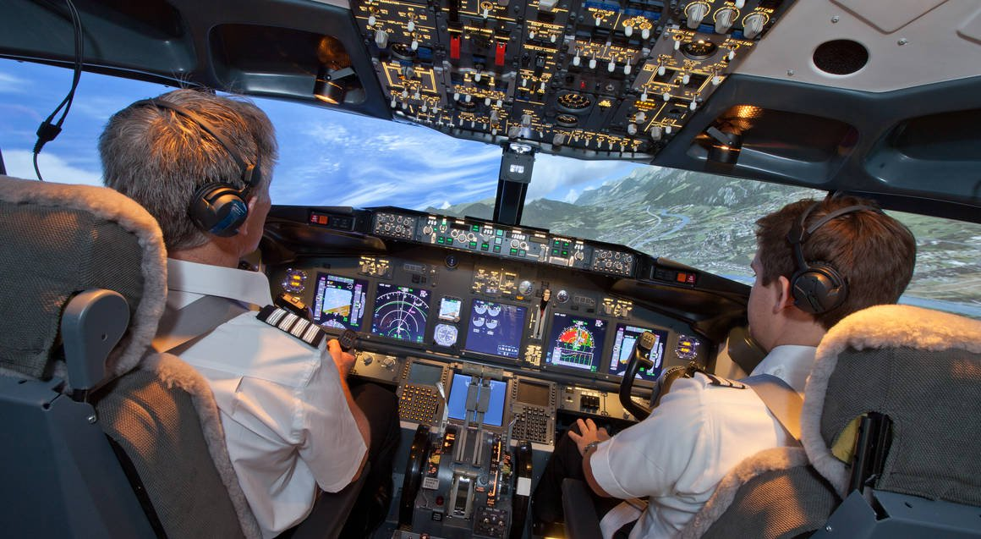
Simulating academic reality
Simulate academic assessments as closely as possible, e.g. annotated bibliography & literature review.
Mirror academic communication - mostly asynchronous via texts not face-to-face.
Use asynchronous communication BlackboardTM Discussion Board & Blog for peer interaction.
Image retrieved 21.8.20 from https://www.redballoon.com.au/product/boeing-737-800-flight-simulator---60-minutes/FLE003-M.html

Slide 11
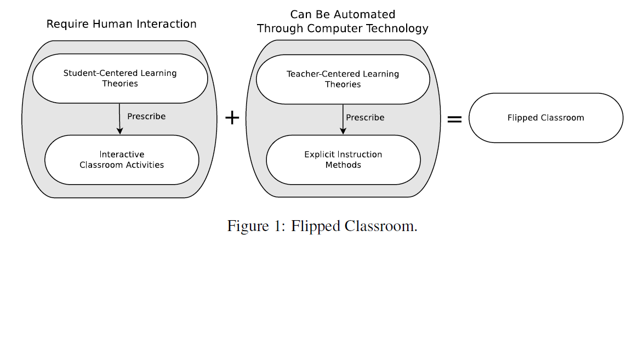
Defining the flipped classroom
An educational technique that consists of interactive group learning activities inside the classroom, & direct computer-based individual instruction outside…
Bishop & Verleger, 2013
Notes:
In the flipped classroom the teacher and student are not together as much and so the times they are together have to add significant value.

Slide 12
Design principles shared at teacher induction
Materials driven flipped learning – bridging coursebook lessons to online synchronous sessions with voiceover PowerPointTM presentations.
  Keep it simple – don’t let technology become the focus of your lessons.
  Don’t waste students’ time – focus on key learning outcomes.
In 50 mins there is no time to move through typical activities that a teacher controls: set up tasks, discuss in pairs, share with class. Instead:
  Concept check (to elicit understanding) – teach as new (only if needed) – provide metacognitive summaries and links to assessment.
  Show answers & discuss why these are the answers.
  Focus on metacognitive aspects – to enable transfer of learning to degree studies (Monbec, 2018).

Slide 13
Some of the issues
Synchronous sessions were not learning critical
  Students with tech issues could not access these in real time
  The main purpose of synchronous sessions was to build a class community of practice to support asynchronous peer-to-peer activities
Key issue with teacher identity
  Many teachers were unhappy with lack of face-to-face teaching.
  Essential engagement with students was lost in their view
  Some teachers felt “designed out” of the course & were uncertain of their role
Teacher knowledge about language
  Teachers new to the programme and some more experienced teachers did not fully understand the concepts they were teaching.

Slide 14
Theories of learning informing reflection
Laurillard (2002 and 2012) informs EAP Essentials chapter 3
  Designs for learning with & through technology
  Data-driven – informed by empirical studies at the Open University
Sarma & Yoquinto (2020) the science transforming how we learn
  Recently published monograph tracing the history of learning theories
  Main author is the Head of Open Learning at MIT.
Maton (2020) Kirk (2018) Monbec (2018)
  Legitimation Code Theory, a sociological theory of knowledge
  Aims to explain how people become experts & how they teach others
  Specific toolkits semantic gravity & semantic density enable analysis & evaluation of classroom interactions promoting knowledge building

Slide 15


Teaching as collaborative conversation
Becoming aware of differences in understanding
Working together towards a shared goal
Laurillard, 2002 in Alexander et al. 2018 (2nd ed.) p 121-2
Notes:
Teacher and student describe to each other their understanding of a concept.
Both become aware of differences in their descriptions.
Teacher adapts her description to the level of understanding of the student.
Student uses this feedback to change own understanding.

Slide 16
Collaborative conversation – talk is crucial
Uses feedback
to change metacognitive understanding
Provides feedback on task outcome with metacognitive explanation
Shows understanding, by doing a task with metacognitive talk
Explains a new concept & illustrates with real world task
Laurillard, 2002 in Alexander et al. 2018 (2nd ed.) p 121-2
Notes:
Teacher explains a concept and provides an environment where student can interact with a real world task or problem
Student describes his understanding by doing the task and talking about task outcome
Teacher judges how well the student has understood and provides feedback on task outcome
Teacher adapts her description to the level of understanding of the student with metacognitive explanation – what kind of thing is being learned.
Student uses this feedback to change own understanding.
Student’s developing understanding leads to a new focus for the conversation.

Slide 17


Other collaborative conversations
Feedback on some tasks can be automated
Use feedback to repeat tasks or try new ones
Collaborate in completing tasks & understanding metacognitive aspects & feedback
Peers can share understanding & give feedback
Laurillard, 2002 in Alexander et al. 2018 (2nd ed.) p 121-2
Notes:
Peers can share their understanding of a teacher’s description of a concept and also give each other feedback
Peers can collaborate in completing tasks and understanding metacognitive aspects the tasks and the teacher feedback
Feedback on some tasks, especially convergent tasks with limited number of correct answers can be automated.
Student has to value all forms of feedback in order to use it to change own understanding.

Slide 18

The science of learning
Human to human education is best but technology can support this (p. xxvi)
Theoretical concepts need to be contextualised in real situations (embodied cognition) to be understood (p. 49)
Experiential learning in communities of mentors or peers develops embodied cognition (p. 145-6)
Effortful retrieval – having to work hard to recall concepts – helps to fix them in long term memory (p. 128)
Effortful retrieval can be promoted through spacing recall, interleaving recall of different subjects, metacognition and regular testing (p.136)
Sarma, S. with Yoquinto, L. (2020). Grasp: the science transforming how we learn. London: Robinson.

Slide 19
Issues for flipped learning
A human teacher is essential for discussion of & feedback on divergent tasks with no single correct answer, e.g. formative writing tasks.
A human teacher is essential to develop metacognitive understanding.
A computer can provide correct answers to convergent tasks, e.g. grammar practice activities.
Peers can provide learning communities to develop embodied cognition
Teachers have to be prepared to cede control of learning to computer-based materials and to students.
Many teachers prefer being face-to-face in a classroom where they feel they have more control and the interactions are ‘real’.

Slide 20
Legitimation Code Theory
With apologies to those who already know and use this theory to inform their practice.
  To be successful, students have to be able to use meaning-packed, non-context-dependent language and prove that they understand it by unpacking it and grounding it in the real world.
i.e. general (conceptual) >> specific (real world case or example)
Ingold, R. and O’Sullivan, D. (2012) Riding the waves to success. Modern English Teacher Volume 26 Issue 2.

Slide 21
Legitimation Code Theory
How much meaning does something contain?
Semantic density, SD+ e.g.
  Plagiarism, Scholarship SD+
  Copying the work of others or using your own voice SD-
How close to a specific context do you have to be to understand something? Semantic gravity SG+, e.g.
  Specific task on your PSE in your institution SG+
  Metacognitive understanding of task outcome to enable transfer to degree studies SG-
Ingold, R. and O’Sullivan, D. (2012) Riding the waves to success. Modern English Teacher Volume 26 Issue 2.

Slide 22
Semantic density +SD / gravity +SG
SG- context reduced
Recalls and reviews information
Relates ideas, e.g. compares
Generalises / summarises
Transforms and personalises
Selects & integrates information
Develops and sustains ideas
Argues, evaluates, justifies
Applies principles to new situation
SD- cognitively undemanding
SD+ cognitively demanding
Interpersonal interactions. Tells personal stories. Describes situations and actions.
Discipline-specific epistemology – ways of knowing and performing.
Applies frameworks to cases
SG+ context embedded
Notes:
Students take responsibility for context embedded knowledge building while teachers can support context reduced performance

Slide 23
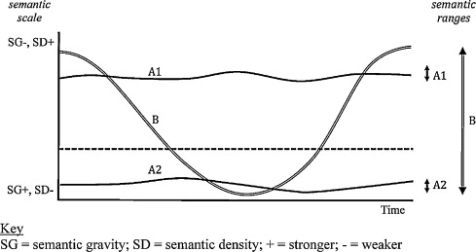
Making semantic waves
Generalises concepts
Builds metacognition
Contextualises – describes examples and cases, enables embodied cognition
Retrieved from Making semantic waves 2013 https://doi.org/10.1016/j.linged.2012.11.005

Slide 24
Semantic wave analysis of a lesson
Materials for this lesson can be found here https://eap-essentials.com/arguing-from-sources-with-writers-voice/
The most powerful and sustainable form of immunization against plagiarism is the development of an academic writer’s voice (Argent, 2012).
Rather than dwelling on the term plagiarism, it is more fruitful to consider the opposite side of the coin, scholarship.
Access EAP: Frameworks, Unit 8 Section 4, focuses specifically on activating writer's voice & identifying components of writer's voice in two (constructed) student texts.

Slide 25
Writer’s voice Graduate attribute
Preparation PowerPointTM
--SG
SS Activating Writer’s voice
SS Analysing essay titles
SS Writer’s voice
SS operationalisation
-SG
SS = Study Smart metacognitive summary
Contexts
Transition implicit
Transition implicit
Transition implicit
+SG
Aims
Purpose of sources
Analyse specific title
Apply to assessment
Follow up analyse assessment for writer’s voice
Plagiarism
Brainstorming surveying/selecting sources
Case study student texts
Example
Metaphors
Planning
Language analysis
++SG
Time
30 min
60 min
90 min
120 min
150 min
180 minutes
Notes:
Peaks in the wave show the Study Smart boxes from the coursebook, where the components of a concept or the procedures for achieving it are summarised. Red dotted lines show where there should be better transitions in the lesson.

Slide 26
Writer’s voice GA
Collaboration PowerPointTM
--SG
SS Activating Writer’s voice
SS operationalisation
-SG
SS = Study Smart metacognitive summary
Contexts
Expected transition
Expected summary transition
+SG
Aims
Key Analyse specific title
Key Purpose of sources
Plagiarism
Apply to assessment
Follow up analyse own assignment for writer’s voice. This acts as a summary of the learning outcomes
Writer’s voice
Brainstorming
Example
Planning
St discussion notes/outline
St discussion Case study texts
Language analysis
++SG
Metaphors
Time
10 min
20 min
30 min
40 min
50 min
60 minutes
Notes:
Green highlights show where answer key was given in preparation and simply needs checking here not teaching as if it is new. The first part of the lesson was a review of previous lessons and has been contracted in terms of timing.
Yellow highlights show two points for student discussion in breakout rooms (see suggested lesson plan) At least this should involve some student interaction. This part of the lesson has been expanded in terms of timing.
Red dotted lines are where there should be better transitions in the lesson, which we hope the teachers would make.

Slide 27
Results of LCT analysis
Preparation PowerPointTM profile has missing transitions to make links between stages of the lesson explicit for students.
Collaboration PowerPointTM provides answer keys for tasks and creates a space for student interaction in the lesson.
Teachers in the recorded lesson did not often make explicit transitions between stages or provide metacognitive summaries of learning points.
There was some good use of the interactive affordances of the Collaborate classroom, chat, emojis and polls
Many teachers read through the PPT with little interaction with students
Did they feel constrained by having PPT provided for the online class?

Slide 28
Student evaluation
Learning in advance, reviewing in time and learning to summarize is the most effective self-learning for anything.
What impressed me most about the online language class was to preview the homework in advance, […] very different from the Chinese way of teaching.
Assessed courseworks are linked to the real coursework in university.
The best thing that I will remember is team-work and teacher's patience.
This course can attract lazy student like me to feel attraction, funny, very useful to future study, very good course design which several activity, especially very continue and logic lesson help me improve step by step, easy to difficult, familiar to new.

Slide 29
Teacher evaluation
I have the feeling that because [students] have less class time, they have both the energy to do more self-study and the desire to engage more (synchronously and asynchronously) in order to get their 'community' fix. I think this approach to the programme has great potential.
I've rather resigned myself to the horrible imbalance of TTT to STT. I don't think it has to be this way, but I've struggled not to slip into me monologuing [..] My feeling is that, apart from the very strongest students, most of the obvious moments of learning come when I really insist on responses/input and then spend time really pushing them to reflect on what they've said in chat and why.

Slide 30
Questions for reflection
How well does your course design support learning?
  Pass rate > 98% & generally positive student evaluation
How well does your course design support transfer to degree studies?
  Supports embodied cognition through peer learning & assessment
  Metacognitive aspects need to be improved.
How well do your teachers understand your course design principles?
  Not so well in some cases: can use example recordings and LCT analysis at induction to explain requirements.

Slide 31
Final thoughts
LSCS 2020 Integration, Internationalisation & the Individual July – August.
A slow conference “adapting to the needs of circumstances & audience” *
Key take outs from the conference
Reflecting on evolving identities of teachers & students in moving online.
Challenging assumptions about communication face-to-face & online.
Creating communities of practice so students feel confident & safe to contribute
Valuing what students bring to their new education context, e.g. a knowledge of their field.
* Professor Tom Ward, Deputy Vice-Chancellor: Student Education

Slide 32

Any questions

Slide 33
References
Argent, S (2012) Making the transition from General English to EAP. New College Nottingham: EAP in the East Midlands (May 2012).
Bishop, J.L. & Verleger, M.A (2013) The flipped classroom: a survey of the research. Paper presented to 120th Annual Conference of the American Society for Education in Engineering. Atlanta.
Ingold, R. and O’Sullivan, D. (2012) Riding the waves to success. Modern English Teacher Volume 26 Issue 2.
Kirk, S.E. (2018). Enacting the Curriculum in English for Academic Purposes: A Legitimation Code Theory Analysis. Durham theses, Durham University. Available at Durham E-Theses Online: http://etheses.dur.ac.uk/12942/.
Laurillard, D (2002) Rethinking University Teaching: a framework for the effective use of learning technologies. London: Routledge Falmer.
Laurillard, D. (2012). Teaching as a Design Science: Building Pedagogical Patterns for Learning and Technology. New York and London: Routledge.
Maton, K. (2020). Semantic waves: Context, complexity and academic discourse. In Martin, J.R., Maton, K. & Doran, Y.J. (Eds.) Accessing Academic Discourse: Systemic Functional Linguistics and Legitimation Code Theory. Abingdon, Oxon: Routledge, pp. 59-85.
Monbec, L. (2018). Designing an EAP curriculum for transfer: A focus on knowledge. Journal of Academic Language & Learning, 12/ 2, A88-A101.
Sarma, S. with Yoquinto, L. (2020). Grasp: the science transforming how we learn. London: Robinson.

