Slide 1

What can cognitive linguistics do for the EAP community?
Dr Sally Zacharias
BALEAP 2019

Slide 2
OutLine
What is cognitive linguistics?
Cognitive linguistics and educational discourse: a new approach to thinking about the role of language in learning?
Apply some principles of cognitive linguistics to educational discourse: examples from the classroom.
Future directions: cognitive linguistics and EAP
- for our students?
- for the EAP practitioner and research community?

Slide 3
Cognitive Linguistics: some basic principles or ‘commitments’
There is no autonomous, special-purpose ‘language acquisition device’ that is responsible for language acquisition and language processing.
A single set of cognitive processes operates across all areas of language, and these processes are involved in other types of knowledge and learning besides language.
Words provide only a limited and imperfect means of expression
Language is inherently meaningful although grammatical meanings are more abstract than lexical meanings. Littlemore (2009:1)
Language is ‘usage-based’ in that it is a product of physical interaction with the physical [and social] world.

Slide 4
Language is usage-based: The embodiment hypothesis
‘Human physical, cognitive, and social embodiment ground our conceptual and linguistic systems’. (Rohrer 2007: 27)
Conceptual Metaphors (Lakoff & Johnson 1980)
LIFE AS A JOURNEY
‘I was at a crossroad’
‘I didn’t know which path to take’
DISEASE IS THE ENEMY
‘We need to fight the infection with a course of antibiotics’
We understand more difficult abstract domains through more familiar, concrete embodied experiences.

Slide 5
Framing Human-MiCROBE RELATIONS: The Military metaphor
‘The language we use to frame our relationship with microbes has profound effects. 'Crises' are imminent with the rise of microbial resistance; we face a looming 'apocalypse' as the antibiotics fail to work; we 'fight' disease, and structure public health campaigns around 'military style' campaigns. As we divide microbes into those that are friendly, and those 'superbugs' that are 'enemies' we barely think of the impact that this language has. Yet we as humans we are comprised of viruses, bacteria and fungi such that our bodies are inseparable from these. This way we understand human-microbe relations has had profound effects; but as the antibiotic era draws to an end, we now need new ways of reconceptualising our relationship with microbes’.
Re-Imagining AMR (antimicrobial resistance): Beyond the Military Metaphor:
https://docs.google.com/forms/d/e/1FAIpQLSf_LMqd1leViJAsF2JtraKGzxcOVBa1TCZKKhvU-eqc6-XEiQ/viewform

Slide 6


Language is ‘usage-based’
Image-schemas (Johnson 1987)
S
She walked from her office to the bus.
The raindrop fell from the leaf.
The raindrop fell.
SOURCE-PATH-GOAL
The children are in the airplane.
I’m in love.
The book’s in Spanish.
CONTAINER

Slide 7
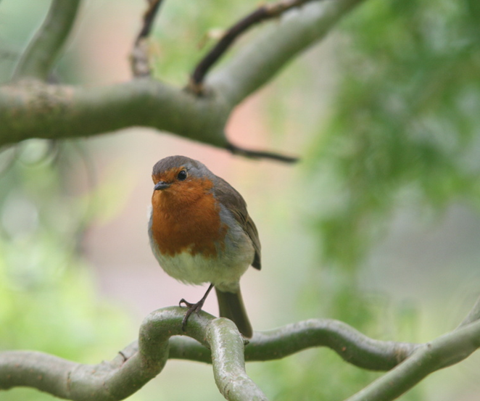

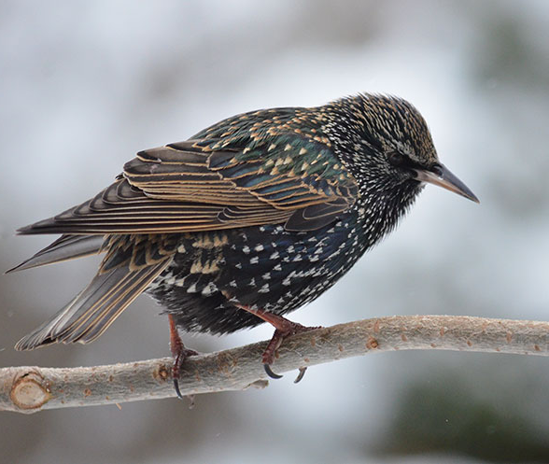
The same cognitive processes involved in language, knowledge-building and learning:
Which is the birdiest bird?
Prototype Theory
(Rosch 1973)
This Photo by Unknown Author is licensed under CC BY-NC-ND

Slide 8


Words provide only a limited and imperfect means of expression
bread
This Photo by Unknown Author is licensed under CC BY-SA

Slide 9
Cognitive linguistics and educational Discourse
Relatively slow uptake of CL principles in language teaching (including EAP)
Exceptions in EAP: Metaphor and Lectures (Littlemore 2001; Low et al. 2008)
Possible Reasons:
Research in cognitive linguistics has only recently looked seriously at naturalistic data.
Cognitive linguistics literature can be inaccessible. Only a few scholars have written for practitioners (e.g. Littlemore 2007 , Tyler 2012, Cushing 2018,Giovanelli and Harrison 2018, Zacharias 2019 & forthcoming)
Sociocultural turn in language teaching has created a false binary whereby ‘cognitive’ construes the mind as a machine.

Slide 10
Looking at Classroom discourse from a cognitive linguistic perspective
Learning a new subject involves learning unfamiliar discipline specific abstract concepts. Challenging to learn and teach.
Taking a cognitive linguistics approach we can understand role of language in this process more fully.
Research Data
Learning episodes from first year secondary school science lesson
Classroom discourse was recorded, transcribed and analysed using cognitive discursive framework (Zacharias 2019, Zacharias forthcoming)
Analysis shows how abstract scientific concepts (e.g. heat energy) develop over time and space in a social setting.

Slide 11
Abstract concept of Living: Categorization (instance of a prototype)
Mr D: ok boys and girls (.) that's fine thank you very much (.) we go around a find out how you would define living shall we start over here go on then someone
Kate: we didn't know how to define it (.) so we thought about something that all living things need like every single thing that is living needs water
Mr D: good that’s brilliant(.) one thing that living things do need is moisture dampness and water (.) brilliant fantastic do non-living things need that sort of thing I talked about? a pair of scissors(.) a pen well a pen? doesn't really need water(.) a pair of scissors doesn't really need water plastic doesn't really need water right anything else
Kate: um um like err they all they grow

Slide 12
Abstract concept of Energy Transfer: IMAge schemas
Sally: yeah and Rose and you thought something slightly different didn’t you so can you remember what you thought at the time?
Rose: like if you put on a jacket it’s not like (.) instantly warm (1.0) the body heat needs to heat up the jacket.
Sally: u– huh
Rose: so the jacket hadn’t been on a radiator (.) or near any heat so if you put it on the snowman it wouldn’t make any difference (.) and there’s no like source of well there’s the cold of the snow but it wouldn’t keep him cold like
Sanja: at first I thought like (.) the cardboard would melt the ice (.) the snow it’s trapped (.) and it has no way of like cold air to keep it (.) to keep it to keep it a solid so I thought the heat would go to the snow
Sally: m-mh have you changed your view?

Slide 13
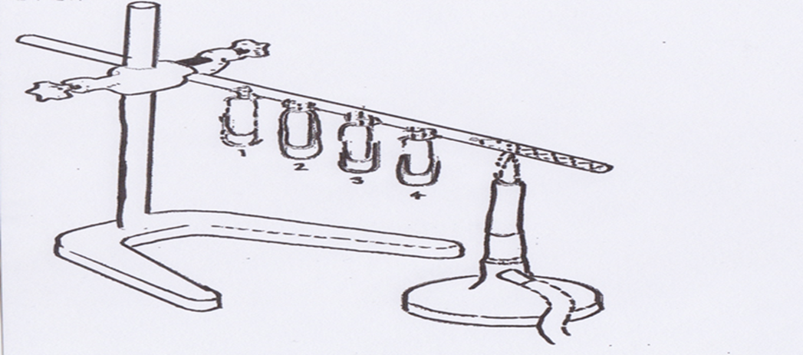
Explanation of energy Transfer: Macro and Micro Mental Spaces
Student’s response: “The heat spreads through the solid rod and the particles start vibrating and it keeps going along the solid rod until all the paper clips have fallen off”.
Teacher’s response: “What I would say is that the copper rod carries heat energy. The copper rod is made of particles, packed quite closely together. When one end is heated, the particles in the solid vibrate more quickly. These particles collide with the other ones, which then vibrate more quickly, and that's the way heat energy is transferred. That is what I would have written”. (from interview 18.03.15).

Slide 14
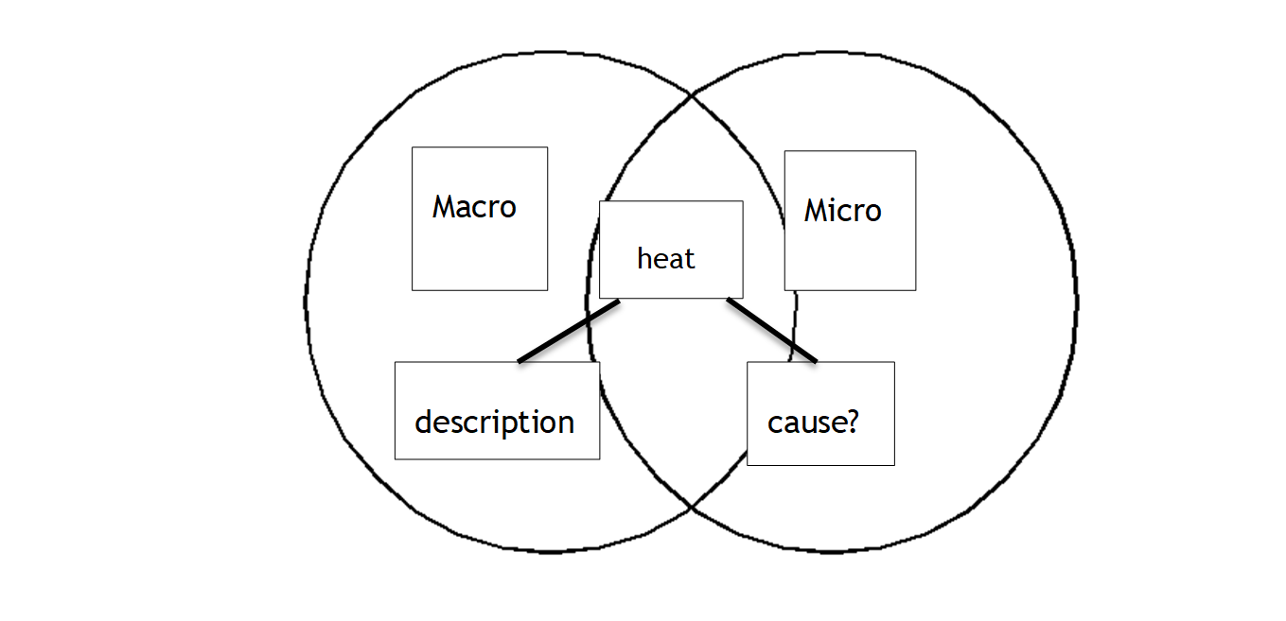
Mental Spaces: Macro and MiCRO WORLDS

Slide 15
Model of Linguistic Knowledge
(Zacharias forthcoming)
Component Part | Details
Lexical and syntactical constructional knowledge Experiential knowledge: Fillmore (1976) | Knowledge of how lexical items and syntactical patterns are used in context. Shared understanding of what these items and patterns refer to within discourse community.
Cognitive processes Construal operations (based on Langacker 2008; Croft and Cruse 2004: 46) e.g. schematization categorization epistemic modality image schemas metaphor/metonymy mental space etc. | ability to recognize item’s structure as instance of prototypical schema (categorization) a condensed redescription of perceptual experience (image schema)
Formal knowledge structures Van Dijk & Kintsch 1983), ‘cognitive genre’ (Bruce 2008) | Knowledge of rhetorical purpose

Slide 16
How Can this Be Embedded into EAP PRACTICE?
Metaphor analysis
  AMR, climate change, economy, immigration, Brexit….
  What are they key conceptual metaphors?
  How do they frame the debate?
  Could other more constructive metaphors be used?
  Are the same metaphors used in your own language?
  Mental spaces
  What conceptual spaces are present in the text? What markers are used by the writer to switch between these spaces?
  Grammar/image schemas etc
  Sort structures according to underlying image schema.
  Look at how these structures are used to foreground various aspects object/event?

Slide 17
Cognitive Linguistics and EAP
Radical approach to thinking about language yet compatible with established approaches (e.g. Halliday’s systemic functional linguistics)
Benefits for Students
Students expected not only to represent their ideas but also to learn new abstract concepts in target language. This involves a series of re-construals over time (Giovanelli in conversation).
Knowing what these construal operations are and how concepts are shaped through language can facilitate this process.
Thinking about grammar becomes more meaningful.

Slide 18
Benefits and challenges for practitioners and researchers
Brings insight into conceptual world of students and how cognitive, physical, linguistic, cultural and social factors play a role in conceptual development
Sits well with current approaches (e.g genre, SFL)
Can be embedded into current practice
Requires CPD!

Slide 19
Thank you for listening!

Slide 20
References
Bruce, I. (2008) Academic writing and genre: A systematic analysis, London: Continuum International Publishing Group.
Cushing, I. (2018). Stylistics goes to school. Language and Literature, 27(4), 271-285.
Croft, W. and Cruse, D. A. (2004), Cognitive linguistics, Cambridge: Cambridge University Press.
Fillmore, C. (1976), ‘Frame semantics and the nature of language’, Annals of the New York Academy of Sciences, 280(1), 20-32.
Giovanelli, M., & Harrison, C. (2018). Cognitive Grammar in Stylistics: A Practical Guide. London: Bloomsbury Publishing.
Lakoff, G. and Johnson, M. (1980) ‘Metaphors we live by’, Chicago: University of Chicago Press.
Johnson, M. (1987) The body and the mind: The bodily basis of meaning, imagination, and reason, Chicago: University of Chicago Press.
Langacker, R.W. (2008a), Cognitive Grammar: A basic introduction, Oxford/New York: Oxford University Press.
Littlemore, J. (2009). Applying cognitive linguistics to second language learning and teaching. Basingstoke: Palgrave Macmillan.
Rosch, E.H. (1973). "Natural categories". Cognitive Psychology. 4 (3): 328–50.
Rohrer, T. (2007). Embodiment and experientialism. In The Oxford handbook of cognitive linguistics. Oxford: OUP.
Tyler, A. (2012). Cognitive linguistics and second language learning: Theoretical basics and experimental evidence. New York: Routledge.
van Dijk, T. A. and Kintsch, W. (1983), Strategies of discourse comprehension, New York: Academic Press.
Zacharias, S. (2019), ‘The development of the abstract scientific concept of heat energy in a naturalistic classroom setting’, in Bolognesi, M. and Steen, G. J. (eds), Perspectives on Abstract Concepts: Cognition, Language and Communication. Amsterdam: John Benjamins. (In Press)
Zacharias, S. (forthcoming) ‘Towards a concept-driven pedagogy: a model of linguistic knowledge’ in Giovanelli, M., Harrison, C. and Nuttall, L. (eds.), New Directions in Cognitive Grammar and Style. London: Bloomsbury Publishing.

