Slide 1
TEAP accreditation:
Generating momentum for TEAP portfolio submission through collaboration, structure and developmental focus
Paul Hendrie,
CELFS, University of Bristol

Slide 2
What is TEAP accreditation?
Professional recognition and accreditation
Guide to personal development
Roadmap for career development
Submission of:
  Portfolio of evidence
  Reflective account of Professional Practice

Slide 3
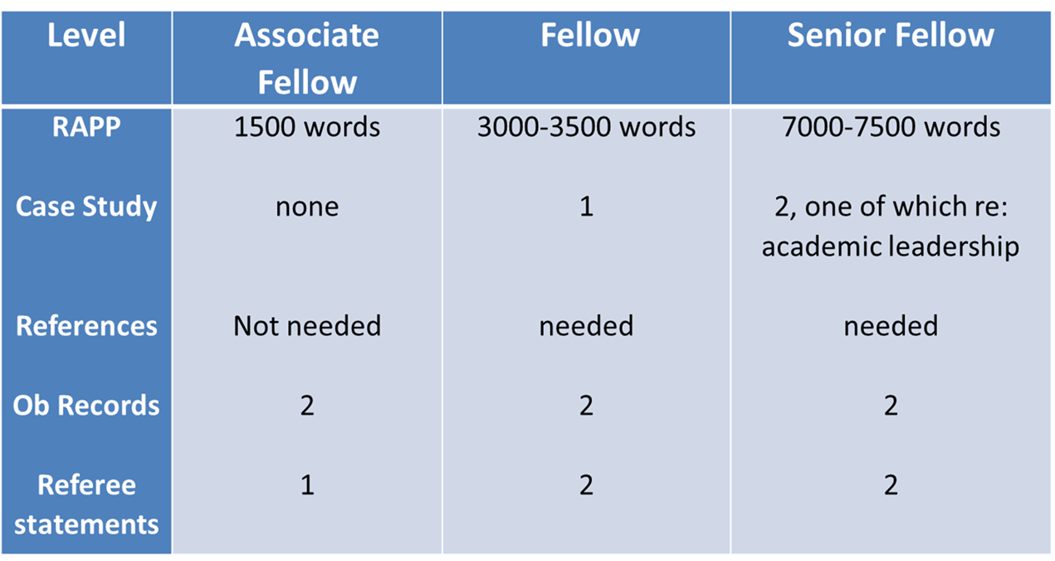
Submission requirements

Slide 4
Overview
Obstacles to submission (Sept 2017)
Experiences setting up TEAP group with PS teachers (Jun - Aug 2018)
Online resources for setting up TEAP groups (present)

Slide 5
Obstacles to portfolio submission (Sept 2017)
Obstacles to submitting TEAP fellowship accreditation | Possible solutions
Finding the time Always a more pressing deadline Managing heavy workloads Handbook is dense Task unclear No idea for case study Difficulties with structure Lack of motivation No incentive - what’s the point? | Set structure & checkpoints Approach it gradually; ‘rubbish first drafts’ Regular discussion to share challenge & resolve difficulties Refocus on development Bypass motivation: regular time to relate current work to portfolio collection

Slide 6
The approach:
Weekly TEAP meetings during Presessional (Fridays 3.30 - 4.30pm)
Completely voluntary participation
Signup in week 1
  Clear rationale for attendance
  Connection to development & employment
Facilitated by another teacher (no need for assessor/ senior fellow)
Simple 3 part structure to each meeting:
  Input: what have we done/learned this week?
  Discussion: how does this relate to the criteria? What do I want to learn next?
  Writing: write 200-250 words of the RAPP

Slide 7
Outcomes of PS TEAP Group
Increased interest & engagement with TEAP scheme
29 teachers signed up out of 80
Limited number of TEAP observations
4 successful AF submissions in November 2018 (target was 3)

Slide 8
Next iteration: year round workshops
(Sept 2018- Jun 19)
Each session has a theme, eg:
    Understanding the task
    Evidence collection
    Outlining the RAPP
    Writing a case study
Some engagement
    Range of levels
Timing & priorities

Slide 9
Next iteration: autonomous PS TEAP groups
Set up and facilitated by volunteer teachers themselves
  Within a variety of institutions
Guided discussion & activities
To provide
  Structure
  Focus on development
  ‘Shared struggle’
Problem solving: finding mentors, observers
Group can Invite speakers to attend

Slide 10
Links to TEAP resources
Facilitator guide, video induction, ppts for sessions
Copyright free, open to all:
https://padlet.com/paulhendrie/TEAPResources
Template for Associate Fellow portfolio:
https://padlet.com/paulhendrie/AFmodel

Slide 11
Next iteration: PS Summer 2019
Greater teacher autonomy: time, location, format
Teachers choose to be facilitators
  Encourage returners to volunteer
Flipped content
Access to all resources online
Consultative role for me

Slide 12
Invitations to collaborate
Set up a group in your institution
Compare experiences
Establish cross-institution bottom up collaboration
Feedback on the resources
paul.hendrie@bristol.ac.uk

