Slide 1

Trouble at mill: pedagogic responses to the rise and rise of custom written essay services
Martin Seviour
Nottingham Language Centre
Nottingham Trent University
April 13th, 2019

Slide 2
What is an Essay Mill?
“An organisation or individual, usually with a web presence, that contracts with students to complete an assignment or assignments for a student for a fee.”
QAA Contracting to Cheat In HE (2017)
“ (contract cheating is) a qualitatively different concept to that of ‘cut-and-paste plagiarism’, or obtaining inappropriate help from a friend … . The act of payment makes contract cheating deliberate, pre-planned and intentional” (Newton, 2018).

Slide 3
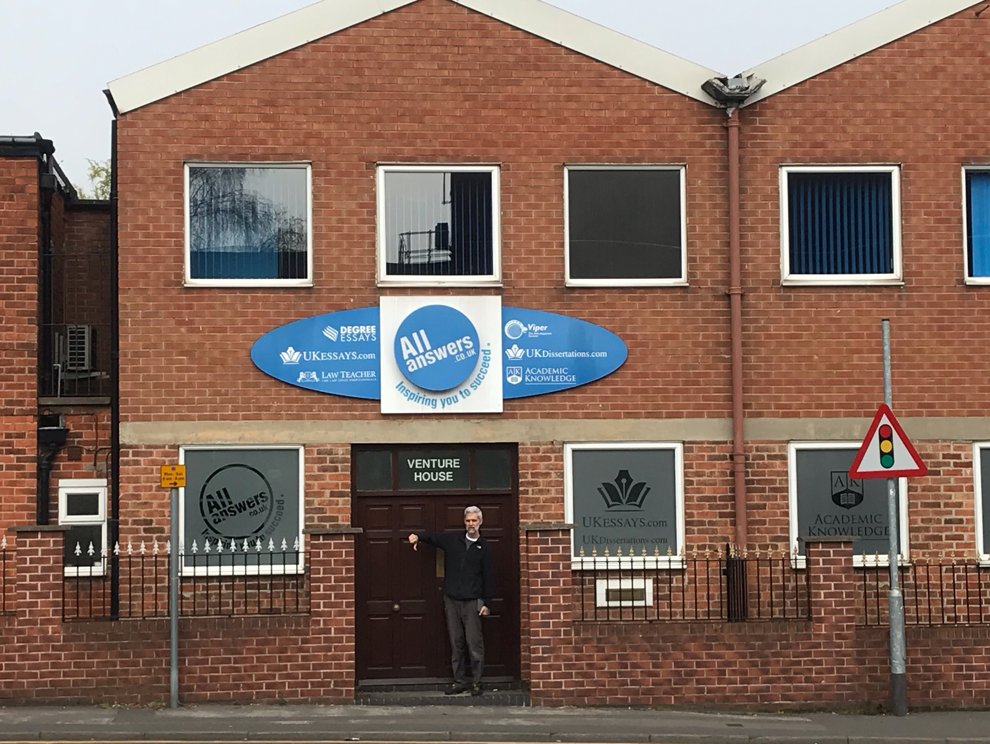
What does an essay mill look like?

Slide 4
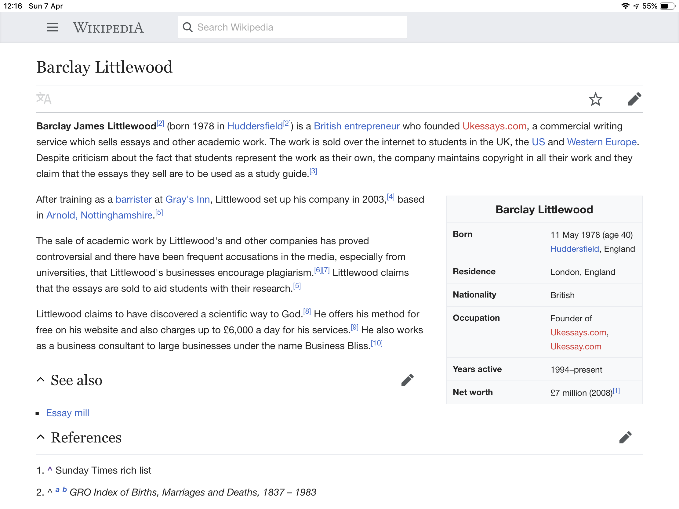


Slide 5
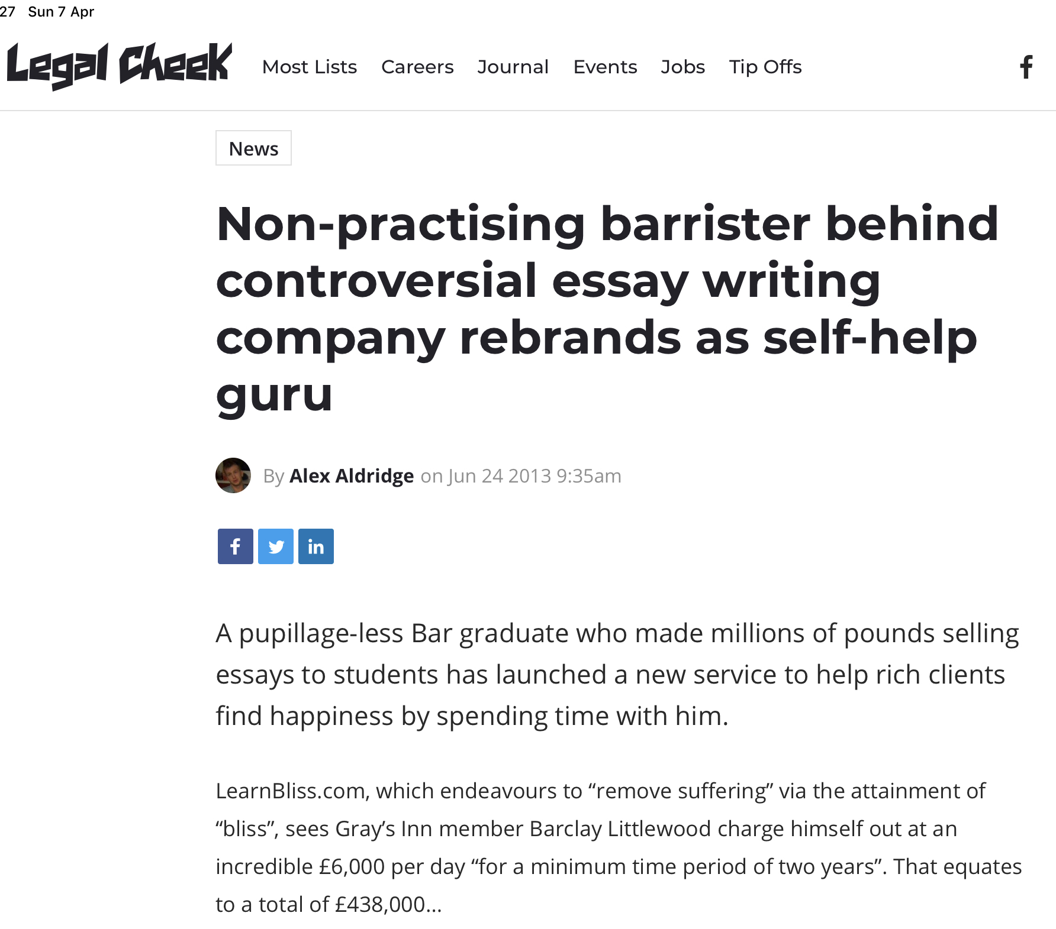
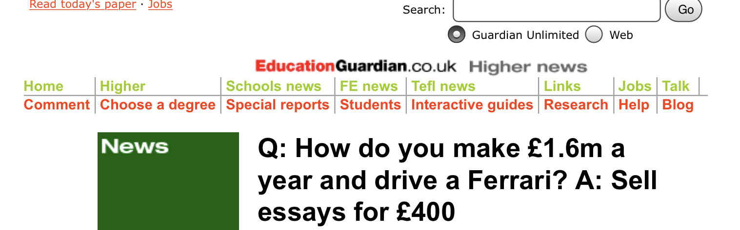
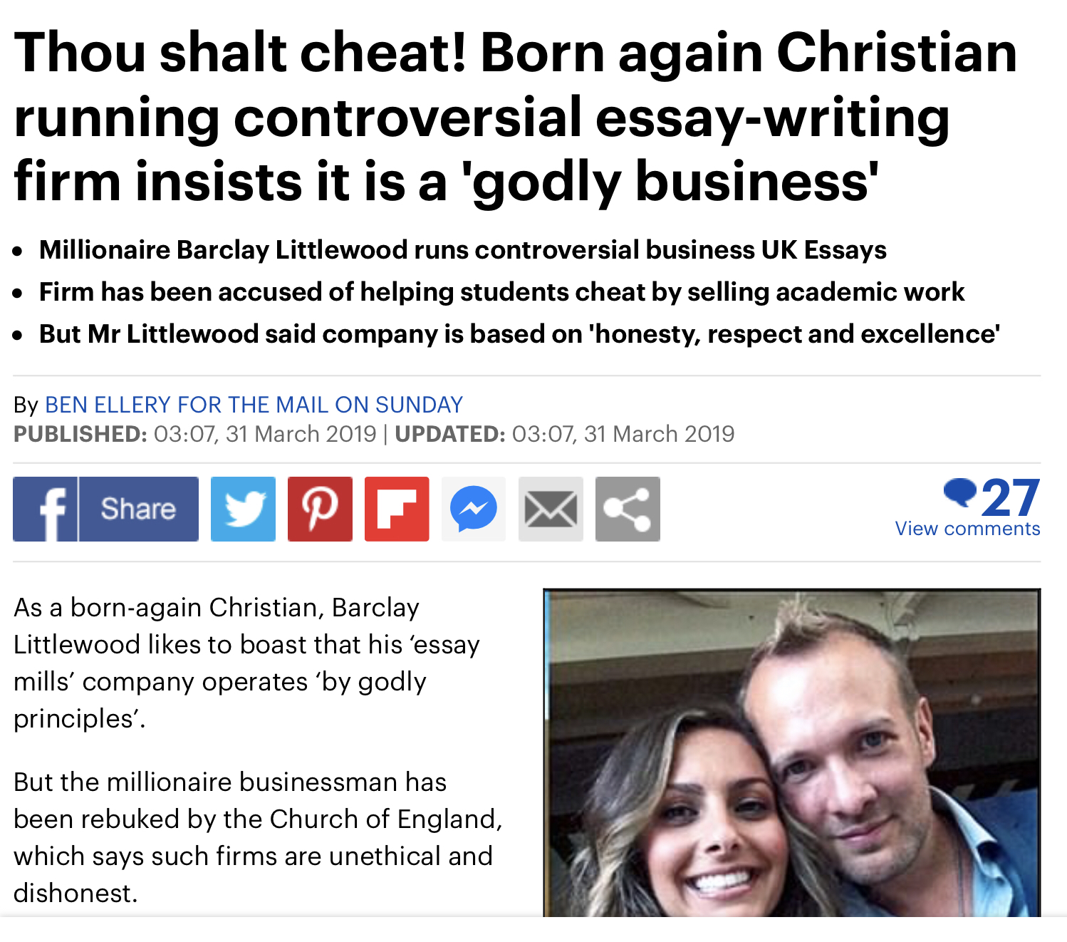

Slide 6
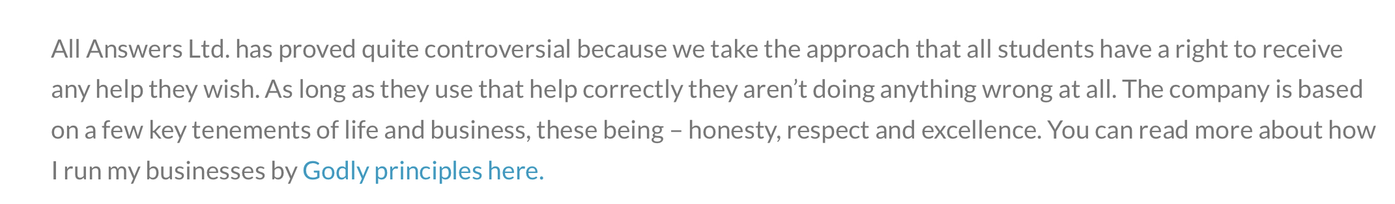
Excerpt from Barclay Littlewood’s website
https://barclaylittlewood.com/

Slide 7
The UK Essays website
https://www.ukessays.com/

Slide 8
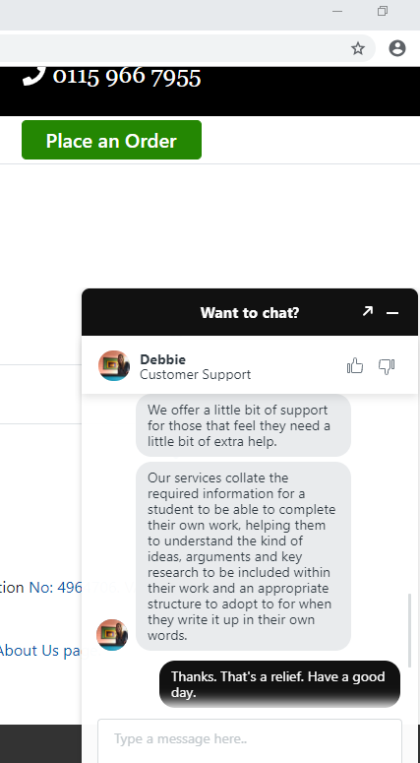

Slide 9
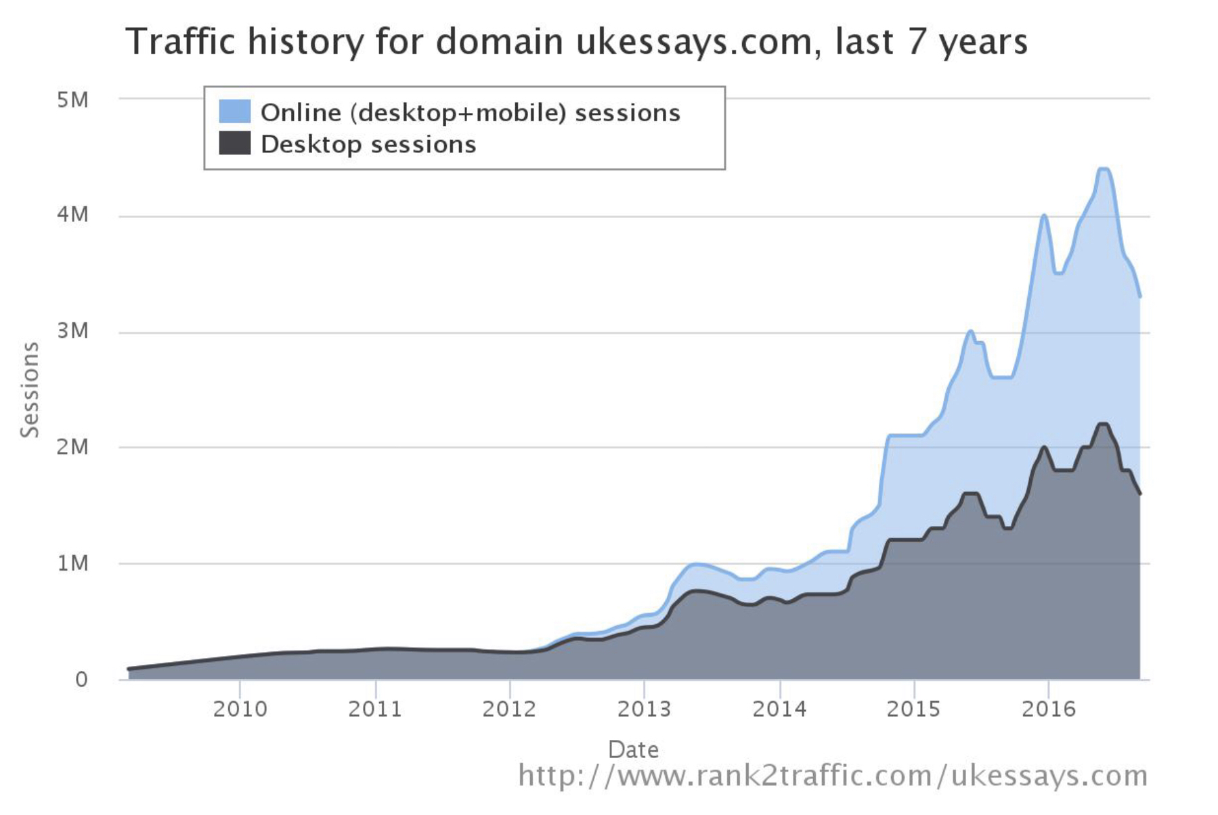
The growth of UK Essays (http://thomaslancaster.co.uk/blog/)
Notes:
vvvvvvvv

Slide 10
The extent of the problem
Newton (2018) synthesised findings from 65 prior studies(1978-2018) involving over 54514 HE students
Contract cheating self-reported by average of 3.52% of students
NTU has approx. 30,000 students. So over 1000 of them could have made use of contract cheating at some point.
“explosion in contract cheating” (IJEI, 2017)

Slide 11
Why do students use essay mills?
Persuasive marketing by essay mills (Rowland et al, 2018)
Ease/convenience/laziness
To get better grades- poor performers more likely to cheat (Park et al., 2013)
Pressure on students - stress- lack of time (Dante, 2010)
‘Normalisation’ of cheating (Stephens et al., 2007)
Disengagement from studies–lack of motivation (Walker & Townley, 2012)
Commodification of HE (Page, 2004)
Disconnection from submitted work (Ritter, 2006)
Lack of confidence in written academic English skills (Bretag et al., 2018)
Poor understanding of assessment briefs/expectations (Bretag et al, 2018)
Insufficient feedback (Bretag et al., 2018)
Assumption of untrustworthiness (Walker & Townley, 2012)

Slide 12
Responses
Legal
Disrupting
Detection
Institutional regulations and sanctions
Student led AI awareness campaigns
Pedagogic responses
  Changing assessment type and design
  In the classroom/lecture theatre/tutorial

Slide 13
Why EAP teachers are key players
We have early opportunities to influence students’ attitudes and practice
We often see more of the students’ work than their subject teachers
Students may feel more able to discuss their work with us
We are good at scaffolding difficult tasks
We are good at giving feedback
We analyse briefs carefully and provide targeted support

Slide 14
Focus on process
“Pre-sessional students … are often ‘fixated’ on the summative assessment at the end of the course rather than on … learning and making use of the formative feedback and opportunities for reflection along the way. This leads to students leaving assessed work until deadlines loom, rather than developing a text over a number of weeks. The outcome of this is that work … often displays poor academic practice including textual copying, plagiarism … or, at worst, contract cheating” (Seviour, 2015).

Slide 15
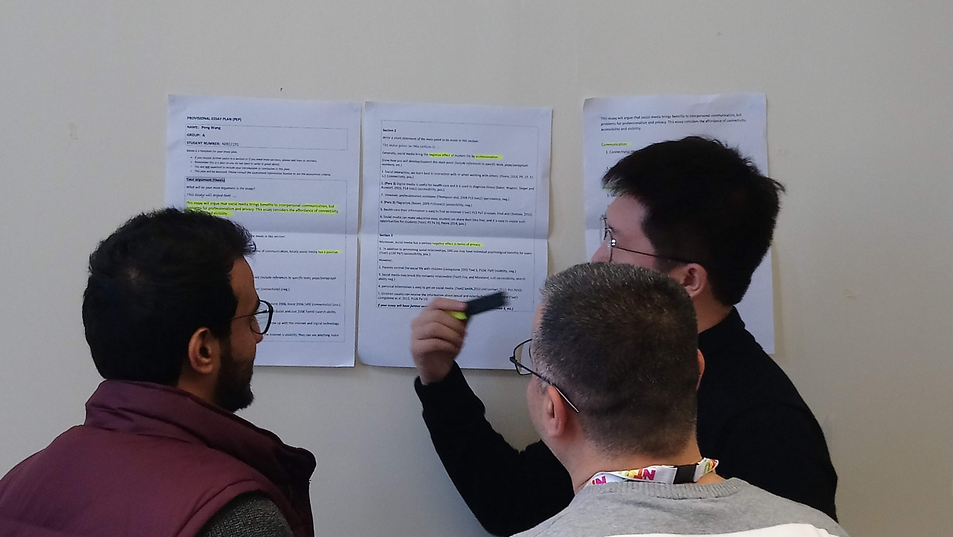

Slide 16
Focus on assessment literacy
“In order for assessment activities to support learning students must be given frequent opportunities to explore and engage with the criteria … (Boud & Falchikov, 2006 p. 408). … assessment criteria should be explicit and accessible to students so that they can be clear about what is required of them, how it will be assessed and what constitutes an acceptable performance (Seviour, 2015).

Slide 17
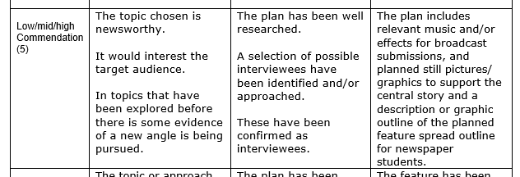
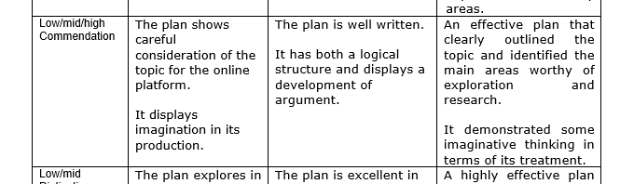
Viability of Feature
What can you remember about the criteria?

Slide 18
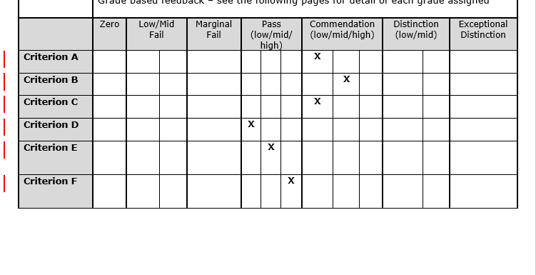
Which plan? ‘Blind Football’ or ‘Homelessness’?

Slide 19
Focus on language
“… we are able to facilitate whole-class and group activities (including collaborative discussion and brainstorming, notemaking, summarising, etc.) which support reading, planning and drafting and help students develop the functional language they need” (Seviour, 2015).

Slide 20
Transforming knowledge
THESIS STATEMENT
POINT #1
ANALYSIS OF VISUAL EVIDENCE
ANALYSIS OF WRITTEN EVIDENCE
LINK BACK TO THESIS STATEMENT
POINT #2

Slide 21
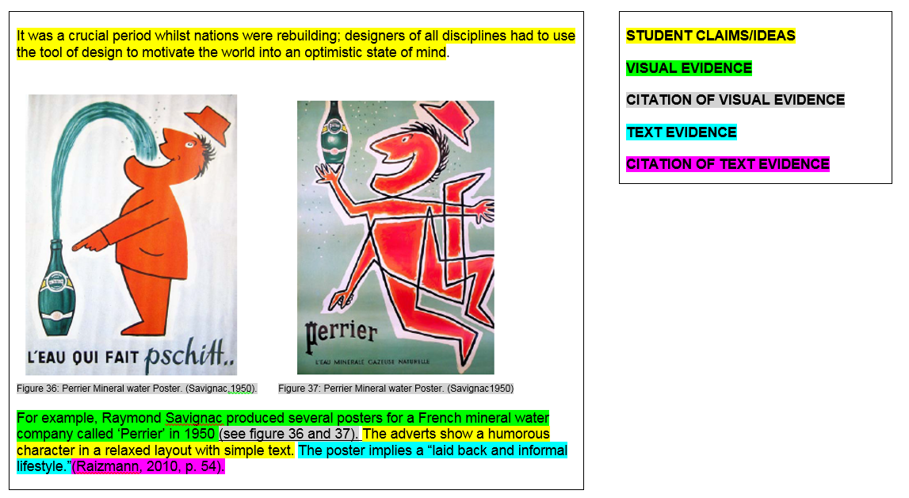

Slide 22
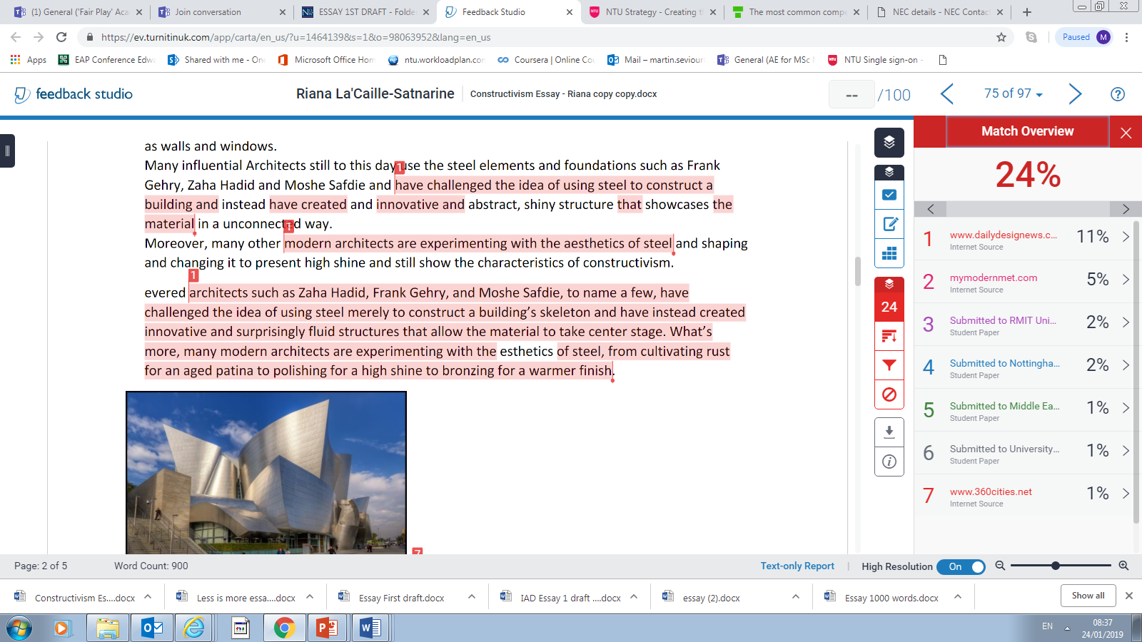
Interpreting the Turnitin report

Slide 23
Talking about good academic practice and academic integrity
“ Take every chance to reiterate the integrity message” (QAA, 2017)

Slide 24
Which of these is most serious?
EXAMPLES OF POOR ACADEMIC PRACTICE –WE’LL HELP YOU TO DEVELOP SKILLS TO AVOID THESE
Making a mistake in your list of references
Not changing the original text enough when you paraphrase
Making a mistake with citation
Summarising someone’s work but forgetting to cite it
Quoting someone but not using quotation marks
Using Google Translate
Copying the work of another student
Working with another student to write an essay together
Asking another person to write your essay for you
INTENTIONAL PLAGIARISM
COLLUSION
CONTRACT CHEATING

Slide 25
Why do students use essay mills?
Persuasive marketing by essay mills (Rowland et al, 2018)
Ease/convenience/laziness
To get better grades- poor performers likely to cheat (Park et al., 2013)
Pressure on students - stress- lack of time (Dante, 2010)
‘Normalisation’ of cheating (Stephens et al., 2007)
Disengagement from studies–lack of motivation (Walker & Townley, 2012)
Commodification of HE (Page, 2004)
Disconnection from submitted work (Ritter, 2006)
Lack of confidence in written academic English skills (Bretag et al., 2018)
Poor understanding of assessment briefs/expectations (Bretag et al, 2018)
Insufficient feedback (Bretag et al., 2018)
Assumption of untrustworthiness (Walker & Townley, 2012)

Slide 26
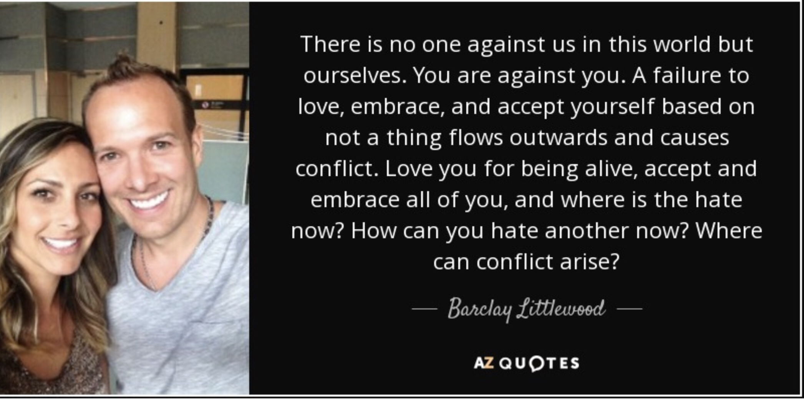
A word from the mill owner ….

Slide 27
Selected References
Curtis, G. and Clare, J. (2017). How Prevalent is Contract Cheating and to What Extent are Students Repeat Offenders? Journal of Academic Ethics. Volume 15, Issue 2, pp 115-124
Newton, P. (2018). How Common Is Commercial Contract Cheating in Higher Education and Is It Increasing? A Systematic Review. Frontiers in Education, Volume: 3
QAA (2017). Contracting to cheat in Higher Education – How to address contract cheating, the use of third-party services and essay mills.
Seviour, M. (2015). Assessing academic writing on a pre-sessional EAP course: Designing assessment which supports learning. Journal of English for Academic Purposes, 18 pp 84-89
Walker, M., and Townley, C. (2012). Contract cheating: a new challenge for academic honesty? Journal of Academic Ethics, 10(1)

Slide 28
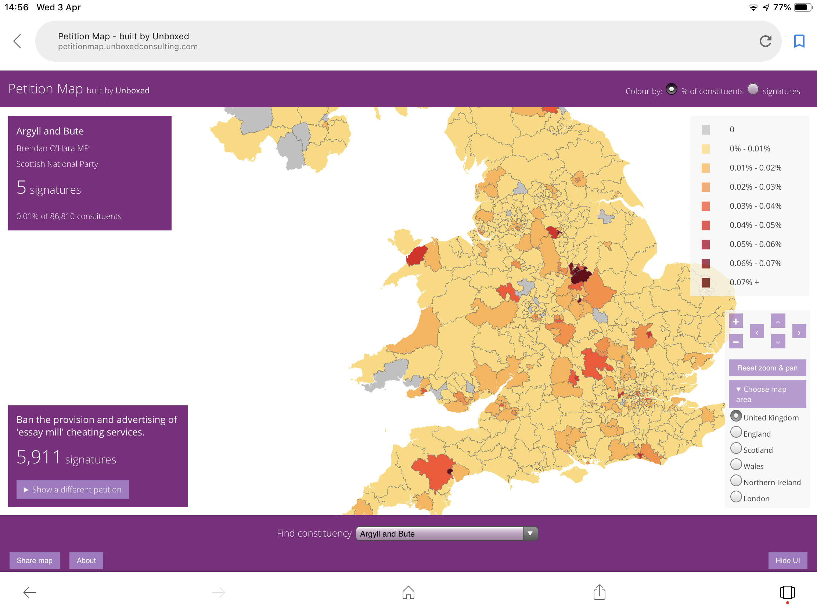

Slide 29
Pedagogic responses
Focussing on what good academic practice looks like
Developing assessment literacy - brief/criteria/question analysis
Teaching key skills of critical reading, use of sources, essay planning
Formative use of Turnitin to teach source use
Use of student exemplars
Opportunities to draft writing and receive feedback
Vivas in which students talk about their writing
Peer review and feedback opportunities
Knowing our students -spotting warning signs - offering support
Talking directly about the risks involved in contract cheating

