Slide 1
Exploring the transformative potential of Microsoft Office 365
Liz Chiu, SFHEA
Senior Teacher of EAP

Slide 2
Changing the way we teach
We need to respond to:
the Learning and Teaching Strategy of our institution
Equality, Diversity and Inclusion
Digital Capabilities
Data security:
WhatsApp groups?
putting student videos on YouTube?

Slide 3
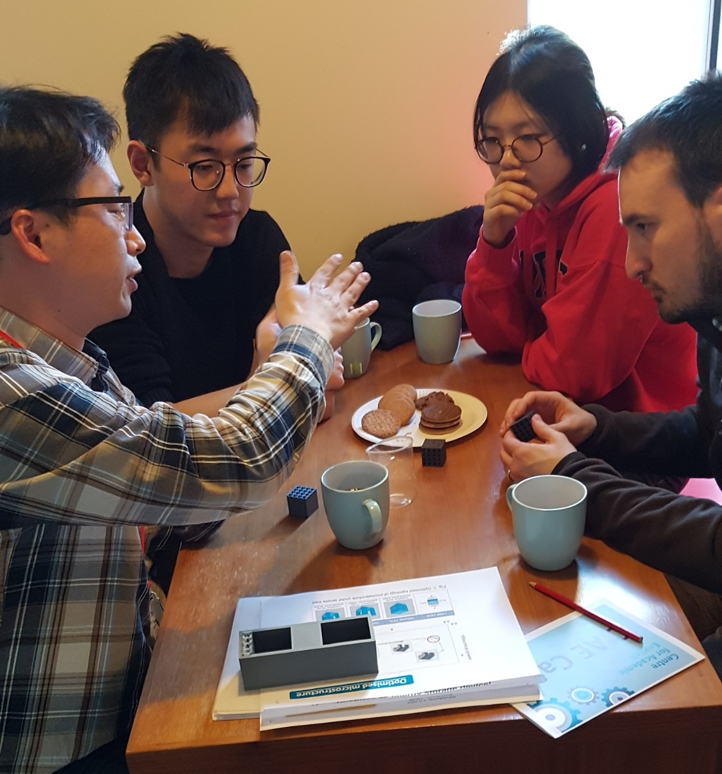
Changing the way we teach
1.
Learning and Teaching Strategy "using more interactive techniques in higher education enables more effective learning"
Café Scientific
An academic explains his research

Slide 4
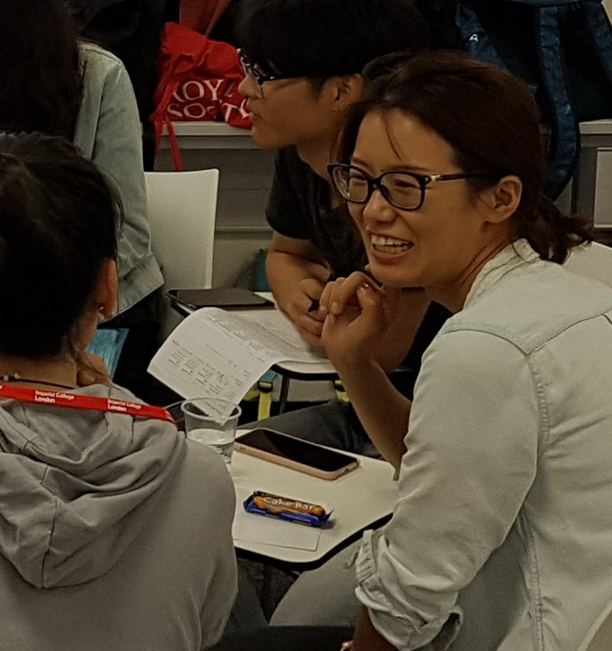
Changing the way we teach
2.
Equality, Diversity and Inclusion Strategy
Inclusive Excellence - "reforming structures and practices that maintain inequality"
NNS accessibility

Slide 5
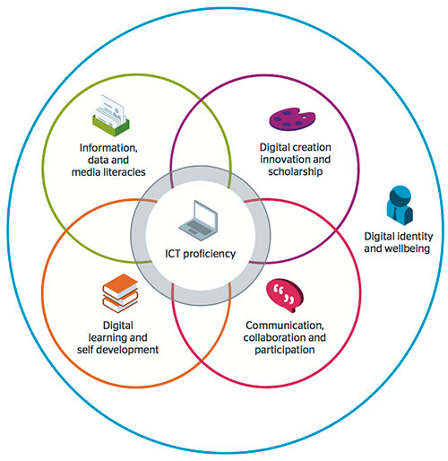
Changing the way we teach
3.
JISC Digital capabilities
"the skills and attitudes that individuals and organisations need if they are to thrive in today’s world"
Orientation to College IT systems

Slide 6
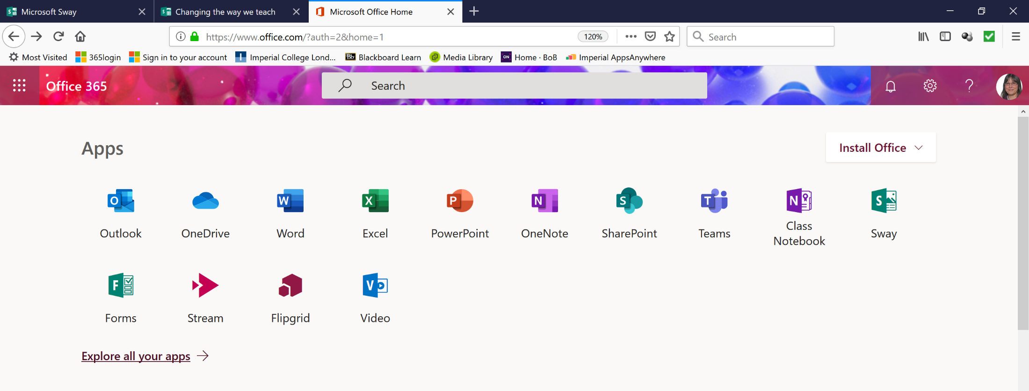
Our institution provides Office 365
…. so let’s see what it can do

Slide 7
Office365 enables new interactions
a closed network for sharing info and files
apps which are private (replacing YouTube, What’sApp, etc)
assistive technology learning tools
flipped learning and out-of-class learning
student autonomy
collaboration
peer-support

Slide 8
Whistlestop tour of Class Notebook, Stream, SharePoint, Teams

Slide 9
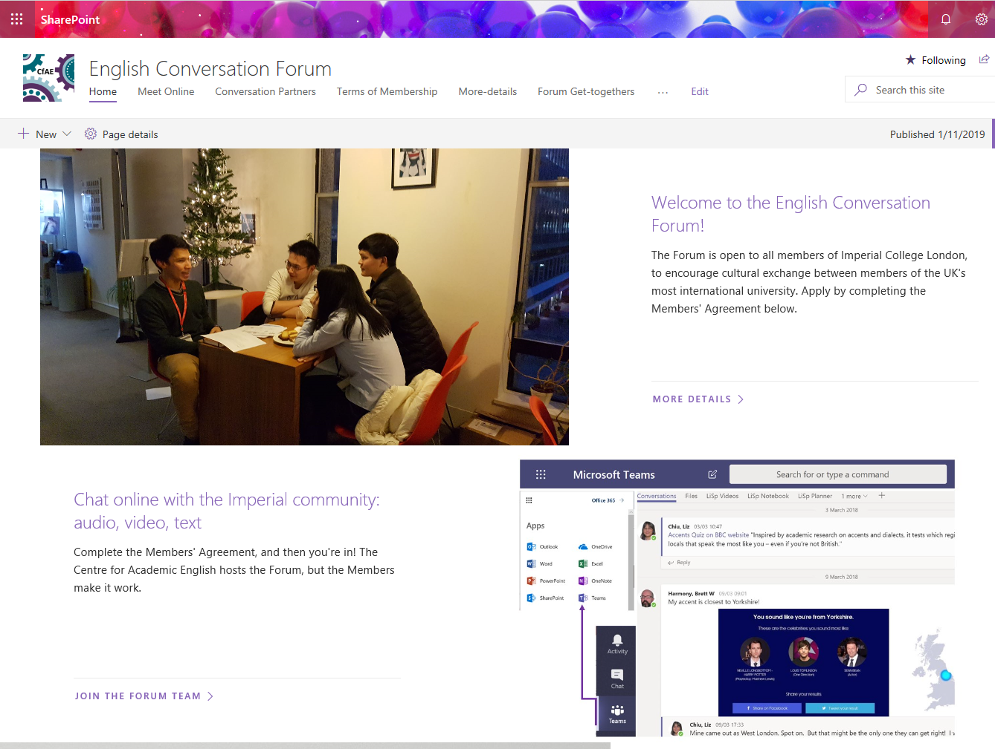
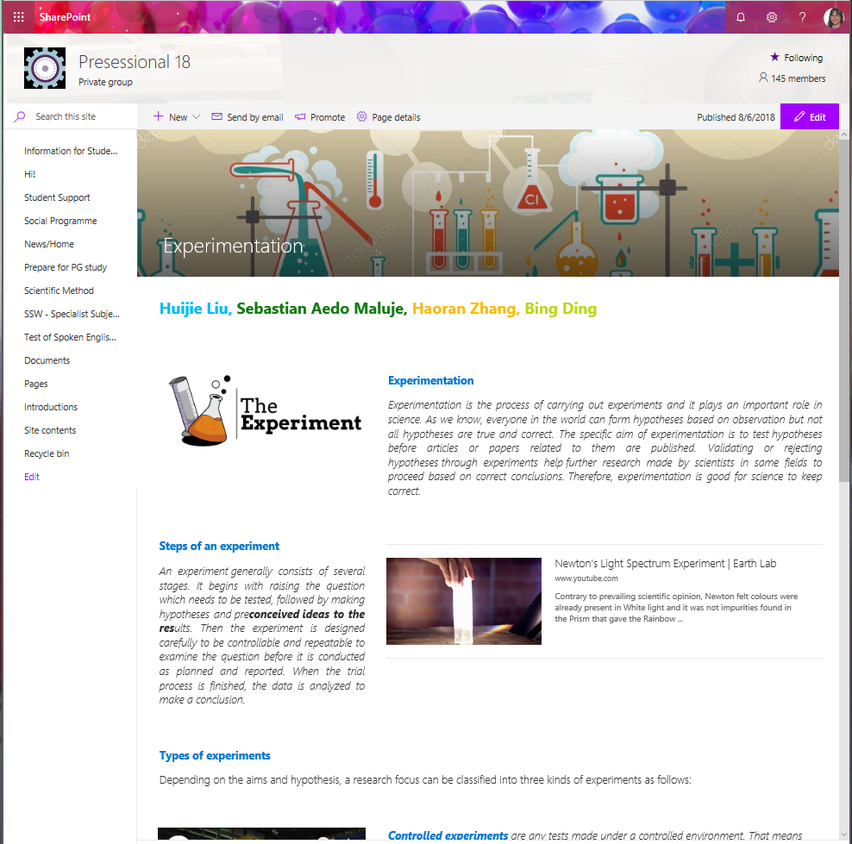
Storing and access to news / information Sharing, publishing online, peer review
We use SharePoint for
1. communicating with college members, making contact, getting people to meet and talk to each other
2. Group task: publishing online. Students are given a webpage to curate, research and contribute to in writing
1. Communication site
2. TBL groupwork

Slide 10
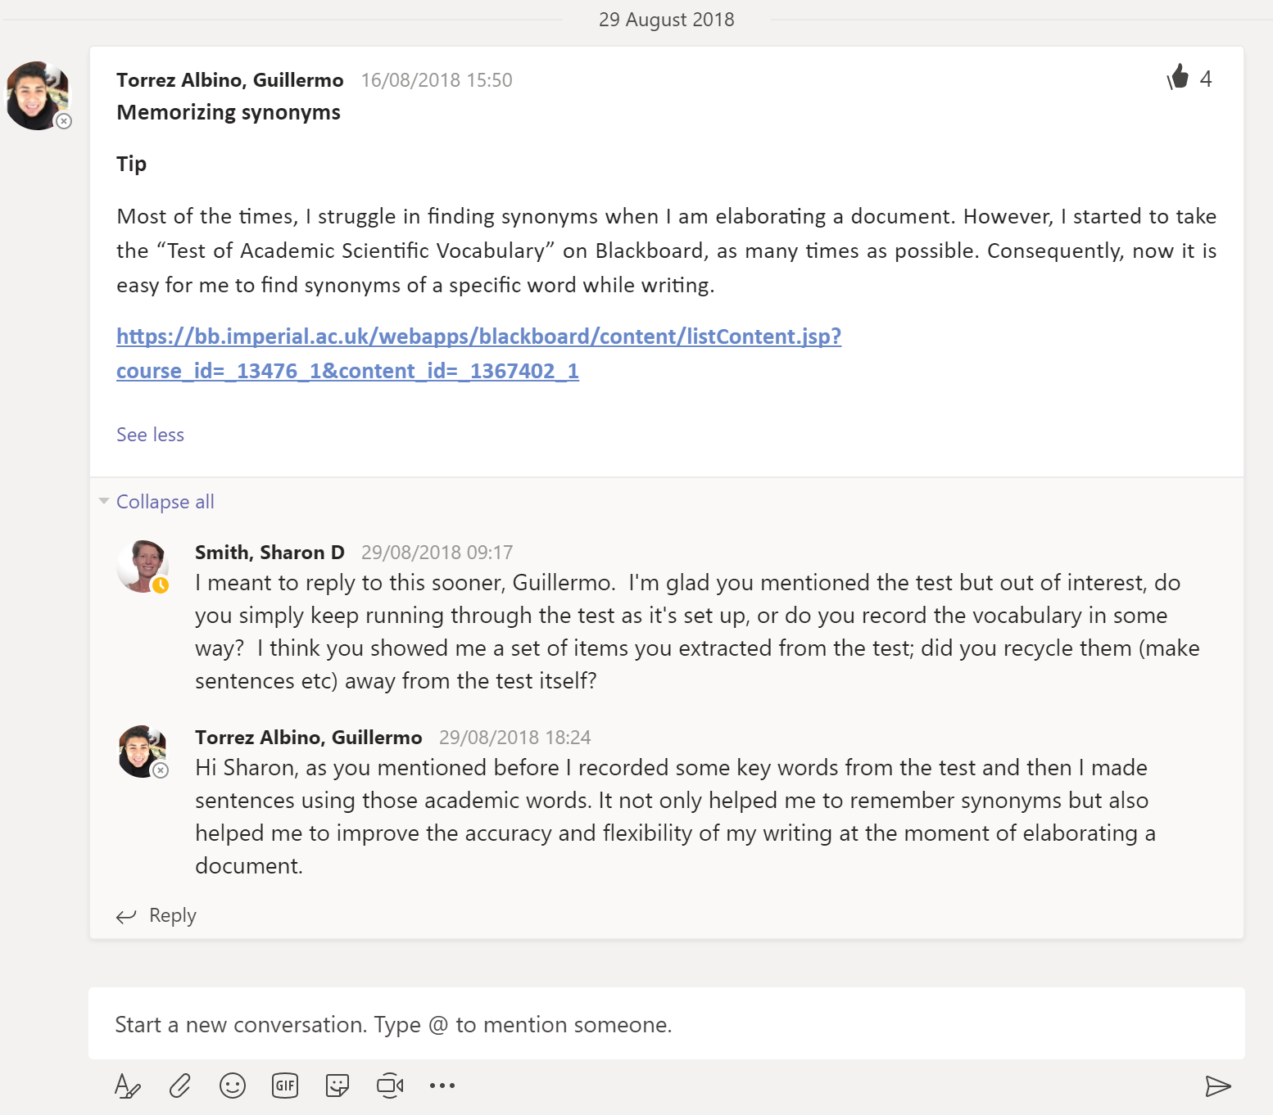
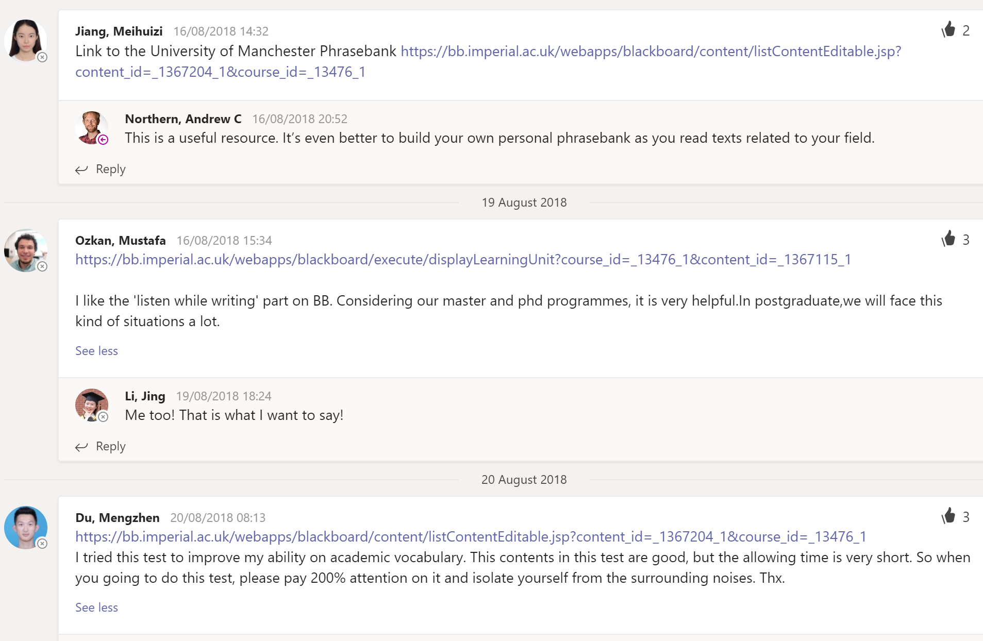
Group interaction, peer support like WhatsApp (limited to the cohort)
We use Teams for:
1. Peer interaction, support and review. Students can chat in private or in 'chat-rooms', 1:1 or 1:many.
2. Noticeboard for informing the whole cohort, sharing photos, social programme arrangements
3. Teacher-student interaction with whole class or individuals. Audio and video chat are both available along with screen sharing.
Mobile platform across all devices
Peer-peer and teacher-student interaction

Slide 11
Features of Teams
Flipgrid for student video interaction:
https://www.youtube.com/watch?v=PumeJ4_LJVs&list=PLiluTszfwwMKx-yVe7ekBX6gsLIHf1Z8k
What is Voice?
Equal access for hearing impaired students
https://www.youtube.com/watch?v=pm3fwUd7P14

Slide 12
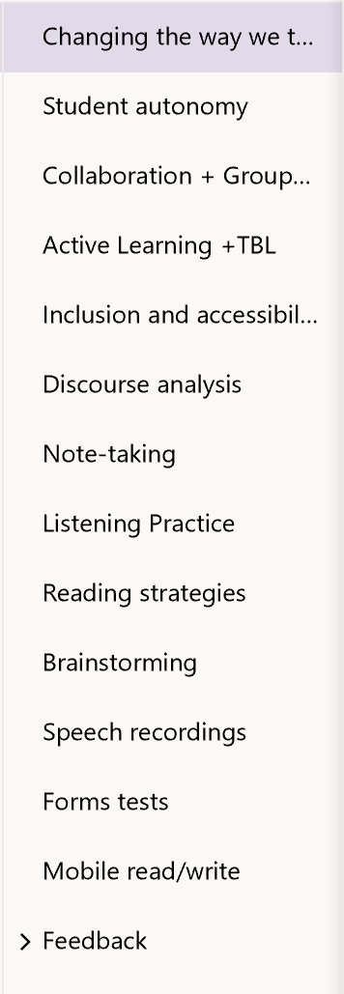
Student autonomy, collaboration, flipped learning, feedback
We use Class Notebooks as an online digital classroom.
OneNote is ideal for note-taking; key points can be tagged and everything is searchable. Video is easily embedded.
Students can record audio from their phones directly into the page.
Digital pens are supported for hand-writing.

Slide 13
Features of Class Notebook
Learning Tools for accessibility and inclusion
Dictate speech-to-text: https://www.youtube.com/watch?v=c8WiXwX_-Xs
Immersive reader text-to-speech: https://www.youtube.com/watch?time_continue=2&v=JT7aSnZuK6o
Quiz/Tests with Microsoft Forms in Notebooks:
https://www.youtube.com/watch?v=lqv2oDCQJQg&list=PLiluTszfwwMKx-yVe7ekBX6gsLIHf1Z8k&index=14
Collaboration Space for peer review and groupwork.
Personal space for reflection and private feedback.

Slide 14
Video player (like YouTube but in-house)
Videos are easily embedded in Class Notebook and SharePoint.
Students can make their own video, upload, share and display.

Slide 15
Accessibility is driving technology
Text-to-Speech
for students restricted by
low vision
dyslexia
L2
Immersive Reader
in Word, OneNote,
use Office Lens with IR
Seeing AI app
Speech-to-Text
for students restricted by
low hearing
learning differences
L2
Narrator
in Word, OneNote,
Translator

Slide 16
Students are adults, high-flyers, fast learners, digital natives
This is about empowering our students by …
Giving them access and control for social networking
Enabling peer support
Letting them make best use of their own digital capabilities
Handing over responsibility for their own learning

Slide 17
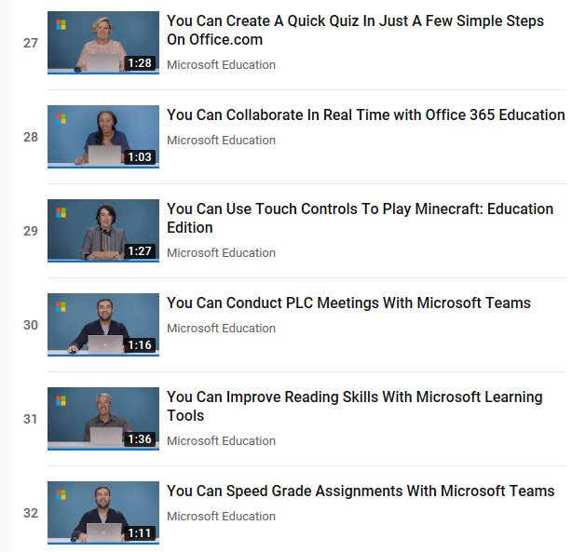
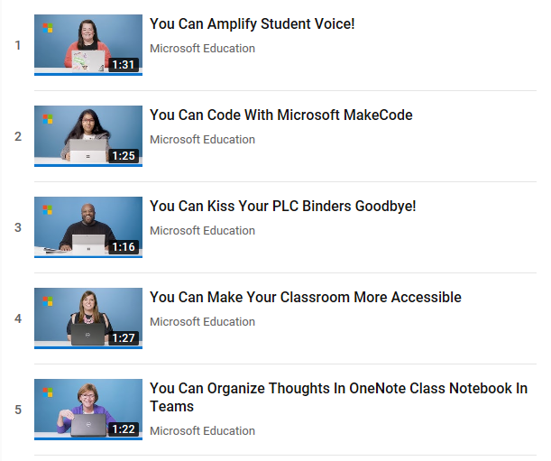
MS training videos - You can in :90 seconds
Quick Tip
Videos on YouTube

Slide 18
SCONUL Seven pillars of Information Literacy
IDENTIFY - Able to identify a personal need for information
SCOPE - Can assess current knowledge and identify gaps
PLAN - Can construct strategies for locating information and data
GATHER - Can locate and access the information and data they need
EVALUATE - Can review the research process and compare and evaluate information and data
MANAGE - Can organise information professionally and ethically
PRESENT - Can apply the knowledge gained: presenting the results of their research, synthesising new and old information and data to create new knowledge and disseminating it in a variety of ways

Slide 19
References
Chun, C. W. (2015). Power and meaning making in an EAP classroom: Engaging with the everyday. Bristol: Multilingual Matters.
Dudeney, G., Hockly, N., & Pegrum, M. (2013). Digital Literacies. New York: Pearson Education.
Li, Y., Wang, L. (2016) English for Academic Purposes - A New Perspective from Multiple Literacies. World Journal of English Language
Vol. 6, No. 2; 2016
SCONUL Seven Pillars of Information Literacy Core Model for Higher Education (updated 2011). Available at: https://www.sconul.ac.uk/sites/default/files/documents/coremodel.pdf
Simpson, R., Obdalova, O. A. (2014) New Technologies in Higher Education – ICT Skills or Digital Literacy? The XXV Annual International Academic Conference, Language and Culture, 20-22 October 2014.
Walker, A. (2014). Technologies. In E. de Chazal (Ed.), Oxford handbooks for language teachers: English for Academic Purposes (pp. 581-620). Oxford: Oxford University Press.
Walker SA, White G. (2013). Technology Enhanced Language Learning: connecting theory and practice. Oxford Handbooks for Language Teachers. Oxford: Oxford University Press
White, J. (2015). Digital Literacy skills for FE teachers. Sage: London.
Wingate, U. (2015). Academic Literacy and student diversity: The case for inclusive practice. Bristol: Multilingual Matters.

Slide 20
“We argue for the inclusion of digital literacies within the EAP curriculum”
Simpson & Obdalova 2014
“technology can enable new approaches as to how learning is delivered and assessed and can make certain pedagogic approaches viable and scalable when considered for higher education that otherwise would not be”
HEA Flexible Pedagogies: Preparing for the future
“effective use of digital technologies requires them to be used within a pedagogic approach that fits the learners, the domain and the context”
Dr Aisha Walker, University of Leeds School of Education http://www.aishawalker.com/page/2/

Slide 21
“We argue for the inclusion of digital literacies within the EAP curriculum”
Simpson & Obdalova 2014
“technology can enable new approaches as to how learning is delivered and assessed and can make certain pedagogic approaches viable and scalable when considered for higher education that otherwise would not be”
HEA Flexible Pedagogies: Preparing for the future
“the ability of some EAP teachers to use technology still has the potential to improve.”
Li & Wang 2016
(citing Walker A 2014)
“effective use of digital technologies requires them to be used within a pedagogic approach that fits the learners, the domain and the context”
Dr Aisha Walker, University of Leeds School of Education http://www.aishawalker.com/page/2/
“Students who develop digital literacies as an integral part of their learning are more effective in their study and more employable on graduation (Jisc 2012)” https://www.heacademy.ac.uk/knowledge-hub/digital-literacies

