Slide 1
Thesis and Dissertation Needs Analysis Study
Dr. Elena Cotos, Aaron Bertram, Angelica Jasper, Lynn-Tyre Lundy-Evans, and Kristin Terrill
Iowa State University
Graduate College
Center for Communication Excellence
BALEAP, 2019

Slide 2
Motivation
Concerns about quality of published theses and dissertations – specifically, writing quality
Opportunity to develop pedagogical materials for graduate students
Approach: EAP (English for Academic Purposes)
Notes:
This study was motivated by concerns of leaders in the graduate college
Writing quality of theses and dissertations
Possible lack of support for writing skills from SMEs on committee
Benefits of dedicated writing support at CCE
EAP is appropriate because of the situated nature of graduate theses and dissertations

Slide 3
Key Stages in English for Specific Purposes
Needs analysis
Evaluation
Course design
Assessment
Teaching-
learning
Dudley-Evans & St. John, 1998
Notes:
ESP relies on principled procedures for instruction
Process is cyclical and iterative; begins and ends with NA

Slide 4
Key Stages in English for Specific Purposes
Needs analysis
Evaluation
Course design
Assessment
Teaching-
learning
Dudley-Evans & St. John, 1998
Notes:
NA was purpose of present study; limited curriculum for T&D was in use, but did not address quality of writing.

Slide 5
Identify stakeholders
Consult previous NA and research in the area
Devise best methods of collecting data (triangulate from multiple sources, situations, methods)
Collect and analyze data (needs, wants, necessities, analysis of specialist discourse)
Translate findings into list of communicative events
Determine syllabus items based on the above
Evaluate course
Notes:
With an understanding of the types of needs we were investigating and the focus of our analysis, the next step was to devise the best methods of collecting data.

Slide 6
Needs Analysis
What kinds of needs?
What is the viewpoint?
What is the best analysis strategy?
Notes:
To conduct a systematic NA, it is important to clarify how the researcher understands some aspects of needs and analysis.
NA should specify the nature of the needs, the viewpoint, and the best analysis strategy.

Slide 7
Needs Analysis
What kinds of needs? | objective/perceived; product-oriented
What is the viewpoint? | discrepancy
What is the best analysis strategy? | present-situation analysis
Notes:
For this study we looked at needs that can be described as objective/perceived, since the learners themselves were not the ones who brought attention to the existence of the need. They are also product-oriented, since awareness of the needs was triggered by reviewing the finished theses and dissertations.
The viewpoint for this study is discrepancy, since we examined whether there was a gap between the skills that writers need and the skills they have.
Finally, the best analysis strategy for this study was present-situation analysis, since a wealth of information is already available about the target situation (ideal theses and dissertations).

Slide 8
Information gathering procedures
Need type = objective/perceived; product oriented
Viewpoint = discrepancy
Analysis strategy = present situation analysis
“Written data analysis (a.k.a. text analysis) seeks to understand the structure and other features of written texts collected as writing samples from the particular ESP” (Brown, 2016, p. 67).
Notes:
Based on these, it was determined that written data analysis was the best method to use. PAUSE TO LET AUDIENCE READ THE DEFINITION.

Slide 9
Information gathering procedures
Need type = objective/perceived; product oriented
Viewpoint = discrepancy
Analysis strategy = present situation analysis
“Written data analysis (a.k.a. text analysis) seeks to understand the structure and other features of written texts collected as writing samples from the particular ESP” (Brown, 2016, p. 67).
Notes:
This approach involves looking at text structure and features, which are objective facts. It uses written texts, which in this case are a final product. We also have the ability to collect samples from the real present situation, since graduate theses and dissertations are published online very soon after the student completes their defense.
PAUSE. BREATHE.

Slide 10
Method
Mixed methods - Exploratory Design (Mackey & Gass, 2016, p. 281-282)
QUALitative data and results
QUANTitative data and results
Interpretation
Notes:
Our data analysis method follows an exploratory mixed method design. We began with qualitative analysis of textual structure and features. We followed that with quantitative analysis that involved comparing the rate of occurrence of qualitative features across a representative sample of texts. We then interpreted the results of both phases.

Slide 11
Research Questions
What discrepancy patterns can be observed in ISU thesis and dissertation samples?
Student status (masters/doctoral)
Discipline
Document structure
Notes:
The research question behind this study was what discrepancy patterns could we observe in the published theses and dissertations.
We wanted to end up with data that could help us target our teaching materials to where they are most needed, so we wanted to be aware from the beginning the kinds of patterns that could help us create targeted materials. Starting with the end in mind, we knew that we were going to be interpreting findings by looking at how contextual factors related to textual features.
We planned to group the data by the contextual factors of student status, discipline, and document structure (IMRD)

Slide 12
Research Questions
What discrepancy patterns can be observed in ISU thesis and dissertation samples?
Student status (masters/doctoral)
Discipline
Document structure
Note:
Generally in the United States,
Masters students write theses
Doctoral students write dissertations.
Notes:
The research question behind this study was what discrepancy patterns could we observe in the published theses and dissertations.
We wanted to end up with data that could help us target our teaching materials to where they are most needed, so we wanted to be aware from the beginning the kinds of patterns that could help us create targeted materials. Starting with the end in mind, we knew that we were going to be interpreting findings by looking at how contextual factors related to textual features.
We planned to group the data by the contextual factors of student status, discipline, and document structure (IMRD)

Slide 13
Research Questions
What discrepancy patterns can be observed in ISU thesis and dissertation samples?
Student status (masters/doctoral)
Discipline
Document structure
Notes:
The research question behind this study was what discrepancy patterns could we observe in the published theses and dissertations.
We wanted to end up with data that could help us target our teaching materials to where they are most needed, so we wanted to be aware from the beginning the kinds of patterns that could help us create targeted materials. Starting with the end in mind, we knew that we were going to be interpreting findings by looking at how contextual factors related to textual features.
We planned to group the data by the contextual factors of student status, discipline, and document structure (IMRD)

Slide 14
Identify stakeholders
Consult previous NA and research in the area
Devise best methods of collecting data (triangulate from multiple sources, situations, methods)
Collect and analyze data (needs, wants, necessities, analysis of specialist discourse)
Translate findings into list of communicative events
Determine syllabus items based on the above
Evaluate course
Notes:
With an understanding of the types of needs we were investigating and the focus of our analysis, the next step was to devise the best methods of collecting data.

Slide 15
Sample collection
List of ISU graduates (2015-2017)
Sample included 10% of theses and dissertations from each department (one document from each department with <10 graduates)
IMRD/C structures only (no creative component papers included)
Randomly selected 1 section from each paper
10% page sample from each section (randomly selected pages using Excel spreadsheet tool)
Notes:
Data collection began with a list of all ISU graduates (not undergrads) from 2015 – 2017. These were grouped by department, and we randomly selected 10% of the names from each department. If there were fewer than 10 graduates in a department, we randomly selected one name from that department.
We then found those graduates’ thesis or dissertation on ProQuest, and verified that it was IMRD structure. This ensured comparability across texts and also avoided any problems with analyzing an unfamiliar genre.
We randomly selected 1 section (IMR or D) from each paper, such that we ended up with an equal amount of samples from each section.

Slide 16
Sample collection
List of ISU graduates (2015-2017)
Sample included 10% of theses and dissertations from each department (one document from each department with <10 graduates)
IMRD/C structures only (no creative component papers included)
Randomly selected 1 section from each paper
10% page sample from each section (randomly selected pages using Excel spreadsheet tool)
Introduction
Methods
Results
Discussion/conclusion
Notes:
Data collection began with a list of all ISU graduates (not undergrads) from 2015 – 2017. These were grouped by department, and we randomly selected 10% of the names from each department. If there were fewer than 10 graduates in a department, we randomly selected one name from that department.
We then found those graduates’ thesis or dissertation on ProQuest, and verified that it was IMRD structure. This ensured comparability across texts and also avoided any problems with analyzing an unfamiliar genre.
We randomly selected 1 section (IMR or D) from each paper, such that we ended up with an equal amount of samples from each section.

Slide 17
Sample collection
List of ISU graduates (2015-2017)
Sample included 10% of theses and dissertations from each department (one document from each department with <10 graduates)
IMRD/C structures only (no creative component papers included)
Randomly selected 1 section from each paper
10% page sample from each section (randomly selected pages using Excel spreadsheet tool)
Notes:
Data collection began with a list of all ISU graduates (not undergrads) from 2015 – 2017. These were grouped by department, and we randomly selected 10% of the names from each department. If there were fewer than 10 graduates in a department, we randomly selected one name from that department.
We then found those graduates’ thesis or dissertation on ProQuest, and verified that it was IMRD structure. This ensured comparability across texts and also avoided any problems with analyzing an unfamiliar genre.
We randomly selected 1 section (IMR or D) from each paper, such that we ended up with an equal amount of samples from each section.

Slide 18
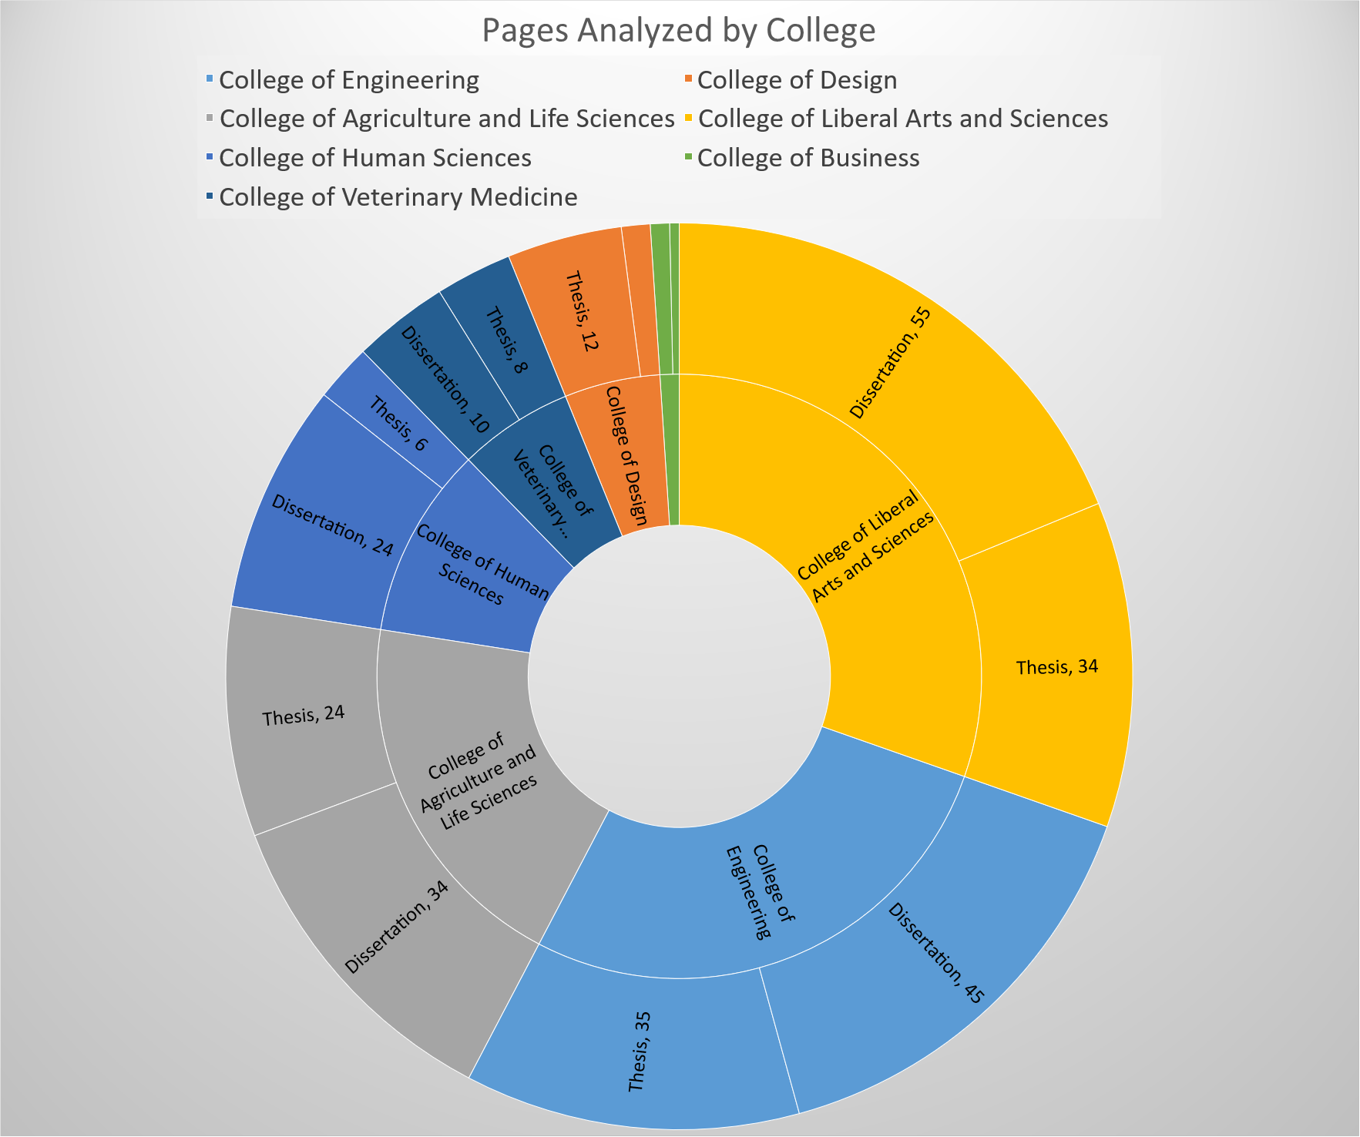
Notes:
This pie chart depicts the ratio of documents from each college. The outer ring is divided to show the ratio of theses and dissertations. (PAUSE TO LET AUDIENCE GAZE IN WONDERMENT).

Slide 19
Qualitative analysis methods
Framework provided by experienced EAP instructor
Rating scale developed for quantifying findings
Four trained coders:
  Applied linguistics and technology
  Mechanical engineering
  Gerontology/HCI
  Supply chain & information systems
Notes:
For the qualitative analysis, we started with a framework that one of our colleagues has developed for her teaching. I will show you an overview of that framework in just a moment.
Using that framework, we devised a rating scale so that we could later compare our findings quantitatively. We didn’t want to simply count errors, since not all of the concerns described in the framework are actual errors, and because not all of the concerns are equally important in terms of their impact on writing quality.
Four coders from different disciplinary backgrounds, trained to use the framework and rating scale.
Two coders analyzed each text sample and questions were adjudicated as a group in weekly meetings.

Slide 20
Qualitative analysis methods
Framework provided by experienced EAP instructor
Rating scale developed for quantifying findings
Four trained coders:
  Applied linguistics and technology
  Mechanical engineering
  Gerontology/HCI
  Supply chain & information systems
All raters were experienced EAP scholars or practitioners
Notes:
All of the coders were experienced EAP scholars or practitioners.

Slide 21
Qualitative Framework
Local | Global
Accuracy of language use Grammar Lexis Overlapping concerns | Communication effectiveness Inappropriate or lacking transition Coherence/cohesion Inappropriate or lacking logical development Inappropriate or unclear expression; clarity of idea
Mechanics Punctuation Inconsistency in citation style Spelling and capitalization
Formatting | Conformity with genre conventions Ineffective or lacking argumentation Content integration
Notes:
Here is our qualitative framework, and this was adapted from teaching materials that one of our colleagues had been developing through use in her classes.
Pause.
I hope that some of you notice, as I did, some overlap between our categories and an idea that Dr. Harwood touched on during the wonderful plenary yesterday – the difference between local and global issues is one of the critical types of knowledge that an effective writing mentor needs, whether that is a proofreader, teacher, or writing center worker.

Slide 22
Results (quantitative)
Student status (masters/doctoral)
Discipline
Document structure
Notes:
Now I’ll talk about how the findings were distributed across the sample. Again, we wanted to know whether there were any patterns that stood out in terms of the student status, the writer’s discipline, or an aspect of the document struction.

Slide 23
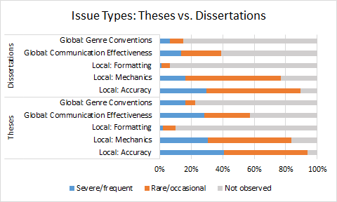
Notes:
This shows how areas of concern were distributed across theses and dissertations. You can see that rare/occasional local issues are pretty frequent, and although they’re not severe, the 10% sample tended to be around 3 pages. So the fact that we observe some local concerns on about half the texts sampled does suggest that editing and proofreading is lacking in general. Severe/frequent errors were not found as much in the sample, but again they are present, especially for local concerns. The distribution across theses and dissertations is not dramatically different, so it seems like any support that we develop will probably be equally applicable to masters’ and doctoral students.

Slide 24
Quantitative Results
Disciplines with most frequent concern:
Art and Visual Culture (1 thesis) and Graphic Design (2 theses) had high rates of frequent/severe concerns.
Computer Science (3 theses/1diss), Genetics Development and Cell Biology (1 thesis), and Materials Science and Engineering (1 thesis/1diss) had moderate rates of frequent/severe concerns and moderate rates of rare/minor concerns.
Notes:
As far as disciplinary distribution, it was a mixed bag. In a few cases we did have 100% of texts in the sample with a rating of 1 or 2, which means that there were moderate to severe concerns in every sample.

Slide 25
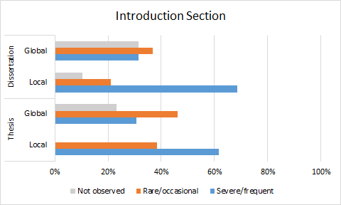
Notes:
Moving on to document structure, we were interested in finding out if any sections of the thesis or dissertation are particularly likely to contain quality issues. This chart compares quality concerns within the introductions section. You can see that severe/frequent local issues are more of an issue here in both theses and dissertations, with some rare/occasional global issues.

Slide 26
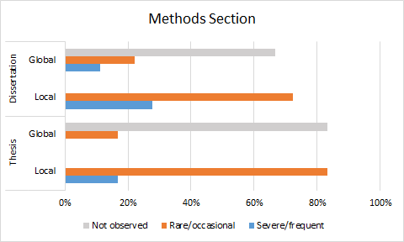
Notes:
In the methods section, we actually see a lot of samples that do not contain any global issues, with local issues occurring only rarely/occasionally. So across the board it seems like this section isn’t going to need as much support.

Slide 27
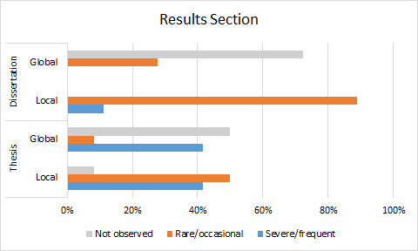
Notes:
With the results section, again, there are a lot of samples that don’t really have any global issues, but here you can see that for theses, frequent/severe issues are observed at both the local and global level. So this suggests that extra support for writing up results could have a lot of benefit for masters’ students.

Slide 28
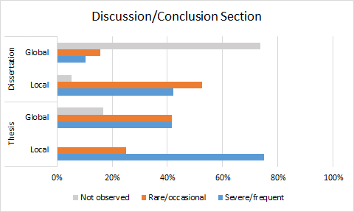
Notes:
Last, but not least, we have the discussion/conclusion sections. This includes all discussion sections, all conclusion sections, and all combined sections. Here, again, there is a large number of dissertations that do not have any global issues, but for theses we can see that there are quite a few severe local and global issues. So again, support for writing up discussion conclusion sections could have a strong benefit for masters’ students, and doctoral students would also benefit from some support for editing the local issues in this section.

Slide 29

Notes:
So….what is this Lichtenstein doing here?

Slide 30
Discussion
Need for support for all levels of graduate students
  Discipline-specific
  Sub-genre specific
  Local and global
Notes:
Support is needed for masters’ and doctoral students in addressing writing quality issues at the local and global levels
Because issues are not distributed evenly across all departments, some of the issues may be discipline-specific, which would call for the development of targeted teaching materials for those students
Writing instructors should be aware that writing issues may emerge within certain sections of theses and dissertations, even if other sections are of high quality.

Slide 31
Limitations and Future Research
Next steps: translate findings into list of communicative events
Product-oriented; objective/perceived needs
  Process?
  Subjective/felt needs?
  Discipline-specific needs?
Notes:
The next phase of the NA cycle is translating our findings into a list of communicative events.

Slide 32
Key Stages in English for Specific Purposes
Needs analysis
Evaluation
Course design
Assessment
Teaching-
learning
Dudley-Evans & St. John, 1998
Notes:
This cycle isn’t necessarily something that has to occur in sequence. Every phase is critical, but you can always revisit a phase as needed. ESP is dynamic and we should strive to be responsive to its shifts.

Slide 33
Thesis and Dissertation - Academic Genre
Known issues
  Semi-occluded genre
  High-stakes
  First publication
Genre ecology (Erickson, 2000)
  Statement of purpose
  Research article
  CV
  Research statement/research agenda
Notes:
Theses and dissertations are known to be a difficult genre. They are semi-occluded, so most students don’t read very many of them prior to writing their own. They are high-stakes, and they may be a scholar’s first published work. This document can define someone’s scholarly identity, so it is critical that graduate students have adequate support for writing it. Another reason this genre is important is that it is related to other genres that early career researchers need to write, so support for thesis and dissertation writing should be geared toward helping the writer achieve confidence with related genres.

Slide 34
References
Basturkmen, H. (2010). Developing Courses in English for Specific Purposes. New York: NY: Palgrave Macmillan.
Brown, J. D. (1995). The elements of language curriculum: A systematic approach to program development. Boston, MA: Heinle & Heinle Publishers.
Brown, J. D. (2016). Introducing Needs Analysis and English for Specific Purposes. Oxford: Routledge.
Charles, M. (2018). Corpus-assisted editing for doctoral students: More than just concordancing. Journal of English for Academic Purposes, 36, p. 15-25.
Dudley-Evans, T., & St. John, M. (1998). Developments in ESP : A multi-disciplinary approach. Cambridge, U.K.; New York: Cambridge University Press.
Evans, M. J. St. J. (Cambridge language teaching library). Cambridge, U. K.; New York: Cambridge University Press.
Erickson, T. (2000). Making sense of computer-mediated communication (CMC): Conversations as genres, CMC systems as genre ecologies. In R. H. Sprague, Jr. (ed.). 33rd Hawaii International Conference on System Sciences. Maui: IEEE Computer Society Press.
Mackey, A. & Gass, M. (2016). Second Language Research: Methodology and Design. New York: Routledge.

Slide 35
Thank you.
I welcome your questions and feedback.

Slide 36
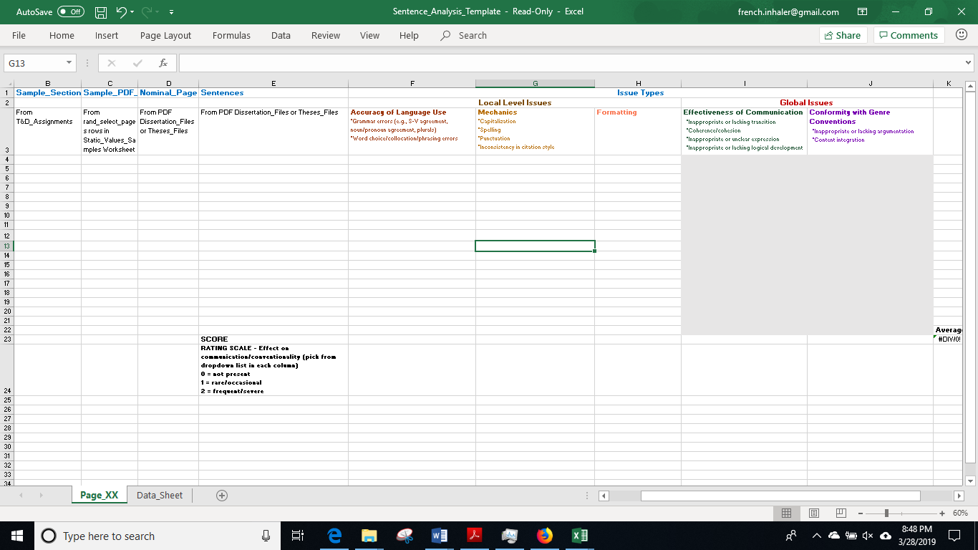
Notes:
This is the worksheet that we used to record our analysis for each text. Don’t worry about reading the tiny text; I’ll show you some of the details in a moment. I think this is useful for you to visualize our process of conducting mixed-methods NA. For samples with multiple pages, each page was rated on a separate sheet.

Slide 37
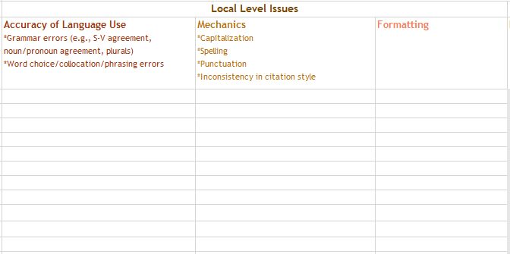
Notes:
Here is where the coders input their findings. Text from the sample would be copied and pasted into the appropriate column. We wanted to collect real examples of features, since we were planning to develop teaching materials from this analysis. Using this worksheet ensured that this data would be traceable back to the context where it originated.

Slide 38
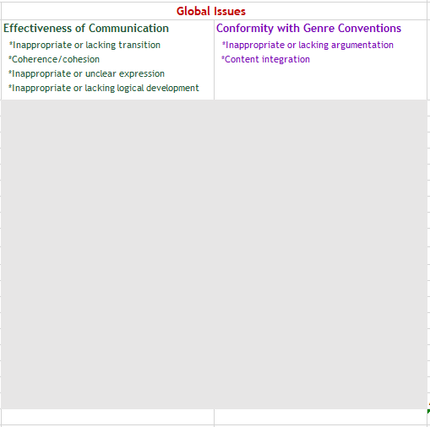
Notes:
Here is where the global issues were described on the worksheet. We also used a very detailed coding guide for reference as we analyzed each text. For the global issues, it wasn’t practical to cut and paste small chunks of text, since a global issue could involve an entire page worth of text.

Slide 39
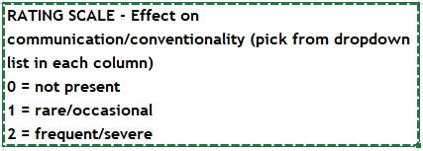
Notes:
Here is a detail of the rating scale.
Again, we didn’t want to simply count errors, but on the other hand, frequency was a factor in how severely the presence of a particular concern impacted the writing quality. So within this rating scale we do reference frequency, but it is a relative frequency, not an absolute.

