Slide 1
Reviewing the Literature:
"A framework into which you can fit your own little contribution".
Cathy Benson
Kenneth Anderson
The University of Edinburgh

Slide 2
The story
The Birth of a Course
Our Research: handbooks
Our Research: research articles
Our Research: supervisor surveys
Our Research: student interviews
The course content: outline
The course content: tasks and assignments
Course evaluation

Slide 3
Acknowledgement
We would like to note our great appreciation of the contribution of our colleague Dr Sarah Thomas, who couldn’t be here. Sarah:
Came up with the original idea for the course
Participated in the research
Contributed to the design of the materials
Now teaches on the course

Slide 4
The birth of a course

Slide 5
UoE in-sessional EAP: English Language Support for International Students (ELSIS)
ELSIS courses for PhD students prior to 2016-17:
Writing a PhD First-Year Report Yr 1
Writing up PhD Qualitative Research Yr 3
Writing up PhD Quantitative Research Yr 3
→ GAP: Yr 2

Slide 6
Published literature on writing Literature Reviews: Handbooks

Slide 7
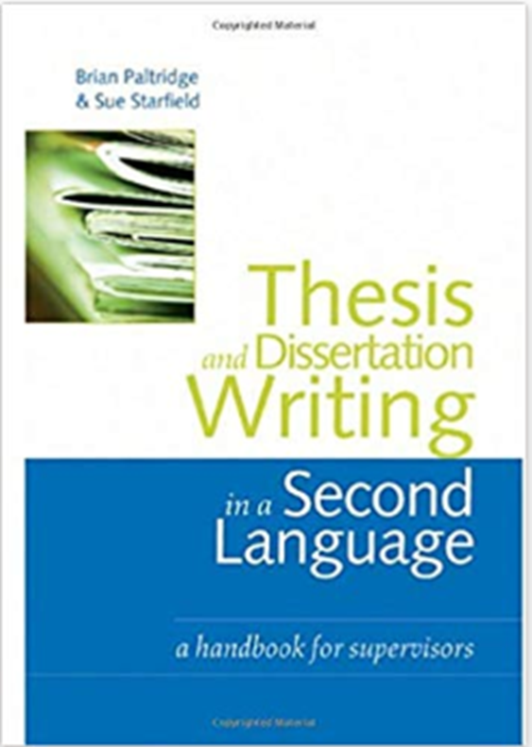
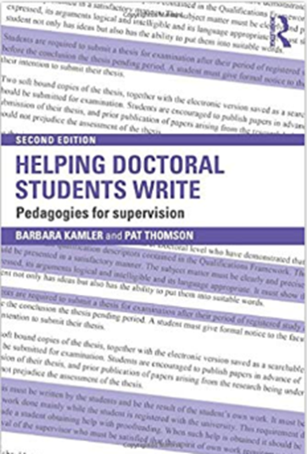
... For supervisors

Slide 8
In his discussion of self-writing, Foucault agrees with me when he says: “These practices are nevertheless not something that the individual invents by himself. They are patterns that he finds in his culture....” (Foucault, 1998: 11)

Slide 9
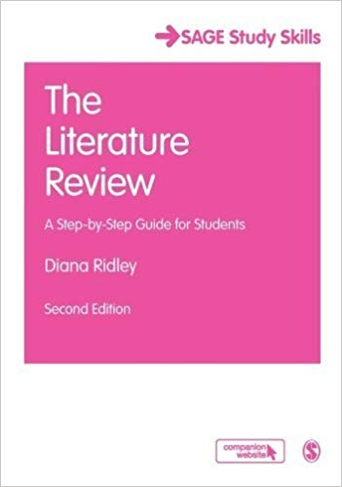
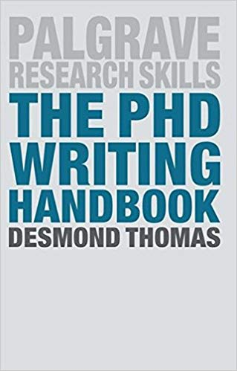
For students...

Slide 10
Published literature on writing Literature Reviews: Research Articles

Slide 11
Boote and Beile (2004)
Criteria (adapted from Hart, 1999) to evaluate quality of PhD LRs

Slide 12
Kwan (2006)
Notes that three main thesis formats identified:
ILrMRD (‘traditional format’)
Article-compilation (portfolio of research papers)
Topic-based (LR chapters may have specific topic headings)
LR not confined to single chapter
“Not all theses contain a recognizable literature review” (p 35)
Notes:
KA
‘Article-compilation’ format corresponds to UoE “PhD by Research Publications”. Submitted with abstract and general critical review. Each paper includes own specific LR.

Slide 13
Kwan (2006)
Genre analysis approach – characteristic rhetorical structure of LRs in doctoral theses.
Pedagogical literature on research writing often conflates Introduction & LR genres.
20 LRs from doctoral theses, compared with Swales’s 3-move CARS model (1981, 1990) for Introductions, as revised by Bunton (2002):
  1 Establishing a territory
  2 Establishing a niche
  3 Announcing the present research (Occupying the niche)
In most cases, LRs:
  were realised in more than one chapter
  displayed Introduction – Body – Conclusion structure

Slide 14
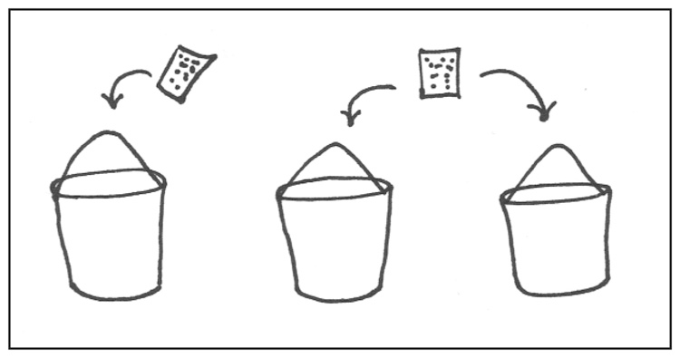
Cisco (2014): Visual representation of theme creation (synthesising research)

Slide 15
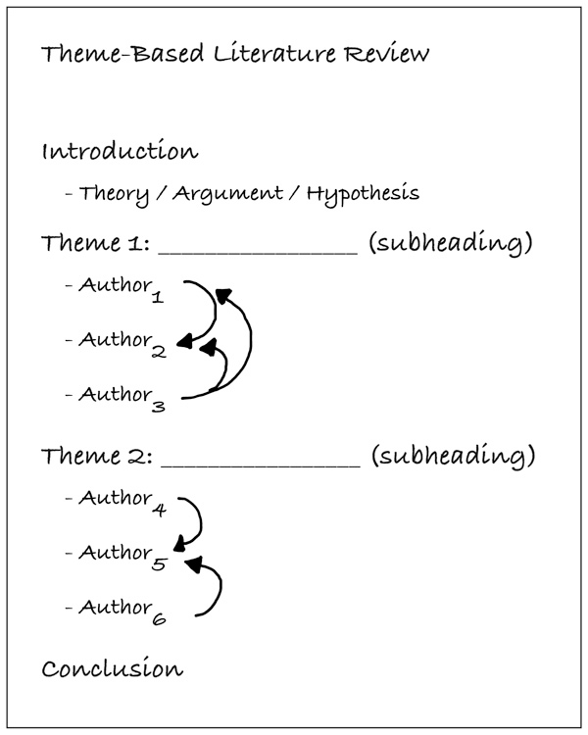
Cisco (2014)
Notes:
Theme-based LR outline

Slide 16
Our Research: supervisor surveys

Slide 17
Supervisor survey (email)
Open-ended questionnaire.
17 PhD supervisors responded
Range of disciplines:
  Biomedical Sciences (Discovery Brain Sciences, Cardiovascular Science), Veterinary Sciences, GeoSciences, Informatics, Education (TESOL, Physical Education), Linguistics & English Language, History.

Slide 18
Supervisor questionnaire
What in your opinion, is the purpose of a Literature Review?
In what ways do you help your supervisees to plan and write their Literature Review chapter?
What aspects of producing a Literature Review tend to be more difficult for students?
Can you suggest effective ways of organising the Literature Review in your discipline?
Please complete the table below with what you consider to be the main characteristics of a successful and a weak Literature Review.
A successful LR | A weak LR

Slide 19
Responses to Q5 – characteristics of successful LR
We identified 8 broad themes:
    Structure
    Clarity
    Coverage
    Focus / content
    Argumentation
    Voice / stance / criticality
    What the LR reveals about the student / Benefits for the student
    Use of visuals (Anatomy / Veterinary Science)
As a task in Unit 1, we gave students an unsorted list of responses, and asked them to group these, then compare with Boote and Beile (2004) criteria.

Slide 20
Disciplinary differences
“I’m not sure what you mean by ‘literature review’ so I am going to translate it as ‘introductory chapter’.” (Biomedical Sciences)
“Avoid using the term “Literature Review”. The problem with the word ‘Review’ is that it has the connotations of needing to be comprehensive. I don’t think that is right. To the contrary, it should be an introduction to the thesis. Maybe Scholarly Introduction is a better term.” (Biomedical Sciences)
“I don't think any of these theses [‘dozen or so’ supervised] has had a 'Lit Review chapter'. I tell the students to 'write it like a book'. Obviously they have to read - and understand - and show awareness of - the literature. But they do that through real scholarly processes. The 'Lit Review' is an artificial exercise. If it were to become mandatory in my discipline, I would regard this as dumbing down. In view of the above, I see no need for a course in how to write a 'Lit Review chapter'. A course in how to be a scholar, maybe.” (History)
Notes:
Several question legitimacy of separate ‘LR’ genre in their discipline – hence change of course title from ‘Writing the Literature Review’ to ‘Reviewing the Literature’. NB these comments from Biomedics confirm Ridley claim (2008: 107) that medicine is example of field where ‘the introduction is a long chapter which includes the literature review’ – cited in Unit 2 (p2).

Slide 21
We also asked for sample successful literature reviews…
.. but the only ones forthcoming were from Applied Linguistics and Education.
This was definitely a limitation.
Notes:
Although responses across disciplines about what constituted a successful LR had a lot in common…

Slide 22
Our Research: student interviews

Slide 23
Student interviews
Student | Nationality | Field | Year of PhD
1 | Columbian | History of Science | 2nd
2 | Saudi | Applied Linguistics | 4th
3 | Thai | Pathway Medicine | 3rd
4 | Columbian | Population Health Science | 3rd
5 | Chinese | Literature | 1st
6 | Italian | Architecture | 3rd
7 | Saudi | Water Use in Scotland | 3rd
8 | ? | Nursing Studies | 3rd
Notes:
Students were volunteers from our existing PhD writing courses.

Slide 24
Among the questions we asked students…
What they understand to be the purpose of a LR?
What they considered to be the most difficult aspect of writing a LR?
What they thought were their supervisor’s and examiners’ expectations in regard to their LR?
What they would like to see included in a course about writing their LR?
Notes:
Not all questions… we focus on 2nd and 4th as influenced our course design most.

Slide 25
Some common themes
Difficulties and challenges
Selecting what’s relevant; the sheer amount of reading
Organising, by principles not just providing a list; how to group arguments.
Taking a critical approach; expressing one’s own voice; not feeling “qualified” to be critical.
Difficulties with language “frustrating”; “finding” the words she would like to use; different academic discourse.
Notes:
Focus on difficulties and challenges and what hoped for from course

Slide 26
Some common themes (continued)
What they would like from a course:
Focus on the language used in an L.R., eg common grammar and vocabulary
Focus on organisation and structure of LR
Importance of models and samples to analyse
“Space” to draft sample extracts of L.R.
Importance of feedback and guidance from tutor.

Slide 27
The course content: outline and approach.

Slide 28
Course outline
5 weeks:
Week 1: Basic issues: criteria for success, purpose,
  citation skills
Week 2: Organisation and Structure
Week 3: Expressing Your Voice and Writing Critically
Week 4: Synthesising Sources
Week 5: Individual tutorials
Notes:
Based on what we were told by students and supervisors, ordered according to what we surmised would be lesser to greater challenge.

Slide 29
Course content (what we tell students)
The course materials are based on some sample (successful) PhDs, on the literature about reviewing literature, and on interviews with supervisors and students.
There will also be some summaries of frequently used language features

Slide 30
Teaching approach
The teaching approach includes group discussion, and tasks involving analysis of texts, including extracts from successful University of Edinburgh PhD theses. Each week, your teacher will suggest a written task for you to work on at home; you then email your texts to your teacher, who will give you individual feedback on your writing in the following week’s class. We would warmly encourage you to submit these assignments to your teacher, in order to benefit fully from the course.

Slide 31
Course content: tasks and assignments

Slide 32
Sample tasks
Discussing expectations
Critiquing
Analysing structure
Focus on language: noticing
Focus on language: production
Brief writing tasks

Slide 33
Assignments
Unit 1 Basic issues: criteria for success, purpose, citation skills
Choose a paper, chapter or book which you will incorporate in your revue, and draft a short summary, around 200 words. If appropriate, you can include one or two short quotations.
When you send your summary to your tutor, please include the original text, so that she/he can see what you have selected to include in your summary, and how you have modified the original wording.
Unit 2 Organisation & structure
Draft an outline of one section of a chapter in which you review literature, then draft a short introduction and a summary, or a transition paragraph. Look for ways in which you can highlight the relevance of the literature to your own work.

Slide 34
Assignments
Unit 3 Expressing Your Voice and Writing Critically
Write a paragraph summarising and evaluating a source that you would like to cite in a positive way.
Write a paragraph summarising and evaluating a source that you would like to cite in a negative way.
Write a paragraph summarising and evaluating a source about which you have mixed feelings.
Unit 4 Synthesis
Find 4-5 articles on a topic closely related to your PhD. Write a text of 2-4 paragraphs in which you synthesise the content of the articles, organising your text thematically, and avoiding simply providing a series of summaries. At the same time, remember to allow your “voice” to be “heard”, as we discussed in Unit 3.

Slide 35
Course Evaluation
Notes:
Based on on-line surveys (low response rate) and tutor feedback.

Slide 36
The students
The course gives you guidelines on how to write LR in appropriate ways. Step by step. Have a very supportive lecturers. (18-19)
I think these courses are essential for any theses. I recommend them to everyone in my department (17-18)
the course enables me understanding literature review comprehensively and knowing how to craft a proper literature review. (17-18)
Best writing course ever! (17-18)
Caveats:
Overall, I found the course was useful for students in qualitative research. But, there was hardly anything specific for quantitative research.(18-19)
can't say - strike... (17-18)

Slide 37
The teacher (this term):
The course - as always - was very good and I felt satisfied it had what I thought was important for the students to learn….I also had the clear impression that students themselves felt they were getting a lot out of the course and that what we were doing was helpful for them

Slide 38
The teacher (last term):
Generally students found the course useful in providing guidelines for writing a Literature Review for a PhD thesis. But there was a feeling that it was oriented towards content for Qualitative and not for Quantitative research.
I am not at all sure that it will be practical to include more content directly relevant to students doing Quantitative Research. The course was designed and developed on the basis of survey and questionnaire feedback from a large number of supervisors and lecturers from a range of disciplines and their views on what makes a good LR review. It is not clear if students feel that the requirements for a Quantitative LR is essentially different from that for a Qualitative study or if they just would like to see some texts/excerpts taken from non-social science disciplines. However, it might be worth having a relook to see if it is possible to inject additional/different texts into the existing structure of the course.

Slide 39
References
Boote, D.N. and Beile, P. 2004. The quality of dissertation literature reviews: A missing link in research preparation. Paper presented at the annual meeting of the American Educational Research Association, San Diego, CA.
Bunton, D. 2002. Generic moves in Ph.D. thesis introductions. In J. Flowerdew (Ed.) Academic Discourse. London: Pearson Education: 57-75.
Cisco, J. 2014. Teaching the Literature Review: A Practical Approach for College Instructors. Teaching and Learning Inquiry: The ISSOTL Journal 2/2 [online: accessed 9 April 2019]. Available at: http://muse.jhu.edu/journals/teaching_and_learning_inquiry__the_issotl_journal/v002/2.2.cisco.html
Hart, C. 1999. Doing a Literature Review: Releasing the Social Science Research Imagination. London: SAGE.
Kamler, B. and P. Thomson (2014). Helping Doctoral Students Write: Pedagogies for supervision (2nd edition). Abingdon: Routledge.
Kwan, B. 2006. The schematic structure of literature reviews in doctoral theses of applied linguistics. English for Specific Purposes 25/1: 30-35.
Paltridge, B. and S. Starfield (2007). Thesis and dissertation writing in a second language: a handbook for supervisors. Abingdon: Routledge.
Ridley, D. (2012). The Literature Review (2nd edition).London: Sage.
Swales, J. 1981. Aspects of Article Introductions. Birmingham: University of Aston.
Swales, J. 1990. Genre Analysis: English in Academic and Research Settings. New York: Cambridge University Press.
Thomas, D. (2016). The PhD writing Handbook. London: Palgrave.

Slide 40
Do you have any questions?
Do you have any suggestions?
Cathy.Benson@ed.ac.uk
Kenneth.Anderson@ed.ac.uk

