Slide 1
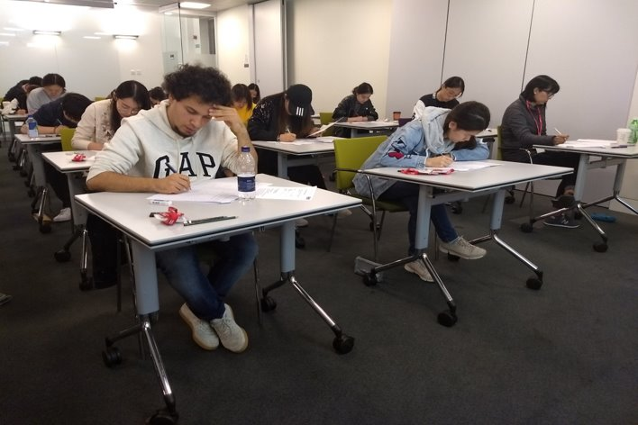
“ Assessment is a key issue in English for Academic Purposes programmes, and yet few EAP practitioners are actively involved in wider debates about what constitutes EAP assessment. […] ”
“ Most of the assessment work of EAP practitioners is hidden away and thus contributes little to theory-building or wider understandings of EAP assessment in practice. ”
Schmitt & Hamp-Lyons, 2015
Notes:
Further rationale
Few practitioner accounts - Schmitt and Hamp-Lyons 2015
Few accounts of EAP assessments as part of live EAP programmes– Schmitt and Hamp-Lyons 2015.
See e.g. Seviour (2015), Westbrook and Holt (2015)
Progress – e.g. BALEAP PIM on assessment in March 2019

Slide 2
From testing to teaching and back again
Dr Julie Hartill
BALEAP 2019
Notes:
Aim and contribution - Practitioner account of a live in-house EAP exit assessment

Slide 3

Context
Notes:
Context
Pre-sessional for STEMM students only
Task-based, process-oriented syllabus
Authentic STEMM texts
‘The scientific method’
Academic language and literacy development
Criticality and autonomy

Slide 4
Validity and washback
Alignment of learning outcomes, course content and assessment
Positive
washback
Notes:
Widely accepted concepts and how they relate

Slide 5
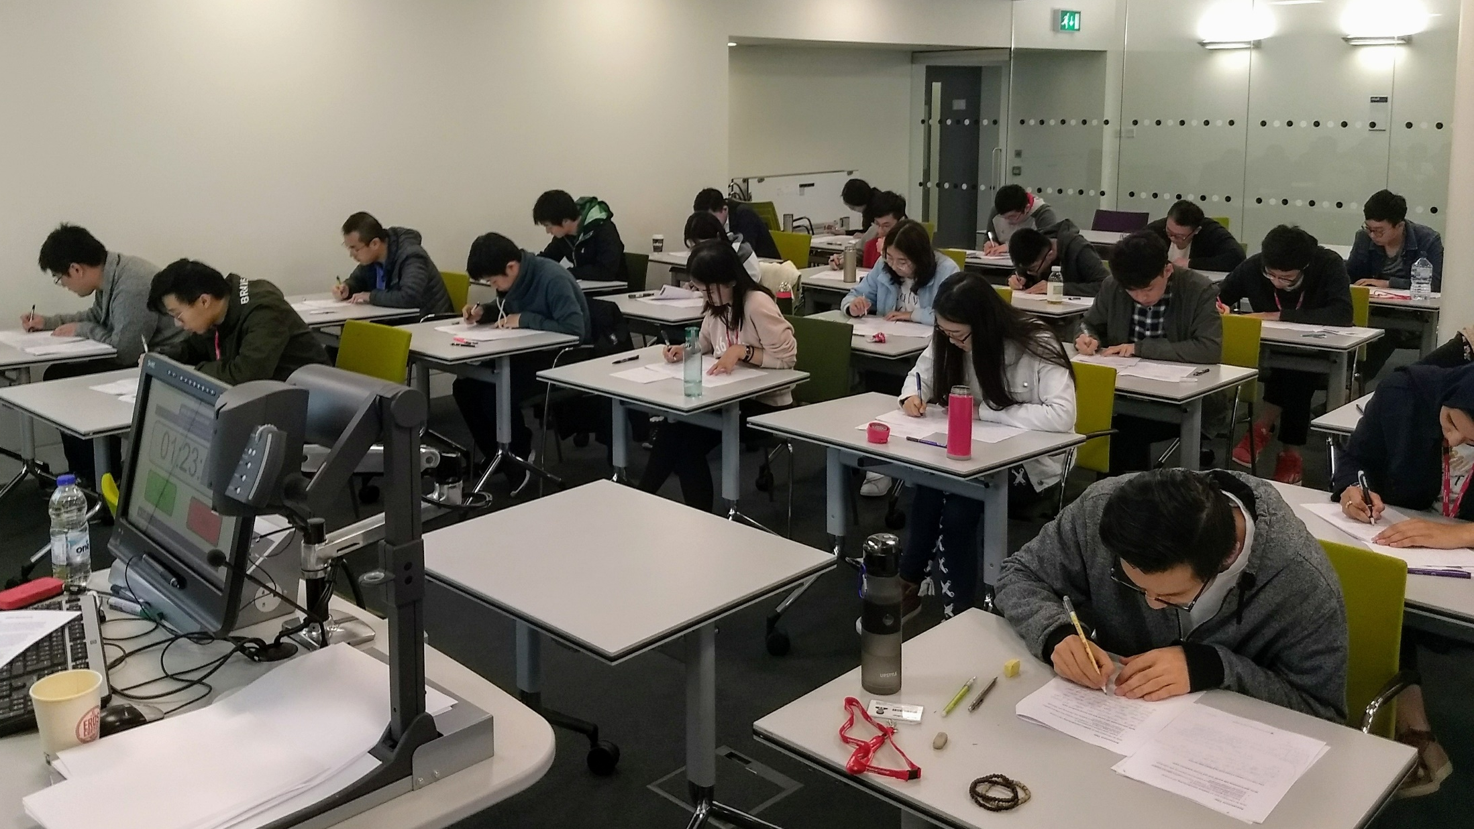
Summer 2017
Notes:
We implemented an assessment that we had put a great of thought and work into. Integrated reading-into-writing. We believed fulfilled the criteria of validity and exemplified positive washback from test to teaching.

Slide 6

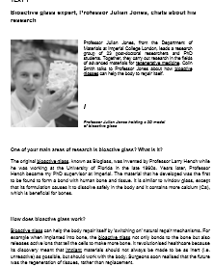
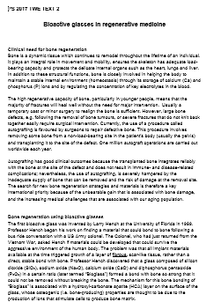
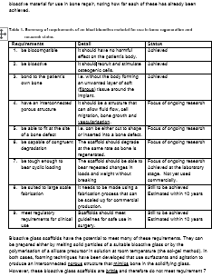
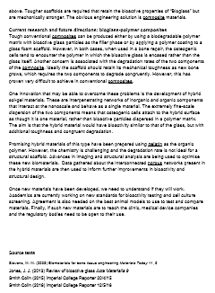
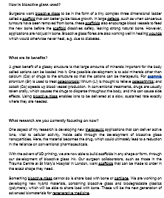
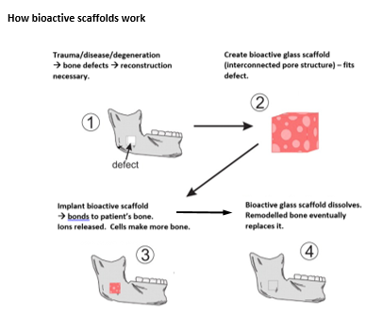
The test
Notes:
2017 Format as illustrated
Title
Write an informative text on bioactive glass.
Briefly introduce the autografting technique that is currently used for repairing large and serious bone defects and explain why bioactive implant materials are needed.
Describe the role that bioactive glass plays in bone regeneration.
Explain what the limitations of bioactive glass currently are and explain how current and future research might help to overcome them.
Write approximately 350 words and use formal academic style.
BUT the process was tough and provided a very varied experience for students, so we began a process of revision and improvement.

Slide 7
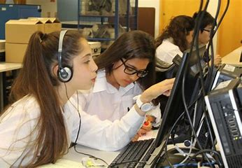




Starting points
Past test performance
Revisiting validity
Feedback
Future needs
Notes:
Starting points
Previously recorded areas where test performance was inadequate:
Responding to prompt/task
Having confidence to tackle task
Reading Selectively
Making targeted notes
Integrating information
Use of vocabulary precisely
Demonstrating awareness of needs of reader
Validity
Aim - Learning that facilitates assessment and assessment that promotes learning
Feedback (Teachers)
T1 –Ss had a go at reaching the IC standard
T1 –Ss struggled getting to grips with the need to make notes and write form their notes
T1 - My Ss got through because great demands were placed on them
T2 - 'in at the deep end’
T3 - Written assignments were well done, well set and well thought through and valid
T4 - Scaffold: read and take notes in class, could be a more scaffolded supported process
Future needs:
Read with a purpose
Identify and select relevant info
Explain understanding in own words
Plan and organise information
Adapt writing for specific readers/ situations/publications
Produce concise, clear, accurate STEM text (conventional and reader-friendly)
→ The Academic Process at Imperial

Slide 8
2018 Test Specification
Validity
The academic process for STEMM at Imperial
Topic and Materials
Standards
Clear feedback on course work informed by exit test marking criteria
Notional IELTS 6.5 or 7.0 and aligned to CEFR B2/C1 threshold descriptors
Feedback and marking
Type and Format
Achievement. Reading into writing, test not course work
Imperial-focused, authentic STEMM text, current interdisciplinary research
Test takers
New graduates, technically able, highly focused, instrumentally motivated
Notes:
(see Bachman and Palmer 1996, Weir 1997, O’Sullivan 2011)
Aligns with teaching and learning
Is transparent and fair
Tests achievement on the course
Can be marked efficiently/reliably
Permits accurate judgements of Ss’ abilities
Aligns with external standards
Meets constructs of validity for our context

Slide 9
2018 Teaching
Academic Process component week-by-week
Week 1 Awareness raising | Week 2 Discourse & cohesion (Nuclear Technology*) | Week 3 Defining & Explaining (e.g.process) (Aerial robots) | Week 4 Problems/ Solutions (Ocean Plastic) | Week 5 Comparing/ contrasting (Bioactive Glass) | Week 6 TWE
Notes:
2018 teaching plan – academic process component
Week by week focus and topic
* Only non-IC topic
The course – Scaffolded, iterative,
Clarity of feedback – linked to assessment criteria
Transparent teaching focus (not merely topic)
Time for consolidation built in
Academic process mirrored and extended in other course components

Slide 10
2018 Teaching
Report writing: Data task
Reading Strategies, text analysis,
vocab
Review cycle,
vocab
Gr for writing
Discourse –process/defs
Review cycle, vocab Rewriting,
Reading
Discourse-comparison
Review cycle
Review cycle
Reader awareness
vocab
Sample answers
Reader awareness
Vocabulary
Week 1 Awareness raising | Week 2 (Nuclear Technology) | Week 3 (Aerial robots) | Week 4 (Ocean Plastic) | Week 5 (Bioactive Glass) | Week 6 TWE
Effective academic writing for STEM
Review cycle Discourse-
Sentence start-up
Plagiarism, paraphraseplanning
R+W, TII
Text analysisselecting info, planning, R+W
Text analysis, guided notes, plan R+W
R+W practice
Notes:
Academic Process for 2018
The course – Scaffolded and iterative,
5 strands interwoven through context-focused and context-relevant tasks using a blended approach to teaching
Familiar topic and vocabulary
Clear, relevant feedback – linked to assessment criteria
Time for consolidation
Academic process weekly focus mirrored and extended in other course components

Slide 11
Comparison of results
 | Total number of Ss | = PASS | MERIT (PASS ↑) | RESIT | FAIL
2017 | 89 | 69 | 13 (8) 15% | 7 | 2
2018 | 129 | 91 | 33 (12) 26% | 5 | 1
Notes:
Numbers don’t reveal the whole picture
Qualitative evaluation:
Test marking experience much more positive than in 2017. Students could tackle the test and demonstrated learning.
Huge reduction in marking time
Much easier decisions at the crucial pass-fail threshold.

Slide 12
Example student reflections (OneNote)
S1 I feel that my academic writing ability has improved, and it is no longer the writing of the IELTS model. By looking at the essays written in the academic course, you can clearly see the difference. Now in the writing process, I will consciously guide the readers, try to make the language expression clearer and more coherent, and the terms are more objective and more academic.
Notes:
Examples - Reflection Task 3 examples from approx. 40 similar examples in Ss’ individual Academic Process OneNote Notebook
Instructions
Write a 300-word evaluation of your pre-sessional experience
1. Aims of the task:
• To help review overall performance on the pre-sessional course
• To help think about what you has been learnt and gained from the course as a whole in terms of language skills, confidence and communication
• To be more involved in own learning
• To help actively monitor own progress moving into postgraduate studies at Imperial College London
2. Preparing to do the task:
Think about performance throughout the course. Also think about feedback from teachers and other students on class tasks and completed course work.
Identify strengths and weaknesses. Evidence?
What have you learnt about
Yourself?
Groupwork ?
What aspects of communication could you improve further? What specific things can you do to improve them?
When will you evaluate yourself in future and how will you do this?
OneNote Academic Process Notebook journal entry - Example S1

Slide 13
S2 During the pre-sessional course, I have developed a large variety of effective technical strategies. For example, I have learned how to do research about my technical and specific topic and select information in articles or in textbooks. Moreover, I learned how to finish reading into writing successfully in a limited time. Although I had learned many kinds of English skills before I came here, I still find that there are many differences between what I did in my undergraduate university and what I do now in Imperial College London. I need to study hardly about basic grammar and technical vocabularies and learn how to use them correctly. […]
These taught strategies and methods could benefit me in my science fields in the future. I have learned how to review my writing and think like a reader to correct my grammar and spelling mistake. In groupwork session, I have known how to connect with different people and have a clear conversation. The academic process teacher helped me a lot.
Notes:
Examples - Reflection Task – 300-word evaluation of your pre-sessional experience
OneNote Academic Process Notebook journal entry - Example S2

Slide 14
S3 I used to write an article without a clear planning, I used to write full sentences from the beginning, which was time-consuming and lack of overall organization. It was dangerous when I needed to do some reading into writing. After several practices, I started to plan the structure of an article and write the topic sentences to lead my following words. Thus, the logic flow of information within and between paragraphs was clearer and more appropriate than before.
Notes:
Examples - Reflection Task – 300-word evaluation of your pre-sessional experience
OneNote Academic Process Notebook journal entry - Example S3

Slide 15
Validity and washback
CONTEXT
Alignment of learning processes, course content, learning outcomes and assessment
Scaffolding forward and washing back
Notes:
Revised 'take' - context-informed and context-facing course and assessment

Slide 16
References
Bachman and Palmer (1996) Language Testing in Practice Oxford: OUP
O'Sullivan, B. (2011) ‘Language Testing’ in Simpson, J. (ed.) Routledge Handbook of Applied Linguistics Abingdon: Routledge pp.259-273
Plakans, L. & Gebril, A. (2013) ‘Using multiple texts in an integrated writing assessment: Source text use as a predictor of score’ Journal of Second Language Writing 22 pp. 217-230
Seviour, M. (2015) ‘Assessing academic writing on a pre-sessional course: designing assessment which supports learning’ Journal of English for Academic Purposes 18 pp.84-89
Schmitt, D. and Hamp-Lyons, L. (2015) ‘The need for EAP teacher knowledge in assessment’ Journal of English for Academic Purposes 18 pp.3-8
Weir C. (1992) Understanding and developing language Tests Harlow: Prentice Hall
Westbrook C. & Holt, P. (2015) ‘Addressing the problem of outside assistance in pre-sessional writing assessments’ Journal of English for Academic Purposes 18 pp.78-83

Slide 17
Acknowledgements
With thanks to colleagues in the Centre for Academic English.
Special thanks to Liz Chiu and Andrew Northern and pre-sessional tutors James Arthurs and June Hammond.

