Slide 1
What makes writing academic April 12 2019 BALEAP LEEDS
Julia Molinari
PhD Researcher and EAP Tutor
University of Nottingham, UK
julia.molinari@nottingham.ac.uk

Slide 2
what is seen as ‘academic’ writing is contestable and always emergent
A. Archer & Breuer, 2016a, p. 2

Slide 3
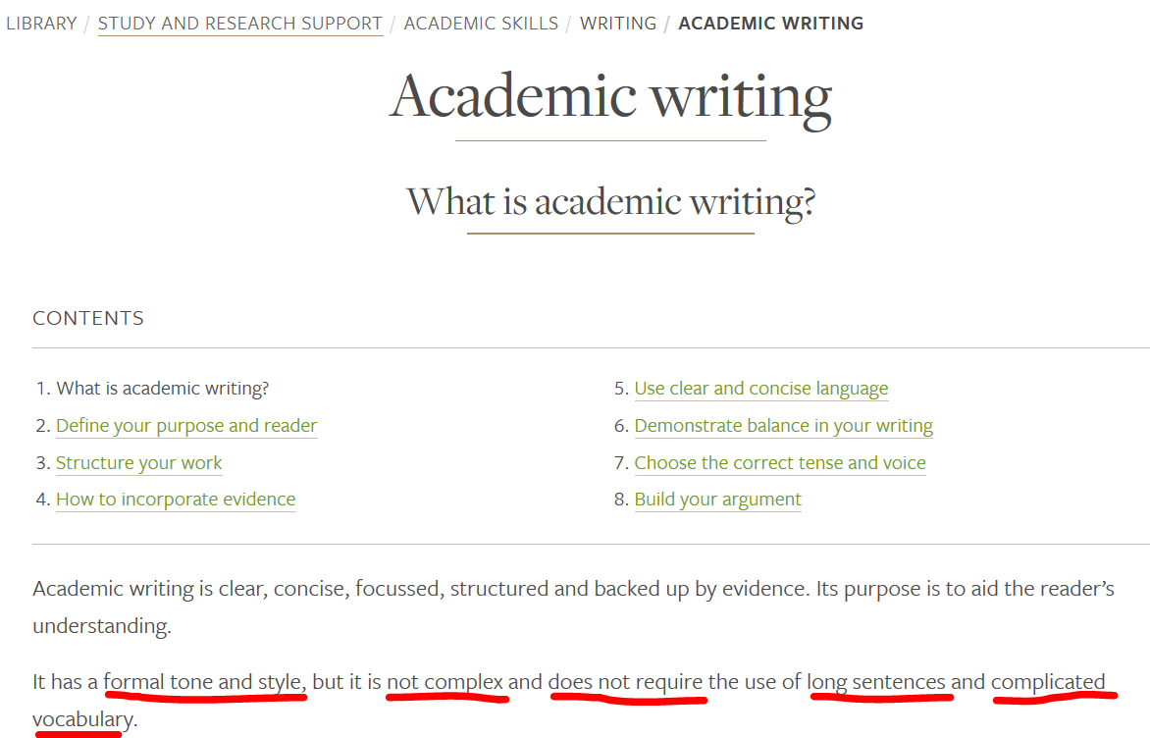

Slide 4
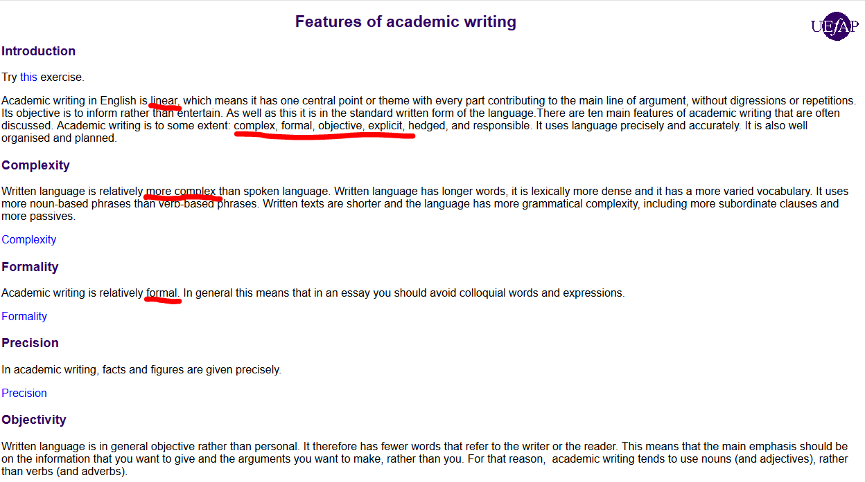
Notes:
http://www.uefap.com/writing/feature/intro.htm

Slide 5
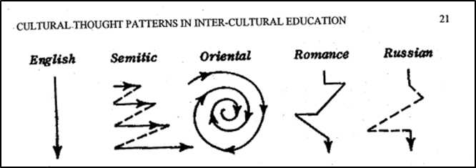
English is described as ‘linear’ rather than ‘digressive’
The paragraph begins with a general statement of its content, and then carefully develops that statement by a long series of […] illustrations. While it is discursive, the paragraph is never digressive. There is nothing in this paragraph that does not belong here; nothing that does not contribute significantly to the central idea. The flow of ideas occurs in a straight line from the opening sentence to the last sentence (Kaplan, 1980 [1966], p. 14)
Notes:
The linearity of western thinking is captured in this quote

Slide 6
Dr Nick Sousanis, Associate Professor Comics Studies, Liberal Studies, Humanities
Notes:
The linearity of Western thinking is illustrated throughout Sousanis (2015b, pp. 37, 44, 58, 63, in particular)
Sousanis: http://meaningoflife.tv/videos/37781

Slide 7
Dr A.D. Carson, Associate Professor of Hip Hop and the Global South
Notes:
Further disruption of linearity: It’s not simply a matter of rap, but a kind of cultural production.
people are engaging with that question: social justice and racism at Clemson uni Socio-academic practice is political
Carson: 34-tracks https://aydeethegreat.bandcamp.com/album/owning-my-masters-the-rhetorics-of-rhymes-revolutions
https://aydeethegreat.bandcamp.com/album/owning-my-masters-the-rhetorics-of-rhymes-revolutions

Slide 8
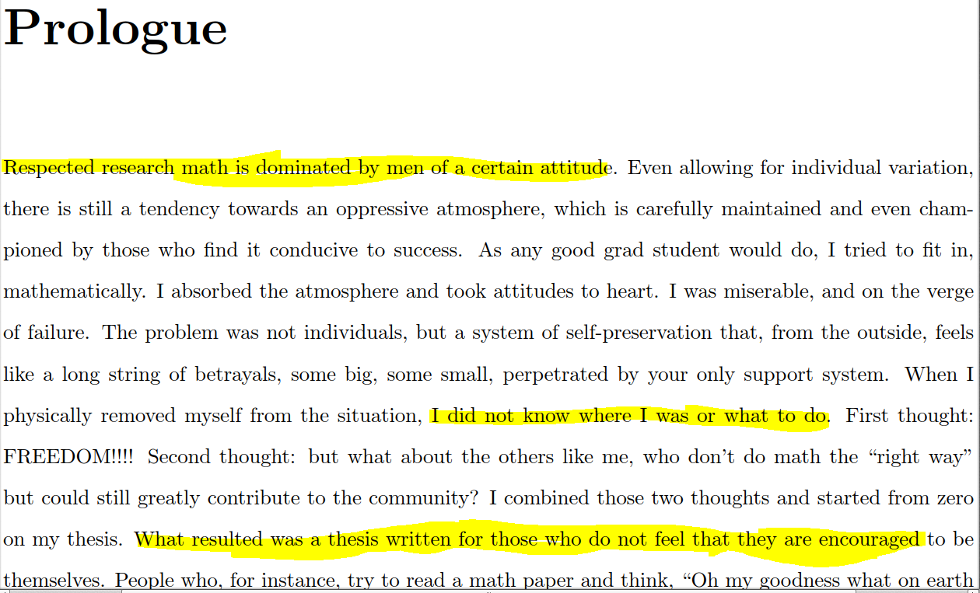
Dr Piper Alexis Harron, Temporary Associate Professor of Mathematics
Notes:
Disruption of formality: https://math.hawaii.edu/wordpress/people/paharron/
Harron: http://www.theliberatedmathematician.com/wp-content/uploads/2015/11/PiperThesisPostPrint.pdf:
Interests: intersectional feminism, Number Theory, anti-racism, humanizing mathematics Socio-academic practice is ideological
Piper Harron is a faculty member of the University of Hawai'i at Mānoa Department of Mathematics. In 2016 she received her PhD in mathematics from Princeton University under Manjul Bhargava

Slide 9
Notes:
Further disruption of formality: https://www.nature.com/articles/nm0197-30
https://www.rollingstone.com/culture/culture-news/swedish-scientists-hide-bob-dylan-lyrics-in-scholarly-articles-241478/ Socio-academic practice is fun

Slide 10
Hapax Legomena?
Notes:
Maybe, but they are still examples of academic texts? So, what makes them academic

Slide 11
What makes these texts academic?
non-linearity
Notes:
Non-linearity is a feature of complex systems

Slide 12
A complex system is one in which there is a multiplicity of causal factors contributing to the dynamics of the system, in which there are causal interactions among the underlying causal factors, and in which causal interactions are often non-linear. Non-linearity is important here, because it implies that a small change in one or more factors may lead to very large changes in the outcome (Little, 2018)
Notes:
They enact SAPs, multiplicity of causal factors include agency and textual forms
Think of the difference ‘I’ makes: epistemology, ontology, ethnography
Non-linearity: the effect is disproportionate to the cause
https://understandingsociety.blogspot.com/2018/05/social-generativity-and-complexity.html

Slide 13
Notes:
https://www.google.com/search?safe=active&client=firefox-b-d&biw=1280&bih=888&tbm=isch&sa=1&ei=Sw6wXOVWja2DB6eXq6gM&q=penny+coin+pusher+gif&oq=penny+coin+pusher+gif&gs_l=img.3...12454.14065..14590...0.0..0.59.234.4......1....1..gws-wiz-img.dPUjWuzz6Lg#imgrc=AxkaYKFMtxsOLM:

Slide 14
Dr A.D. Carson, Associate Professor of Hip Hop and the Global South
Notes:
http://www.chronicle.com/article/An-Activist-Defends-His/239335

Slide 15
What makes these texts academic?
open systems
Notes:
Complex systems are also open systems

Slide 16
Academic Writing is an Open System
energy and matter can be exchanged between the system and its environment
characterised by several variables which have varying degrees of causal relevance

Slide 17
What makes these texts academic?
emergence

Slide 18
Academic Writing is Emergent
a purely physical system, composed exclusively of bits of matter, when it reaches a certain degree of complexity in its structural organisation, can begin to exhibit genuinely novel properties not possessed by its simpler constituents Kim, 206, p. 548
Notes:
H₂0

Slide 19
What makes these texts academic?
agency

Slide 20
… human action [is] not governed by behaviouristic laws, nor as a conditioned response to pre-determined social structures, but as individual agency
Human agency is both enabled and limited by the opportunities and constraints afforded by social structures, at the same time maintaining the fabric of these social structures, which are fairly stable, but capable of gradual change […].
This means that, while learner writers often find themselves operating in a “given” (but not fixed or static) context, where academic writing is an undisputed fact of academic life, they are able to make efforts to empower themselves (Pratt, 2011, pp. 27-28)
Notes:
Open systems are generative

Slide 21
Crunch What makes writing academic …
is contestable and emergent
is its non-linearity
is its complexity within an open system
is its non-reductive and emergent quality
What makes writing academic emerges from an interaction between the Writer and their Textual Environment
This can allow us to explain diversity and novelty

Slide 22
Bibliography
Archer, A., & Breuer, E. (2016a). A Multimodal Response to Changing Communication Landscapes in Higher Education. In A. Archer & E. Breuer (Eds.), Multimodality in Higher Education (Vol. 33, pp. 1-17). Leiden/Boston: Brill.
Collier, A. (1994). Critical realism: an introduction to Roy Bhaskar's philosophy. London: Verso.
Judd, D. (2003). Critical realism and composition theory. London: Routledge.
Kim, J. (2006). Emergence: Core Ideas and Issues. Synthese, 151(3), 547-559. Retrieved from http://www.jstor.org.ezproxy.nottingham.ac.uk/stable/20118828.
Little, D. (2018). Social generativity and complexity. Retrieved from https://understandingsociety.blogspot.com/2018/05/social-generativity-and-complexity.html
Pratt, D. (2011). Modelling written communication: a new systems approach to modelling in the social sciences. Dordrecht: Springer.
Rose, M. (1985). The Language of Exclusion: Writing Instruction at the university. College English, 47(4), 341-359. Retrieved from https://www.jstor.org/stable/376957.

