Slide 1



Transformative Pedagogy: Team-Based Learning in EAP
Beck McCarter, TBLC and University of Bradford @beckmccarter
Joy Robbins, University of Leeds @manifoldJoy
#baleap2019

Slide 2
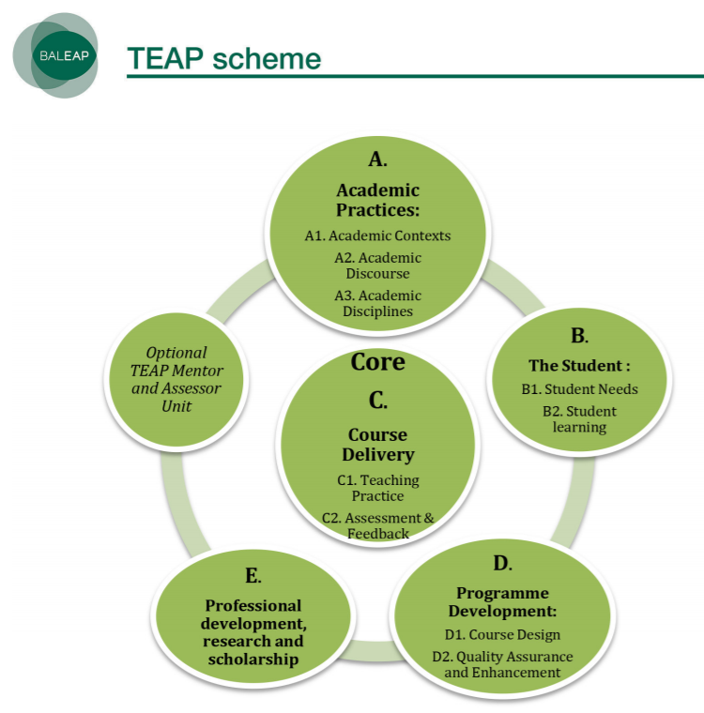
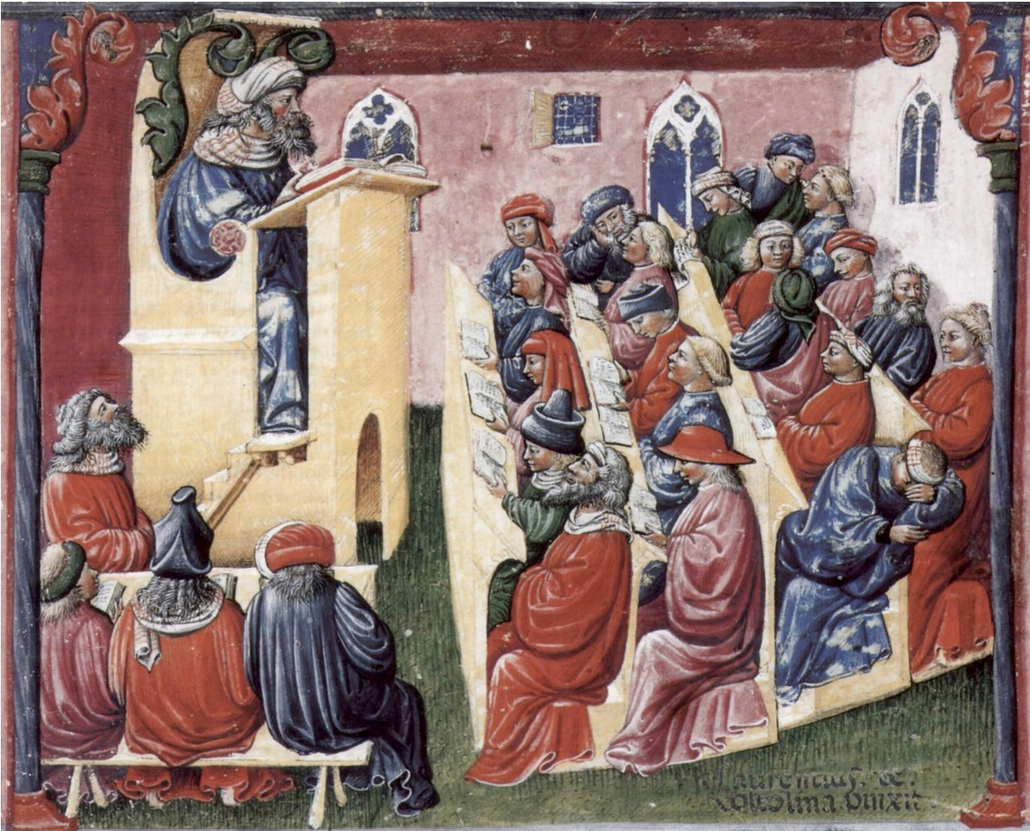
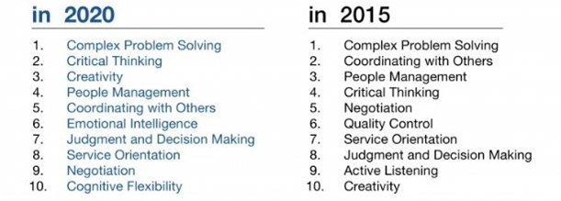
TBL and EAP are natural allies
Both have student-centred pedagogy at the core
Both prepare students to navigate demanding, changing environments
Top 10 Skills
(Future of Jobs Report, World Economic Forum)
but...

Slide 3
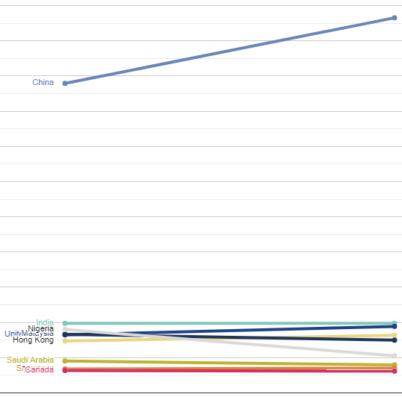
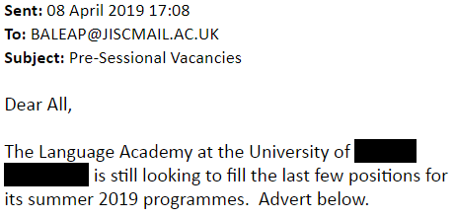
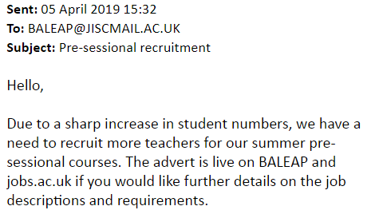
...unlike TBL, EAP is difficult to do well with large cohorts
Rising student numbers, need for teachers...
110,000
100,000
90,000
80,000
70,000
60,000
Source: HESA, HE Students Statistics: UK 2017/18
50,000
40,000
30,000
20,000
10,000
0
2013/14
2017/18

Slide 4
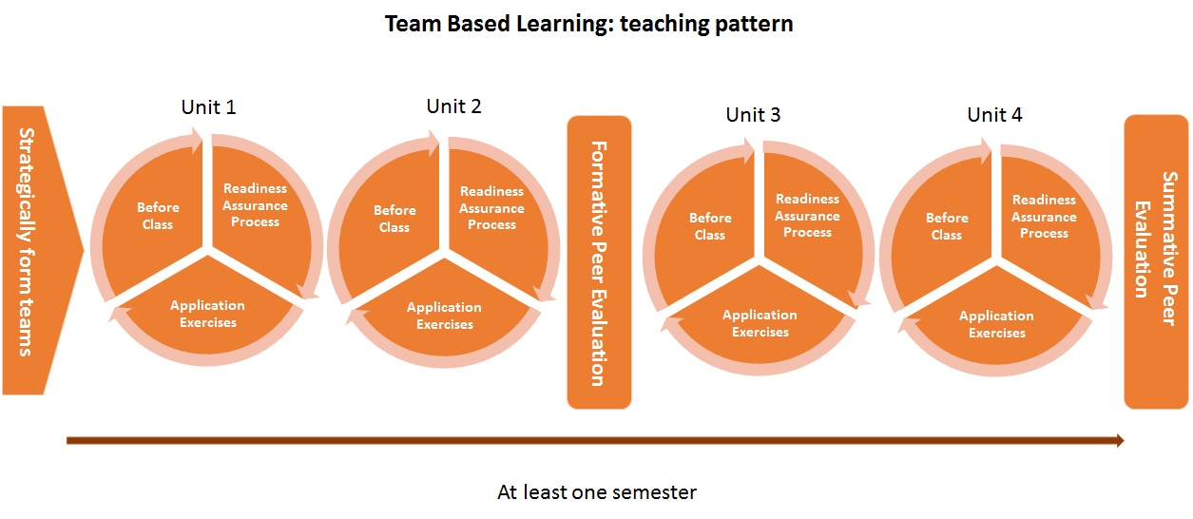
Overview of TBL

Slide 5
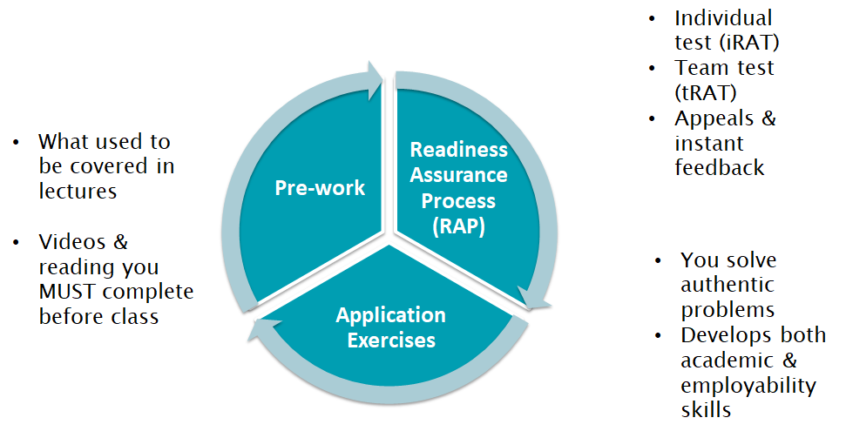
Overview of TBL – unit level

Slide 6
"English is not my first language, and for me it was much more easier to learn by reading, and in a home environment, than at school, when you get stressed, and I forget everything straight away because I get anxious…even when the exams came …I just had to think of the answer and I already knew the answer."
"It's much better...I really enjoy it...not only do I get more confidence but I get less stress...I love it; I absolutely love it"
"University work can be a bit isolating at times like, you think you’ve just got to do it all yourself, but I think TBL really makes you appreciate what you can learn from peers…sometimes you learn better from your peers"
"You had to be prepared before you came in, and I was quite; oh I don’t know if I’m going to like this, is it going to work; but I did, I preferred it. and I thought if the whole year was like that…it would keep you more interested"

Slide 7

Team formation
Line up by class size you most commonly teach – smallest number of students to largest:
Up to 15 students | 16-25 | 26-50 | 51-100 | Over 100
A | B | C | D | E
#baleap2019 @beckmccarter @manifoldJoy

Slide 8

Individual Readiness Assurance Test (iRAT)
www.pollev.com/beckster

Slide 9
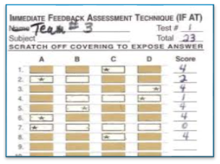
Team Readiness Assurance Test (tRAT)
How to score your tRAT
1st attempt | = 4 points
2nd attempt | = 2 points
3rd attempt | = 1 point
≥ 4 attempts | = 0 points
Please hand your scratch card in when finished

Slide 10

Debrief
Challenges & clarification session
Purpose of the RAP

Slide 11
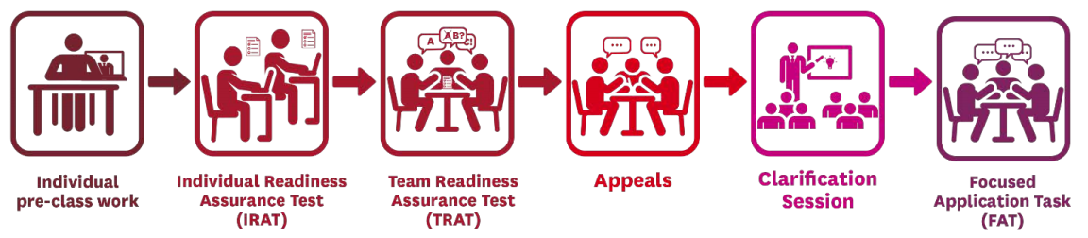
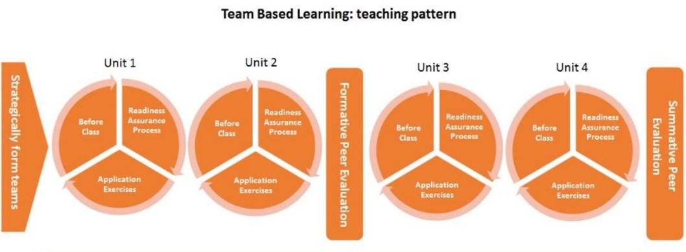
Quick note about TBL teaching pattern
45-75 mins class time
1-4 hours class time

Slide 12
Application Task
Which of these EAP activities would be most enhanced by TBL delivery?
A. Analysing the meaning of a text/ set of texts.
B. Understanding the structure and typical language of a particular academic genre (in field XYZ).
C. Understanding why, when, and how to reference.

Slide 13




Summary and questions
Team-Based Learning Masterclasses
26th June, Dundee
etblc@teambasedlearning.org
#baleap2019 @beckmccarter @manifoldJoy

