Slide 1
The EAP Practitioner and the Echo Chamber –
do we need to step outside and shout a little louder?
Jonathan Smart

Slide 2
Outline:
What we mean by ‘echo chamber’ in this context
EAP practitioner baggage – relevance to the echo chamber
EAP practitioner as auslander
How language and terminology reinforces image and identity
Parallels with other professional groups within H.E.
Consequences – the retreat to the echo chamber
Reference to feedback from 2017 survey

Slide 3

‘To exist in an echo chamber and only talk to people with whom we agree is fruitless’ Tomi Lahren

Slide 4
One definition…
“…any situation in which information, ideas or beliefs are amplified or reinforced by transmission inside an ‘enclosed’ space”
Potter (2010)

Slide 5
By the end of this presentation…
Do you recognise the ‘echo chamber’ concept as applied to EAP?
If so, what is / would be your own personal formula for breaking out of that echo chamber?

Slide 6
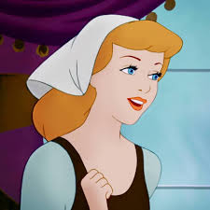
EAP: ‘a sort of Cinderella status’ (Sharpling 2002;
Turner 2004, 2012; Charles & Pecorari 2016; Ding &
Bruce 2017)

Slide 7
Definition of ‘Cinderella’
1. a woman who achieves fame after being obscure
2. a. a poor, neglected, or unsuccessful person or thing
[a ‘poor relation’]
b. (as modifier)
a Cinderella service that's been denied funding
3. (modifier) relating to dramatic success
a Cinderella story
Return

Slide 8
…in many institutions EAP has a sort of Cinderella status and staff do less well in terms of salary, opportunities to research and other benefits than staff in other subjects (Charles and Pecorari 2016)
…regenerating it [EAP] from a ‘Cinderella’ subject to one which is fully worthy of consideration as an academic discipline (Sharpling 2002)
…associated with:
the lack of prestige or status often accorded to academics based in central or faculty university units rather than ‘teaching’ departments (McCulloch 2018)

Slide 9
EAP practitioner - Identity and image
Marginalised (e.g. Turner 2004; Stevenson 2007)
Peripheral to academia (Ding and Bruce 2017)
Outsider status (Hyland 2012) - auslanders
Handmaidens (Hyland 2014)
Butlers (Raimes 1991)
Servicing disciplines, faculties and departments
(Barron 1992, 2002) Return

Slide 10
Survey interviewees (2017)
“At worst one was treated as a rather superior version of a cleaner”
“I think they think of us as ‘remedial’”
“…large numbers of our colleagues are on employment terms rather like nineteenth century mill-hands”
[Career progression] “…compares unfavourably with other academics…”
“…on the whole I think our status is very ambivalent”
“I don’t think they [subject tutors] really knew what EAP was for”
“I think they think of us as remedial” [communications issue?]

Slide 11
Mind your language?
Support (‘support’ eschewed by Masterson & LD)
Training (objectivist - Skinner) – circus?
Servicing (boiler?)
Denies notion of EAP being ‘academic,’ educational, transformative (irony?), constructivist (Vygotsky) – unlike disciplinary teaching
C.f. ‘Bibliographic instruction’
‘Their lack of status is reflected in the language used to describe their positioning in the academic world’ (Strauss 2013: 2)

Slide 12
Institutional perspectives reinforce
EAP’s lack of recognition as discipline
Remedial / deficit model
Marketisation (macro-effect on H.E.)
Collocation with non-academic functions
Lack of agency

Slide 13
Managerial clichés aid acceptance…
‘When the wind blows, some people build
walls, others build windmills’
‘Challenges’ – not ‘problems’
‘Have to do more with less’
Lemons
Why are we so accepting – even complicit?

Slide 14
Causal outcomes?
What are the likely consequences of
lack of recognition and marginalisation?
Perceived as ‘attack’ on ID & professionalism

Slide 15
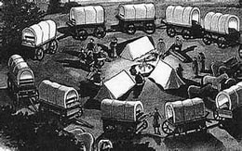
Silo Echo Chamber

Slide 16
Welcome to the echo chamber
Shared issues: EAP practitioners, Information Professionals & LD back
Bundy (2004); silos - talking to the converted; ‘Where are the subject specialists?’
‘Echo chamber’ pejorative, but comforting:
‘It’s cosy in here’ (Wiseman 2016)
….and what about CoPs?
But…..

Slide 17
Synthesis (new level of understanding)
Thesis (argument)
Antithesis (counter-argument)
Dialectic (Hegel)

Slide 18
Echo chamber / CoP
Circular non-progressive arguments – tribal reverb’ns
Dissent likely to be ‘absorbed’
Inclusive to their own – de facto excludes ‘outsiders’
Group is insulated insularity ‘They stayed separate, kept their rituals, preserved their culture, and protected themselves.’ Identity in foreign land
EAP - lack of agency ‘colluded in its own marginalisation’ (Turner 2004: 96)

Slide 19
Breaking out of the Echo Chamber(?)
Collaboration – Holy Grail (Dudley-Evans & St John 2012; Flowerdew & Peacock 2001; Hyland 2006,2014 etc.)
Change of mindset – political savviness, ‘play the game’
Learn the discourse – deploy it as part of the ‘tribe’
Effective self-marketing – talk up successes
Realpolitik – alliances, ‘champions’
Collaborative conference papers, HEA / Advance H.E.
‘The Neil Effect’ – importance of shared agenda (language / content)

Slide 20
Breaking out of the Echo Chamber (cont.)
Involvement with faculty meetings represents opportunities – esp., e.g., T & L committees
1. ‘One of theirs’ – confidante (periphery advantage)
2. Can learn and be part of the political dialogue
3. Forge (influential) alliances
4. Meeting-savvy - advance prep + raise awareness

Slide 21
Shouting a little louder?
‘academic success is rarely attributed to good language use’ (Turner 2004: 99) – establish link?
Challenge ‘technicist’ discourse around language-learning (Turner 2004; Hadley 2011)
Inseparability between subject content and language
(Gustaffson et al. 2015; Al-Maamari 2016; Lee 2009)
…leads to…
Establishing and marketing connection between EAP and academic success – HEA/Advance H.E.?

Slide 22
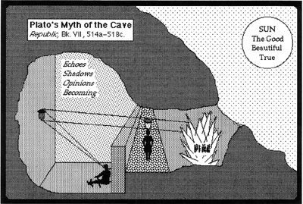

Slide 23
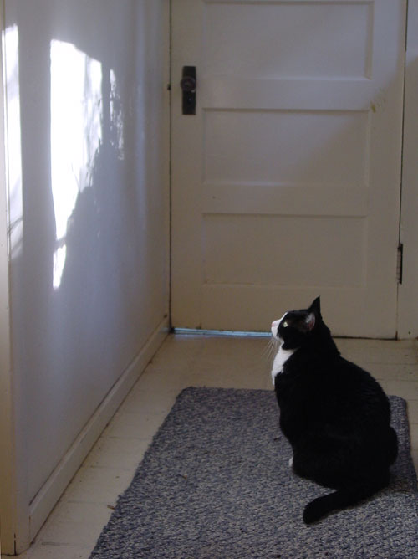

Slide 24
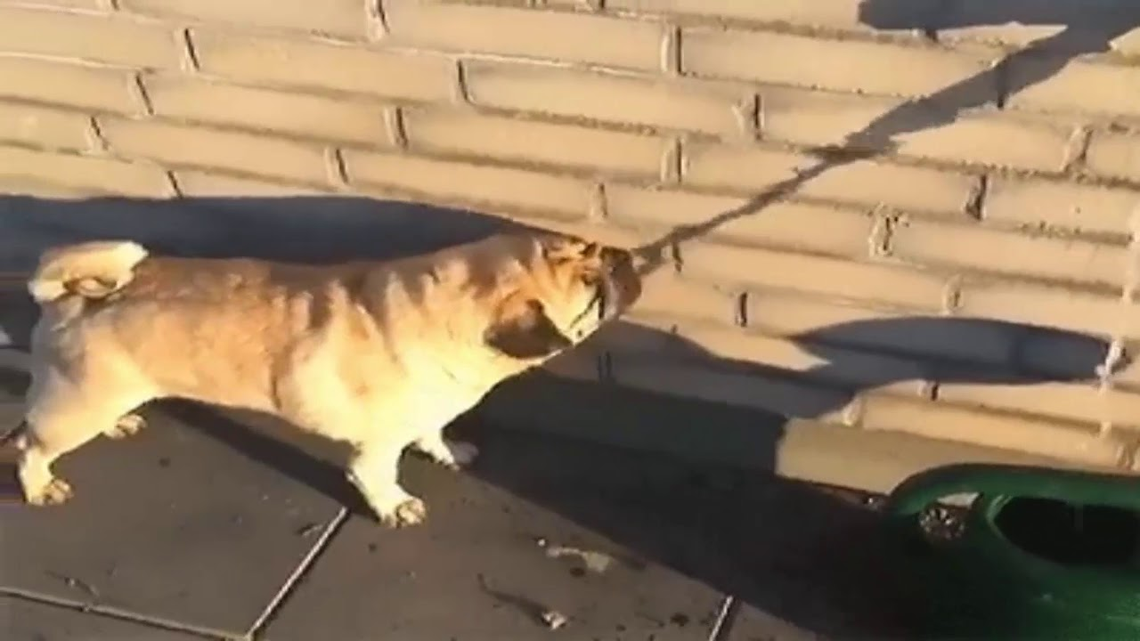

Slide 25
Concluding remarks and prognosis
Comfort zones - do we really want to move out? (Strauss 2013)
Cinderella status – fame after obscurity; dramatic success – EAP’s aspiration? Back
“I think that it [EAP] is seen as remedial, but this is starting to
change” (survey interviewee)
EAP must be convinced of its own status (otherwise self-fulfilling prophesy) – comfortable in its own skin, not only to step out of its own echo chamber but to have confidence to step into others and sell itself effectively.

Slide 26

Back to questions

Slide 27
References
Al-Maamari, F. (2016) Programme Identity in Academia: The Case of One EAP Unit in the Arabian Gulf. AWEJ [online] 7(3): pp. 425-444. Available at: https://www.researchgate.net/publication/314468936_Programme_Identity_in_Academia_The_Case_of_One_EAP_Unit_in_the_Arabian_Gulf [Accessed 8th April 2019].
Barron, C. (1992) Cultural syntonicity: co-operative relationships between the ESP unit and other departments. Hongkong Papers in Linguistics and Language Teaching, [online] 15: pp. 1-14. Available at: http://files.eric.ed.gov/fulltext/ED355766.pdf [Accessed 9th April 2019].
Barron, C. (2002) Problem-solving and EAP: themes and issues in a collaborative teaching venture. English for Specific Purposes [online] 22:3: pp. 297-314. Available at: http://www.sciencedirect.com/science/article/pii/S0889490602000169 [Accessed 8th April 2019].
Bundy, A. (2004) Beyond information: the academic library as educational change agent. 7th International Bielefeld Conference [online] pp. 1-13. Available at: http://conference.ub.uni-bielefeld.de/2004/proceedings/bundy_rev.pdf [Accessed 9th April 2019].

Slide 28
References
Charles, M. & Pecorari, D. (2016) Introducing English for academic purposes. Oxford: Routledge.
Ding, A. & Bruce, I. (2017) The English for academic purposes practitioner: operating on the edge of academia. Palgrave Macmillan.
Dudley-Evans, T. & St John, M. (2012) Assessment: Continuous assessment and testing. In Developments in English for specific purposes. Cambridge: Cambridge University Press ELT.
Flowerdew, M. & Peacock, M. (ed.) (2001) Research perspectives on English for academic purposes. Cambridge, UK: CUP.
Gustaffson, M. et al. (2011) Collaborating for content and language integrated learning: The situated character of faculty collaboration and student learning [online]. Available at: http://digitalknowledge.cput.ac.za/bitstream/11189/4925/3/Gustafsson_M_Eriksson_A_R%C3%A4is%C3%A4nen_C_Stenberg_AC_Jacobs_C_Wright_J_Wyrley-Birch_B_Winberg_C_Health%20%26%20Well_2011.pdf.pdf
[Accessed 9th April 2019]
Hyland, K. (2006) English for academic purposes: an advanced resource book. Oxford, UK: Routledge.

Slide 29
References
Hyland, K. (2012) The past is the future with the lights on: Reflections on AELFE’s 20th birthday. Ibérica [online] 24(24): pp. 29-42. Available at: https://scholar.google.co.uk/scholar?q=hyland+the+future+is+with+lights&btnG=&hl=en&as_sdt=0%2C5 [Accessed 9th April 2019].
Hyland, K. (2014) Re-imagining literacy: English in Hong Kong’s new university curriculum. English Language Education and Assessment. Springer Singapore: pp. 139-151. Available at: https://www.researchgate.net/profile/Ken_Hyland/publication/289315441_Re-imagining_Literacy_English_in_Hong_Kong's_New_University_Curriculum/links/5697a80b08aec79ee32b3d47.pdf [Accessed 9th April 2019].
Masterson, D. & Kosinska, A. (2014) Connecting language with subject content (Encouraging students to form a triangular relationship with a language tutor and a subject specialist). Presented at Plymouth University, UK, 27 June 2014.
Lee, C. (2009) Promoting interdisciplinary collaboration: three case studies. HKBU Papers in Applied Language Studies [no longer available electronically]
McCulloch, A. (2018) The disciplinary status of doctoral education. Available at: https://s3.amazonaws.com/academia.edu.documents/57819970/McCulloch_2018_HER.pdf?AWSAccessKeyId=AKIAIWOWYYGZ2Y53UL3A&Expires=1554894367&Signature=XIBi2ssBFXMnBz8nMMgdR7Qp%2F2A%3D&response-content-disposition=inline%3B%20filename%3DThe_disciplinary_status_of_doctoral_educ.pdf [Accessed 9th April 2019]
Potter (2010) Escaping the echo chamber. Presentation at City Business Library, London. Available at: https://prezi.com/if9wccvvunup/escaping-the-echo-chamber/ [Accessed 9.4.2019]

Slide 30
References
Sharpling, G.P. (2002) Learning to teach English for academic purposes: some current training and devel9pment issues. ELTED [online] 6 (Summer): pp. 82-94. Available at: http://wrap.warwick.ac.uk/3252/1/WRAP_Sharpling_V6Sharpling.pdf [Accessed 6th April 2019].
Stevenson, M. & Kokkinn, B. (2007) Pinned to the margins? The contextual shaping of academic language and learning practice. Journal of academic language and learning, 1(1), pp.A44-A54. Available at: http://journal.aall.org.au/index.php/jall/article/viewArticle/38 [Accessed 9.4.2019]
Strauss, P. (2013) ‘I don’t think we’re seen as a nuisance’: the positioning of postgraduate learning advisors in New Zealand universities. TEXT Journal of Writing and Writing Courses [online] Available at: https://openrepository.aut.ac.nz/handle/10292/10239 [Accessed 9.4.2019]
Turner, J. (2004) Language as academic purpose. Journal of English for Academic Purposes [online] 3: pp. 95-109. Available at: http://www.sciencedirect.com/science/article/pii/S1475158503000547# [Accessed 9th April 2019].
Turner, J. (2012) Academic literacies: Providing a space for the socio-political dynamics of EAP. JEAP 11, 17-25. Available at: https://www.sciencedirect.com/science/article/pii/S1475158511000828 [Accessed 9.4.2019]
Wiseman, E. (2016) Get out of my echo chamber. It's cosy in here. Guardian [online] 11.12. Available at:
https://www.theguardian.com/lifeandstyle/2016/dec/11/get-out-of-my-echo-chamber-its-cosy-in-here [Accessed 9.4.2019]

