Slide 1

Can Lexical Bundles Increase (the Perception of) Fluency?

Slide 2
1.
The study
What was done?

Slide 3
The Study
4 weeks of lexical bundles training
46 participants: 23 language specialists, 23 non langugage specialists
Finding: Lexical bundles usage was not perceived as ‘fluent’ (when fluency was presumed as ‘spoken’)
Find the full study here: irst.squarespace.com/blog/2019/2/5/class-of-2018-19
irst.squarespace.com/blog/2019/2/5/class-of-2018-19

Slide 4
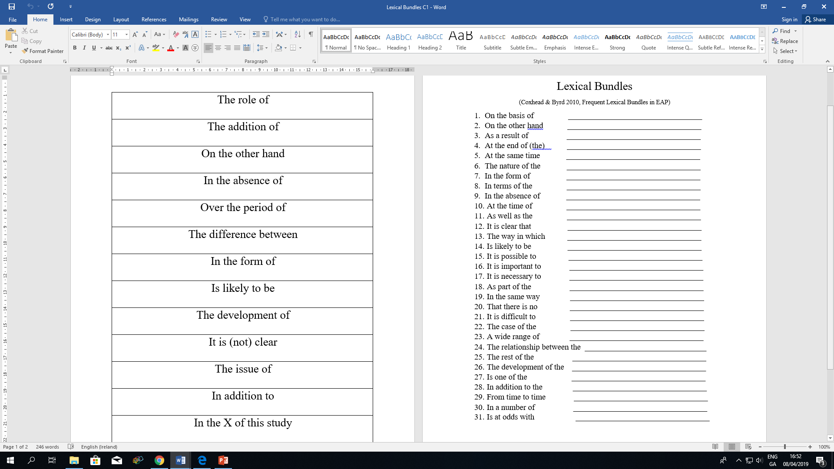
The Lexical Bundles

Slide 5
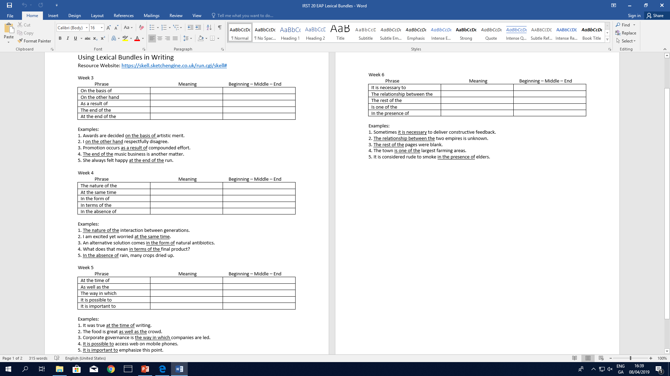
B1 learners trained with SKeLL (sketch engine)
The Lexical Bundles

Slide 6
2.
The method
How were Lexical Bundles taught?

Slide 7
Stages for increasing automaticity of Lexical Bundles (Wood, 2004)
Input
Choose a text for learners to react to (with lexical bundles).
Have learners identify the bundles in a section of the text.
Automaticity
Activities requiring high repetition of bundles to increase memory and minimize lexical retrieval.
Practice
Learners write a paragraph reaction to the original article using lexical bundles.
Production
Learners brainstorm related topics, then write another paragraph with bundles.

Slide 8
3.
The Materials
What was created?

Slide 9

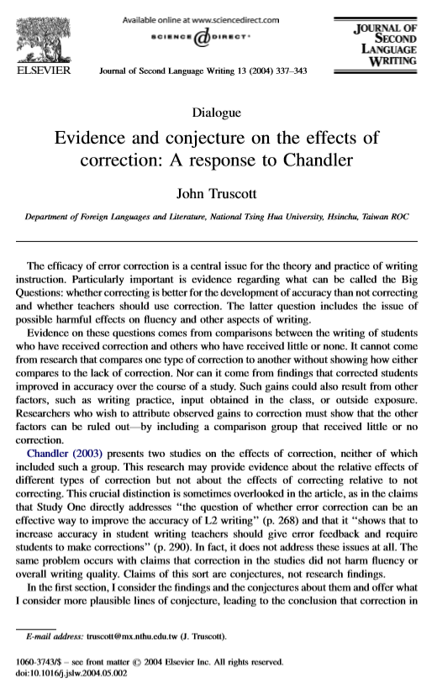
Text for original ‘Input’

Slide 10
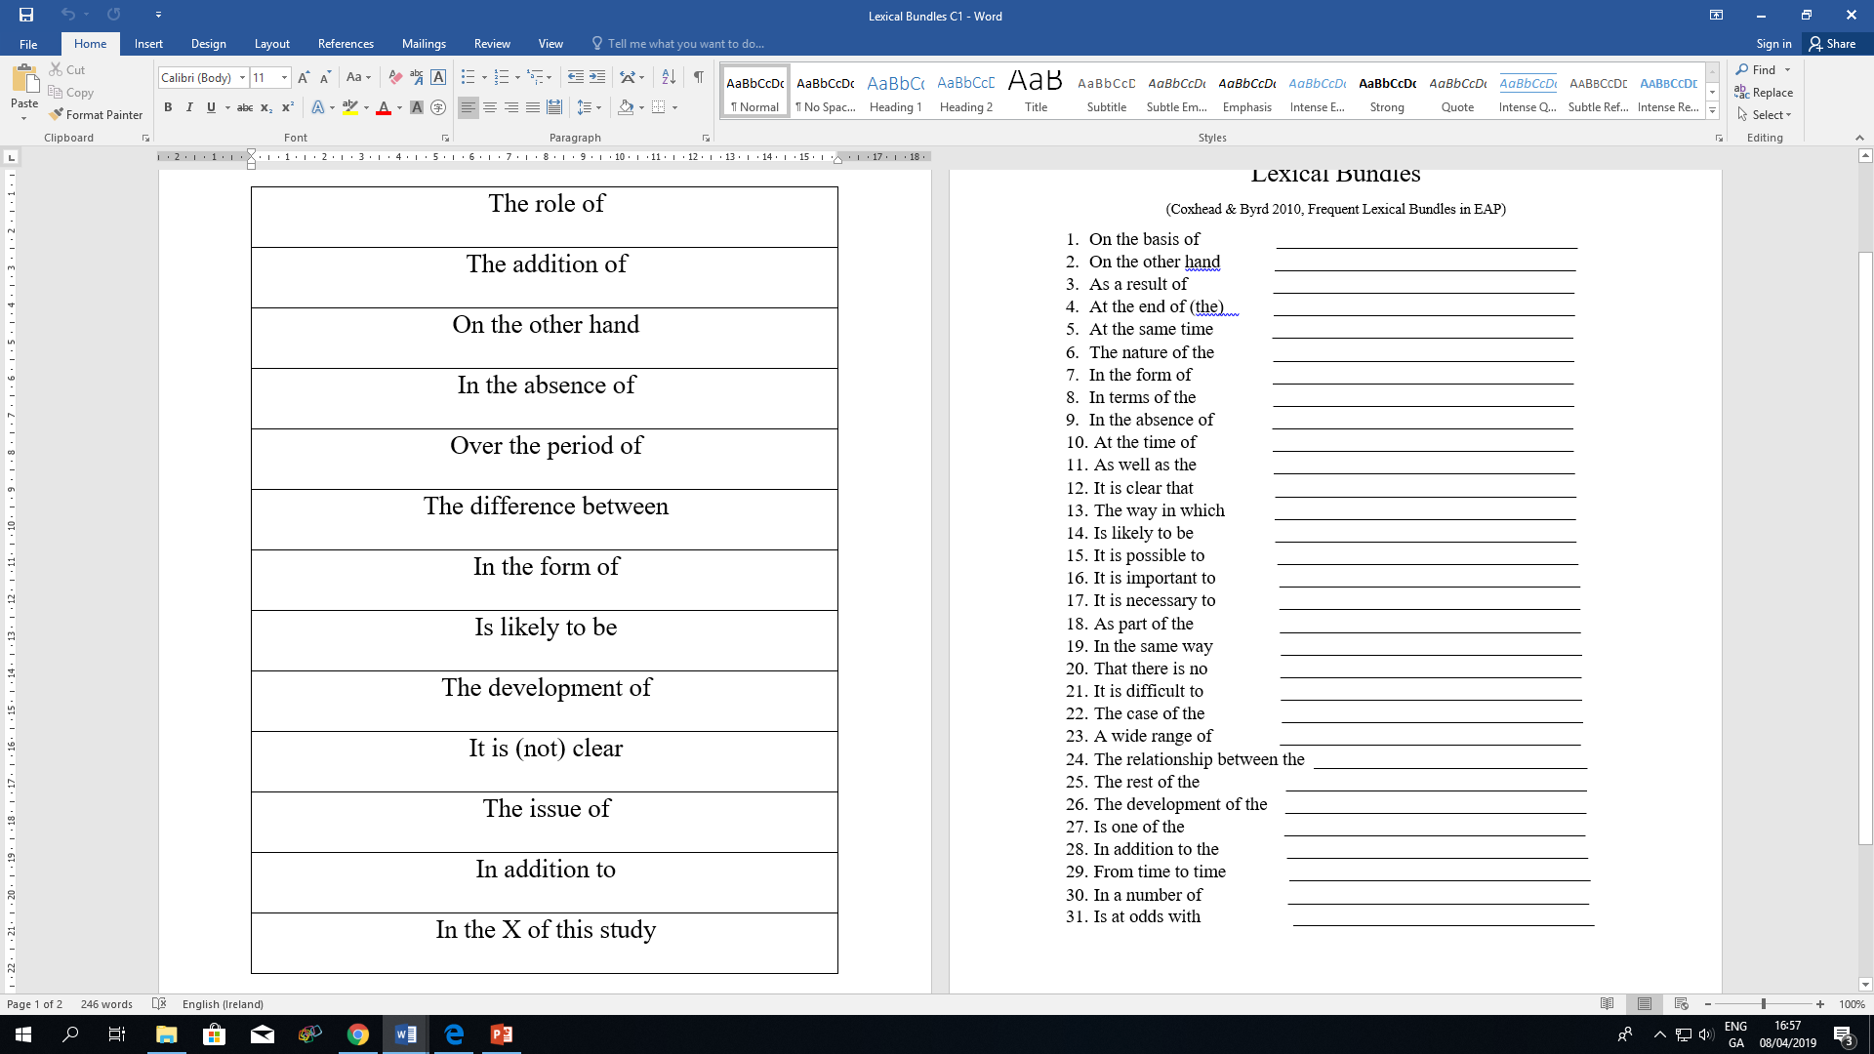
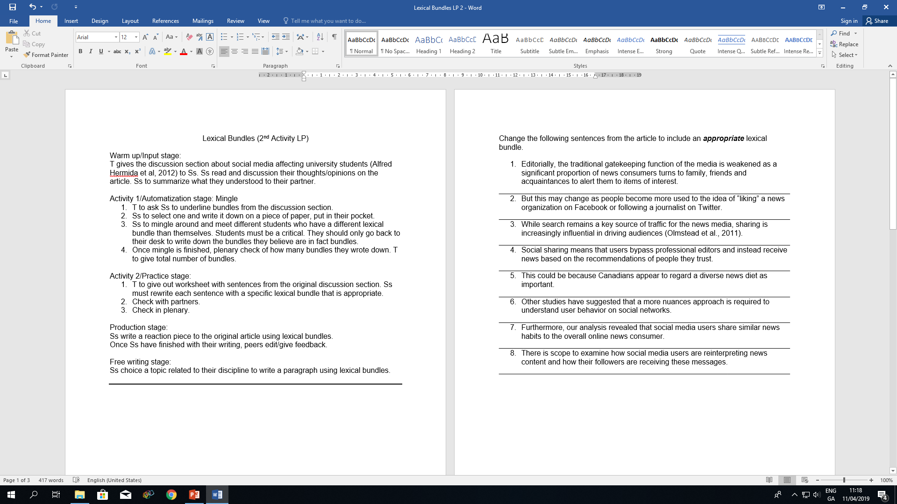
Activities targeting automaticity
1. Learners given slips with L.B., asked to order as seen in the original article
2. Learners choose 6, write a sentence three times in their notebook.
-OR-
1. Learners choose one, then mingled/milled to gather others from their classmates to write in their notebooks.
2. Learners given sentences from article without L.B. and asked to add appropriate L.B. to the sentences.

Slide 11
4.
The responses
What did learners think about the (L.B.) activities?

Slide 12

Rewriting sentences? (Mixed)
Mingle (Mixed)
Structured LP
Would use in future writing

Slide 13
References
Abdel Latif, M.M.M. (2012). What do we mean by writing fluency and how can it be validly measured?. Applied linguistics. 34(1), pp.99-105.
Byrd, P., and Coxhead, A. (2010). On the other hand: Lexical bundles in academic writing and in the teaching of EAP. University of Sydney Papers in TESOL. 5. 31-64.
Liu, D. (2012). The most frequently-used multi-word constructions in academic written English: A multi-corpus study. English for Specific Purposes. 31. 25-35.
Snellings, P., van Gelderen, A., and de Glopper, K. (2002). Lexical Retrieval: An Aspect of Fluent Second Language Production That Can Be Enhanced. Language Learning. 52(4). 723-754.
Wood, D. (2004). An Empirical Investigation into the Facilitating Role of Automatized Lexical Phrases in Second Language Fluency Development. Journal of Language and Learning. 2(1). 1-15.
Tian, C. (2012). An Empirical Research on the corpus-driven lexical chunks instruction. International Journal of English Language Teaching. 2(2).1-36.

Slide 14

Any questions?
Contact me here:
Cathryn.bennett@ucd.ie

