Slide 1
What would you classify as collaboration?
Students make a video together about a topic
Students plan an essay together and write it individually
Students plan and write an essay together
Students conduct research together and write individual reports based on the results
Students plan an essay together and individually write different sections
Students prepare and deliver a group presentation
Students write essays individually and work with another student for peer review
Students discuss a topic together
Students discuss ideas for an essay together and write it individually

Slide 2



Are we talking about the same thing?
Researcher and teacher perspectives of student collaboration.
Averil Bolster & Peter Levrai
University of the Basque Country
University of Turku

Slide 3

Our Interest in Collaboration
Wrote a course incorporating collaborative assignments (available to download).
Developed a framework to support group essays (Levrai & Bolster, 2018).
PhD interests in:
Teacher attitude to student collaboration
Assessment of collaborative assignments
https://developeap.weebly.com

Slide 4
Rationale: Theoretical Framework
Grounded in Vygotsky’s (1978) Socio-Cultural Theory (SCT).
Key concepts:
Zone of Proximal Development (ZPD)
Collaborative scaffold (Ohta, 1995)
More Knowledgeable Other (MKO)

Slide 5
Rationale: Collaboration in the Disciplines
Collaboration one of the core 21st Century Skills identified by Partnership for 21st Century Learning – P21 (Battelle for Kids, 2019).
Collaboratives assignments are a feature of undergraduate and post-graduate study, across disciplines e.g. social psychology (Johnston & Miles, 2004), law (Berry, 2010), occupational therapy (Plastow, Spiliotopoulou & Prior, 2010), accounting (Gammie & Matson, 2007).
Also featured in post-graduate courses we’ve done.

Slide 6
Rationale: Collaborative Writing
Higher quality texts (Shehadeh, 2011; Wigglesworth & Storch, 2009).
Better task achievement, with more complex and accurate writing (Fernandez Dobao, 2012; Mulligan & Garofalo, 2011; Storch, 2005; Talib & Cheung, 2017).
Echoed in student perceptions of group essay writing (Levrai & Bolster, 2018; Scotland, 2014).

Slide 7
Investigating collaboration in EAP
Conducted a survey in May 2018 via Google Forms distributed through BALEAP and EATAW mailing list.
Delivering pre-sessional (52%), foundation (56%) and in-sessional (71%) courses.
66
63
27
respondents
institutions
countries
Notes:
66% European, 53% NNES countries

Slide 8
Q1. What does “student collaboration” mean?
57%
Students engaged in any team or group activity in class (and/or online)
37%
Students working together producing a piece of work
17%
Peer tutoring and/or peer feedback
3%
Academic dishonesty

Slide 9
Collaboration: The Practitioner Perspective
Students make a video together about a topic 86.4%
Students plan an essay together and write it individually 54.5%
Students plan and write an essay together 80.3%
Students conduct research together and write individual reports based on the results 65.2%
Students plan an essay together and individually write different sections 71.2%
Students prepare and deliver a group presentation 97%
Students write essays individually and work with another student for peer review 51.5%
Students discuss a topic together 56.1%
Students discuss ideas for an essay together and write it individually 54.5%

Slide 10
Collaboration: The Researcher Perspective
People working together is not automatically collaboration (Hathorn & Ingram, 2002).
Collaboration requires students working together towards a goal with joint responsibility (Hathorn & Ingram, 2002; Storch 2019).
Collaboration is closely related to cooperation, but they differ (Kozar, 2010; Paulus 2005).

Slide 11
Collaboration & Cooperation
Cooperation | Collaboration
Students working together towards a common goal
distinct division of labour individuals working independently towards the common goal individuals may have responsibility for a specialised task | shared creation and shared responsibility for the whole task difficulty in identifying or separating individual contributions interdependence between group members
Hathorn & Ingram, 2002; Kozar, 2010; Paulus 2005; Storch 2019

Slide 12
Collaboration according to the literature
Students prepare and deliver a group presentation 97%
Collaboration
Students make a video together about a topic 86.4%
Students plan and write an essay together 80.3%
Students plan an essay together and individually write different sections 71.2%
Students conduct research together and write individual reports based on the results 65.2%
Cooperation
Students discuss a topic together 56.1%
Students plan an essay together and write it individually 54.5%
Students discuss ideas for an essay together and write it individually 54.5%
Group work
Students write essays individually and work with another student for peer review 51.5%

Slide 13
Why does it matter?
Whether a task is cooperative or collaborative affects
How we design assignments
How we support them
How we assess them
How students work together

Slide 14
Why it matters: Prominence
We gave the definition of a collaborative assignment as one
“where students work in groups to produce a joint piece
of work for which they share joint responsibility”.
Collaborative assignments contribute to final course grades
83.3% (though it varies from course to course)
76% (though it varies from course to course)
Collaborative assignments feature in EAP courses

Slide 15
Why it matters: Potential impact
Students are set a group essay assignment
which could lead to them “working in silos” (Caple & Bogle, 2013)
resulting in a “Frankenstein's Monster” essay of disparate parts (Bolster & Levrai, in press).
and adopt a cooperative approach

Slide 16
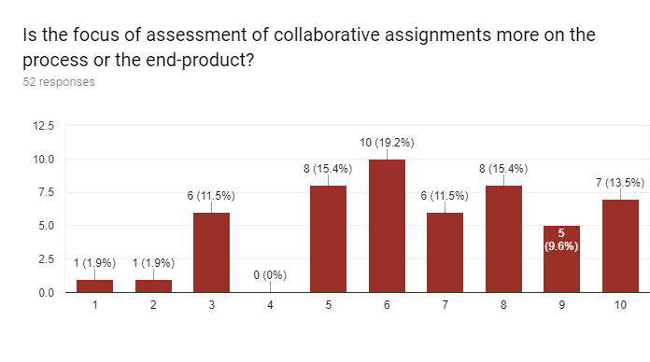
Why it matters: Assessment
Collaborative assignments contribute to final course grades in 76% cases.
There’s little consistency in how a collaborative assignment is assessed.
100% Process
100% Product

Slide 17
Why it matters: Reflecting on practice
A group presentation is the most widely recognised collaborative assignment.
Grading rubrics we’ve used and developed typically focused on product and gave:
Group grade
Content , Organization, Visual aids
Individual grade
Delivery, Language, Q&A

Slide 18
Conclusions
Collaboration does and should feature on EAP programmes.
There is no consistent conception of what collaboration is and wide variation in how it is graded.
We need to narrow the gap between practitioners and literature.

Slide 19
A definition for collaboration in EAP
Researcher conception too narrow (e.g. for extended process writing).
Practitioner conception too broad.
A collaborative assignment is one where learners work together and make equitable contributions to develop an indivisible artefact for which they share responsibility and ownership. During the development of the artefact, learners may work synchronously or asynchronously, face-to-face or online, but there is interdependence between group members, drawing on all their strengths.
(Bolster & Levrai, in press)

Slide 20
Looking Forward
If we speak the same language, we can generate a shared understanding, which could facilitate:
Innovation
Transformation
Exploration
Open further research into collaboration
Change the way we discuss collaborative assignments
Develop new ways of supporting collaboration

Slide 21

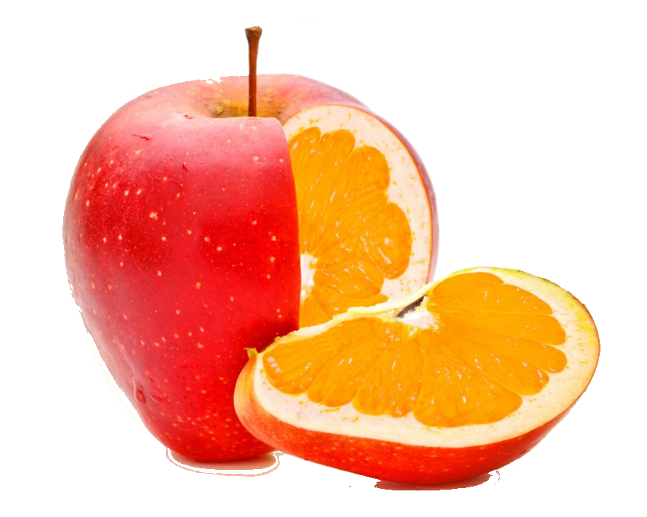
We can go from this to this
Any Questions?
Thank you
Feel free to contact us about researching student collaboration in your context
averibolster@gmail.com
peterlevrai@gmail.com

Slide 22
References
Battelle for Kids (2019) Framework for 21st Century Learning. Retrieved from http://static.battelleforkids.org/documents/p21/P21_Framework_Brief.pdf
Berry, E. (2007). Group work and assessment—benefit or burden? The Law Teacher, 41(1), 19-36.
Bolster, A. and Levrai, P. (In press). Student collaboration in English for academic purposes – theory, practitioner perceptions and reality. Kielikeskus tutkii 4.
Bolster, A. and Levrai, P. (2107). Develop EAP: A sustainable academic skills course. Available from https://developeap.weebly.com/
Caple, H., and Bogle, M. (2013). Making group assessment transparent: what wikis can contribute to collaborative projects. Assessment & Evaluation in Higher Education, 38(2), 198-210.
Fernández Dobao, A. (2012). Collaborative writing tasks in the L2 classroom: Comparing group, pair, and individual work. Journal of Second Language Writing, 21 (1), 40-58.
Gammie, E., and Matson, M. (2007). Group assessment at final degree level: An evaluation. Accounting Education: an international journal, 16(2), 185-206.
Hathorn, L and Ingram. A. (2002). Online Collaboration: Making it Work. Educational Technology, 41 (2), 33-40.
Johnston, L. and Miles, L. (2010). Assessing contributions to group assignments. Assessment & Evaluation in Higher Education, (6), 751-768.
Kozar, O. (2010). Towards Better Group Work: Seeing the Difference between Cooperation and Collaboration. English Teaching Forum 48(2), 16-23.
Levrai, P. and Bolster, A. (2018). A framework to support group essay writing in English for Academic Purposes: a case study from an English-medium instruction context. Assessment & Evaluation in Higher Education, 44(2), 186-202.
Levrai, P. & Bolster, A. (2017). ‘Undergraduate collaborative essays: constructive not a cop-out’, IATEFL 2016 Birmingham Conference Selections. IATEFL

Slide 23
References
Mulligan, C., and R. Garofalo. (2011). A collaborative writing approach: Methodology and student assessment. The Language Teacher, 35(3), 5-10.
Ohta, A. (1995). Applying Sociocultural Theory to an Analysis of Learner Discourse: Learner-Learner Collaborative Interaction in the Zone of Proximal Development. Issues in Applied Linguistics, 6(2), 93-121.
Open University (2018) 6 The Zone of Proximal Development (ZPD). Retrieved from https://www.open.edu/openlearn/languages/understanding-language-and-learning/content-section-6
Plastow, N., Spiliotopoulou, G. and Prior, S. (2010). Group assessment at first year and final degree level: a comparative evaluation. Innovations in Education and Teaching International, 47(4), 393-403.
Scotland, J. (2014). How the experience of assessed collaborative writing impacts on undergraduate students’ perceptions of assessed group work. Assessment & Evaluation in Higher Education, 41(1), 15-34.
Shehadeh, A. (2011). Effects and student perceptions of collaborative writing in L2. Journal of Second Language Writing, 20(4), 286-305.
Storch, N. (2005). Collaborative writing: Product, process, and students’ reflections. Journal of Second Language Writing, 14(3), 153-173.
Talib, T. and Y. L. Cheung. (2017). Collaborative Writing in Classroom Instruction: A Synthesis of Recent Research. The English Teacher, 46(2), 43-57.
Vygotsky, L. S. (1978). Mind in society: The development of higher psychological processes. Cambridge, MA: Harvard University Press.
Wigglesworth, G., and N. Storch. (2009). Pair versus individual writing: Effects on fluency, complexity and accuracy. Language Testing, 26(3), 445-466.

Slide 24
Framework for a collaborative essay
Moodle discussion of input texts (individual)
Group ground rules (group)
First draft (group)
Group work stop, check, reflect (individual)
Peer feedback (individual)
Outline (group)
Second draft (group)
Final Draft (group)
Group-work reflection (individual)
Annotated bibliography (individual)
‘Stormboard’ discussion of potential sources (group)
Tutorial (group)
Levrai & Bolster, 2017

