Slide 1
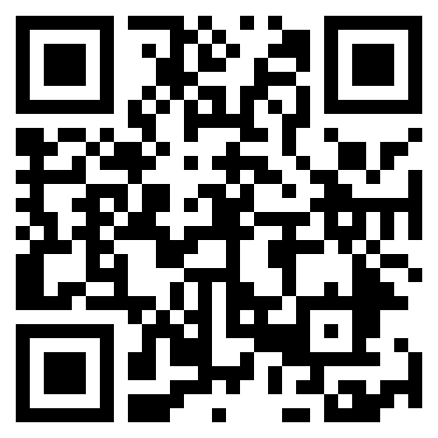
The strength of relationship between IELTS scores and receptive vocabulary knowledge for Chinese speakers
Andrew.Drummond@kcl.ac.uk
@drummondandrew
QR code for PADLET

Slide 2
Correlations between reading test scores and vocabulary test scores
Laufer (1992)
Alderson (2005)
Milton (2013)
Relatively high
.5 / .75
Depending on vocabulary test
.64
Usual range of correlations
.5 and .85
Alderson (2005:88) ‘language ability is to quite a large extent a function of vocabulary size’
(in response strong correlations in all four skills)

Slide 3
Published correlations between vocabulary test score and IELTS scores
 | n | Variables | OIS | Reading | Writing | Speaking | Listening
Milton, Wade and Hopkins (2010) | 30 | IELTS scores + X Lex | .68 | .70 | .76 | .35 | .48
Drummond (2018) | 205 | IELTS score + VST | .68 | .53 | .58 | .62 | .56
But….. Chinese subsample in Drummond (2018) shows much weaker correlation
(n=76; r=.298 for Overall IELTS and VST scores)….. This is not a strong relationship
Notes:
A subsample of Chinese students from Drummond (2018) (n=76; including one Cantonese speaker; (r=.298) exhibited a markedly weaker OIS-VST correlation than the whole group (n=205; r=.68) and the non-Chinese subsample (n=129; r=.64).

Slide 4
Research question
How strong is the relationship between IELTS score and receptive vocabulary knowledge for a large sample of Chinese-speaking students on a pre-sessional course in the UK?
(Does additional testing support the weak relationship seen in Drummond 2018?)
Notes:
Was the weak correlation found in Drummond a particular to that sample or is there evidence that it is consistently weak?
Chinese speaking students in this study are those who self identify as either Chinese or mandarin speakers.

Slide 5
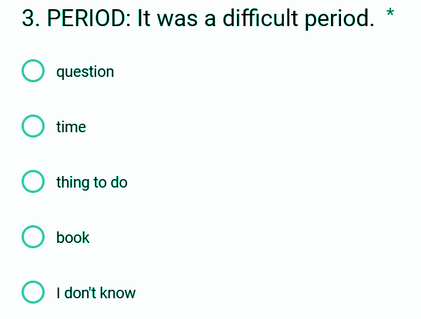
Instrument: Vocabulary size test (Nation, 2007)
140 questions (first 100 mandatory to answer in this version)
14k version
10 questions per level of 1k word frequency (based on BNC wordlists)
“I don’t know option” included (Zhang, 2013)
Online version
Response rate (83.35%)
Notes:
This is a well known and validated for item difficulty vocabulary test
140 questions organised into 14 bands… each band is effectively a ten question sample of that 1000 word frequency band
So the first ten questions are from the most common 1000 words in the language
And the second ten questions are from the second most common 1000 words in the language
I included an I don’t know option to discourage guessing.
The test was given offered to whole kings presessional at induction to be completed online
Over 1000 students. High response rate.

Slide 6
Chinese Sample n=660
Mixed Sample n=53
Male 155 | Female 550 | 5 other / prefer not to say
613 completed undergrad | 22 completed high school | 25 completed Masters
Average age 22.8 | English medium school 78
Male 15 | Female 37 | 1 other / prefer not to say
38 completed undergrad | 3 completed high school | 12 completed Masters
Average age 27.8 | English medium school 3
L1 - major groups Thai 16 Japanese 10 Turkish 4 Korean 4 Arabic 3 Spanish 2 ++
Big difference in size and
Homogeneity vs heterogeneity
Notes:
Only those with IELTS scores less than 12 months kept
Removed those who didn’t want to be in study
Massive Chinese sample but much smaller representation from other nationalities
Chinese speakers were those who self identified as Chinese or mandarin speakers. Since Mandarin is normally conflated with Chiense.
Overwhelmingly these were students hoping to enter MA programmes with a few BSc and a few phd students.

Slide 7
Average IELTS scores by sample Mean VST scores (data from this study)
Mean VST scores (data from this study)
 | Overall | IELTS Reading | IELTS Writing | IELTS Speaking | IELTS Listening
Mixed sample in this study (n=53) | 6.45 | 6.71 | 5.93 | 6.2 | 6.63
Chinese students in this study (n=660) | 6.42 | 7 | 5.91 | 5.87 | 6.60
All IELTS China 2017 | 5.81 | 6.15 | 5.41 | 5.46 | 5.97
 | Mean VST Score
Whole sample | 59.2
Chinese (n=660) | 58.16
Non Chinese (n=53) | 72.79
Notes:
Our Chinese students at KCL have higher IELTS avg maybe through repeats tests. Maybe relatively high entry requirements
Avg IELTS scores of Chinese and mixed sample very similar
Show results….
but mean VST scores for each sample quite different
In this sample, the Chinese group have apparently achieved comparable IELTS scores with less receptive lexical knowledge

Slide 8


Descriptive data
 |  |  | 5.5 |  | 6 |  | 6.5 |  | 7 |  | 7.5
Chinese | N |  | 71 |  | 174 |  | 227 |  | 169 |  | 19
Non-Chinese |  |  | 7 |  | 10 |  | 24 |  | 5 |  | 7
Chinese | Mean |  | 53.27 |  | 55.00 |  | 58.94 |  | 61.47 |  | 66.58
Non-Chinese |  |  | 64.43 |  | 65.90 |  | 71.71 |  | 77.60 |  | 91.29
Chinese | Std. Deviation |  | 21.56 |  | 17.36 |  | 18.78 |  | 15.61 |  | 16.84
Non-Chinese |  |  | 13.77 |  | 11.83 |  | 15.66 |  | 14.03 |  | 15.62
Chinese | Variance |  | 465.0 |  | 301.5 |  | 352.5 |  | 243.6 |  | 283.5
Non-Chinese |  |  | 189.6 |  | 139.9 |  | 245.3 |  | 196.8 |  | 243.9

Slide 9
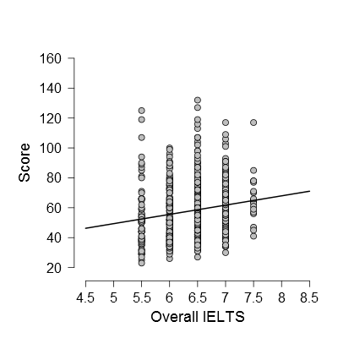
Results
N.B. Milton: Usual range of correlations = .5 and .85
 | Overall IELTS | IELTS Read | IELTS Writing | IELTS Speak | IELTS Listening
Chinese data set | 0.211 | 0.140 | 0.175 | 0.141 | 0.147
Mixed data set | 0.432 | 0.222 | 0.120 | 0.426 | 0.388
Spearman Correlations (rho) IELTS scores and VST scores
Plot for Chinese sample (n=660)
Notes:
Correlations between vocabulary test scores and IELTS are very low for both samples
The rho for the Chinese speakers is the lowest correlation of this type I have seen.
It was so low checked everything for technical errors.
The plot shows that for a given overall IELTS bands, your vocabulary score could basically be anything. They aren’t bunched together
Mean VST scores don’t increase much as overall IELTS bands increase
Even band seven has a wild variety of language knowledge unperinnning this sought after grade.
Until overall 7.5 seems pretty to hit that with low vocabulary knowledge.

Slide 10
Sub-samples’ data
Weak relationship IELTS-VST is consistent
 |  | IELTS Overall | IELTS Reading | IELTS Writing | IELTS Speaking | IELTS Listening
Mixed sample (n=53) | Rho (p value) | 0.432 (0.001) | 0.222 (0.110) | 0.120 (0.393) | 0.426 (0.001) | 0.388 (0.004)
1. Female sub sample (n=500) | Rho (p value) | .214 (<.001) | .158 (<.001) | .160 (<.001) | .154 (<.001) | .137 (<.002)
2. Male sub sample (n=155) | Rho (p value) | .145 (.071) | .045 (.578) | .153 (.058) | .079 (.329) | .090 (0.263)
3. English education sub sample (n=86) | Rho (p value) | .203 (.062) | 0.164 (.134) | .234 (.031) | .070 (.527) | .211 (.053)
4. Random sample 1 (n=53) | Rho (p value) | .366 (.007) | .342 (.012) | .230 (.098) | .041 (.769) | .296 (.032)
5. Random sample 2 (n=53) | Rho (p value) | .158 (.259) | .081 (.565) | .207 (.136) | .116 (.409) | -.009 (.949)
Notes:
Although larger sample would normally be considered more reliable, I had to check…
Fearing that 660 cases somehow warped the results.
Several other ways of looking at the data give mostly the same kind of very weak relationship.
. Largely all the subsamples have similar or weaker realtionships to the whole sample…. It doesnt matter if you are in the male group / female group / attendend english medium schools / random sub samples…. Well one random sample had slightly stronger. Look at the make result for reading. 0.45 there is no relationship between vocab test results and reading paper results… how is this possible?

Slide 11
Two follow up investigations
Incredibly weak relationship between VST and IELTS for Chinese speakers.
We have seen...
Part 1: Why?
Part 2
So what?
Interview students
Explore VST results
For same group
Ask them to help me understand results:
Investigate test taking practices
Model data from VST score profile to predict text coverage afforded by evident receptive lexical knowledge
Notes:
I didn’t want this to be the end of the story, so the project developed in two further ways.

Slide 12
Sample for interview
n=5; Chinese speakers
All students with VST scores lower than the mean for their IELTS band
Partici- pant | Sex | Age | Prospective study | Most recent IELTS Overall | Language spoken at school | VST score
A | F | 23 | MA Digital Media and Asset Management (DAMM) | 6.5 | English | 35
B | F | 22 | MA Human Resource Management (HRM) | 7 | Chinese | 35
C | F | 21 | MA Digital Marketing (DM) | 7* | Chinese | 52
D | F | 19 | BSc Business Management (BM) | 7 | English and Chinese | 45
E | M | 18 | BSc Business Management | 6.5 | Chinese | 45
Notes:
Initially two groups intended those with VST higher than mean and those with lower. Only the lower group attended

Slide 13
How many times have you taken the IELTS test and what scores did you get?
Student | No. IELTS tests | OIS scores over time
A | 4 | 6 - 6 - 6 - 6.5
B | 6 | 6 - 6.5 - 6.5 - 6 - 7 - 6.5
C | 3 | 6.5 - 7 - 7
D | 14 | 6 - 6.5 - 6.5 - 7 - 7 - 7 - 7 - 7 - 7 - 7 - 7 - 7 - 7 - 7
E | 5 | 4.5 - 5.5 - 5.5 - 5.5 - 6.5

Slide 14
The contribution of intensive training
Four students indicated that they had attended intensive IELTS test preparation in private institutions.
[A] attended an intensive, full-board IELTS training school for one month in which there were at least 8 hours of tuition everyday plus homework.
[B] worked at an IELTS training provider for two years in a role that was part work, part study.
[C] spent also spent one month in a non-residential training centre in the summer during undergraduate study.
[D] no direct comment.
[E] attended an IELTS training centre every weekend for 3 months.
Notes:
Long hours…. Intensive training… some institutions offering classes targeted at particular grade bands
Memorization of patterns for speaking exam

Slide 15
The perceived value of studying vocabulary vs practising test-taking skills
All students agreed not necessary to understand the language to get the right answer [laughter]
A] ‘What we can do is practice more and get higher scores in a short time but we can’t improve our English skills in a short time.’
Preparing for different types of reading question = more effective use of study time
Reading skills such as scanning a text can be improved
Much of a sentence could be ignored: ‘even if you don’t know the meaning of the word, just put it into the answer’
Look at example from [B] switched from learning core language skills to developing test-taking strategies (tests taken 4 weeks apart):
 | Listening | Reading | Speaking | Writing | Overall
First test | 6.5 | 6 | 6 | 6 | 6
Second test | 6.5 | 8 | 6.5 | 6 | 7

Slide 16
Borderline cheating: information sharing app
[C] described: ‘The brother of IELTS’ app or 雅思哥 in Mandarin
Used on examination days to get live information pertinent to the centre at which they were taking the exam.
Students upload the topics at specific test centres to share with fellows
[C] felt this could give an advantage as the speaking topics were quite similar
[B] also felt there was a low probability of getting the same speaking topic.
All the students aware of this app
All agreed that everyone taking IELTS in China would be aware of the app.

Slide 17
Additional themes / comments
Travelling for more lenient assessment
Perception that urban test centres stricter with marks than in smaller towns
Perception that taking IELTS overseas / easier to get higher grades
Comments on VST
Receptive vocabulary test better in Mandarin version (1 item tested; not five)
Scope of language assessed (samples from whole of BNC) not representative of ‘academic’ (only) English
Progression
4 out of 5 progressed from pre-sessional: completing open-book exams and longer essay that couldn’t be gamed as easily

Slide 18
Summary of qualitative data
Beliefs and practices
In pursuit of gains in assessment performances, students go to great lengths: residential training courses; multiple tests; memorisation; borderline cheating
They state a belief in the value of improving test-taking skills over learning general English.
Doesn’t prove that gaming the test allows low levels of vocabulary knowledge to produce high IELTS scores BUT
This is more likely than if all the students reported dedication to general English and vocabulary studies

Slide 19
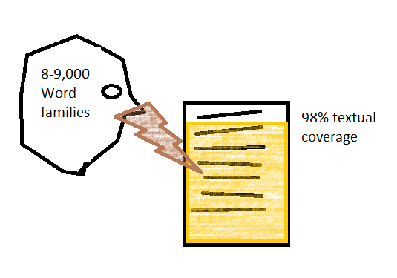
Modelling textual coverage afforded by the students’ VST result
Hu & Nation (2000); Schmitt, Jiang & Grabe (2011): 98% of words needs to be known to read / comprehend text comfortably
Nation (2006) 8-9,000 word family required for 98% coverage of novels and newspapers using same 1k-14k word lists used to make VST
Given the VST score profiles of these students, how much text coverage of articles and books from their destination degrees is their receptive lexical knowledge likely to provide?

Slide 20
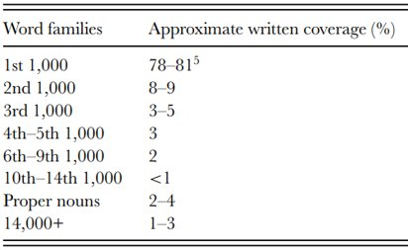
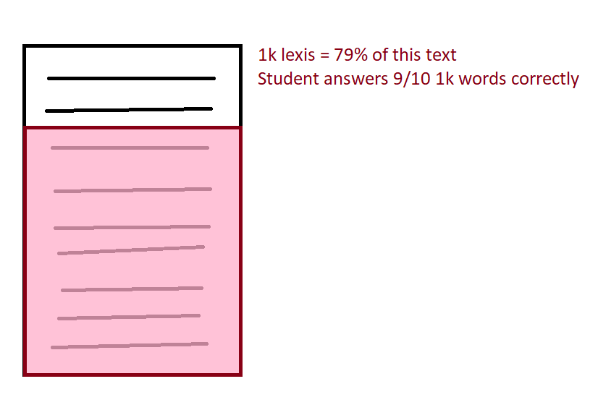
Textual coverage model
71.1%
90% of 79% =
71.1%
Nation’s coverage figures relate to very different texts than the ones the student’s are to read
Nation, P. (2006). How large a vocabulary is needed for reading and listening?
Notes:
Middle figure from Nation (2006)
Make this calculation of each of the 14 levels to an overall coverage figure….
Problem 1: is a sample of ten representative?
Gyllstad, H., Vilkaitė, L., & Schmitt, N. (2015) have addressed the question of how representative a ten item sample is of overall knowledge of a word frequency band, it seems probable that results from MCQ-based tests lead to an overestimation of item knowledge. If this is correct, the textual coverage figures would tend to represent close to the maximum possible for the VST results concerneced. (Their test didn’t include the I don’t know option)...
Study assumes partial receptive recognition of a written word can always be match by an oral productive explication of these knowledge which seems a bit unlikely.
Belgar: Ten items per level is more than sufficient to estimate the test-takers’ lexical knowledge with a high degree of precision (based on Rasch data)
Problem 2: we need to lexical frequency profiles of the texts the students are actually going to read

Slide 21
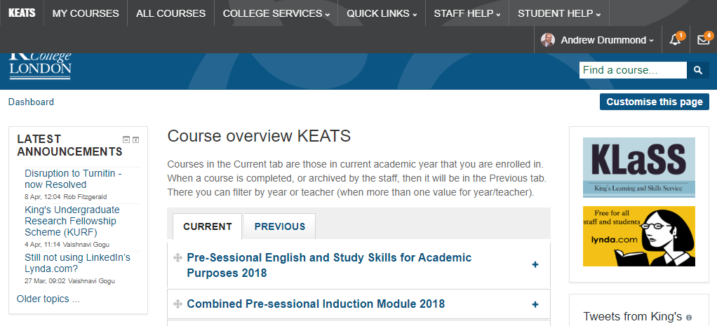

Composition of mini-corpora
Relates to student | Course of study | Tokens | Text(s)
A | MA DAMM | 40173 | Academic articles from semester one VLE module + one book chapter
B | MA Human Resource Man | 40205 | Academic articles from semester one VLE module
C | MA Digital Market | 40166 | Initial chapters of semester one set text book
D & E | Bsc Business Management | 40322 | Initial chapters of semester one set text book
1k? 2k?
Notes:
To explore a model of how much coverage a student would have when reading academic texts in their discipline, we can’t use nations original numbers because they were based on newspapers and novels. The corpora of approx 40 000 words are from term 1 reading list or weekly readings posted on a term 1 module vle. We need to know the proportions of common words to rare more difficult words to meaningfully apply a students VST score. How many words in these texts are from the most common 1000? How from the second 1000? And so on…. Same word lists used as Nations original studny for this, from the BNC. Texts processed with software to allocate each word a partucular frequency band. But decisions need to be made about certain aspects of the texts

Slide 22
Processing the texts
Action taken | Textual items
Deleted content (all texts) | Article title, reference list, running heads, funding statements, end notes, possessive’s, graphics and their headings, tables featuring mostly statistical data, tables with rendered into unreadable syntax in text files; notes on sources of data
Deleted content in textbooks | Tables and lines of text dominated by mathematical or algebraic formulas; numbered practice exercises for students; preliminary comments summarising chapters
Treated as 1k lexis | Abbreviations such as HRM (Human Resource Management), the terms ‘internet’, ‘blog’, ‘email’ ‘smartphone’ ‘cellphone’ ‘‘website’ ‘html’ ‘URL’ ‘webpage’
Added to word lists | Proper nouns added to Nation’s list of proper nouns, absent word family members to relevant word list (level 6 word families), ‘.com’, ‘www’ and ‘http’ treated as proper nouns. Abbreviations relating to proper nouns (e.g. EU) added to proper nouns list
Added to off list | Foreign words ‘hamam’; everything else
Misc processing | Transparent compounds (e.g. videotaped) were separated by a space and read by the software as separate words; and contractions were spelled out in full. References to content in tables such as ‘b1’ rewritten as ‘1’. References such sa ‘D curve’ and so on rewritten and ‘demand curve’.
Notes:
I won’t dwell on this but i took a principled and consistent approach to dealing with ambiguous items, following nation as much as possible (2006 does not have complete detail on this)

Slide 23
Word families for 98% text coverage in the students’ disciplines (With 1k-14k BNC Wordlists)
Word Family | DAMM MA | HRM MA | Dig Market MA | BM Bsc | Combined
1k | 73.45 | 73.25 | 73.47 | 82.5 | 75.6675
2k | 10.9 | 12.57 | 12.6 | 9.25 | 11.33
3k | 2.56 | 2.5 | 2.65 | 2.49 | 2.55
4k | 5.25 | 3.06 | 4.53 | 2.63 | 3.8675
5k | 1.43 | 1.28 | 0.76 | **0.78 | 0.8675
6k | 0.81 | 1.24 | 0.6 | 0.41 | 0.765
7k | 0.89 | 0.41 | 0.28 | 0.26 | 0.46
8k | 0.71 | 0.39 | **1.19 | 0.16 | 0.315
9k | 0.26 | **0.32 | 0.18 | 0.17 | 0.1525
10k | 0.2 | 0.15 | 0.25 | 0.09 | **0.1725
11k | **0.35 | 0.17 | 0.17 | 0.09 | 0.1075
Prop | 1.45 | 3.28 | 2.47 | 0.74 | 1.985
**98% coverage reached with this no. word families + proper nouns
Notes:
When you run it though software antwordprofiler
BNC wordlists used as they are the one behind the VST and behind nations 2007 research showing how many word families are required for 98% c0verage of newspapers and novels
I have the figures for all 14 word lists but they wouldn;t fit on slide

Slide 24
Implied coverage of MA DAMM mini-corpus based on student [A]’s VST score profile
 | 1k | 2k | 3k | 4k | 5k | 6k | 7k | 8k | 9k | 10k | 11k | 12k | 13k | 14k | Prop
Coverage BNC 1k-14k % | 73.45 | 10.90 | 2.56 | 5.25 | 1.43 | 0.81 | 0.89 | 0.71 | 0.26 | 0.20 | 0.35 | 0.31 | 0.58 | 0.12 | 1.45
Correct Answers in VST | 10.00 | 6.00 | 4.00 | 3.00 | 1.00 | 2.00 | 2.00 | 3.00 | 1.00 | 0.00 | 2.00 | 1.00 | 0.00 | 0.00 | n/a
Implied coverage % | 73.45 | 6.54 | 1.02 | 1.58 | 0.14 | 0.16 | 0.18 | 0.21 | 0.03 | 0.00 | 0.07 | 0.03 | 0.00 | 0.00 | 1.45
Total text coverage implied | No. of unknown words per 000 | One in X Words unknown
84.86 | 151.38 | 6.61
Notes:
So to focus one student in particular to show how the model works
First line
Second line
Third line
If the scores at each word frequency level of the test truly reflect the proportion of words she knows at each level, then when she reads these texts in term 1, she will have very frequent unknown words….one in evert six and a half words

Slide 25
The other 4 students’ implied textual coverage of term 1 readings
Student | Destination degree | Total text coverage implied | No. of unknown words per 000 | One in X Words Unknown
B | MA HRM | 80.97 | 190.26 | 5.26
C | MA DM | 92.92 | 70.78 | 14.13
D | Bsc BM | 92.86 | 71.45 | 14.00
E | Bsc BM | 84.40 | 155.98 | 6.41
Comfortable | -- | 98.00 | 20 | 50
All five are very distant from 98% coverage
L2 alone not likely to provide epistemic access

Slide 26
Conclusion: not a deficit but a difference
Large group of Chinese speakers with weakest recorded correlations with IELTS scores and Vocabulary test
Apparently ‘leveraging’ smaller vocabularies into higher IELTS scores
BUT
Chinese students interviewed very adaptive; adapt to presessional
Work ethic; translation strategies apparently overcome apparent severe limitations in vocabulary
Gaming a test requires intense application of cognitive, problem solving resources, these then applied to new problems

Slide 27
Conclusion: assessment and support
Is IELTS test + vocabulary test a more robust assessment?
Avoid IELTS-type MCQs in assessments?
Model predicts major reading problems with Semester 1 texts; is this English-medium education? Shouldn’t we admit role of L1? Social processes?
Is the learning produced different from those with larger vocabulary?
How can we support students with high IELTS scores and low lexical knowledge?

Slide 28
References
andrew.drummond@kcl.ac.uk
@drummondandrew
Alderson, J. C. (2005). Diagnosing foreign language proficiency: The interface between learning and assessment. A&C Black
Beglar, D. (2010). A Rasch-based validation of the Vocabulary Size Test. Language Testing, 27(1), 101-118.
Drummond, A. (2018). Investigating the Relationship between IELTS Scores and Receptive Vocabulary Size. Journal of the Foundation Year Network, 1.
Hu, M., and Nation, I. S. P. (2000). Vocabulary density and reading comprehension. Reading in a Foreign Language, 23, 403–430.
Gyllstad, H., Vilkaitė, L., & Schmitt, N. (2015). Assessing vocabulary size through multiple-choice formats: Issues with guessing and sampling rates. ITL-International Journal of Applied Linguistics, 166(2), 278-306.
Laufer, B. (1992). How much lexis is necessary for reading comprehension? In Vocabulary and Applied Linguistics (pp. 126-132). Palgrave Macmillan, London.
Milton, J. (2013). Measuring the contribution of vocabulary knowledge to proficiency in the four skills. C. Bardel, C. Lindqvist, & B. Laufer (Eds.) L, 2, 57-78
Milton, J., Wade, J., & Hopkins, N. (2010). Aural word recognition and oral competence in English as a foreign language. Insights into non-native vocabulary teaching and learning, 83-98.
Nation, I. S. P. (2006). How large a vocabulary is needed for reading and listening?. Canadian Modern Language Review, 63(1), 59-82.
Nation, I. S. P., and Belgar, D. (2007). A vocabulary size test. The Language Teacher, 31(7), 9-13.
Schmitt, N., Jiang, X., and Grabe, W. (2011). The percentage of words known in a text and reading comprehension. The Modern Language Journal, 95(1), 26-43.
Zhang, X. (2013). The I don't know option in the Vocabulary Size Test. TESOL Quarterly, 47(4), 790-811.
.

