Slide 1
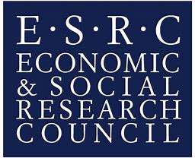
Investigating EAP teachers’ use of e-learning technology – what, why and how?
Sundeep Dhillon
S.Dhillon.5@warwick.ac.uk
@sun1dhillon

Slide 2
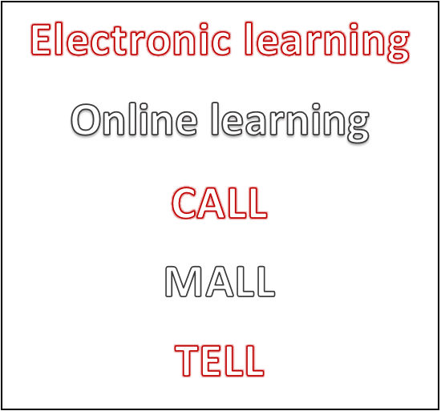


E-learning technology

Slide 3
Key reading
Cowie & Sakui (2013) – e-learning in HE contexts in 4 countries
Prensky (2001) – ‘digital natives’ and ‘digital immigrants’
Gilbert (2013) – corpora
Charles & Pecorari (2016) – Web 2.0

Slide 4
Research questions
What e-learning technology tools do EAP teachers use?
Why do EAP teachers use e-learning technology?
How do EAP teachers develop their conversancy in e-learning technology?
How might teachers’ conversancy in e-learning technology for EAP teaching be developed?

Slide 5
Methodology
Mixed methods
Quantitative data collection – online survey (n=55)
Qualitative data collection – semi-structured interviews (n=4)
Triangulation

Slide 6
Results
What e-learning technology tools do EAP teachers use?
Name of e-learning technology tool | ‘Yes’ responses (out of 55) | Percentage %
Videos (YouTube, TED) | 53 | 96%
Virtual Learning Environment (MOODLE, Blackboard, Edmodo) | 45 | 82%
Plagiarism software (Turnitin, Viper) | 41 | 75%
Writing feedback (MS Word Track Changes, Kaizena) | 41 | 75%

Slide 7
Results
What e-learning technology tools do EAP teachers use?
Name of e-learning technology tool | ‘Yes’ responses (out of 55) | Percentage %
Collaboration (Google Docs, Dropbox, Padlet) | 36 | 65%
Corpus linguistic tools (SketchEngine, AntConc, British National Corpus) | 31 | 56%

Slide 8




Results
Why do EAP teachers use e-learning technology?

Slide 9



Results
How do EAP teachers develop their conversancy in e-learning technology?

Slide 10



Results
How might teachers’ conversancy in e-learning technology for EAP teaching be developed?

Slide 11
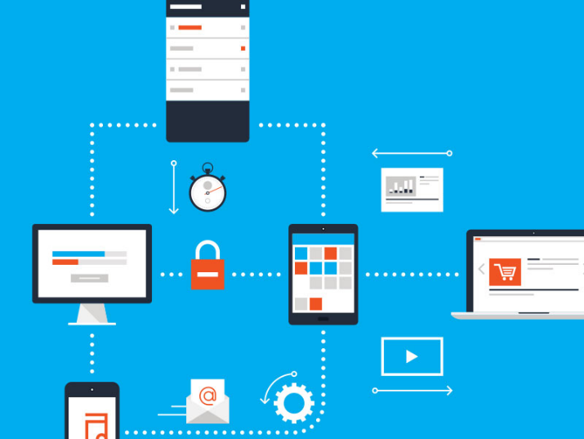
Conclusion
EAP teachers need:
  Context based training
  Institutional support
  Time to develop

Slide 12
References
Charles, M., & Pecorari, D. (2016). Introducing English for Academic Purposes. Abingdon: Routledge.
Cowie, N., & Sakui, K. (2013). It’s never too late: an overview of e-learning. ELT Journal, 67(4), 459-467.
Gilbert, J. (2013). English for academic purposes. In G. Motteram (Eds.), Innovations in learning technologies for English language teaching, 117-143. London: British Council.
Prenksy, M. (2001). Digital Natives, Digital Immigrants. On the Horizon, 9(5), 1-6.

Slide 13
Questions
Thank you for listening
Are there any questions?
S.Dhillon.5@warwick.ac.uk
@sun1dhillon

