Slide 1
The changing demands and the nature of embedded support
Sheila Andon
Dan Bernstein
Damian Fitzpatrick
BALEAP PIM The Future of EAP: Adapt or Die?
Nov 2019

Slide 2
UAL Context
London College of Fashion
Central St Martins
London College of Communication
Chelsea College of Arts
Camberwell College of Arts
Wimbledon College of Arts

Slide 3

The Language Development Programme
Course specific classes
Tutorials
Skills classes
Workshops
Progress Testing
20 HPLs
4 FTs

Slide 4
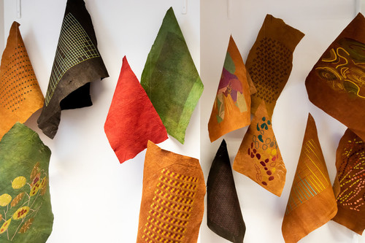
Growing Demand
19,878 students at UAL
2019 – 54% international (EU and Overseas)
18% increase international in 1st years (BA & MA)

Slide 5
Growing Demand
2018 Term 1 – 101 classes per week (132 courses)
2019 Term 1 – 116 classes per week (141 courses)
2018/19 - 2571 students using LD
2019 so far – 2422 students (22% increase like for like)

Slide 6
New modes of support
Many courses have large international cohorts
Language and academic literacy issues
Is the traditional 2 hour class enough?
Many course tutors don’t want the international students packaged off to a separate space
Increasing our reach
More requests for ‘embedded support’
2019 piloting 8 courses

Slide 7

Embedded support
Adaptable to each course
In the studio / classroom
All year groups
Mixed mode
Irregular schedule

Slide 8
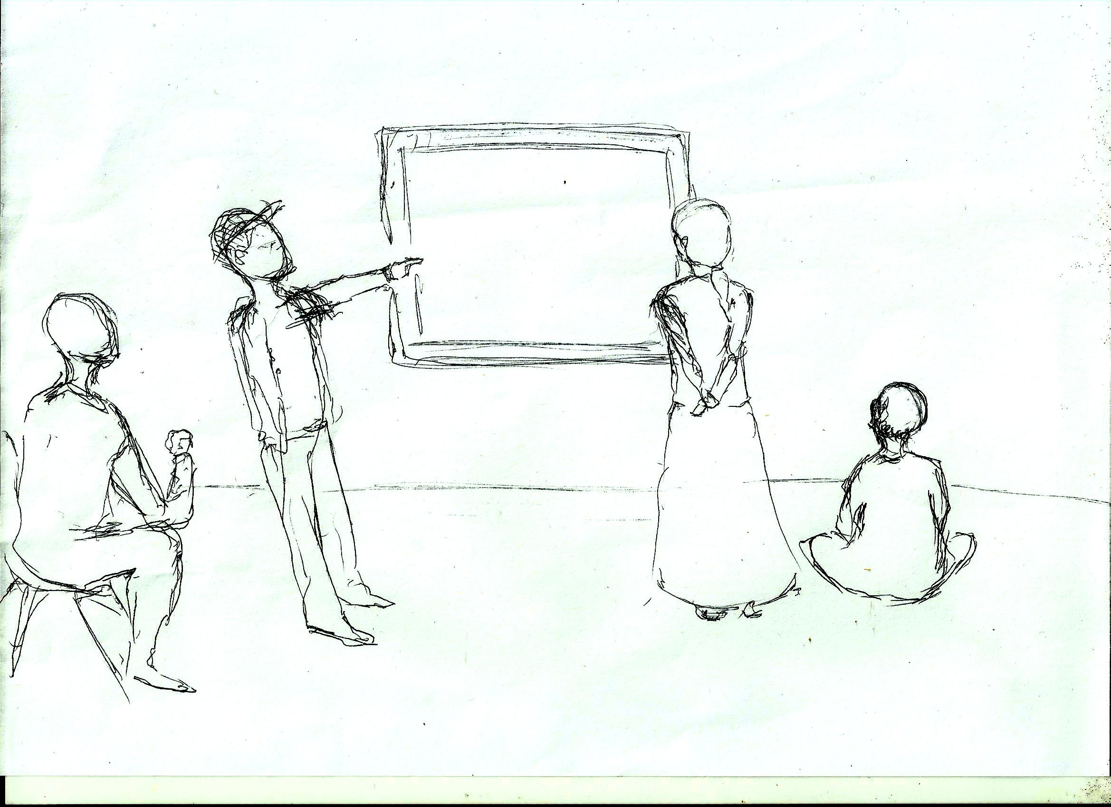
The art/design studio

Slide 9
Some of the challenges
Connecting with each other – academic, student, language tutor
Resource – time, space, people

Slide 10
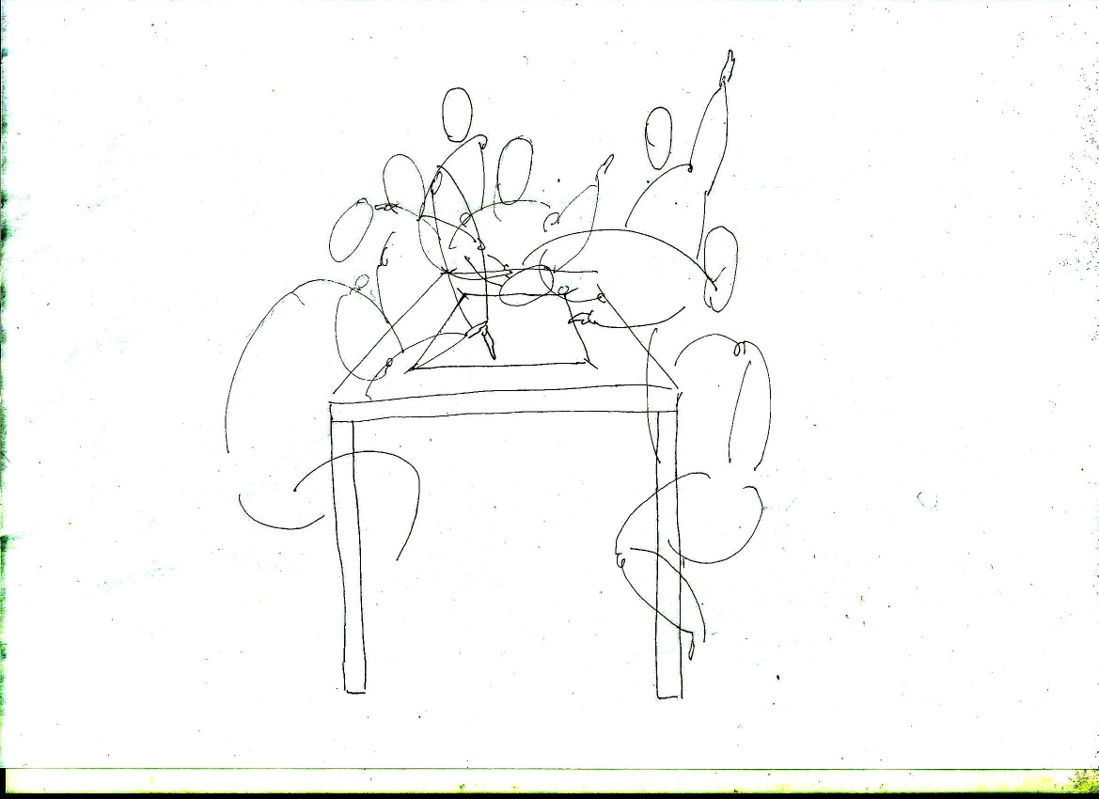
Finding the payoffs
Skills and experience
Flexibility
Small but meaningful interventions

Slide 11
Business School
LCF: Fashion Business School - different type of context/model
Pilot/exploratory project – what does it entail?
Challenges/Positives
Different courses
  Discourses, practices, knowledges and assessment
  Discover more about course
Working across the whole department (Y1-Y4)
  Workshops; Tutorials; Joint classes; Writing project

Slide 12
Challenges
Resources
  Staff/Time
Misunderstandings and Miscommunications
  What do we do? How are we perceived?
  Role? Are we part of the department?
Example: Writing task
  Purpose/Goals
  Terminology

Slide 13
More pay offs
Example: Writing task
  Clarified purpose/roles/implementation
  Better sense from department about what we might able to bring
Role across the whole course
  Awareness of language/practices across department
  Better informed
  How might this embedded model look in the future?

Slide 14
Thank you

