Slide 1
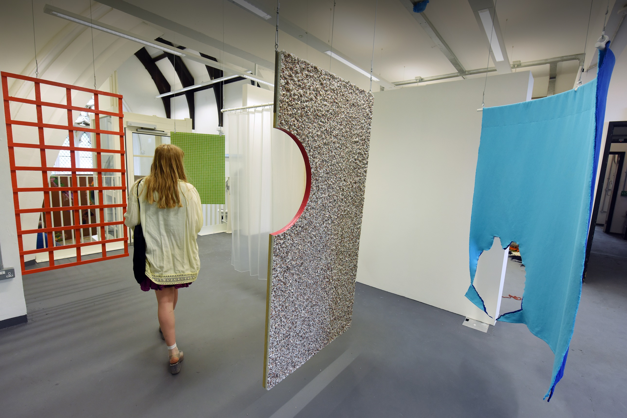
Decolonizing the eap curriculum
English Language Centre
Nina Reece and Sara Ewing
Jenny Alderson, Undergraduate Fine Art, Degree Show 2017

Slide 2
Aims and objectives
This session aims to:
  introduce the integration of ‘Decolonizing Research Methods’ and EAP.
  facilitate the discussion and practice of decolonizing EAP material.

Slide 3

Introductions
Ben Pimlott Building, Goldsmiths, University of London

Slide 4
Introductions
Nina Reece n.reece@gold.ac.uk
Associate Lecturer, EAP. English Language Centre (ELC)
Academic Speaking and Listening
Research: Short fiction of second-generation Caribbean migrants, Creole poetics and decolonizing the canon.
Notes:
1min

Slide 5
Introductions
Sara Ewing s.ewing@gold.ac.uk
Lecturer in EAP. ELC and Academic Skills Centre
Contemporary Theories Textual Analysis
Critical reading, writing and research methods
Research: Decolonizing knowledge construction and reproduction through research methods and pedagogy
Notes:
1min

Slide 6
Discuss with a partner or small group
What does decolonization mean to you?
How content-led are your EAP courses?
If content-led, what is the proportion of white thinkers/artists, etc. to that of people of colour?
What about the proportion of non-Western theorizing/contexts? Can you think of examples?
Notes:
5 mins

Slide 7
eap at the elc
Learning should be authentic.
The setting requires social interaction and collaboration.
Learning needs to be scaffolded.
Learners need an awareness of genre.
(Goldsmiths College English Language Centre, 2018)
Notes:
1 min 30

Slide 8
eap at the elc
Pathway:
Media, Culture and Society
Social sciences
Design
Music
Arts and Humanities
Textual Analysis
Contemporary Theories
Lecture
Seminar
Academic Listening and Speaking
Notes:
1 min 30

Slide 9
EAP and Academic Skills
Artificial differentiation in practice
Discipline-specific EAP and Academic Skills provision
Use texts, materials and assessment types from module, programme or department as basis for provision
Would benefit from an interrogation of perspectives, theories and concepts underpinning epistemological and pedagogical approaches

Slide 10
Decolonizing Academic Skills
Based on students generating ideas about the class theme
Students’ ideas and experiences form the basis of class discussion
Non-traditional theorizing/writing introduced to develop and consider assumptions and values in relation to the theme
Critical reading and writing strategies and practices integrated into the engagement with both text and discussion
Examples include: Theories of Capital, 21st Century Legal Skills, and Sociology of Religion.
Upcoming: Anthropology, Music, Computing.

Slide 11

Analysis
Ben Pimlott Building, Goldsmiths, University of London

Slide 12
in pairs or small groups, Analyse the material
  Where can we identify Eurocentricity?
  Where could we instead incorporate a non-Western perspective?
  What do you think would be added or lost by doing this?
Notes:
10 mins analysis
10 mins feedback

Slide 13

adaptation
Design Festival 2017

Slide 14
in pairs, Adapt the material
  Where would you fit this into the syllabus?
  How could you change the subject/titles to include it?
  What might be the benefit of replacing rather than adding?

Slide 15
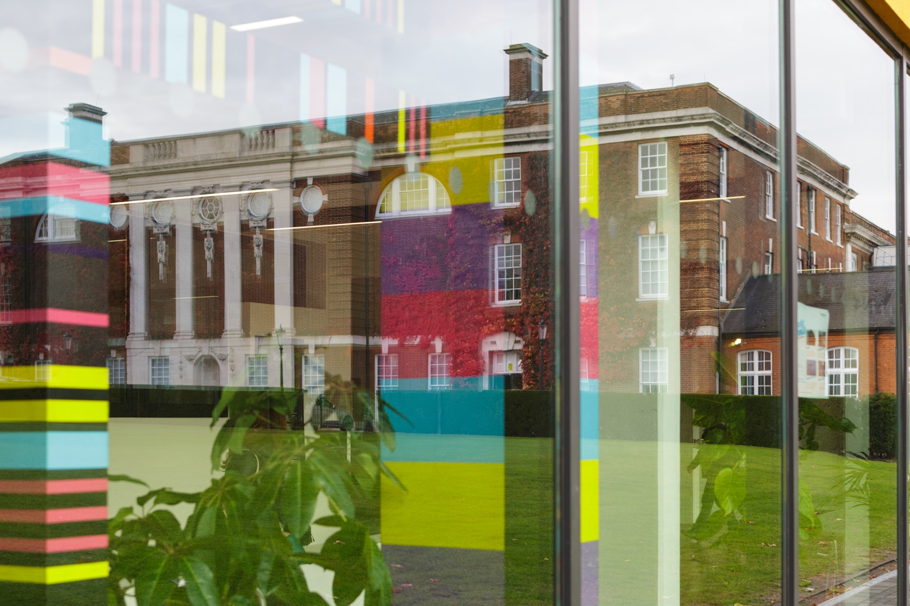
discussion
Richard Hoggart Building reflected in the Whitehead Building windows, Goldsmiths, University of London
Notes:
10 minutes

Slide 16
group discussion:
  What choices did you make?
  Why?
  What might be some institutional limitations?
  What are the next steps?
  How might we continue the conversation?
Notes:
10 mins

Slide 17
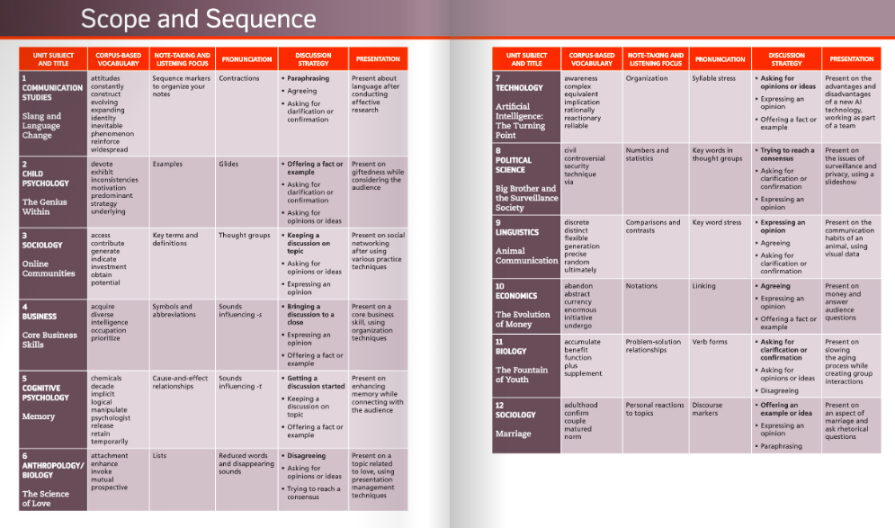
Begler, D. and Murray, N. 2017. Contemporary Topics Level 3: 21st Century Skills for Academic Success, 4th Edition. London: Pearson. p.iv-v

Slide 18
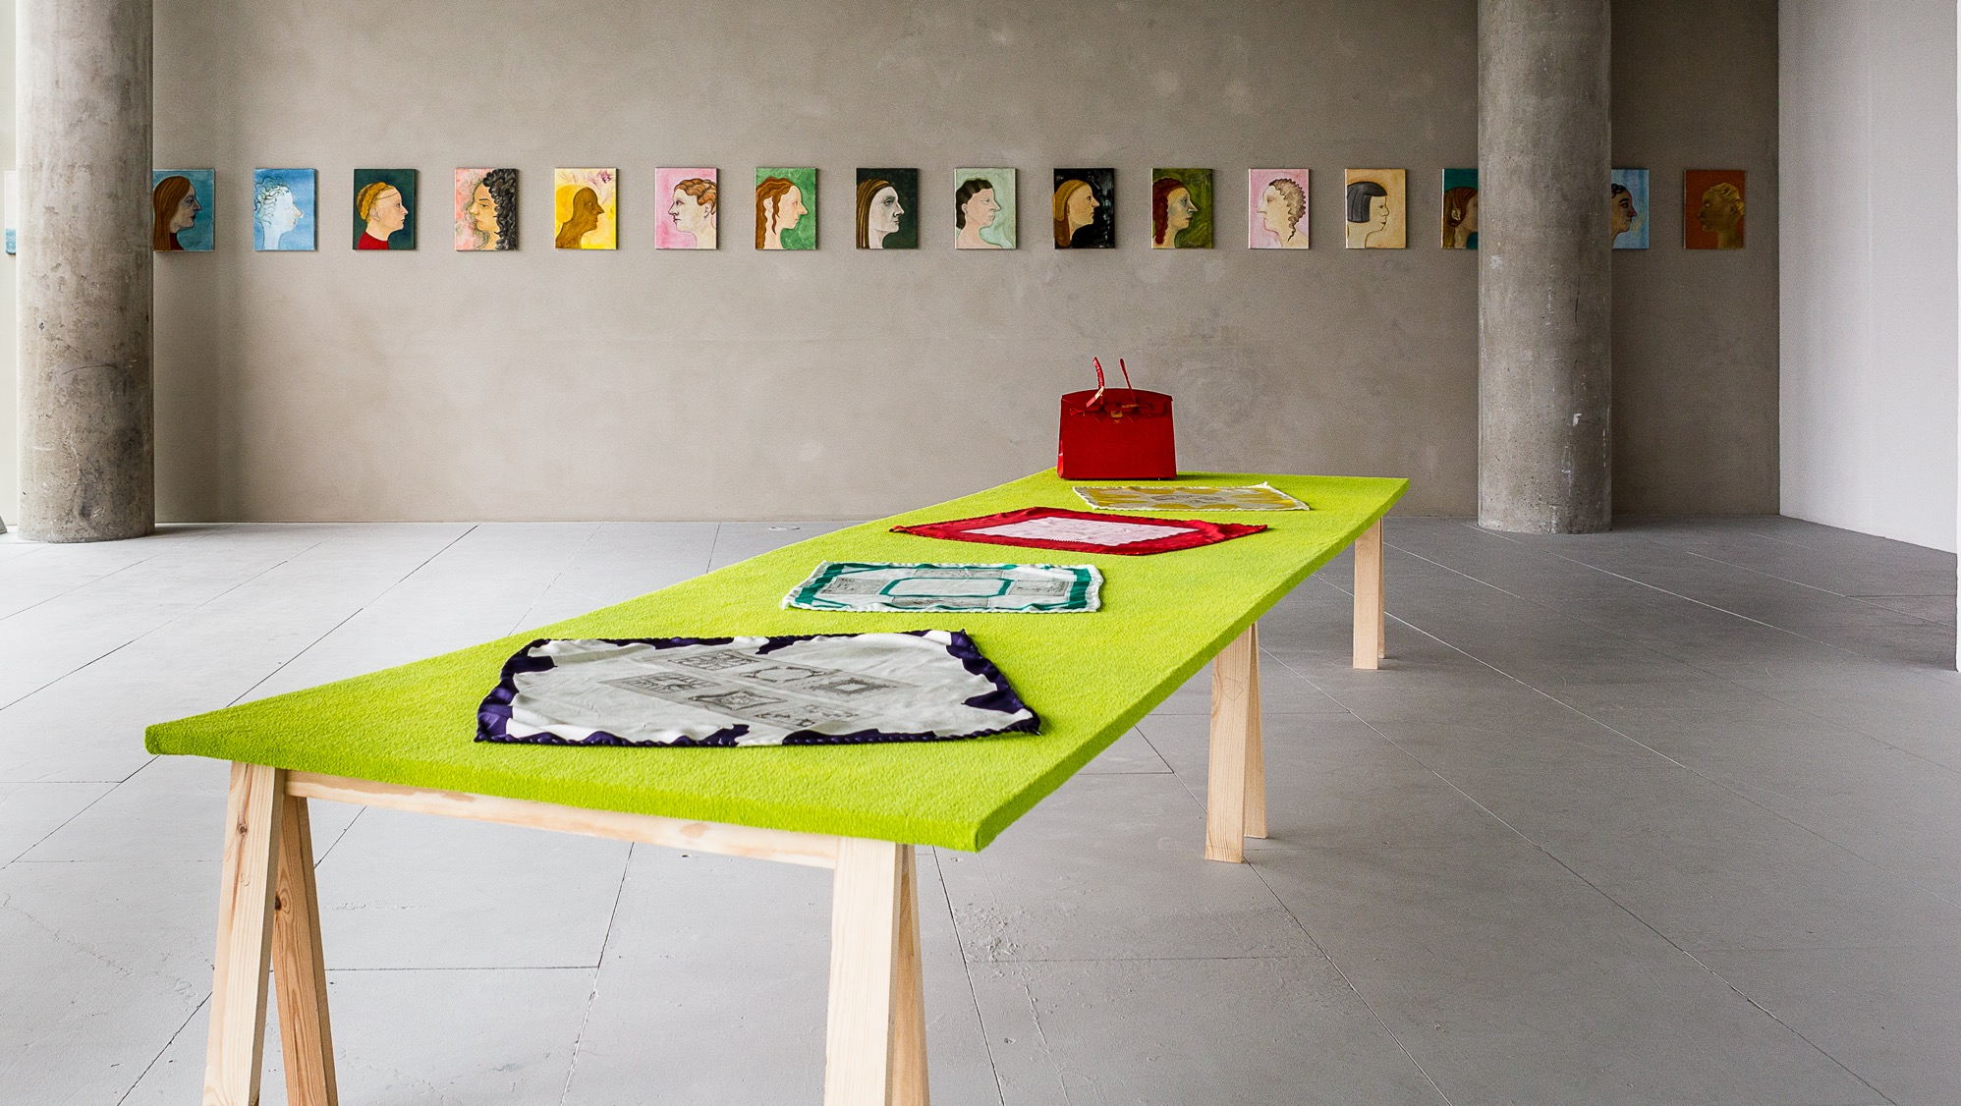
Any questions?
Josefine Reisch, Masters of Fine Art, Degree Show 2017

Slide 19
references:
Begler, D. and Murray, N. 2017. Contemporary Topics Level 3: 21st Century Skills for Academic Success, 4th Edition. London: Pearson. p.iv-v [online] Available at: <https://media.pearsoncmg.com/intl/elt/sampleunits/flipbooks/9780134400792/mobile/index.html#p=4> [Accessed 8 November 2019].
Goldsmiths, University of London, English Language Centre, 2018. Principles of Course Design [pdf]
Ngugi wa Thiong’o. 1986. Decolonising the Mind: The Politics of Language in African Literature. Oxford: James Curry. Pp. 15-20.
Reading Lists@Gold, 2019. Decolonising Research Methods Reading List [online] Available at https://rl.talis.com/3/gold/lists/0E6A59E0-BC5C-6A1D-EC92-8648621570B7.html> [Accessed 8th November 2019].
FURTHER READING:

