Slide 1
A Framework for text – image analysis
Rachel Edmonds – Kingston University

Slide 2
overview
An area of study in my PhD research
A framework for approaching multimodal documents – documents with text and images.
Relevant to today’s topic in the need to find new ways of doing this as we adapt to an increasingly multimodal world.

Slide 3
Background to the study
Tasked with writing discipline-specific Pre-Sessional materials for Creative Art & Design PG students
Very little in the Applied Linguistics and ESAP literature
Tends to be omitted from corpora of Academic English e.g. BAWE corpus has Liberal Arts but no Creative Arts.

Slide 4

Why?
Ideological: Underlying perception of nature of Creative Art & Design disciplines - “unruly”, “unacademic”?
Practical: Difficulty of obtaining data final outcomes are visual or physical pieces?
– subject to rigorous criteria. Cr A&D are arguably some of the most complex linguistic subject areas because the subject area can be basically anything.
- there is nearly always a linguistic product which accompanies the creative one e.g. essay, critique.
- electronic submission is a new opportunity.

Slide 5
The Study – corpus of pg design student assessments
 | Texts | Words
Fashion | 14 | 44,432
Graphic Design | 59 | 367,765
Illustration | 142 | 623,592
Product Design | 9 | 18,215
Sustainable Design | 15 | 118,170
Total | 221 | 1,172,174
Collected assessments from a year’s cohort of Design PG students – after submission and marking.

Slide 6
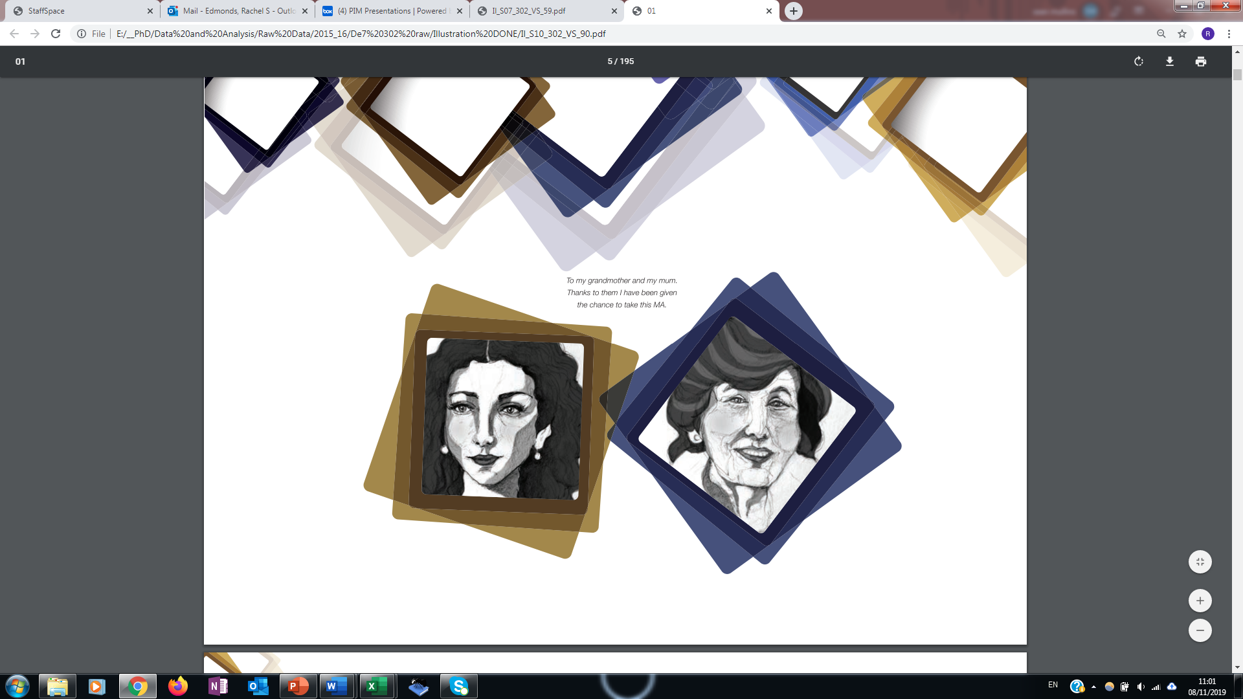
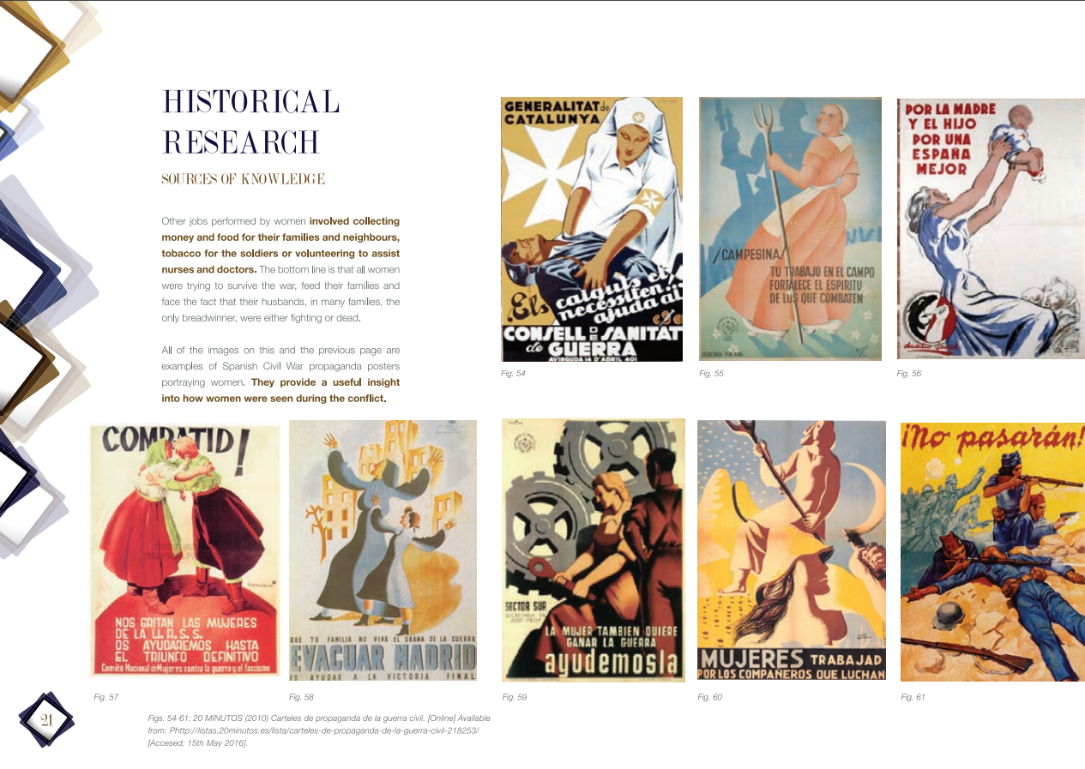
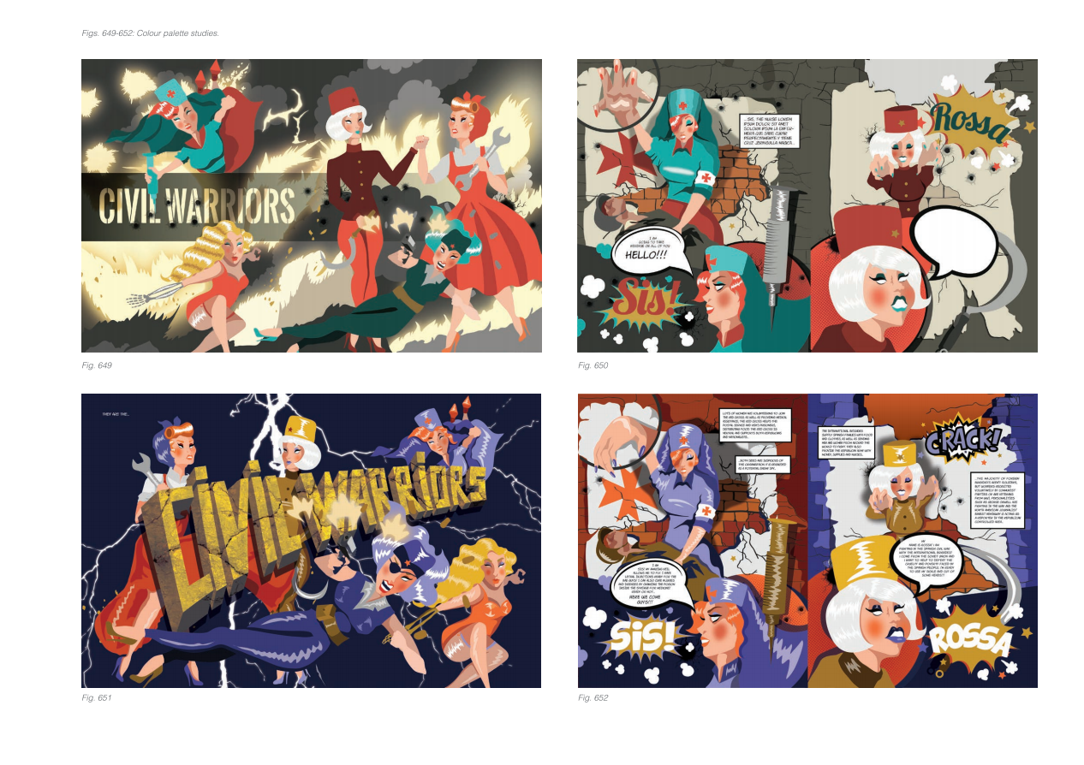
The nature of the assessments
“Visual Summaries” – reports detailing the creative development of the project.
Written language is there – it is important in narrating the visual progression – but images are of central importance and at times writing is wholly absent.

Slide 7
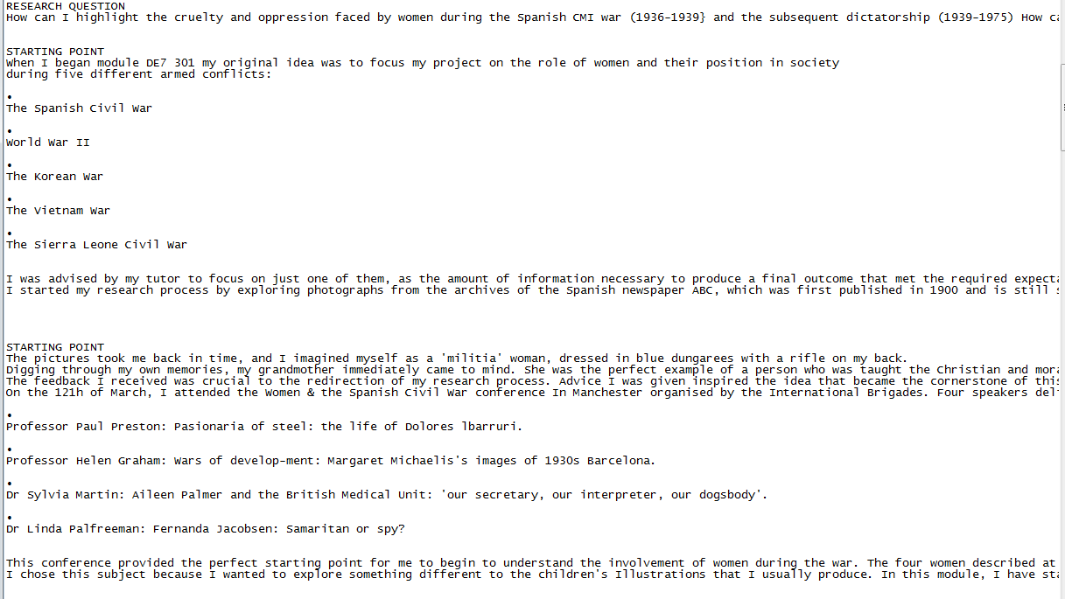
Limitations of a Text corpus
Strips out images.
Only recognizes written text –
not objects placed as images.
- Useful for linguistic analysis but alone literally only paints half (or less) of the picture.

Slide 8
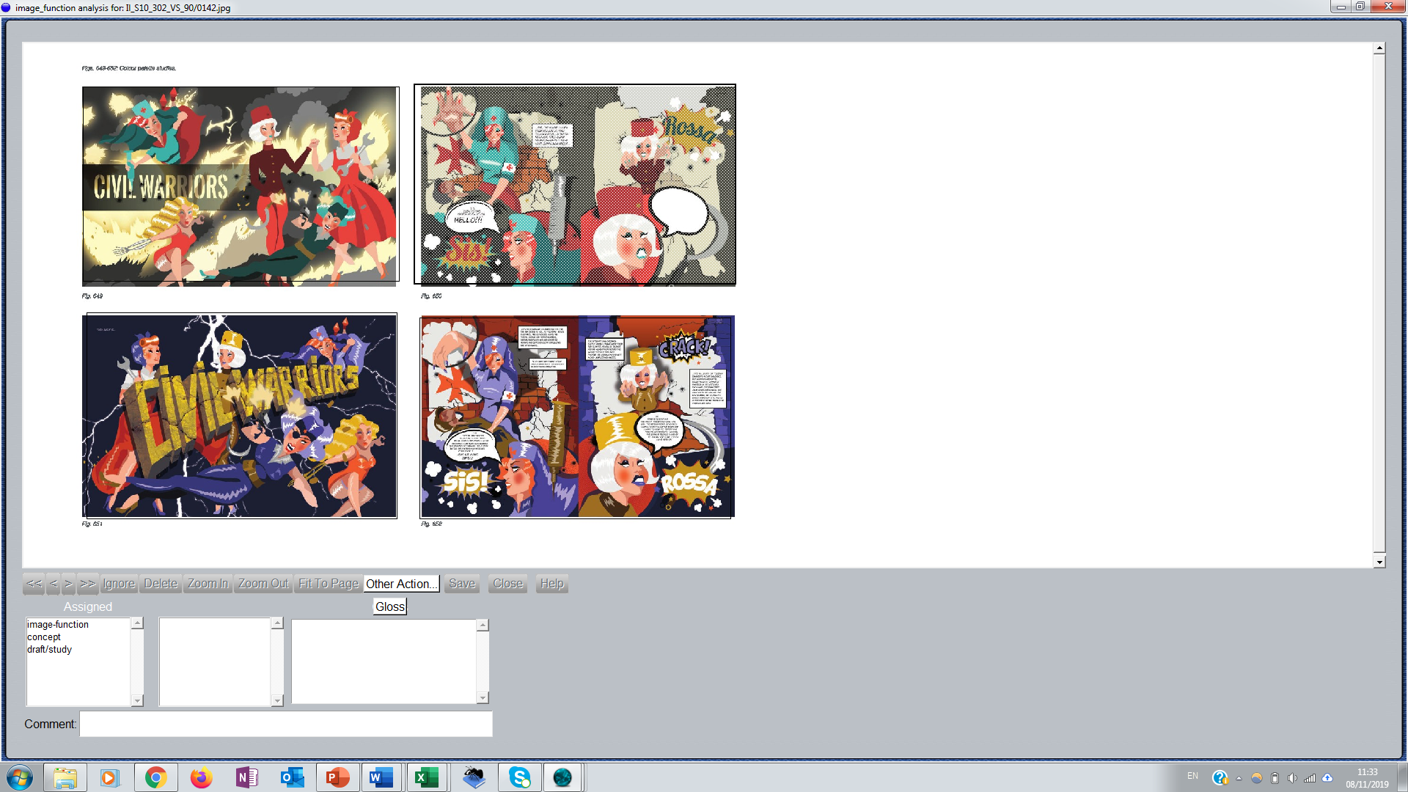
Uam image tool (O’Donnell, 2008)
Freely available for download!
Allows the import of pages of a document as images.
Parts of the page can be manually selected and coded with categories.
Allows the creation of frameworks to code the images.
Results are based of frequency – how many of each category.

Slide 9

Development of a framework
Research Question: What are the images doing in the wider text?
What can this tell us about the nature of the text themselves, the difference between Design disciplines (i.e Illustration vs. Graphic Design) and attainment band.
Multimodal Theory - Existing tools for analysis of images:
Reading Images (Kress and Van Leeuwen, 1996) – seminal concepts – but no applicable framework. Focus on individual images not long documents.
Frameworks based on Systemic Function Grammar e.g. Martinec and Salway (2005); Royce (2002) – draw out how a section of text is related to an image.

Slide 10
Image use as a move
Text-Creating; Discourse
Referencing Sources/ Inspiration/ Fact finding
Conceptualising own Creation
Key to this framework and different to those existing is viewing the use of an image as a textual (!) move in a Swalesian sense.
This immediately opened up the data in a way that felt to be analyzing the story these images are telling.
Three main image functions: Discourse; Reference; Concept

Slide 11
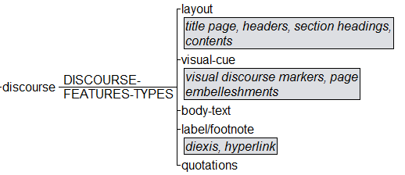
Discourse
Discourse – Visual Cue
Discourse Features are elements which are used in the formation of the text as an assessment. They may be image or language or both.

Slide 12
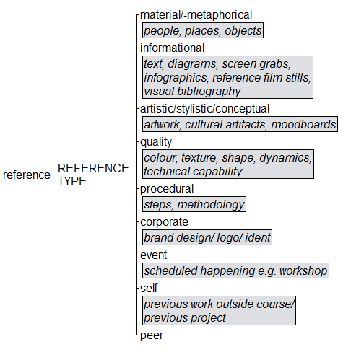
Reference
Any image which is used in gathering resources from the outside world for the purpose of research or documenting the physical or conceptual design journey.
Reference: Artistic

Slide 13
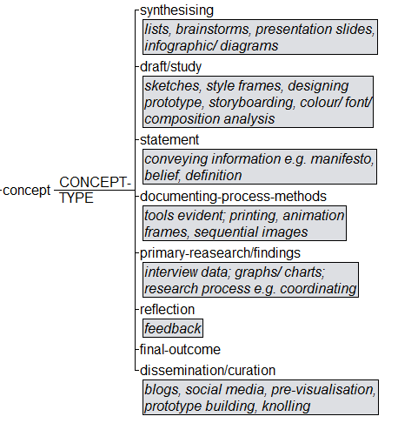
Concept
The moment when students take the references, ideas and evidence from the outside world and begin to synthesise them into the formation of their own design concept.
Concept : Draft/ Study

Slide 14
Findings by band
Band | Total Text N | Total images N
Below 50 (fail) | 26 | 2097
50-59 | 51 | 5481
60-69 | 68 | 8730
70 and above | 75 | 13914
Total | 220 | 30,222

Slide 15
Overall image frequency
Higher scoring assessments within the corpus incorporate more images over more pages.
Lower scoring assessments tend to be shorter and incorporate more images onto each page.

Slide 16
Reference vs concept
Reference to Concept images are relatively evenly split.
The failed category is an interesting outlier with 69% Reference to 31% Concept.
This may point towards more unfinished projects or lack of time management in the production of students’ own work.
It may also present an overreliance on the work of others at the expense of the application.

Slide 17
Reference type by band
All pass bands follow the same order of the first 7 Reference subcategories in most to least used.
The fail category diverges after the first three with Informational with Corporate playing bigger roles than in the pass bands. And less of a role in Quality and Material.
May denote a tendency to go off piste or misunderstand the module expectation.

Slide 18
Concept type by band
Fail category has fewest Documenting Process and Drafts/ Study images but most Dissemination/ Curation.
Fail assessments tend to focus more on the end product at the expense of explicating the process.
Failed assignments have more Primary Research/ Findings and Synthesising images than all other bands.
Tendency to place more value on developing textual concepts than visual ones and more gathering than developing information.
Pass band 50-59% displays reverse trend to the Fail with most Draft/Study and Documenting Process images and least Final Outcome and Dissemination/ Curation.
Assessments which “just” pass managed to show the process but fall short in the concluding product

Slide 19
conclusions/ Implications
Viewing the image as discoursal move within texts can enable the creation of frameworks which can lead to insights about what is happening in multimodal assessment genres.
Can lead to quantitative insights into the issues experienced by students.
Can lead to ESAP course interventions and materials creation.
This technique can be applied to any text type to create discipline and genre specific frameworks of image function – Increasingly worthwhile with the proliferation of multimodal genres (academic or otherwise) in our quest to adapt or die!

