Slide 1

Academic
Skills
Community

Slide 2

Transcultural communication:
Language and locus of integration
in diversifying HE
Victoria Jack, Yoshikazu Sakamoto,
Bijia Xing (Kate), Pelin Derinalp, Katie Smith
University of York

Slide 3

.Today’s session.
.In this session we cover:.
The context & its opportunities
Transcultural Communication module
The pedagogical approach:Co-constructed module content development
Student generated assessment criteria
Student experiences

Slide 4
.The context and opportunities.
Expectations: A friendly international community
The UK is home to over 400,000 international higher education students each year (Higher Education Statistics Agency (HESA) 2018/19). You will be living and studying in a welcoming and multicultural environment.
The UK also ranks as the top study destination in the world for overall student support and satisfaction (The UK’s Competitive Advantage 2017, Universities UK International).
vs
Reality: “The painful process of transculturation”: Ortiz 1995 p102
Notes:
https://www.menti.com/s2835uv7s7

Slide 5
.The context and opportunities cont.
Decolonising the curriculum
Widening participation
Employability: British Council (2013) Culture at Work
Students as partners in curriculum development
Response: Transcultural Communication Module
This module aims to help students understand factors and issues in transcultural communication and how this differs from 'intercultural communication'
Students will be expected to critically analyse stereotyped or essentialist views of culture, whether national, religious or otherwise socio-historically constructed, and move towards an understanding of communication in a constantly fluctuating context where cultural identities are emergent
Notes:
https://www.menti.com/s2835uv7s7

Slide 6
.The Students and the module.
Bijia: Developing module themes
Yoshi: taught session structure
Pelin: the assessments
Katie: assessment criteria (student generated)

Slide 7
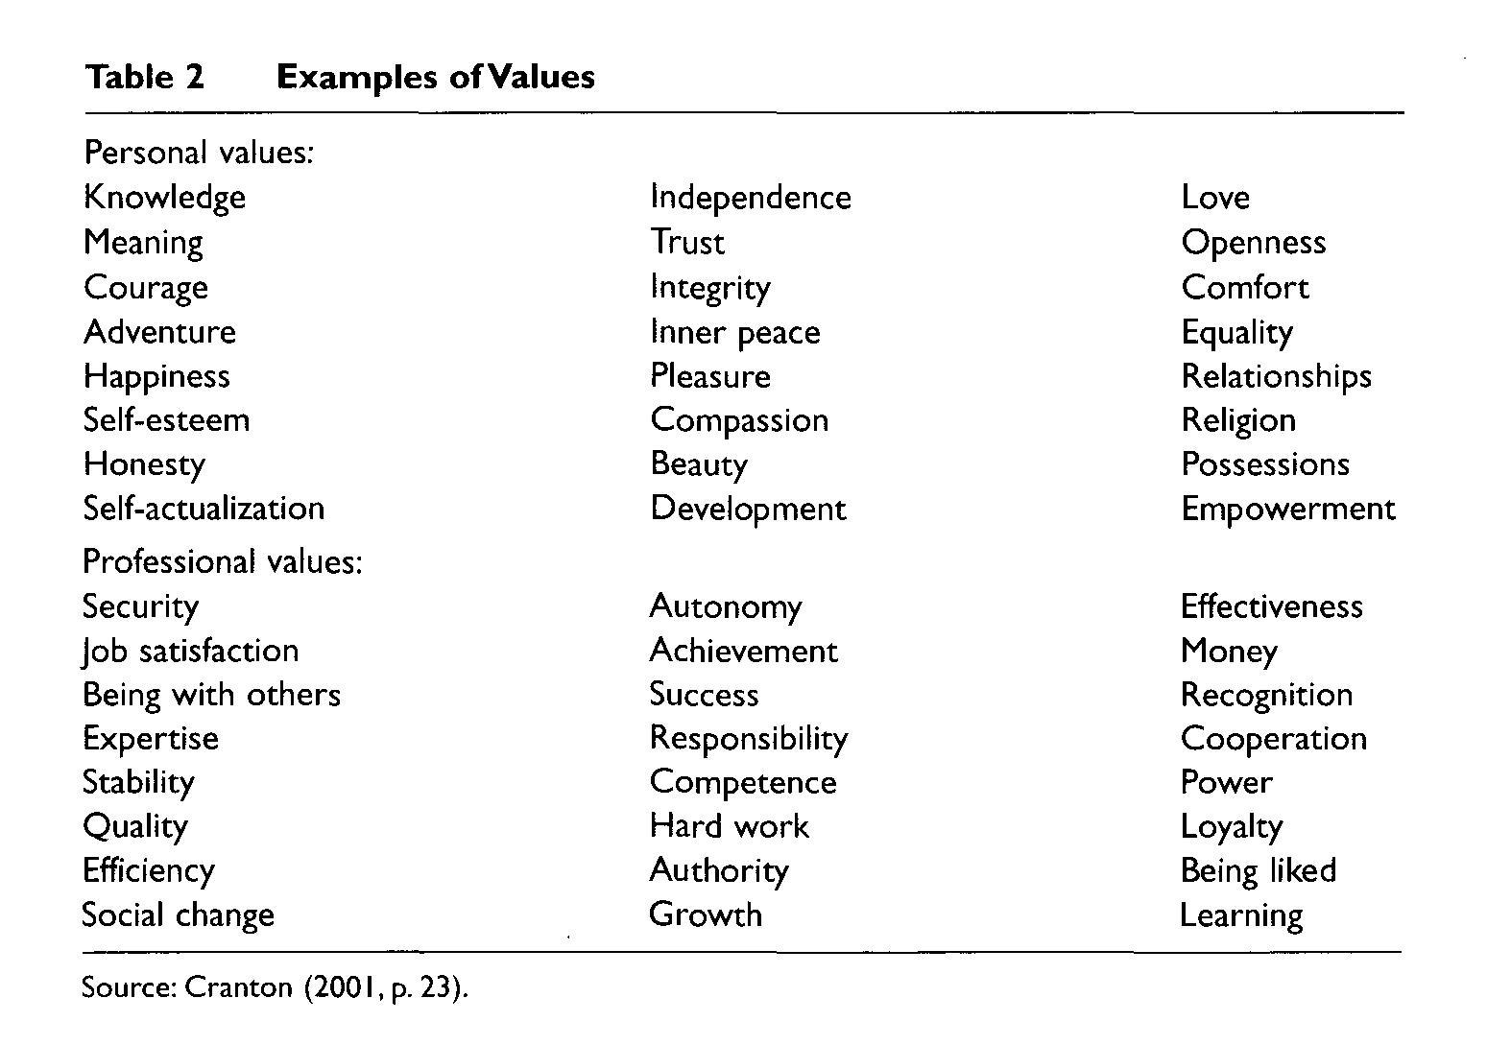
.Developing the module themes: the first session.
Tasks:
Choose five values from the list that are important for you, share them with your group and explain why you chose them.
Choose five values that represent your the cultural group you identify with. Share them with your group, compare them with your group members and your different culture groups.
Which 5 values represent the world’s values?
Cranton (2001) “Becoming an Authentic Teacher” Malabar FL: Krieger Publishing
LINK TO WORKSHEET

Slide 8
.Developing the module themes: your turn.
Group discussion: 10 mins
Think about groups with people from diverse backgrounds that you have been in or facilitated.
Which factors influence the way you or the group members communicate/participate?
Add them to the menti as they come up.
Go to www.menti.com and use the code 2099 1244

Slide 9
.The Module Themes.
Language anxiety: “I’m worried about making mistakes”
Personality type: “I’m too shy”
Identity: “I’m not a leader”, “I’m not that kind of student” “I don’t know what to say in seminars”
Task anxiety: “I don’t know what to do in a debate”
Culture: “We don’t do that where I’m from”
Emergent ideas
Transculturalism
Critical cosmopolitanism

Slide 10
.The Pedagogical Approach.
Before the seminar
Module leader allocates different texts on the topic to different groups
Students do their own literature search based on their experience (sometimes in their own language)
In the seminar
Students with the same text share their understanding of their text and how it reflects their own experience (or not)
Students share their own reading
After the seminar
Students record their reactions to the theme and the texts in their journals
Notes:
https://www.menti.com/s2835uv7s7

Slide 11
.The Assessment.
Group Discussion (15 mins): 33%- 3 module participants and 3 guests
Student generated task (example):
The University is interested in encouraging students from all different backgrounds to socialise and study together (integration).
Discuss your experiences of socialising and studying with students from other backgrounds here at the university. Have you mixed with students from other countries, cultures, social backgrounds? To what extent?
Then, suggest some things the university could do to improve integration.
Self evaluation & reflection on performance in group discussion: 33% 1750 words
Group evaluation 34% 1750 words: analysis of other participants’ performance in the group discussion
Notes:
https://www.menti.com/s2835uv7s7

Slide 12
.The Assessment Criteria.
Group Discussion (15 mins): 33%
Student generated criteria
Self evaluation & reflection on performance in group discussion (1750 words): 33%
Group evaluation (1750 words): 34% analysis of other participants’ performance in the group discussion
Standard Education Department UG3 written assessment criteria
Notes:
https://www.menti.com/s2835uv7s7

Slide 13
.Student Generated Assessment Criteria.
Individually: students complete an assessment grid with categories and descriptors at “strong pass” and “fail” levels
In pairs, then groups of four and then eight, students agree categories
In groups of three or four, students write the descriptors for one category at “strong pass” and “fail” levels
A different group then writes descriptors at 2:1, 2:2 and 3rd levels
A different group then checks across the levels to ensure consistency
Notes:
https://www.menti.com/s2835uv7s7

Slide 14
Assessment Criteria Categories: your turn
Group discussion: 10 mins
Think about communication in groups of people from diverse backgrounds. What represents “good” or “bad” communication?
Which categories would you use to assess transcultural communication?
Add them to the menti as they come up.
Go to www.menti.com and use the code 2099 1244

Slide 15
Example of student Generated Assessment Criteria.
 | Listening | Engagement | Openness/Sensitivity | Clear communication
70+ First Class | Consistently uses appropriate eye contact Consistently uses engaged and open body language. Appropriate and consistent use of gestures and nodding Concise understanding of reading the room and awareness of not interrupting when it disrupts communication Consistent use of turn taking and adapting to others’ contributions to create a balanced conversation | Consistently asks relevant and appropriate questions to the group When contributing, consistently and appropriately contributes meaningfully with detailed content. Effectively builds on points presented in the discussion | Consistently ready to communicate with others Always open for correction Consistently accepting of linguistic and grammatical errors Consistently accepts difference in individual personal values and culture differences Consistently shows great interest in other cultures | As speaker: Consistently speaks clearly and at an appropriate pace Consistently doesn't use idiomatic (exclusive) language As listener: Consistently requests clarification when needed and does not move on when not understanding something
LINK to criteria generated by the 2019 cohort

Slide 16
Student Experiences
What did you learn from the module?
What did you find challenging?

Slide 17
Thank you
Questions or comments?
victoria.jack@york.ac.ukI
Notes:
https://www.menti.com/ihv1mn3q64

Slide 18
References:
Cranton P, (2001) “Becoming an Authentic Teacher” Malabar FL: Krieger Publishing
Ortiz F (1995) Cuban Counterpoint: Tobacco and Sugar, Duke, Durham UK
Notes:
https://www.menti.com/ihv1mn3q64

