Slide 1
BALEAP PIM, MARCH 2021: INTEGRATION
Embedding Writing Support for Undergraduate Nursing Students
Stefani Goga
Oxford Brookes University
sgoga@brookes.ac.uk

Slide 2
OUTLINE
Cohort profile and impact on course design
Pedagogical Approach and Task Example
Evaluation of Course Design
Recommendations
Key Reflection

Slide 3

Designing for the cohort
UG Nursing Students
Time-poor
Carers/parents
In employment
Commuting
Higher proportion of:
Female applicants
BAME applicants
Mature applicants
Entry via Access course
Living off campus
Learning background
‘Gap’ since formal education
Recent transition through levels
Language learning
Relationship to English
L1, L2 (or L1.5)?

Slide 4
Genre-based Approach
= detailed analysis of small sets of texts from disciplinarily specific assessed student genres as the basis for the development of instructional materials (Tribble and Wingate, 2013)
High-scoring assignment
exemplar
Mid-scoring assignment
exemplar
Assignment Brief
Students already familiar with the texts
No additional reading load
Teach using exemplars appropriately

Slide 5
Assignment-based Approach
= explicit teaching of the discourse features necessary to produce their first written assignment
Assignment Structure:
Rationale
Limited input time (15 hours)
Complexity of the assignment
Encourage early writing
Introduction
Part 1: Research Methodology
Part 2: Pathophysiology
Part 3 Critical discussion
Conclusion: Reflection
‘patchwork text’ (Winter, 2003)

Slide 6
Healthcare Writing
Linguistic Difficulties | Sociolinguistic Difficulties
Showing their stance as writers Signalling the link between assignment task and their text Using language that reflects critical skills | Projecting an impersonal voice Making the link between theory and practice
(Gimenez, 2008, p. 160)

Slide 7
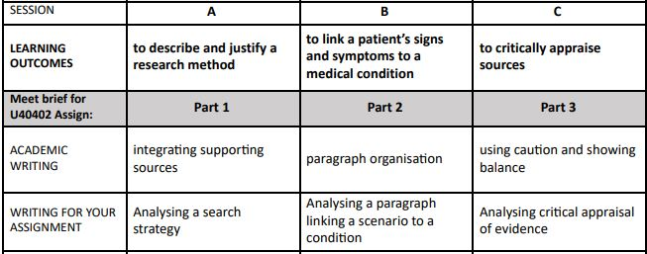
Syllabus (Sessions 1-3)
Address healthcare writing skills
Extract from ‘Academic Writing for Nursing’ syllabus:
Explicit link to assignment
Practise ‘general’ academic writing skills

Slide 8
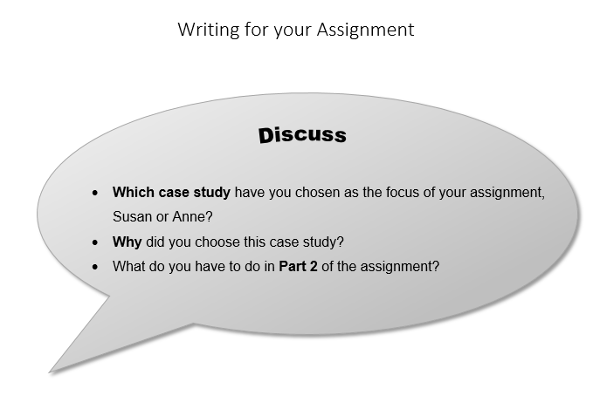
1. Reflect on assignment instructions

Slide 9
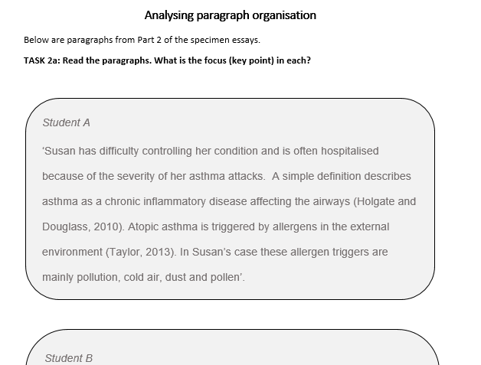
2. Read student extracts

Slide 10
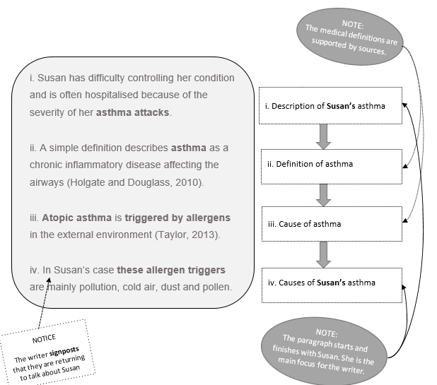
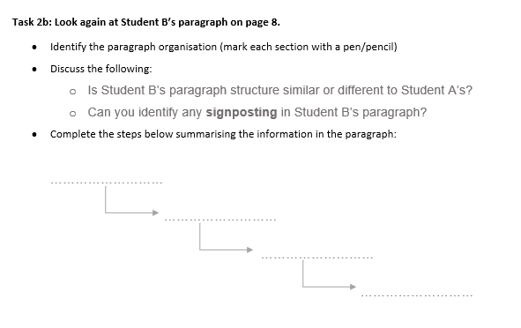
3. Analyse Writing Feature

Slide 11
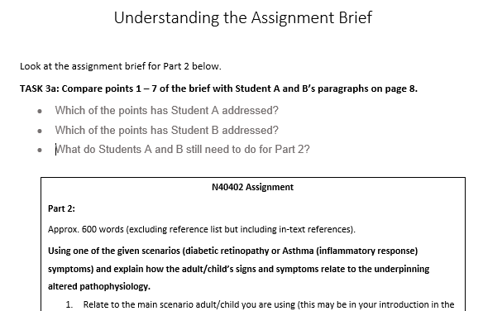
4. Link back to assignment instructions

Slide 12
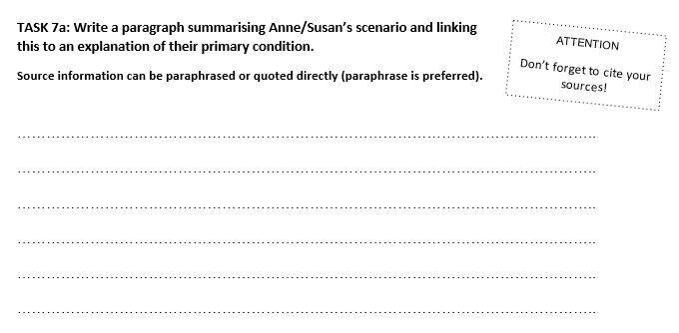
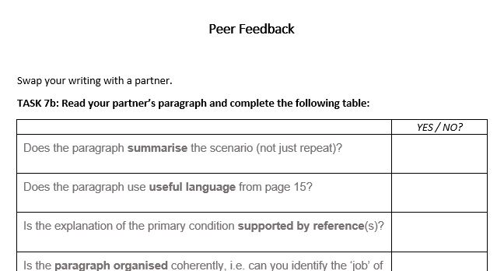
5. Write and peer review

Slide 13
Evaluation of Materials
Positives
Negatives
  achievable tasks
  appropriate for self-study
  strong engagement due to assignment focus
  make abstract academic terms more tangible
  teaching ‘uniformity’
  based on sentences & paragraphs
  → impact text coherence
  longevity/reusability?
  writing before understanding

Slide 14
STUDENT FEEDBACK
Positives
Suggestions
  focused on assignment
  teaching: accessible to all
  opportunity for feedback
  more 1-1 support
  longer course
  more convenient deadlines
Key theme: Student Expectations
‘I learnt much more than I anticipated would’
‘it’s really important for [students] to attend’
‘sessions should be mandatory’
‘letting the student know the important of the module’

Slide 15
RECOMMENDATIONS
Integrate syllabus with core module
- follow on from learning in lectures/seminars
Integrate Nursing presence
- ‘signals that literacy is an essential part of the discipline’
(Tribble and Wingate, 2013)
Integrate diverse ‘English language’ identities
- focus on academic skills and style not English competency
- consider how to recruit for the course
- use student testimonials
Integrate ‘assignment writing’ skills
e.g. Interpreting a brief, using exemplars, managing deadlines

Slide 16
REFLECTION
Which Community of Practice (CoP) – academic or professional?
Do Nursing UGs want to see themselves as academic writers?
What are their priorities during their studies?
To what extent am I (as an EAP practitioner) imposing my priorities on them?
“…any attempt at reconciling Academic Literacies with our students’ expectations needs to address the underlying assumption that students want to participate fully in an academic CoP, rather than their future professional CoPs […].
Our seemingly unacknowledged assumption about our students’ desire to join academic CoPs might, inadvertently, reflect our own identities as researchers […]. It does not take into account that most of our students will never experience this full participation, nor do they necessarily want to do so.
(Canton, Govan and Zahn, 2018, pp. 676-677)

Slide 17
References
Canton, U., Govan, M. and Zahn, D. (2018). Rethinking academic literacies. A conceptual development based on teaching practice, Teaching in Higher Education, 23(6), 668-684, DOI: 10.1080/13562517.2017.1414783
Gimenez, J. (2008). Beyond the academic essay: Discipline-specific writing in nursing and midwifery. Journal of English for Academic Purposes, 7, pp. 151-164. DOI:10.1016/j.jeap.2008.03.005
Lea, M. R. (2004). Academic literacies: a pedagogy for course design, Studies in Higher Education, 29(6), 739-756, DOI: 10.1080/0307507042000287230
Tribble, C. and Wingate, U. (2013). From text to corpus – A genre-based approach to academic literacy instruction, System, 41(2) pp. 307-321, DOI: https://doi.org/10.1016/j.system.2013.03.001
Winter, R. (2003). Contextualizing the Patchwork Text: Addressing Problems of Coursework Assessment in Higher Education. Innovations in Education and Teaching International, 40(2) pp. 112 – 122. DOI: 10.1080/1470329031000088978

