Slide 1



One cohort, one task,
but 15 different academic disciplines
How to integrate subject specificity on an
EGAP Pre- sessional Programme
Vicky Collins & Sarah Mattin
BALEAP PIM 'Integration: we're all in this together'. Northumbia University, March 2021
PREPARING FOR RESEARCH & ENQUIRY
Notes:
My name is Sarah Mattin and I am presenting with my colleague Vicky Collins.
We are lecturers in EAP at the UoR
Int his talk we’re going to look at a new module we developed for our pre-sessional programme and how this enabled us to integrate a discipline specific element to the programme

Slide 2
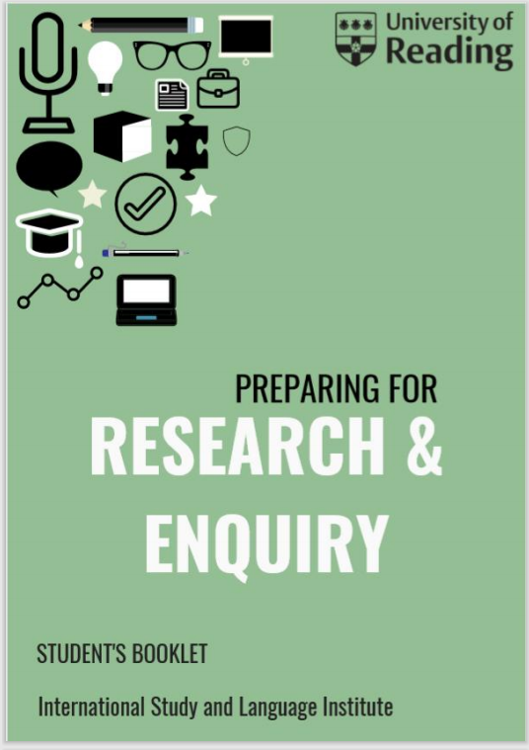
Discipline specificity in Pre-sessional Courses
Institutional context
Course Design: Goals for our new module
Course Design: Compiling the discipline specific reading list
Evaluation
Summary and going forward
Notes:
Here on the left you can see the cover of the students book for Preparing for Research and Enquiry which is the new module we are focusing on in this talk
We’ll cover the following elements in the talk today –so starting with some background and context before focusing on the module itself and then moving on to some evaluation and thoughts about the future

Slide 3
Discipline specificity in Pre-sessional Courses
Institutional context
Course Design: Goals for our new module
Course Design: Compiling the discipline specific reading list
Evaluation
Summary and going forward
Notes:
Here on the left you can see the cover of the students book for Preparing for Research and Enquiry which is the new module we are focusing on in this talk
We’ll cover the following elements in the talk today –so starting with some background and context before focusing on the module itself and then moving on to some evaluation and thoughts about the future

Slide 4
Discipline Specificity on Pre-sessional Courses
Desirable…..
But challenging…..
“….professional communities, each with its own particular practices, genres and communicative conventions…”
(Hyland, 2018, p.391)
Range of disciplines - how specific can we be?
Resource needed for syllabus design and materials development
Risk of Pre-sessional syllabus based on current student cohort / institutional context – how to future proof?
Relevance of the EAP course is more obvious to students – perhaps more motivating
Students can activate and draw on subject-specific knowledge
“……effective ESAP instruction rests on the ability of institutions to offer discipline-specific classes for the given cohort of EAP students. Yet given the large range of options available in institutions, it is frequently impractical to do so.” (de Chazal, 2013, p.145)
Notes:
We have seen over the past few years that some universities are developing discipline specific pre-sessional courses, for example I think
Leeds
Edinburgh
Liverpool
University of the Arts London
Imperial College London
..and I am sure there are others that I have missed here
I think we are probably all aware of why a discipline specific approach is desirable to prepare students for further study within their particular discipline. As Hyland summarises here, there is now a huge literature focusing on variation across discipline and genres. From a practical point of view, DS courses may also be more engaging and motivating for students
However, there are also challenges-
Challenges –range of disciplines – how specific can we be? And how much resource can we draw on to develop several different DS courses to run in parallel
In our context the largest receiving department of summer pre sessional students is the Business School, we would need to ensure that potential ESAP strands on a Pre sessional would be equitable in opportunity, and practically viable for the non Business Management and Finance students. Some cohorts of disciplines are still very marginal. And we need to bear in mind that the institutional context may change.
Edward de Chazal’s article The general-specific debate in EAP:? gives a useful overview of the practical constraints surrounding ESAP PSE courses

Slide 5

Previous extended writing module:
“……an extended assignment related to your field of academic interest.”
Challenges:
Very open task
Assumes disciplinary knowledge
students progressing to conversion degrees
Tempting to ‘recycle’ past work
Goals for the new module:
One core task
One core set of materials
Discipline-specific element allowing task to be ‘customised’
Task genre relevant to PG students future studies
Plagiarism ‘designed out’ as far as possible
‘Future proof’ component that can respond to changes in the student cohort
Notes:
The PRE module we’re focusing on today has replaced the previous extended writing module that existed on the summer PSE. In fact this module also had a DS element as we can see from the task remit. However, there were also some challenges, in particular around the fact that we had a significant number of students progressing to conversion degrees who had no prior knowledge of the subject they were going on to study. This would seem to put those students at a significant disadvantage.
So, or goals for the new module were as follows…

Slide 6
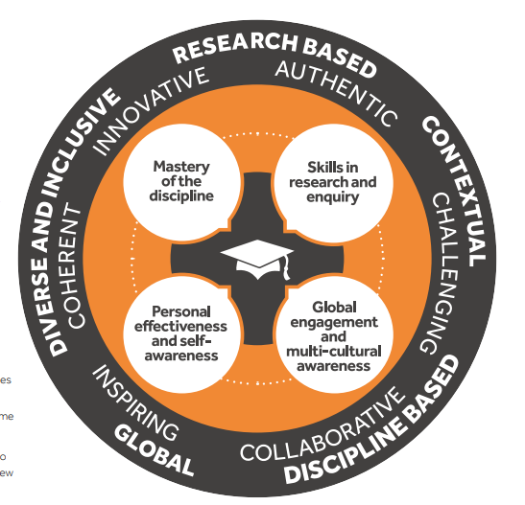
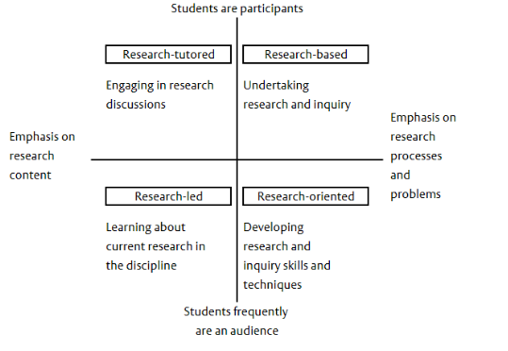
Goals for Preparing for Research and Enquiry: Useful Models
Graduate Attributes
University of Reading Curriculum Framework ‘central to 'what' and 'how' we teach.’
Models of Research & Enquiry: Healey & Jenkins (2009)
Notes:
Two useful models were drawn upon to ensure that this module would be aligned with students’ future PG studies
UoR Curriculum Framework – seen here with the Graduate Attributes
Healey and Jenkins model - useful for thinking about the different ‘levels’ of R&E and what is reasonable to expect from pre-Masters students on a short Pre-sessional at the beginning of their HE university journey. Here you will see the focus on learning about current research in the discipline and developing research skills & techniques

Slide 7

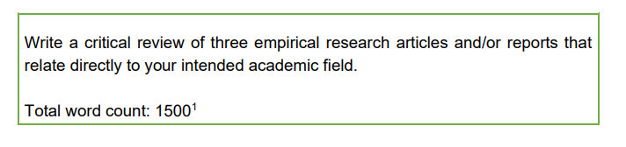
Goals for Preparing for Research and Enquiry:
Review of university assignments
Education
Write a structured critical analysis
of a research report
Accountancy
Write a critical summary of the following research article..
Common feature of ‘appraising research critically’
Environmental Science
Select a research article
to review and evaluate
Psychology
Summarise and discuss the aims,
Methodology and relationship
Between 3 research articles on a
similar topic
Preparing for Research and Enquiry
Notes:
We wanted to ensure that the task genre would be relevant to students’ future studies so Vicky undertook some work surveying tasks across disciplines in the university
Critical summaries or analysis are a key writing genre across university departments, yet one which students are often unprepared for. Here are some examples from different disciplines.
The common feature here is that the writer needs to demonstrate an appraisal of the research with a single text or restricted number of texts on the same topic to better understand how knowledge is developed
In addition, the synthesis and critical evaluation of research is a precursor to language and skills required of the dissertation- another common genre across disciplines.
This led us to conceptualise the final written assessment for the new course which can be seen here

Slide 8

Preparing for Research and Enquiry (PRE)
Opportunity to integrate discipline specificity
Notes:
The reading list from which the student selects their target article is where a DS element can be integrated and I’ll hand over to V now to say more about this

Slide 9

Compiling the
discipline-specific reading list
PREPARING FOR RESEARCH & ENQUIRY

Slide 10

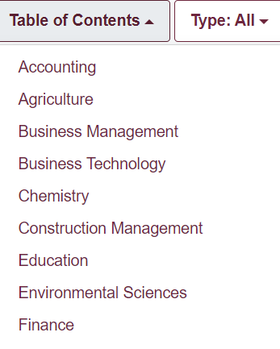
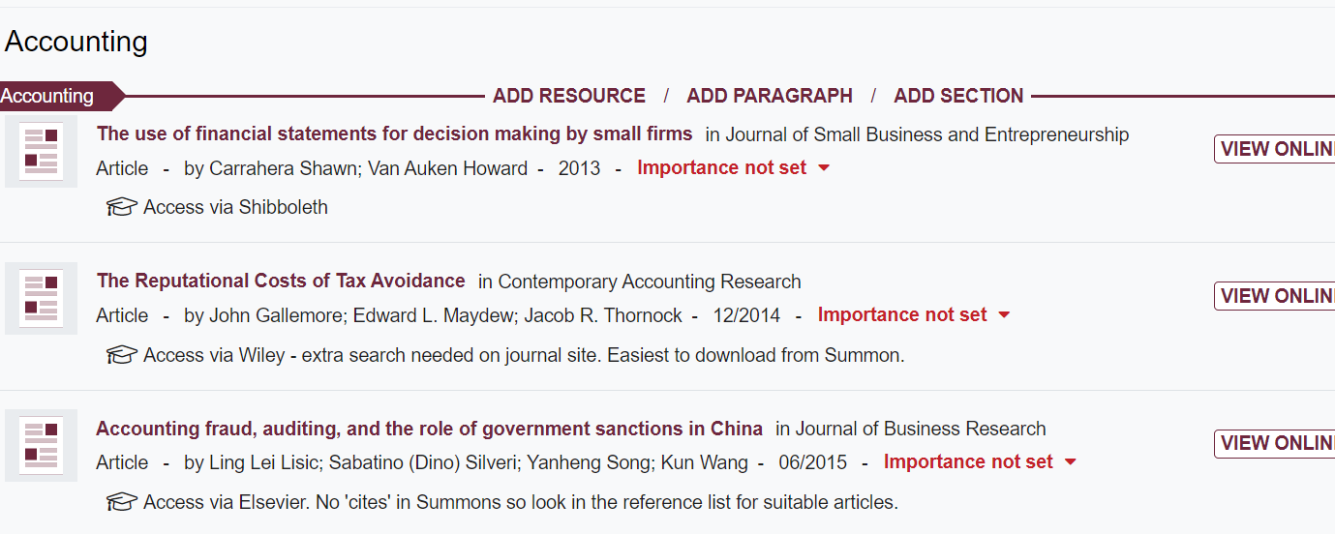
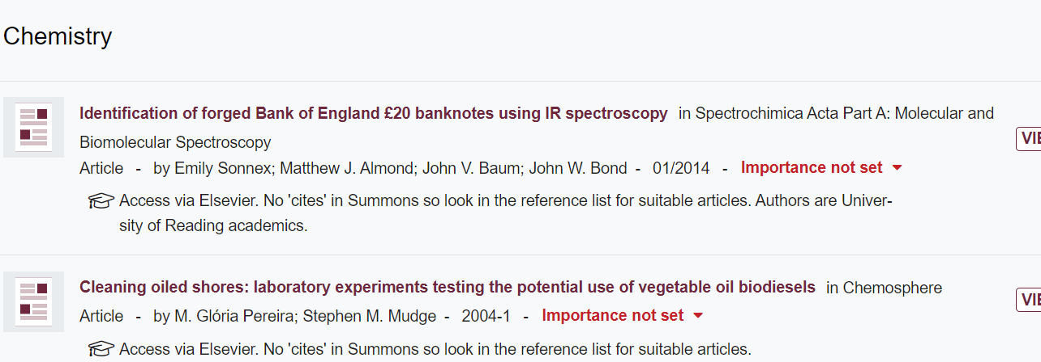


The PRE Reading List
15 different academic disciplines
2-5 articles in each category
Presented in TALIS with and notes
Notes:
So here we explain how different discipline specific articles were compiled and integrated into a reading list.
To determine the scope of articles required, we reviewed data on Pre sessional students intended degree courses, Grouping these by department or school would be too broad e.g at least 4 main programmes feed into the business school; however, by master course title would be too nuanced i.e many different specialisms within one programme of study, so we grouped these according to discipline.
The number of articles in each category was 2-5 presenting more choice for disciplines with larger ratios of students.
The list was presented in Talis an attached to the VLE hence familiarising the students with university tools they would encounter on their main degree. Notes were attached within Talis

Slide 11
The PRE reading list
Accessibility-readability & interest
Rationale for selection
Fit the criteria for before and after related literature
Key concepts on MA/MSc programmes
Written by UoR academics – heighten interest
Notes:
Our selection of articles to include was based on a number of key factors. Firstly, all articles had to the fit the criteria of the assignment brief – empirical research articles ( or reports) only, for which it was feasible to find earlier and later related literature. This means that many of the articles are between published around 2012-2016. [note- feedback comment that the list was not up to date!- point of the selection lost on this student, or tutor!)
The final article the student find independently will be more recent than this.
The other 3 factors here are not inclusive, but helped to guide the selection. Our work on in sessional discipline-specific Academic English support informed us of key concepts on some masters programmes. Obviously readability was a major factor, at least of the sections the students would need to focus on- this was easier for some disciplines than others.
We did in some cases seek assistance from subject specialists to locate articles, invariably though these did not meet the key consideration of the criteria.

Slide 12
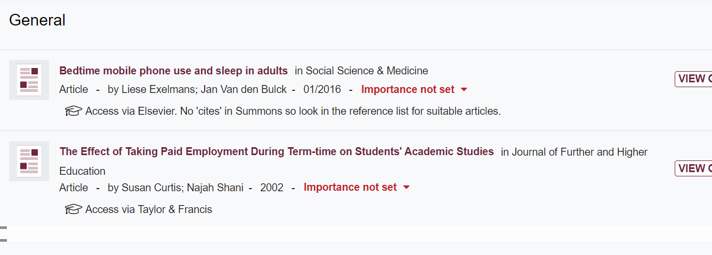

The PRE reading list
Webinars from the UoR library services focusing on:
The relationship between articles
Finding earlier and later related articles
A selection of ‘general’ academic empirical research articles
Contingency & support
Notes:
So what happens if a student’s discipline is not represented on the list?
This was a key consideration, especially as the University of Reading Pre sessional is open to offer holders for other institutions. What do you do for the niche number of students studying typography? – we ensured that general academic articles were available so the student could undertake the task
It is customary for the library services to provide input to the whole cohort on general academic referencing skills and literature searches. Some of these sessions were refocused to provide necessary support on the connection between articles and finding related literature. It is probably true to say these skills for new for some teachers too!

Slide 13
Evaluation
PREPARING FOR RESEARCH & ENQUIRY

Slide 14


Evaluation of the integrated reading list
What worked
Considerations
Choice of articles was relevant for the majority of students
Meta data in Talis-> what was more/less popular; what to remove for future cycles
Less reliance on the ‘general’ category -> list of disciplines becomes more complete
Limited or no choice identified for two disciplines ‘law’ and ‘architecture’
A few students need assistance in identifying their discipline
Tutor comment: I had an architecture student who was a bit disappointed that he couldn't review articles relevant to his subject
Most popular target article: ‘Cultural paradoxes reflected in Brand meaning: McDonald’s in Shanghai, China’
Notes:
… last point.. But sensitizing students to their discipline, even initially by categorizing the field is a valid outcome of the Pre sessional!

Slide 15
Evaluation of the assignment task/course
What worked
Considerations
Most students and most tutors saw the relevance of the task to future studies.
Reading full discipline-specific research articles challenging
Some students needed assistance in selecting their two further articles
Student: It is the first time that I read the research articles in English. I learned how to analyze its structure, aims and methods. I tried to connected those articles with the Chinese research articles I've read before, in the aspect of organization and methodology.
Student: In the previous learning experience, there was little opportunity to evaluate other people's research report. So I learn a lot from writting the Critical Review […] how to analyze articles and the useful language. But what benefited me the most was how to think critically in writing, because we all need to compare aims and research methods in stage 2. For postgraduate students, the ability to think critically and analyze research reports is extremely necessary.
Tutor: This is part of the course I was really impressed with

Slide 16

Summary & going forward
A general academic written genre ( Critical Review) common to different destination courses & a discipline-specific reading list
Challenge of discipline-specific research articles managed through supplying target article
Integrates the cohort but does not address individual discipline-specific writing needs/practices (i.e fully ESAP)
Going forward
‘customizable core’ useful model to replicate
Develop learners’ initial understanding of the relationship between research in their field e.g looking at the mediation of messages around research in popular media
Notes:
Summary:
We selected a general academic genre ( critical review) which we found to be common to different disciplines and a reading list which helped students engage with their field of academic interest The task did not require or assume any prior disciplinary knowledge.
Students were confronted with full discipline specific research articles which they found both challenging, but necessary in preparation for what lay ahead only weeks from the end of the pre sessional. This challenge was managed at design level through supplying the initial target article, and a clear purpose for reading - a structure for critical evaluation.
What this doesn’t address/prepare students for is discipline- specific academic language and literacy needs that students will encounter, as well as practices associated with their individual disciplines e.g writing a case study in law vs a case study in business management. (i.e fully ESAP)
Going forward:
The design of the task ( the customizable core} is a useful model to replicate-
The lesson materials are the ‘core’ of the component and contain examples from a range of disciplines, then the reading list allows the task to be ‘customized’ by the student to suit their particular discipline. The advantage of this approach from a course designers’ point of view is that the reading list can be easily updated with new disciplines added if needed without needing to write new material so the module can easily respond to changes in the institutional context and the student cohort. A similar model could be applied, for example, to a task designed to develop presentation skills or reading skills.
Earlier in the course tasks could be designed which engage students with and develop their initial understanding of the relation between research in their field . This could be analysing the mediation of messages around research e.g how academic research is conveyed in popular or professional publications.

Slide 17
References
de Chazal, E. (2013) The general-specific debate in EAP: Which case is the most convincing for most contexts? Journal of Second Language Teaching and Research 2: 135–48.
Healey, M. & Jenkins, A. (2009). Developing undergraduate research and inquiry. York: Higher Education Academy.
Hyland, K. (2018). Sympathy for the devil? A defence of EAP. Language Teaching, 51(3), 383-399.
University of Reading. (2017). University of Reading Curriculum Framework.

